Slide 1
Thoroughbred Racing:
What Really Happens on the Backstretch

Slide 2
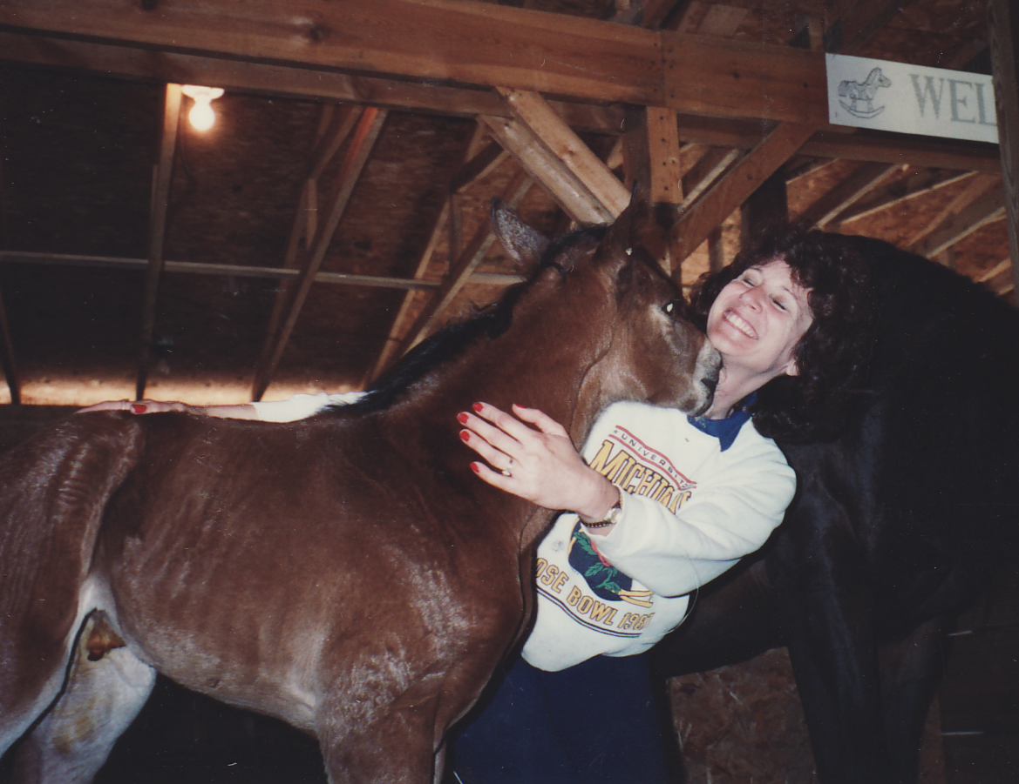
Baby rooting for udder

Slide 3
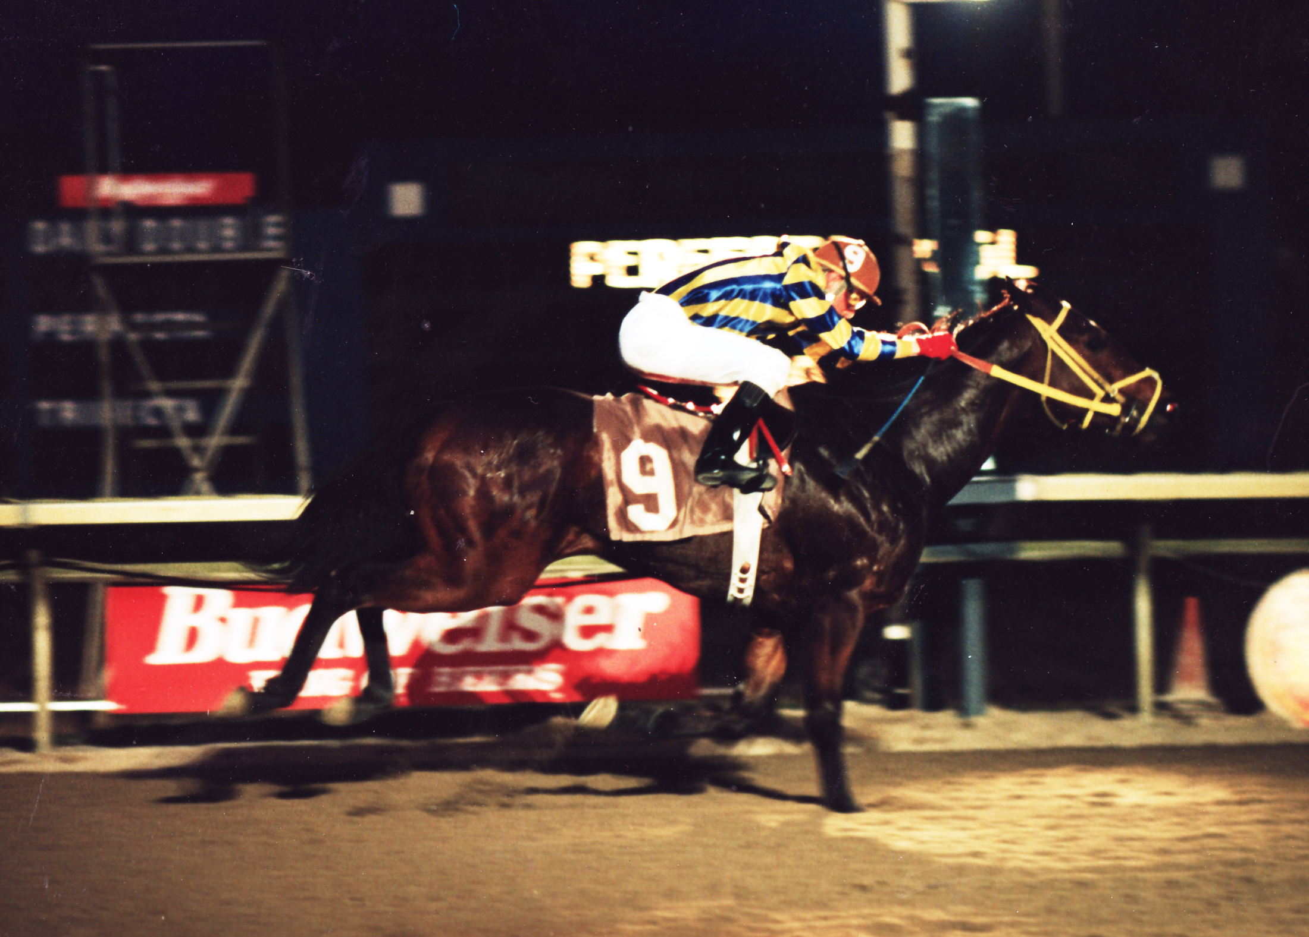

Slide 4
Catastrophic Injury Fractured tibia left hind

Slide 5
Carpal (knee) slab fracture Sandra’s Brave 6 yrs. old

Slide 6
Carpal (knee) slab fracture Sandra’s Brave – 6 yrs. old

Slide 7
Carpal (knee) 9 bone fragments Lady Faltaat

Slide 8
Winds of Love – Right Front Fetlock with pins and fragments

Slide 9
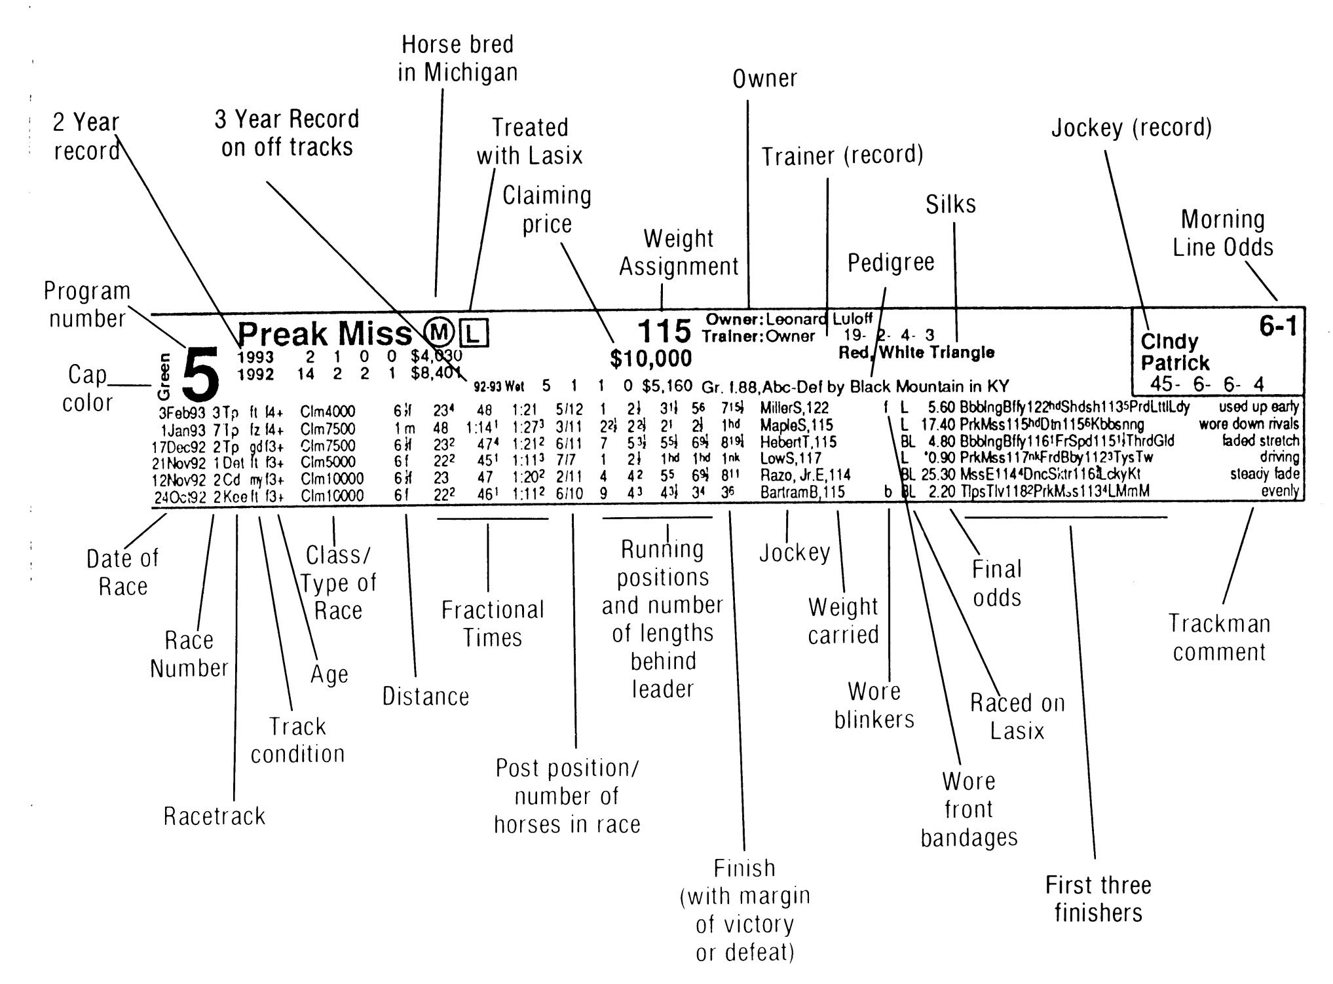

Slide 10
Kentucky Derby 2008 Eight Belles – shattered ankles

Slide 11
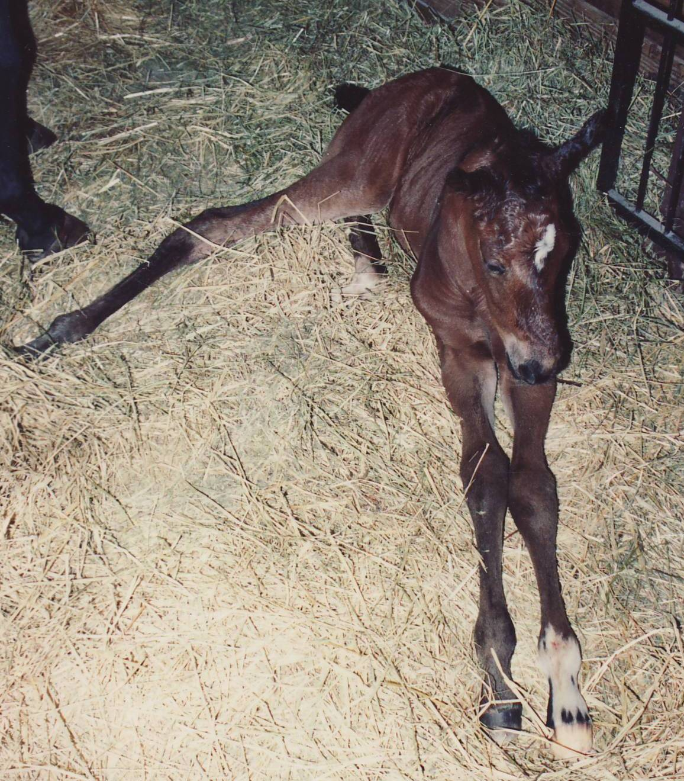
Secretariat Grand Filly – 1hour old

Slide 12
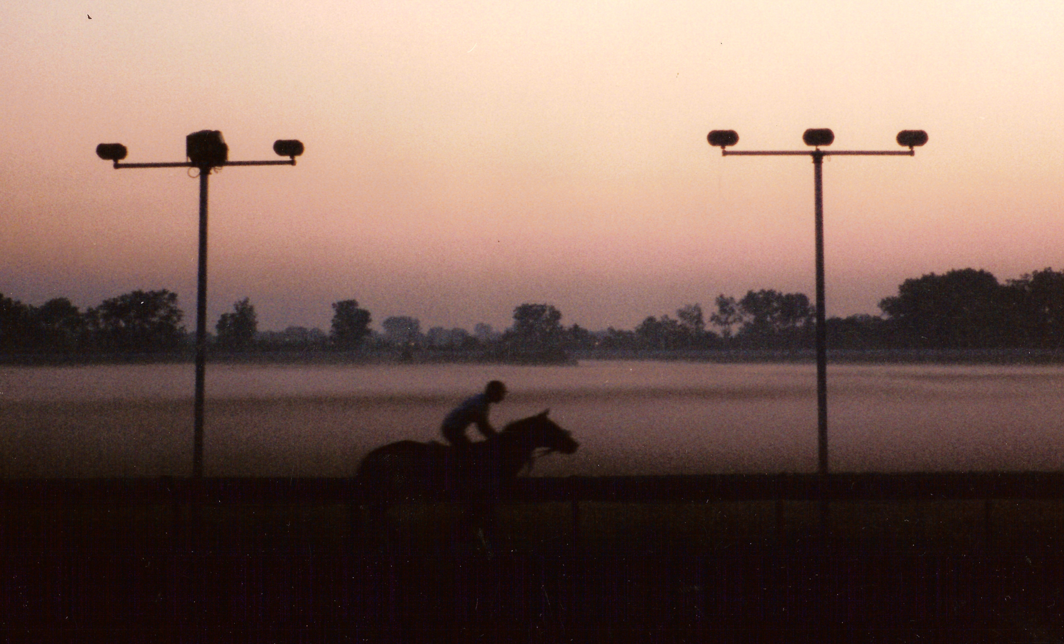
Baby Sunrise Track Training

