Slide 1
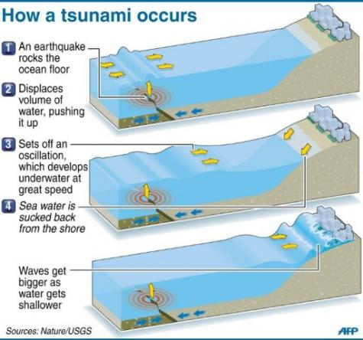
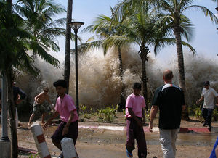
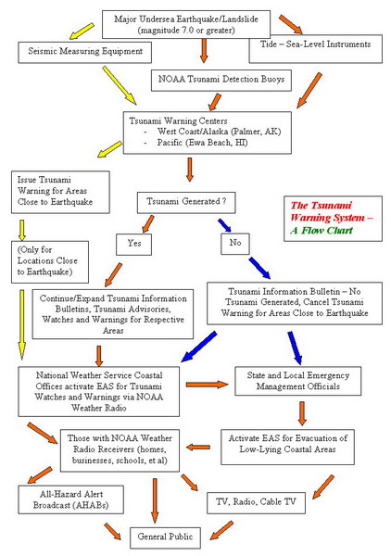
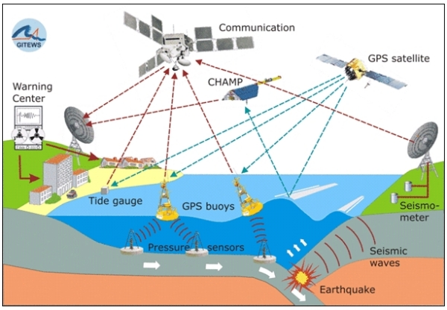

Slide 2
Tsunami education
If you are in an area at risk from tsunamis, you should:
Find out if your home, school, workplace, or other frequently visited locations are in tsunami hazard areas.
Know the height of your street above sea level and the distance of your street from the coast or other high-risk waters. Evacuation orders may be based on these numbers. Also find out the height above sea level and the distance from the coast of outbuildings that house animals, as well as pastures or corrals.
Plan evacuation routes from your home, school, workplace, or any other place you could be where tsunamis present a risk. If possible, pick areas 100 feet (30 meters) above sea level or go as far as two miles (3 kilometers) inland, away from the coastline. If you cannot get this high or far, go as high or far as you can. Every foot inland or upward may make a difference. You should be able to reach your safe location on foot within 15 minutes. After a disaster, roads may become impassable or blocked. Be prepared to evacuate by foot if necessary. Footpaths normally lead uphill and inland, while many roads parallel coastlines. Follow posted tsunami evacuation routes; these will lead to safety. Local emergency management officials can advise you on the best route to safety and likely shelter locations.
If your children’s school is in an identified inundation zone, find out what the school evacuation plan is. Find out if the plan requires you to pick your children up from school or from another location. Telephone lines during a tsunami watch or warning may be overloaded and routes to and from schools may be jammed.
Practice your evacuation routes. Familiarity may save your life. Be able to follow your escape route at night and during inclement weather. Practicing your plan makes the appropriate response more of a reaction, requiring less thinking during an actual emergency situation.
Use a NOAA Weather Radio or stay tuned to a local radio or television station to keep informed of local watches and warnings.
Talk to your insurance agent. Homeowners' policies do not cover flooding from a tsunami. Ask about the National Flood Insurance Program (NFIP). NFIP covers tsunami damage, but your community must participate in the program.
Discuss tsunamis with your family. Everyone should know what to do in a tsunami situation. Discussing tsunamis ahead of time will help reduce fear and save precious time in an emergency. Review flood safety and preparedness measures with your family.
If you are visiting an area at risk from tsunamis, check with the hotel, motel, or campground operators for tsunami evacuation information and find out what the warning system is for tsunamis. It is important to know designated escape routes before a warning is issued.

