Slide 1
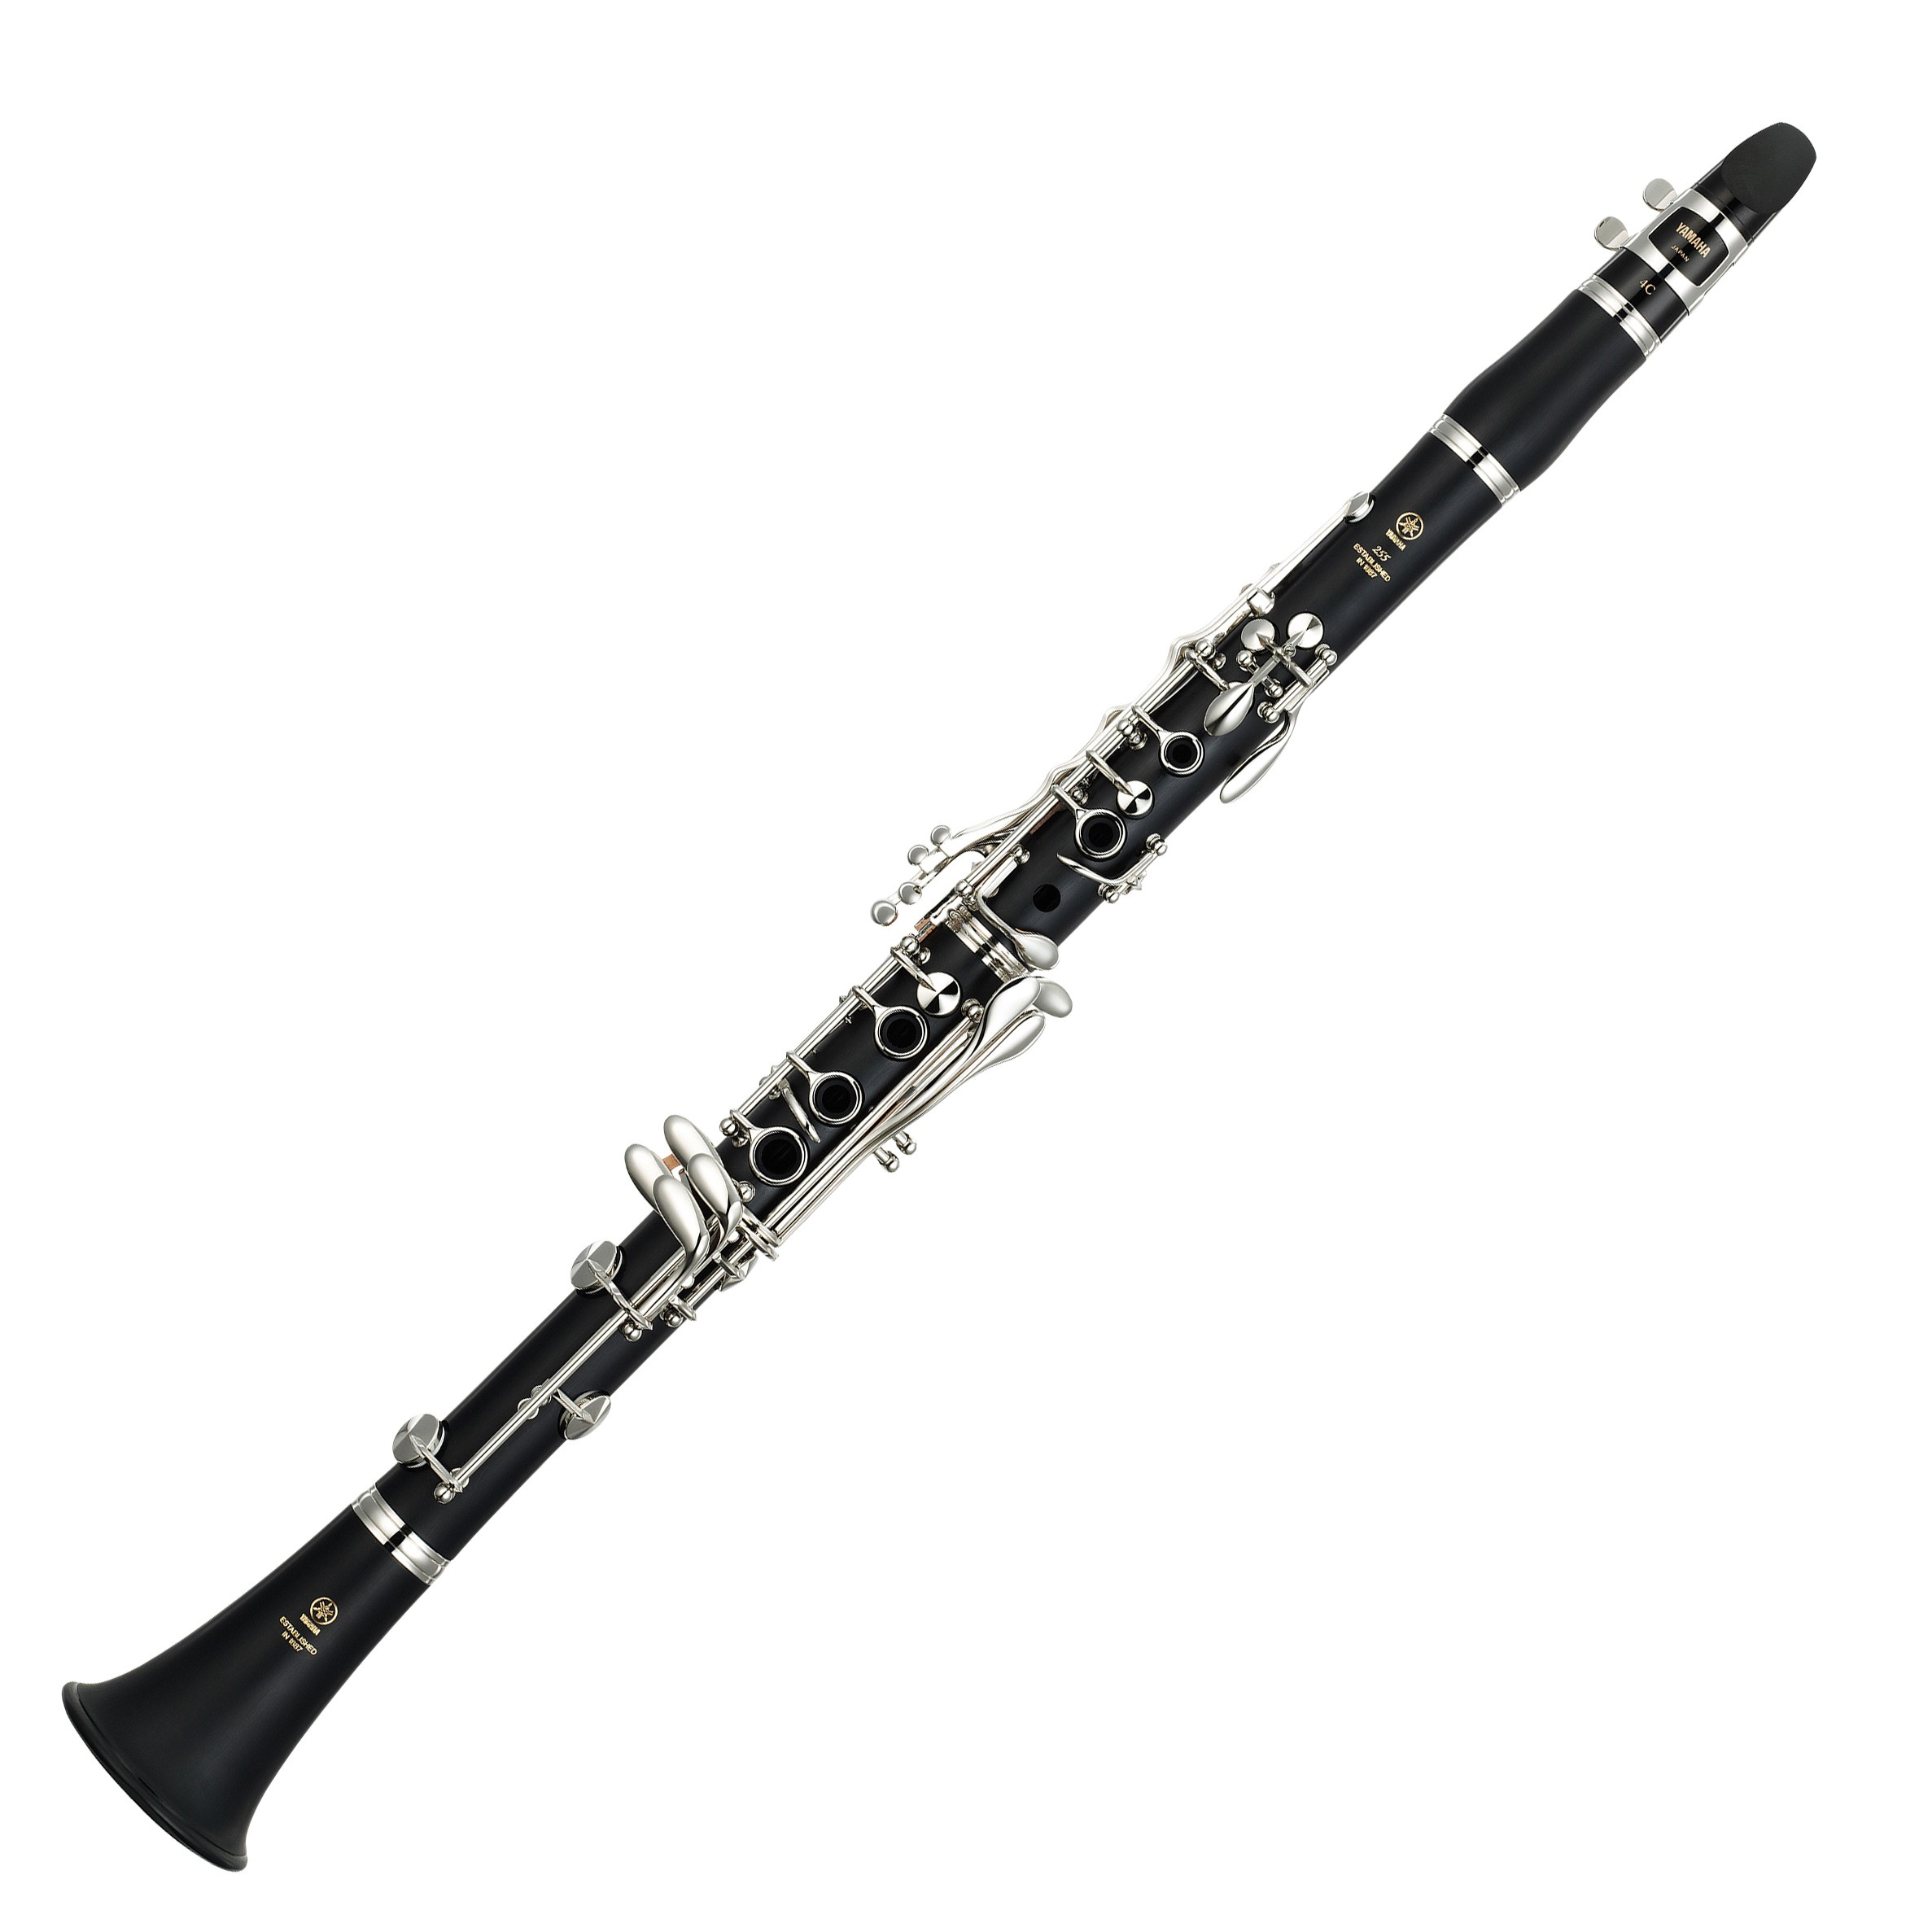
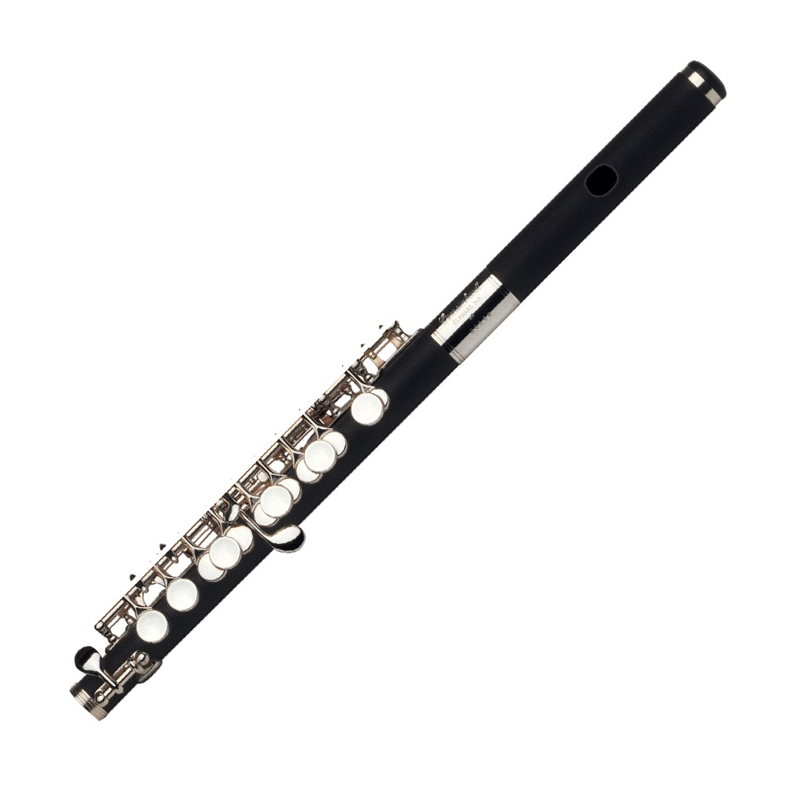
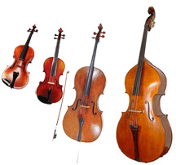
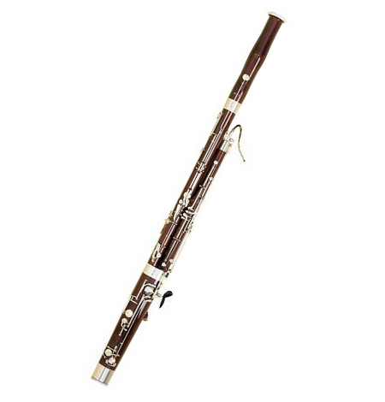
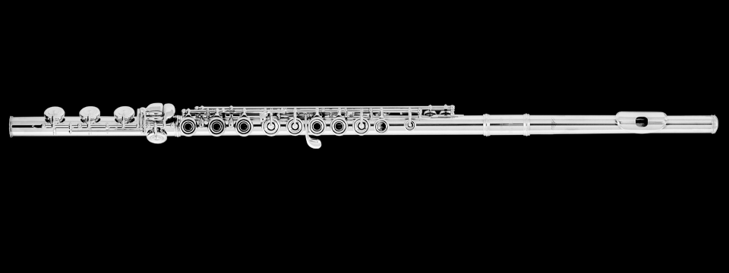
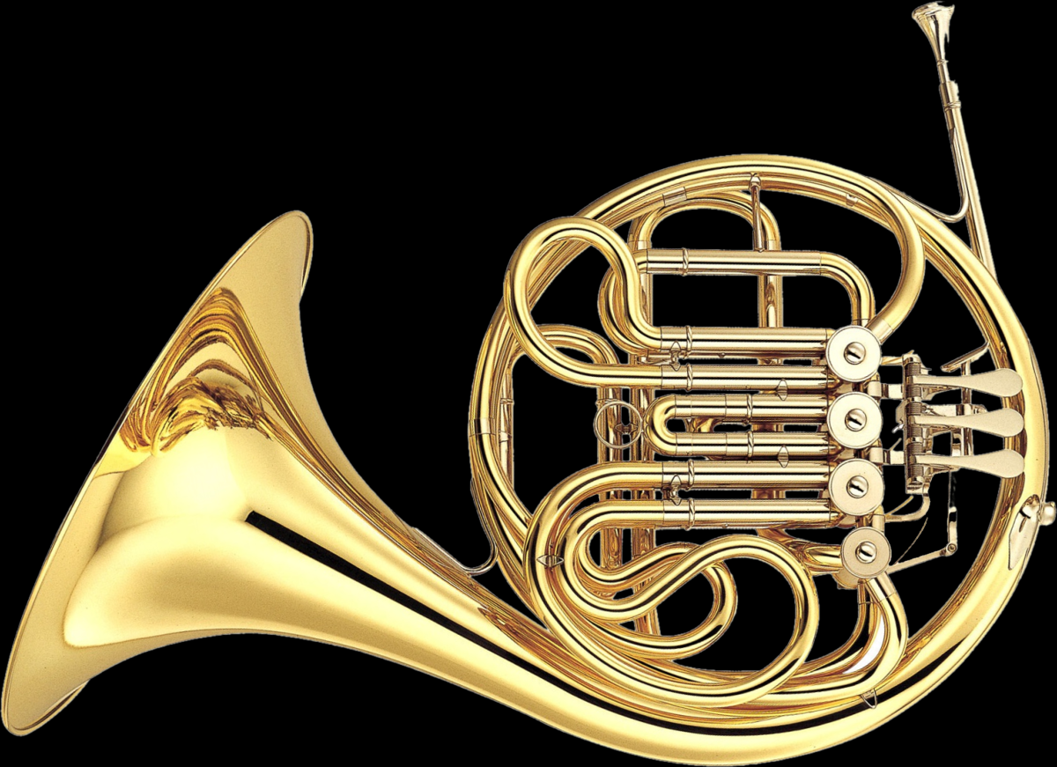
Bartok’s Romanian Dances
Who is the new “friend” in this dance?
Why is the clarinet easier to hear
in the second dance?
Which member of this family
is playing the solo?
Dances #1 & #2
Dance #3
Dance #4
Is the bassoon playing higher
or lower than the flute?
Which member of the Brass Family
has joined the group?
Dances #5
Dances #6 & #7

