Slide 1
IIPS Conference:
MCNC Services
October 20th, 2014
MCNC Website Highlighting Community College Information
Client Network Engineering (CNE) Services
Internet 2
MCNC 2014 Community Day

Slide 2
MCNC Website
Highlighting the Community College Information
& NCCCS Provided Services
Robin Kimble, NCREN Community College Advocate

Slide 3
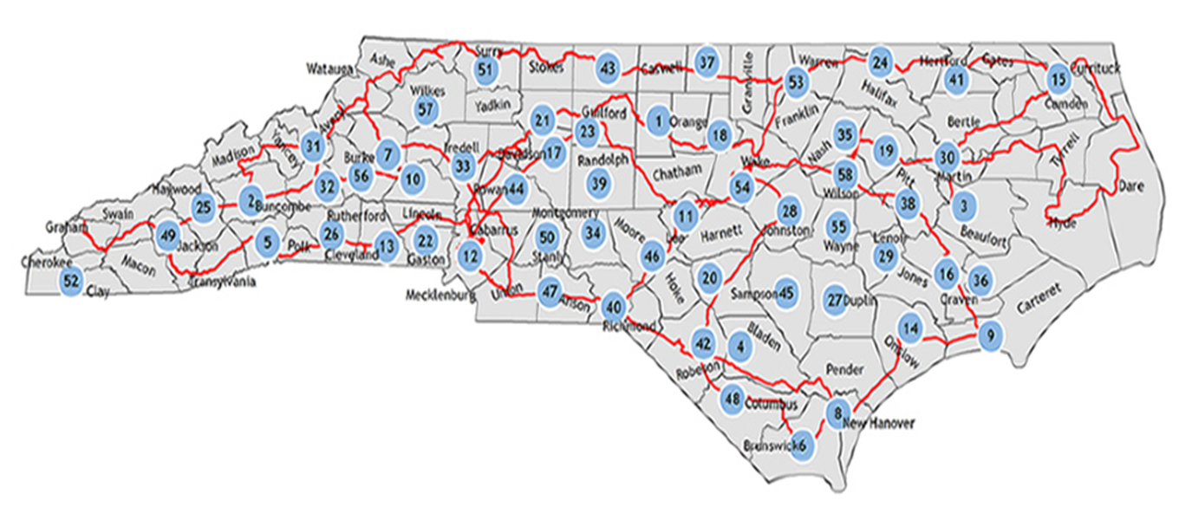
MCNC Operates the NCREN

Slide 4
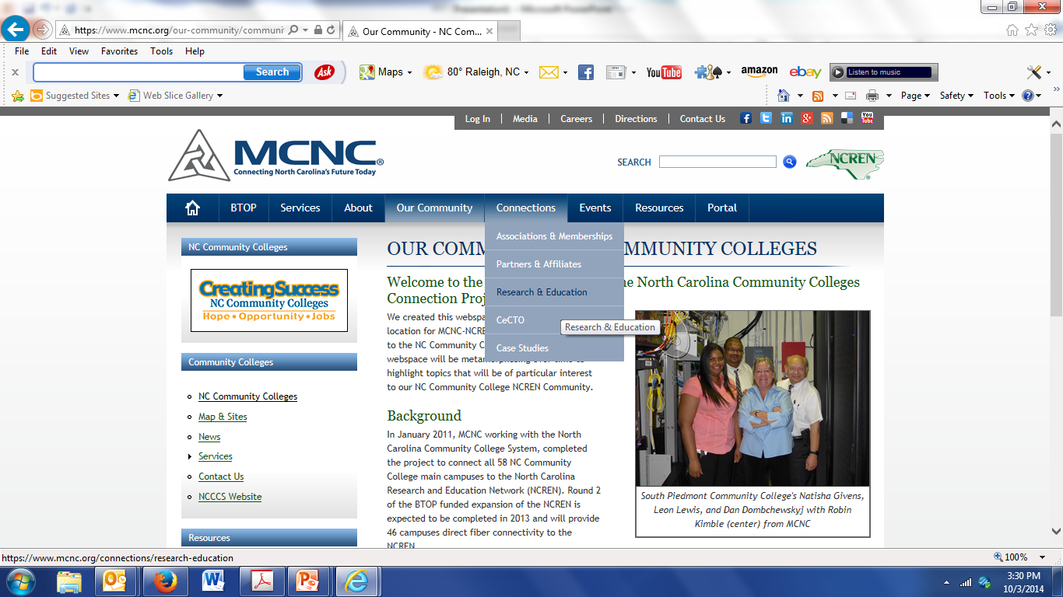
NC Community Colleges Webspace

Slide 5
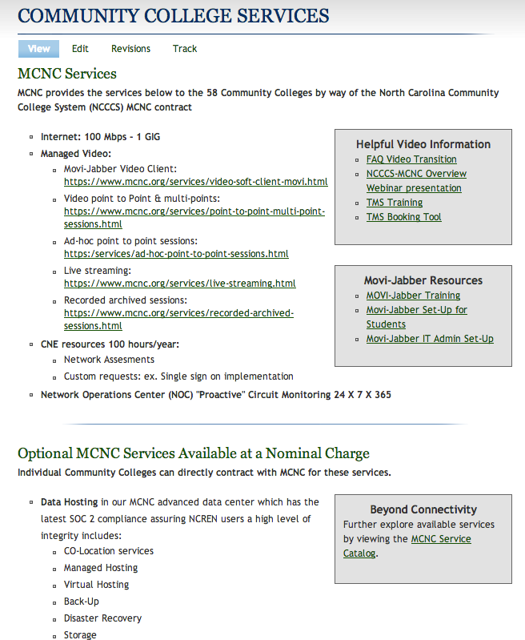
NC Community Colleges Webspace

Slide 6
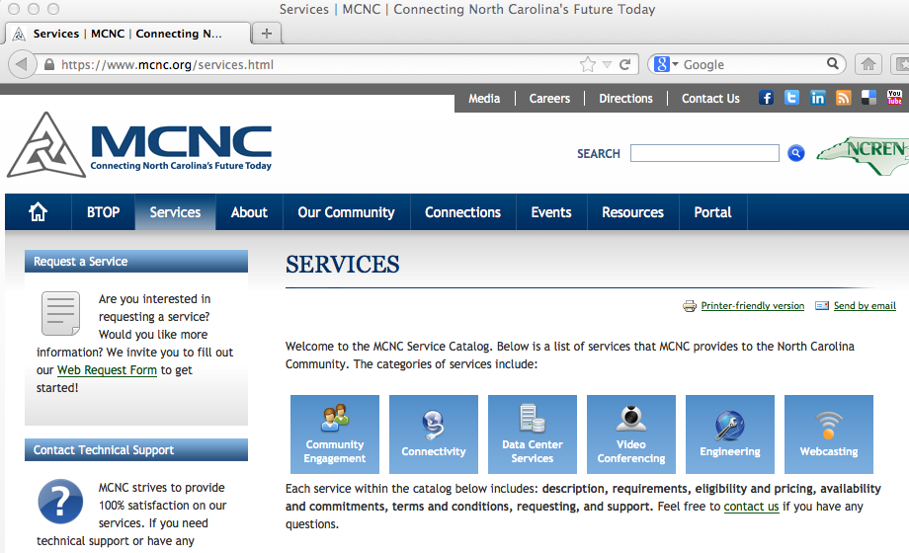
Other MCNC Services

Slide 7
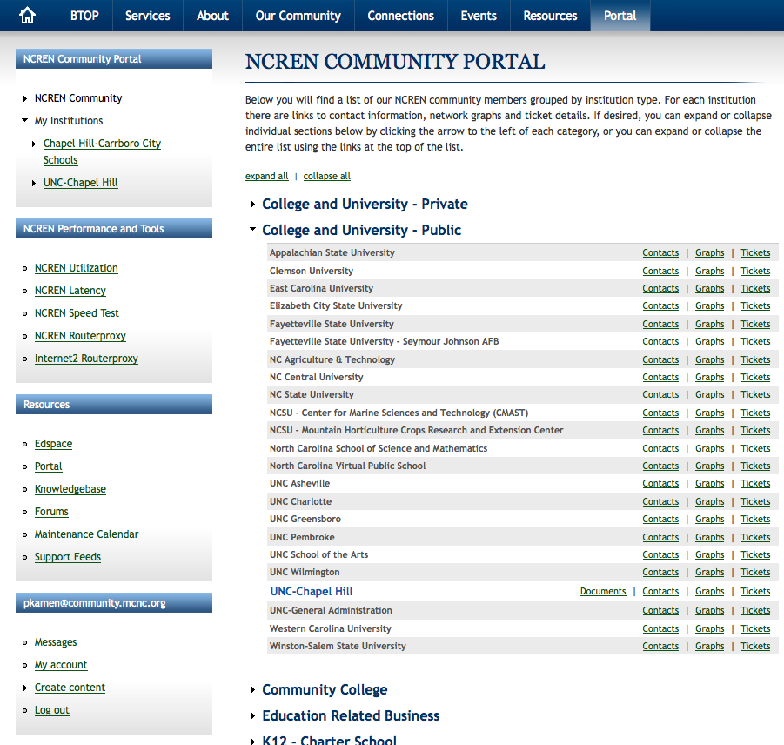
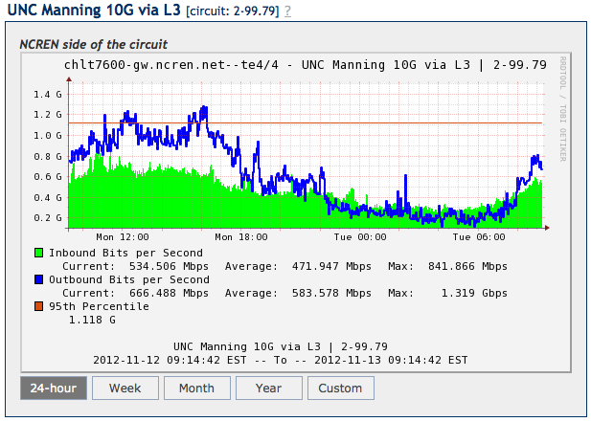
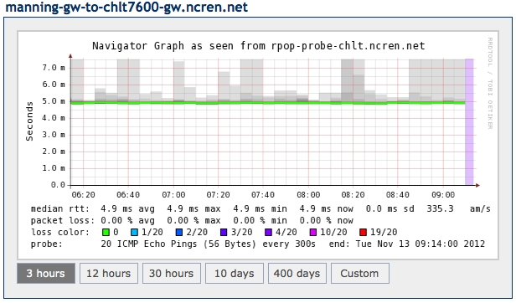
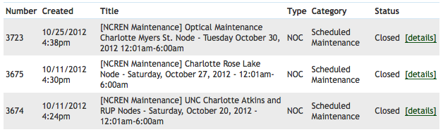
NCREN Community Portal
https://www.mcnc.org/ncren/portal
Graphs
Tickets

Slide 8
Client Network Engineering (CNE) Services
Kevin Moderow, Client Network Engineer

Slide 9
CNE Network Consultancy Services
“They go the extra mile when helping troubleshoot issues and always circle back around and see if everything is going well.
We are fortunate to be working with MCNC.”
-Jeff McEntire
Isothermal Community College

Slide 10

CNE Network Consultancy Services
Network
Baseline
Hosted
Email
Security
Assessments
Google Apps
Migrations
Malware
Infection
Wireless
Assessments
Design
Support
Problem
Resolution
Network
Assessments
Infrastructure
Obsolescence
Directory
Migration
Performance
Issues

Slide 11
CNE Network Consultancy Services
“We are grateful for this terrific service from MCNC and I am
sincerely thankful for your personal professionalism, attention to
detail and broad skill set.”
-Steven Young
Blue Ridge Community College

Slide 12


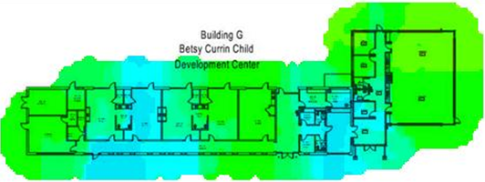
CNE – Recent Community College Engagements
Wayne Community College – provide Google Apps migration assistance from planning to deployment. Assist with migrating emails from Exchange or GroupWise as needed.
Nash Community College – Wireless network assessment to support a funding request for infrastructure upgrades. Assessment included campus-wide wireless site surveys and an analysis of WLAN configuration and performance data.

Slide 13
CNE Network Consultancy Services
“I would highly recommend Kevin and the client network
engineering (CNE) team at MCNC and would encourage those who
are eligible to use their expertise as part of their overall network
infrastructure strategy.”
-Dr. Greg Gleghorn
South Piedmont Community College

Slide 14
Internet 2
Peter Janca, Managed Services Development Lead

Slide 15
Internet 2 is. . . .
A network created originally for the research community, but much more today
A consortium of people working together to solve problems
An environment which enables new ways of sharing and collaboration

Slide 16
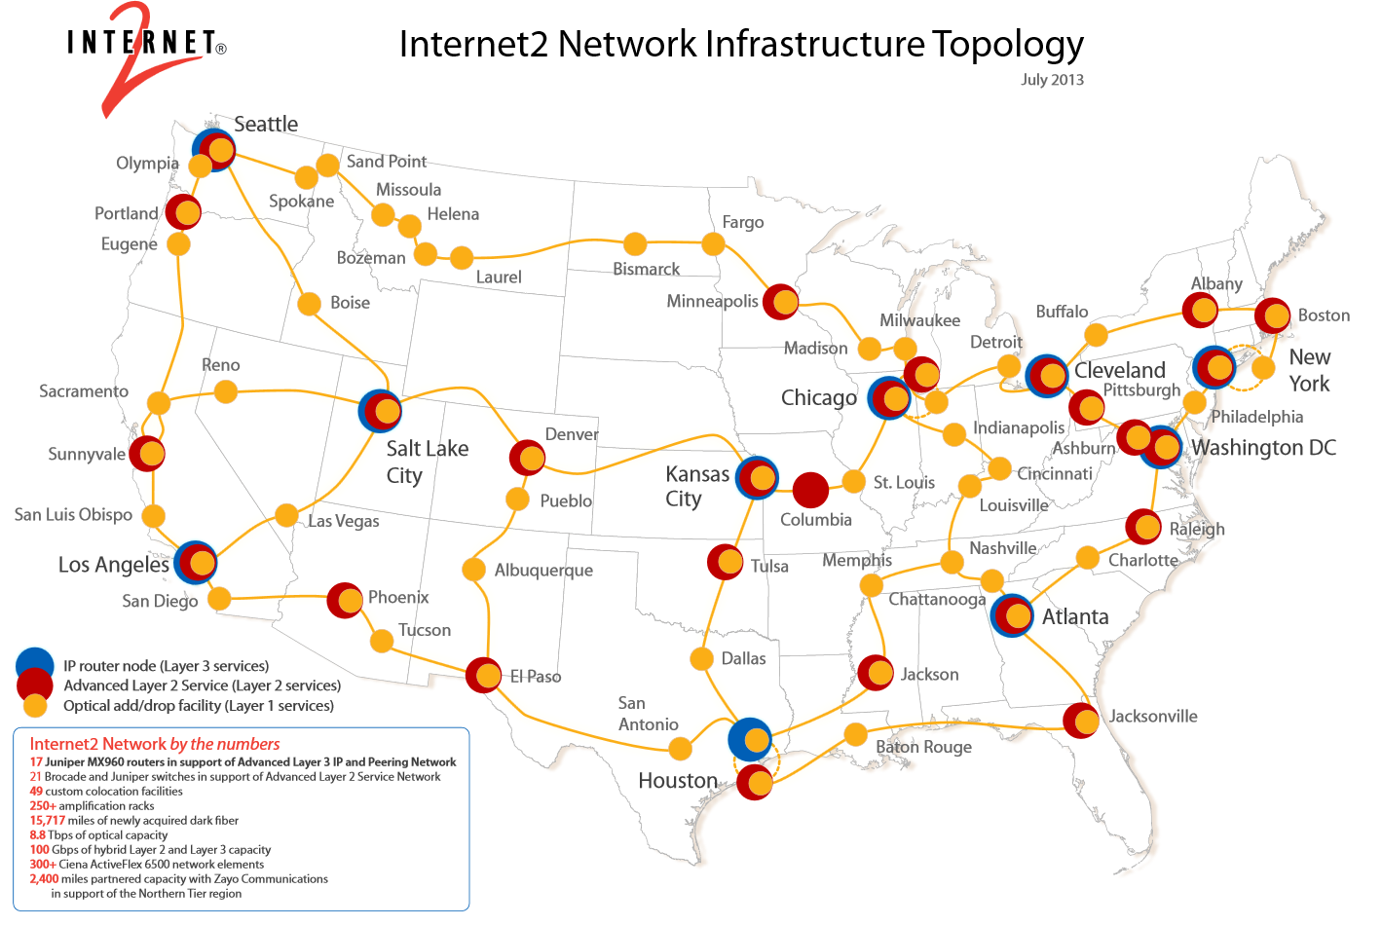
Internet 2 is a network
Internet2 Network
by the numbers
17 Juniper MX960 nodes
31 Brocade and Juniper
switches
49 custom colocation facilities
250+ amplification racks
15,717 miles of newly
acquired dark fiber
2,400 miles of partnered
capacity with Zayo
Communications
8.8 Tbps of optical capacity
100 Gbps of hybrid Layer 2
and Layer 3 capacity
300+ Ciena ActiveFlex 6500 network elements;
Only domestic portion is shown
Internet 2 connects to other networks throughout the world

Slide 17
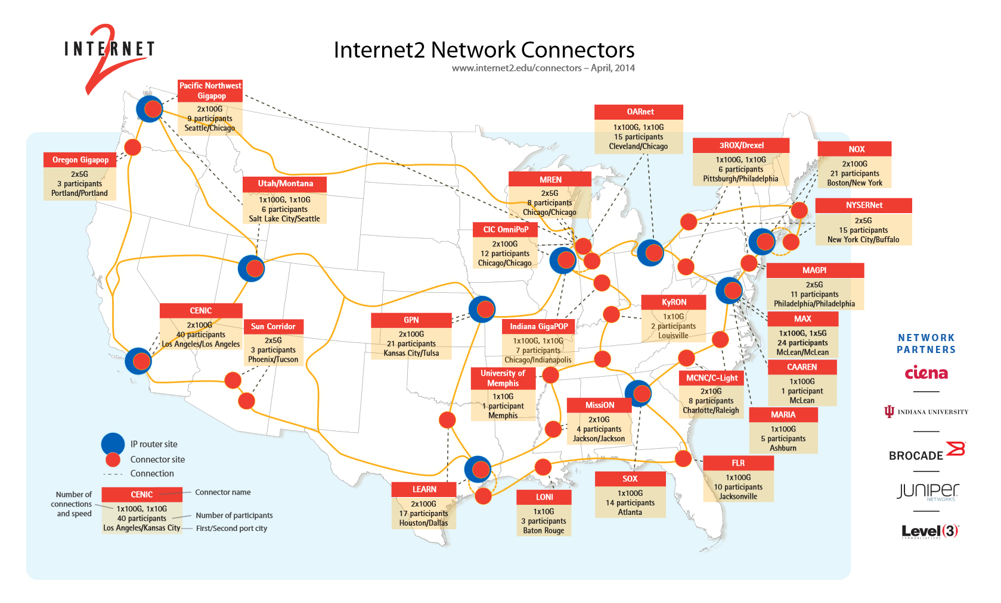
Internet 2 is a network which interconnects with
MCNC currently has 2x100G connections to Internet 2, with a 3rd one on the way
2x100G

Slide 18
NCREN connects to Internet 2 in Raleigh and in Charlotte
Sparta
Henderson
Elizabeth
City
W-S
GBO
Rocky Mount
Asheville
Raleigh
Sylva
Hendersonville
Charlotte
Rutherfordton
Hamlet
MCNC—Internet 2
Connection Points
Wilmington

Slide 19
The Internet 2 connection is used for
Member-to-Member traffic
  This includes participants in the US UCAN K20 project, such as all Community Colleges in North Carolina
Traffic to and from locations peered with Internet 2, such as
  Amazon Web Services
  Microsoft
  Google
Other traffic goes via commodity Internet providers, such as AT&T, CenturyLink, Level 3

Slide 20
Why use Internet 2 for network traffic?
Typically, fewer hops
Typically, use of higher bandwidth connections
Typically, lower latency, less jitter, fewer errors
Typically, less congested routes

Slide 21
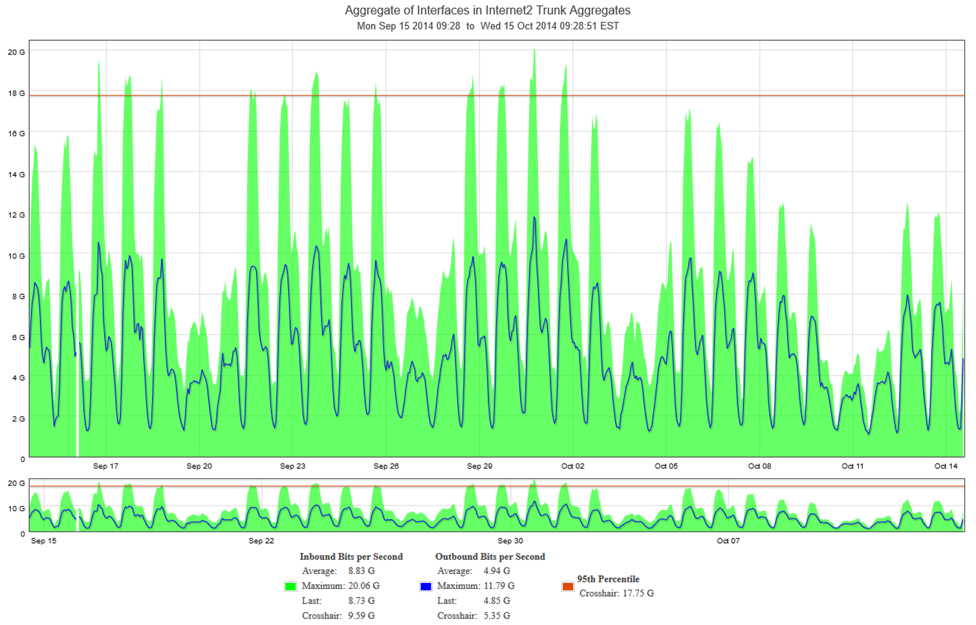
Traffic between MCNC and Internet 2

Slide 22
Internet2 by the Numbers
84, 146 | K-12 Schools
799 | Community and Vocational Colleges
2,237 | Health Institutions
33 | Telehealth Networks
200+ | Museums, Historic Sites, Science Centers, Zoos, Aquariums, Parks and Reserves, and Performing Arts Organizations
31 | Public Radio, TV, Streaming Media Organizations
4,203 | Libraries
1,491 | Colleges and Universities
Notes:
Today, U.S. UCAN includes more than 93,000 community anchor institutions. This number is up more than 40% from four years ago.
This number is based on a 2013 survey among our regional partners. Some additional stats include:
60% of all public schools and 25% of all public libraries.
More than half of all community colleges connect to Internet2.
More than 100 Academic Medical Centers
More than 30 telehealth networks
This represents the 42 States that are US UCAN participants…including Missouri.

Slide 23
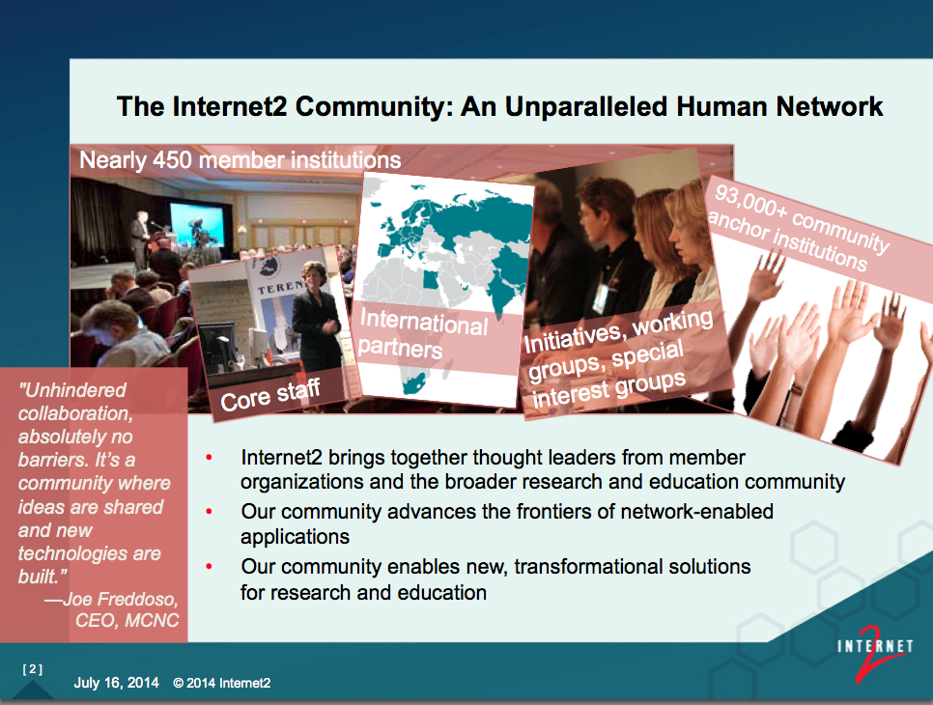
Internet is a human network

Slide 24
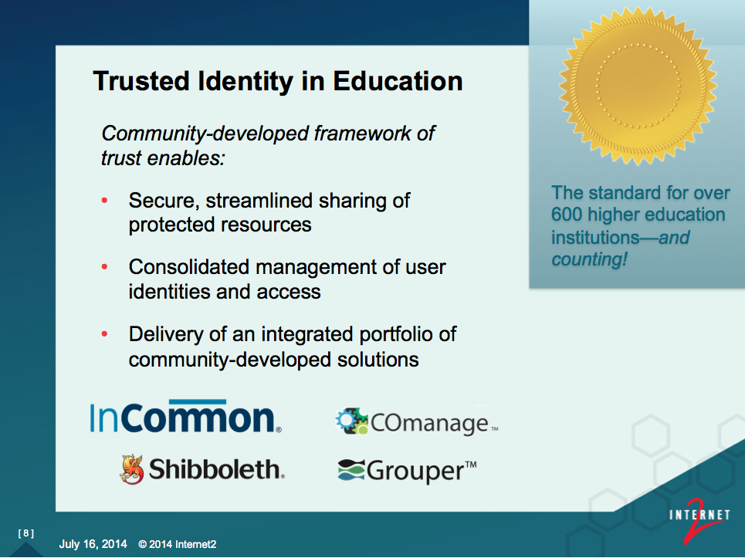

Slide 25
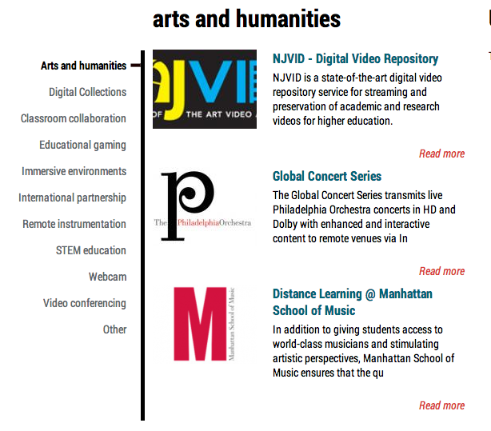
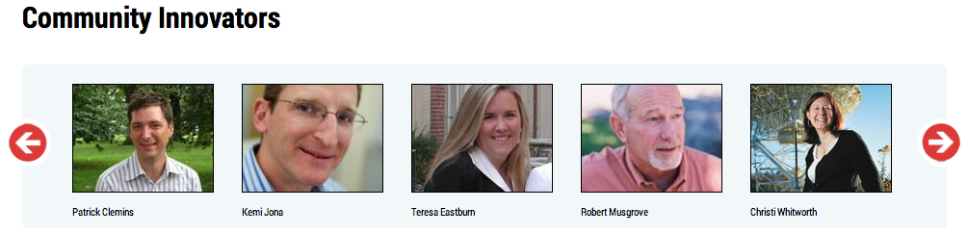
I2 K20 Initiative

Slide 26
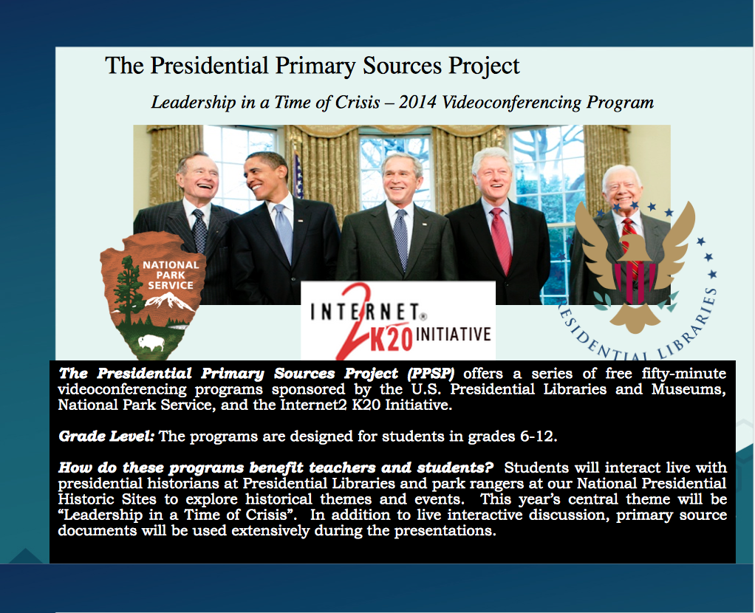

Slide 27
Two-year technical college - - AS, AAS degrees, certificates, diplomas in technical disciplines
Part of Minnesota State Colleges and Universities system
Rural area of the state
Smallest stand-alone college in the system: 420 FYEs, 1600 enrollment

Slide 28
PTC: Technology Flagship
Founded only Virtual Reality Center in 2-year college in Midwest—high speed
Applied research and product development: affordable immersive VR on PC platform for education & training applications
VR applicability to distance learning and applied research through Internet 2
Basis for partnership with universities, including University of Minnesota

Slide 29
PTC: Technology Flagship
Awards from MnSCU System for IT Excellence:
  Fiber Optic Backbone
  JCVR
Products for industry partners: Virtual industrial spray paint booth
  Virtual welding
  Virtual inspection training

Slide 30
Thanks!
Peter Janca, MCNC
pjanca@mcncl.org

Slide 31
MCNC Community Day 2014
Robin Kimble, NCREN Community College Advocate

Slide 32
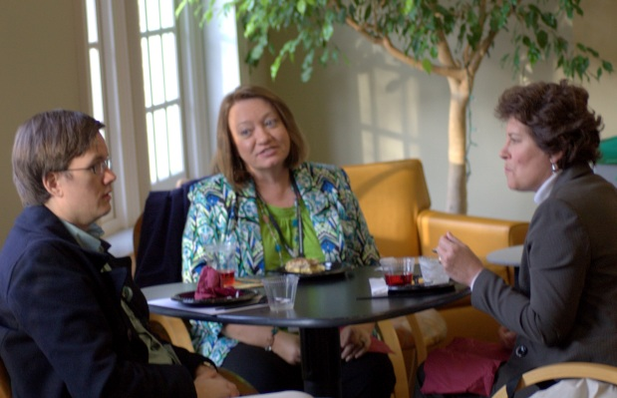
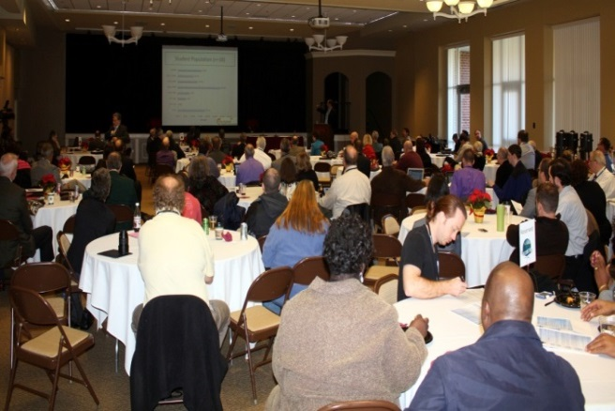
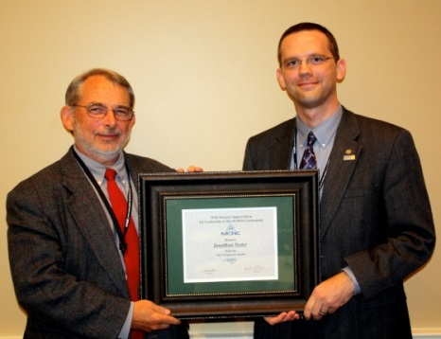
NCREN Community Day
Annual event for NCREN customers
November 5th & 6th NCSU Hunt Library
No registration fee
Recognitions
Workshops based on community input
www.mcnc.org/events/communityday 2014

Slide 33
Questions & email
Questions?
Contact Information:
    Robin Kimble - rkimble@mcnc.org 919.248.1869
    Kevin Moderow - mscheible@mcnc.org
    Peter Janca - pjanca@mailbox.mcnc.org
    MCNC web site - http://www.mcnc.org

