Slide 1
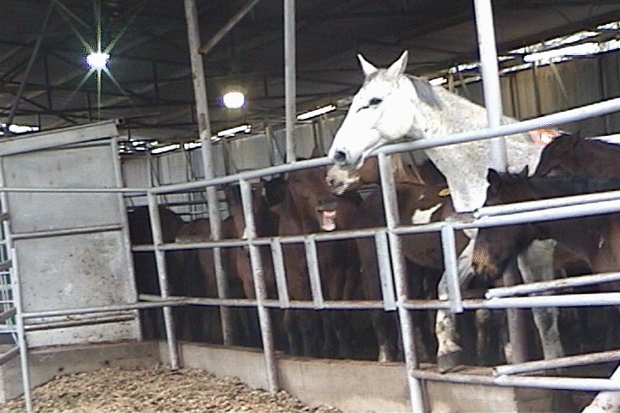

The Impact of Horse Slaughter Plants on Communities
A documented history

Slide 2
Who is Unified Equine?
Unified Equine was founded by Sue Wallis, a state legislator from Wyoming. It has no real offices, staff or experience in the industry.
Wallis claimed her backer was Chevideco, a Belgium based company with slaughter houses around the world.
At their Mountain Grove meeting on 3/12/11, Chevideco officials said they would not invest their own money, but would rent such a facility if it was built with the investment of others.
Chevideco owned the Dallas Crown Horse Slaughter plant in Kaufman, Texas.

Slide 3
Pollution and Waste Treatment
US Horse slaughter plants have all had chronic problems with waste treatment.
It is probable that this is related to the presence of drugs such as antibiotics in the horses, to the volume of blood and to the fact that there are few outlets for byproducts.

Slide 4
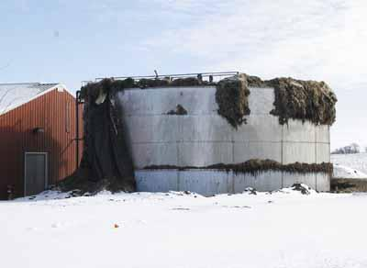
After burning in 2002, Cavel was rebuilt to state-of-the-art standards in 2004.
This photo of its waste treatment tank was taken just months before it was closed in 2007. It was never in compliance on its discharge during the entire period.

Slide 5
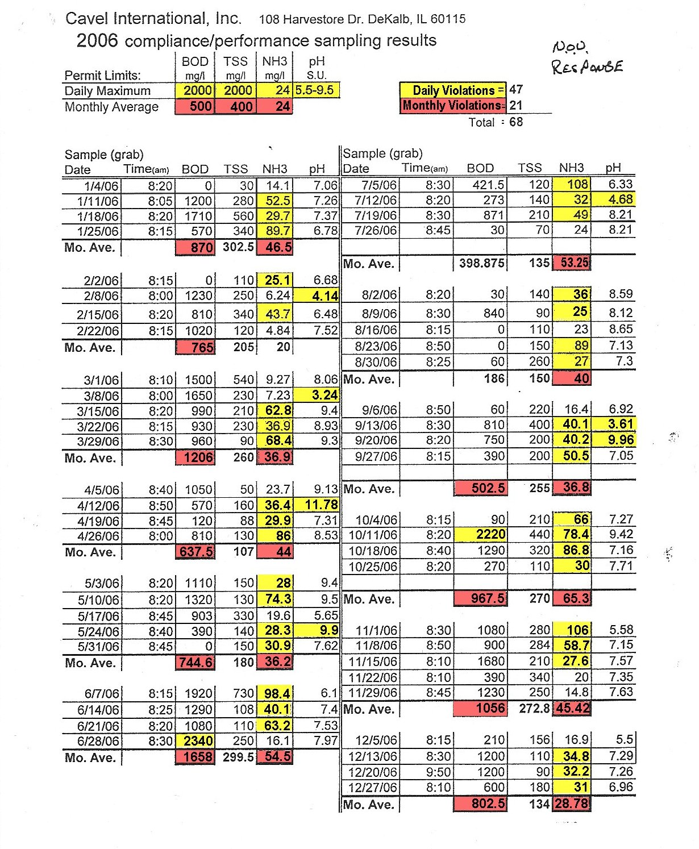
Records show Cavel was in violation in every measure of its discharge

Slide 6
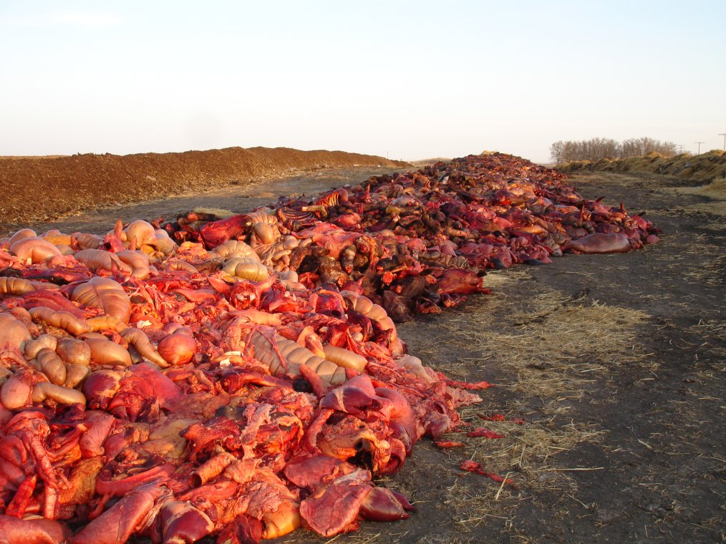
At Natural Valley Farms (SK Canada) the situation was even worse.
Piles of organs, heads and other byproducts for which there was no market were simply spread on the ground and then covered with a thin layer of dirt. The ground remains infertile to this day.

Slide 7
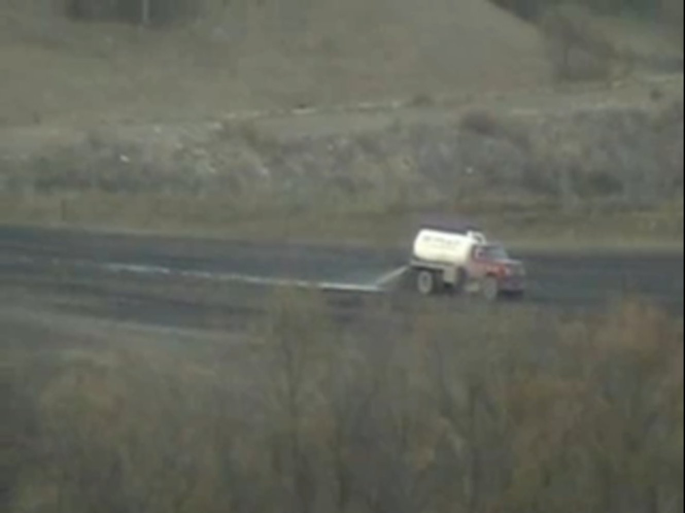
Natural Valley was closed for health violations after 2 years.
It was caught dumping blood from a tanker truck into and around the nearby river.
It used a lagoon system like that proposed by Unified Equine. It left behind 30,000,000 gallons of untreated waste.
It killed half as many horses as Unified Equine proposes, yet generated 15,000,000 gallons a year in untreated waste.
The operation went bankrupt with losses of $42 Million!

Slide 8
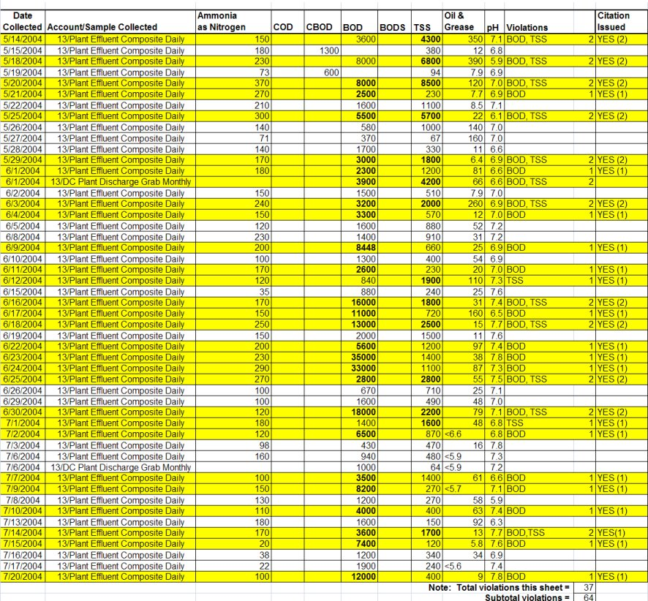
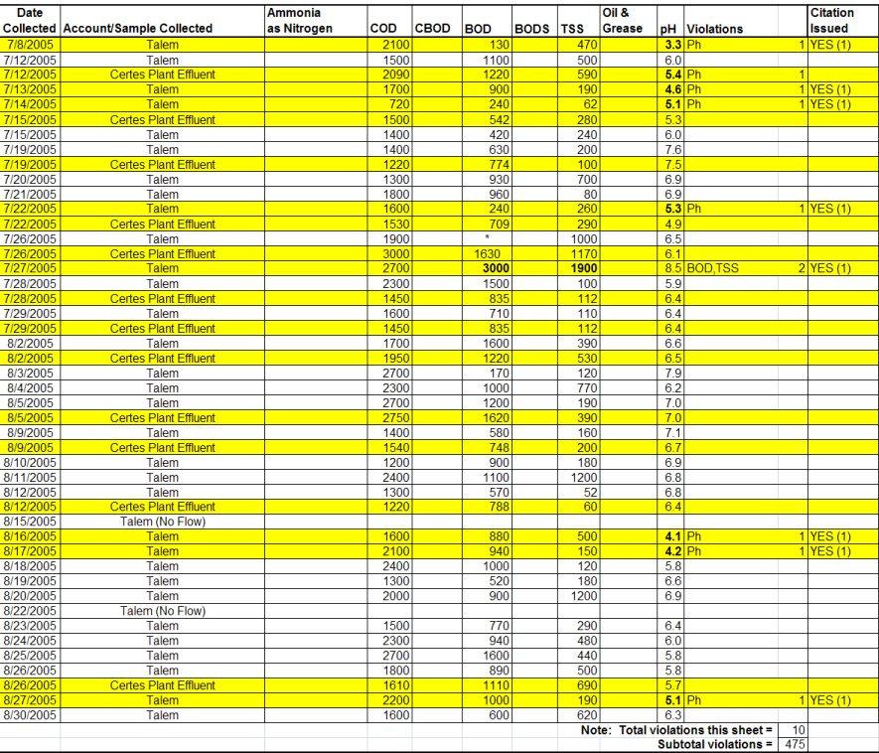
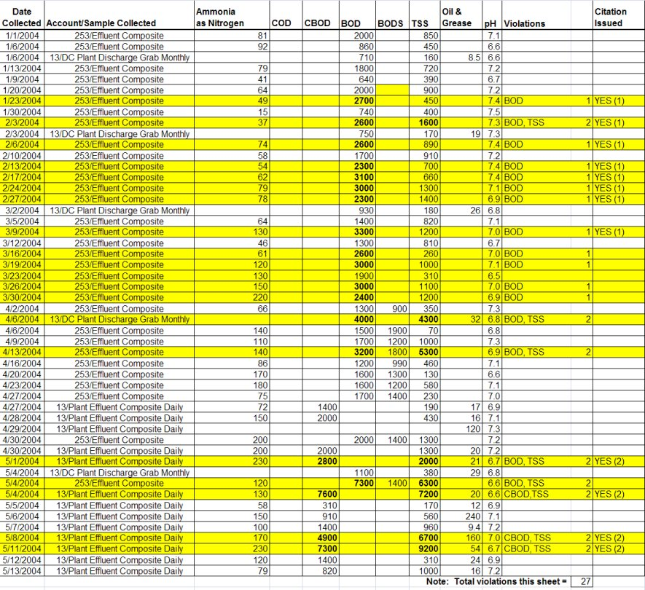
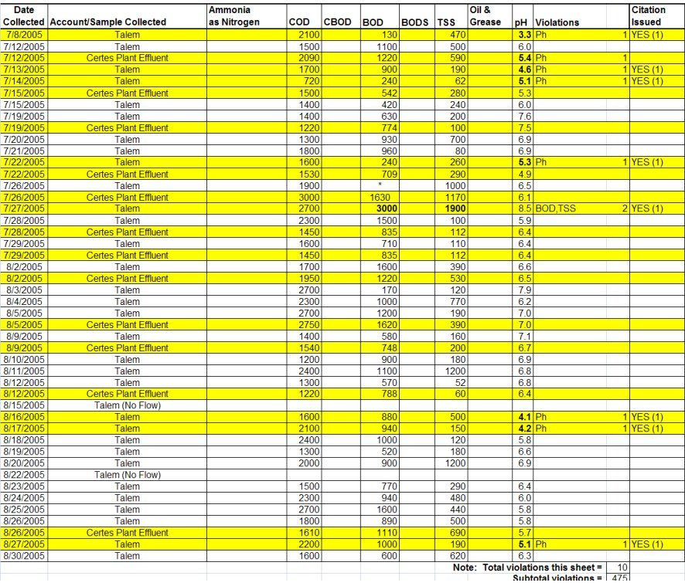
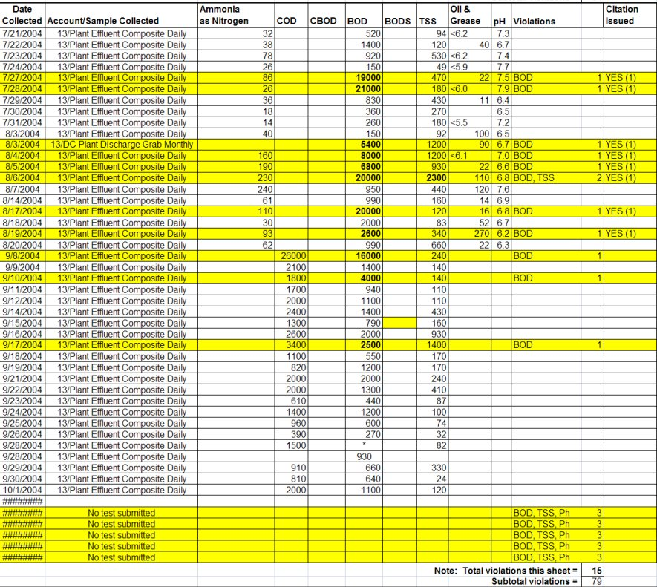
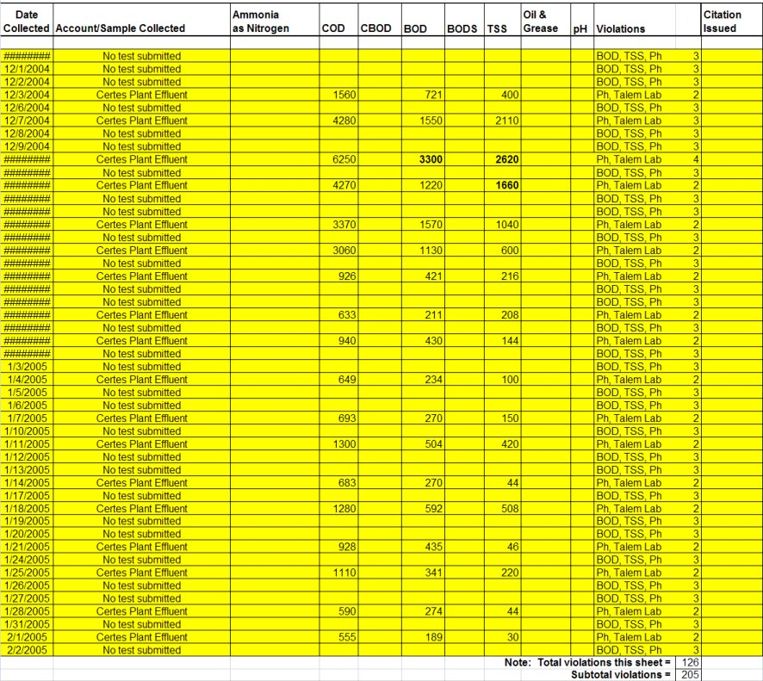
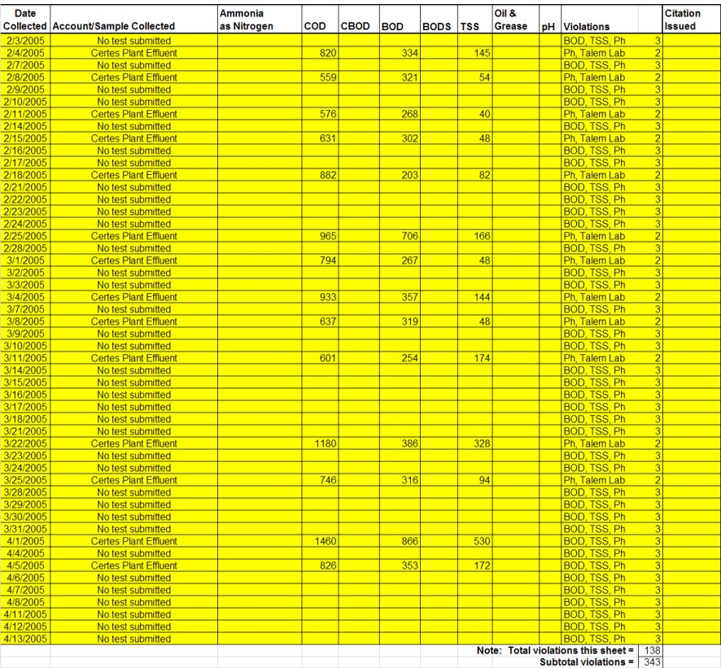
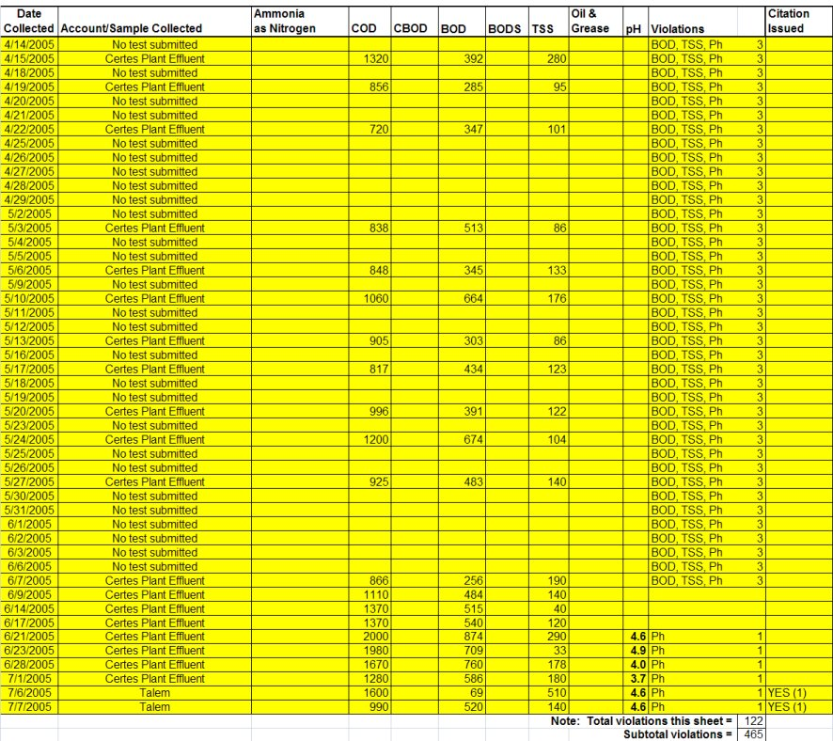
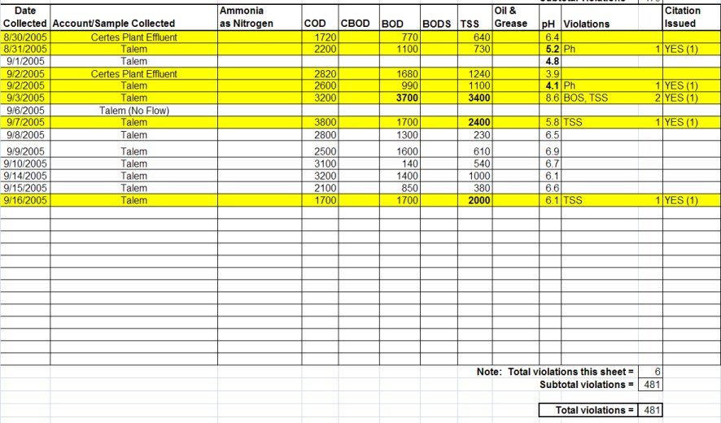
Chevideco’s Dallas Crown
(1980-2007)
Dallas Crown in Kaufman TX was operated by Chevideco, the proposed plant operator for Unified Equine.
The plant was in continuous violation of its sewer discharge, spilled blood in the streets, and created incredible stench.
In one 19 month period of operation Dallas Crown committed 481 violations.

Slide 9
Odors, Sounds and Property Values
The odors from the carnage, and from the chlorine misters meant to cover it up, were overpowering and blew over much of the town.
The hospital, blocks away, was forced to install special air filters to protect its patients.
Residents complained of hearing the horses “screaming”.
A pump installed by Dallas Crown to force their waste down the sewer actually caused blood to rise up into the bathtubs of the neighborhood.
Property values in the neighborhood behind the plant dropped to near zero. Since the plant closed they have increased dramatically.

Slide 10
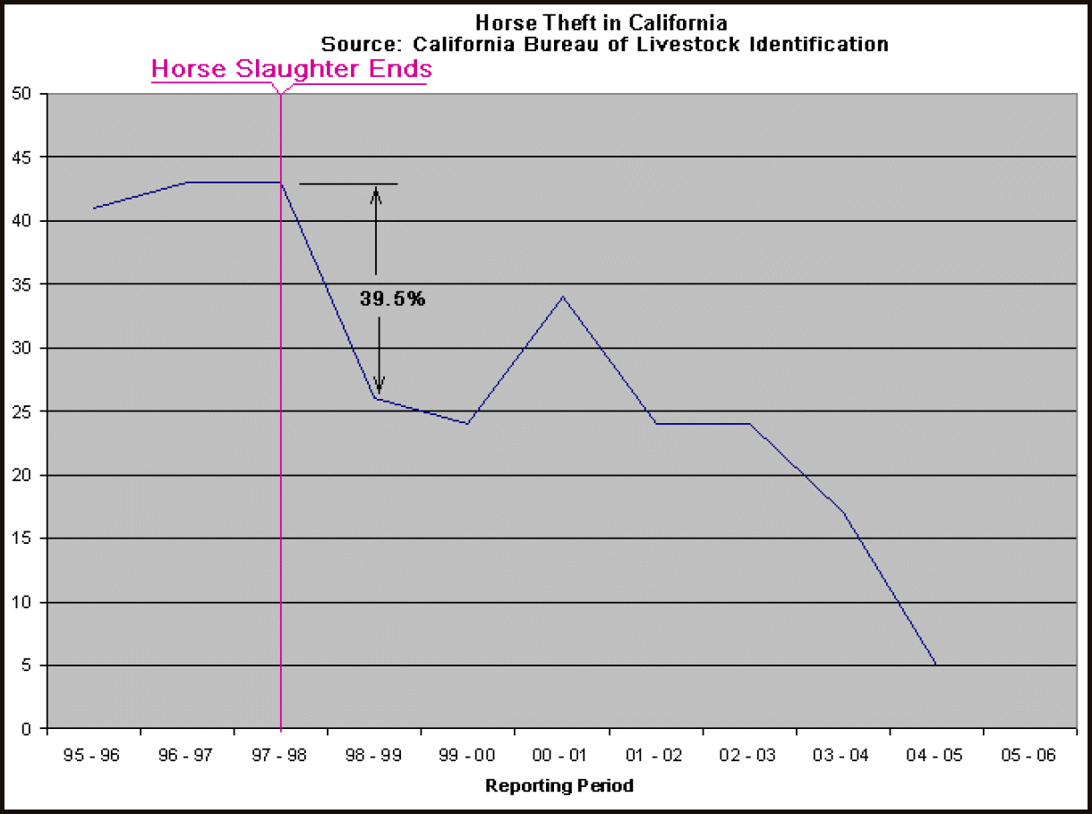
Horse Theft
Horse theft has a devastating effect on horse owners who are its victims.
Horse theft has a long and well known association with horse slaughter.
In the years after California banned horse slaughter, horse theft declined 84%!

Slide 11
Effects on Unemployment
Unified Equine and United Horsemen always claim that their proposed plants will reduce local unemployment.
At the Mountain Grove meeting, Chevideco officials stated bluntly that they hired almost exclusively Hispanic immigrants, saying “they are the only people who will do the job.”
In communities that do not already have a large Hispanic population suffering from unemployment, the result will be only a dramatic shift in demographics, not a reduction of unemployment among native workers.

Slide 12
Crime
There is an irrefutable increase in crime in communities with all slaughterhouses. This appears to be even worse for horse slaughter.
Violent crimes, including sexual assaults and crimes against the family are the most effected.
The definitive study of this phenomenon was done by Fitzgerald and Kalof.

Slide 13
Study Findings
Increases in slaughterhouse employment are linked to increased rape arrests across the entire time period under study.
The significant positive effect of slaughterhouse employment on sex offenses is also noteworthy.
Although studies have found that employment in the manufacturing sector in general has suppressant effects on crime (e.g., Lee & Ousey, 2001), this is clearly not the case for the slaughterhouse subsector of manufacturing.

Slide 14
Crime in Kaufman, TX
After Dallas Crown Closed
Murders dropped 100% (.5/100,000 to 0)
Rapes dropped 100% (6.0/100,000 to 0)
Robberies dropped 65.6%
Assaults dropped 61.2%
Thefts dropped 71.2%
Auto Thefts dropped 83.3%
Only Arsons remained unchanged.

Slide 15
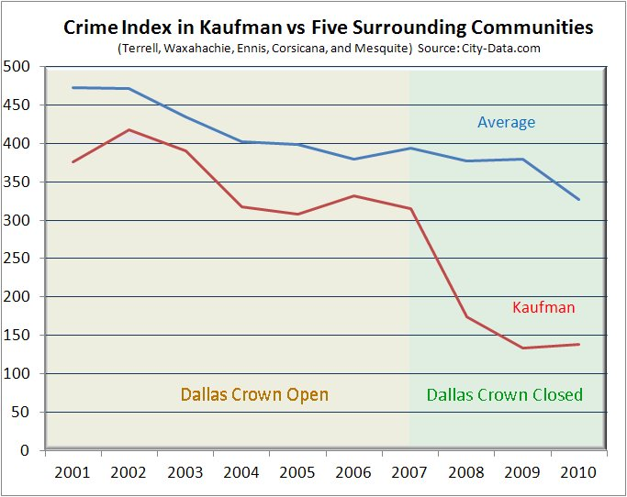

Slide 16
Financial History of Chevideco
Chevideco has a history of using shell companies to avoid taxes and financial responsibility.
At Kaufman they formed Waldo, Inc. to hold the physical assets and Dallas Crown to operate the plant. Thus suits against Dallas Crown could not threaten their assets.
Dallas Crown sold their product, at minimal profit, to a parent owned company in the EU so they could avoid realizing profits in the US.

Slide 17
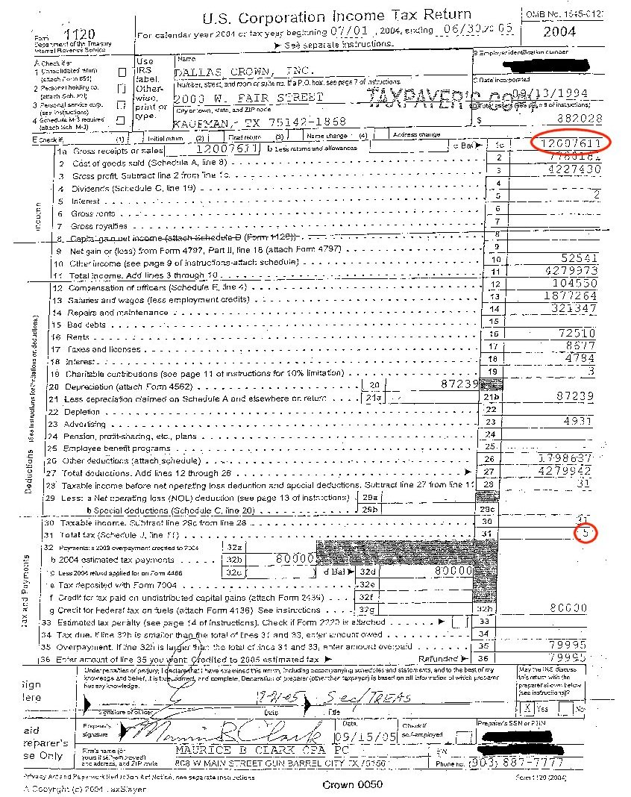
Tax Revenues
By controlling the point at which profits were taken, Chevideco avoided taxes.
In 2004, their Dallas Crown plant paid only $5 in Federal taxes on a gross income of over $12 Million.

Slide 18
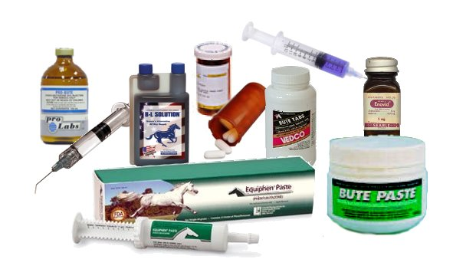
Food Safety
Horses are not raised in the US as food animals.
Horses are given drugs that are banned in animals intended for human consumption.
Phenylbutazone, “aspirin” for horses, causes cancer and bone marrow suppression in humans. Children are especially vulnerable.
In the EU, horses must be designated for slaughter at birth, and all drugs given them are tracked through a “passport” microchip system.
Selling this contaminated meat is immoral at best.

Slide 19
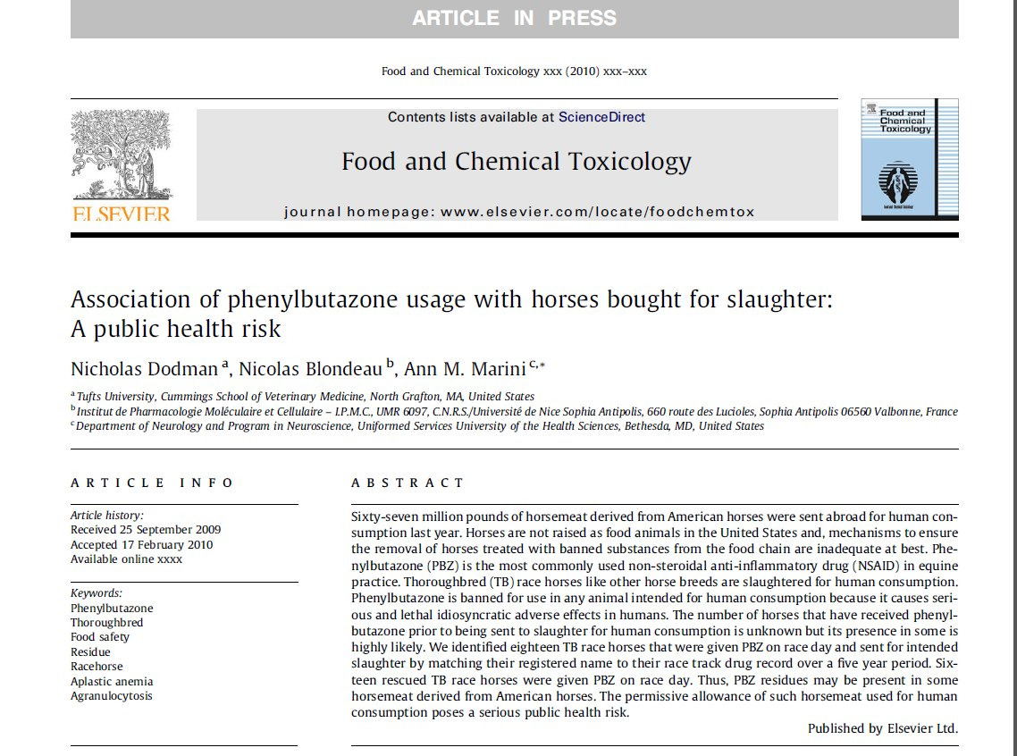
How bad is the problem?
In 2009, Doctors Dodman, Blondeau and Marini did a study of phenylbutazone given to slaughtered race horses.
They tracked 18 slaughtered thoroughbreds using racing records and found all of them had received the banned drug!
The USDA and CFIA use a completely ineffective testing method, and Mexico does not test for the drug at all.

Slide 20
In Conclusion
History tells us that a horse slaughter plant would be:
Bad for the environment
Bad for the community
Bad for law enforcement
Bad for the horses
Bad for horse owners
Bad for the local economy
Bad for the consumers of the meat

