Slide 1

RSAI Region Meeting
NW Region
May 7, 2024

Slide 2

RSAI Team
Justin Daggett, Manson-Northwest Webster, NW Region Rep. (Sept. 2026)
Brent Jorth, Central Lyon, At-Large Rep. (Sept. 2025)
Dan Peterson, At-Large Rep Term Expires: to be elected at Annual Meeting in October
Jen Albers, Administrator
Larry Sigel, ISFIS Partner
Margaret Buckton, Professional Advocate
Dave Daughton, Legislative Advocate

Slide 3
Agenda:
Introductions
RSAI Overview and Processes
Election to Leadership Group (not this year)
Election of Legislative Committee Reps
RSAI Proposed Bylaws, if any
Review of the 2024 Legislative Session
NW Region Priorities for 2025 Session
Brainstorming/Networking Discussion

Slide 4
Introductions
Name ____________________________________
District Role ____________________________________
One Sentence: What’s the best thing happening in your school district today?
________________________________________________________
________________________________________________________
________________________________________________________

Slide 5
History of RSAI
The Rural School Advocates of Iowa began with a few rural school leaders getting together in 2013 to discuss many things:
  Why were rural school voices not represented in statewide decision-making?
  Why did funding formulas not recognize transportation and sparsity factors?
  Why did state policy always seem to have a “one-size-fits-all” approach that left little flexibility to rural schools?
  What could rural school leaders do to change this situation to benefit students in rural schools?
July 1, 2014 RSAI officially formed with 41 member districts

Slide 6
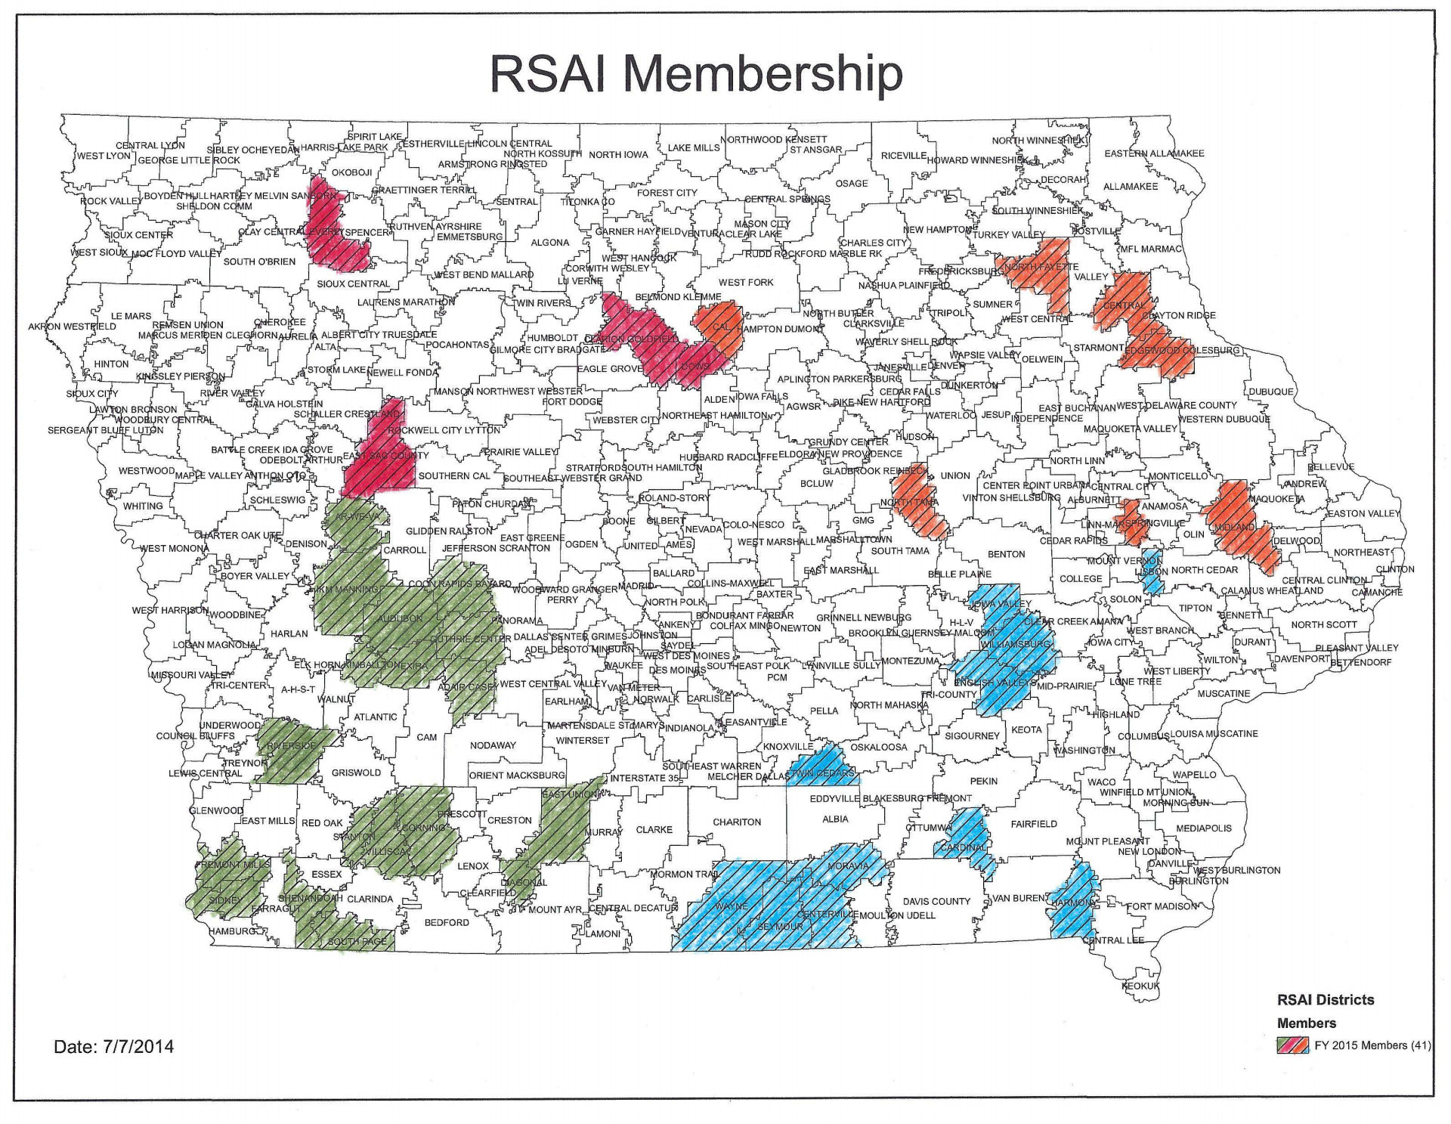
July 1, 2014

Slide 7
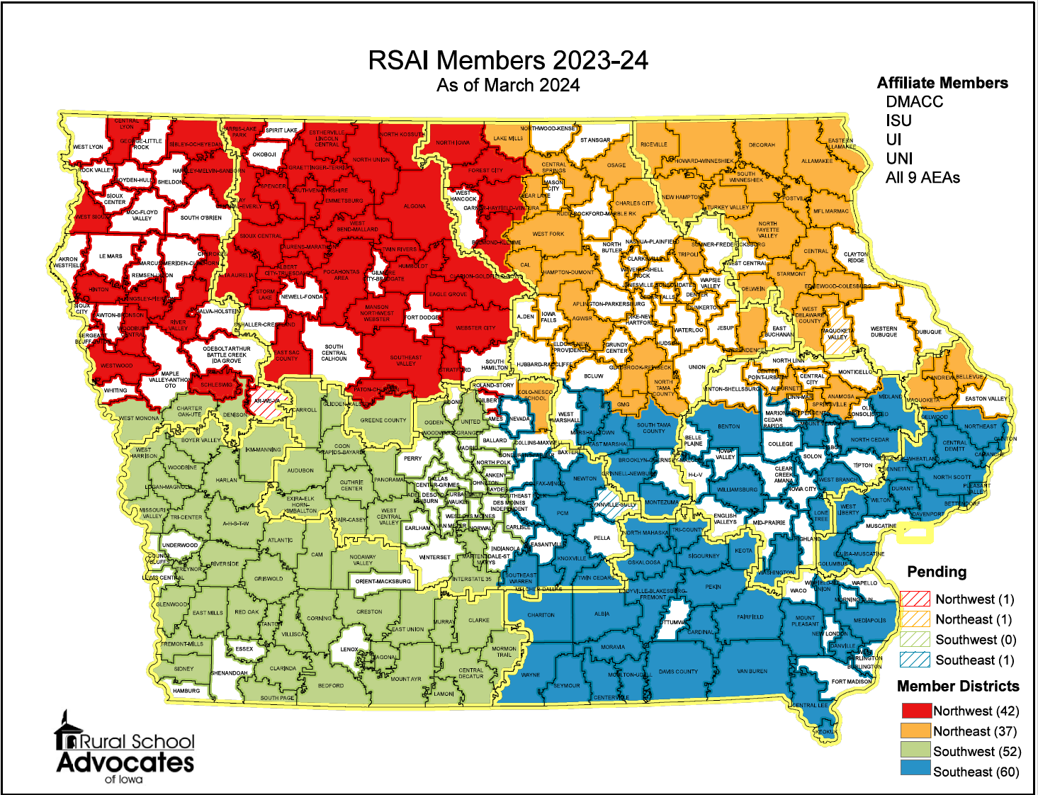
SE Region includes Mississippi Bend, Grant Wood, Central Rivers, Heartland and Great Prairie AEAs

Slide 8
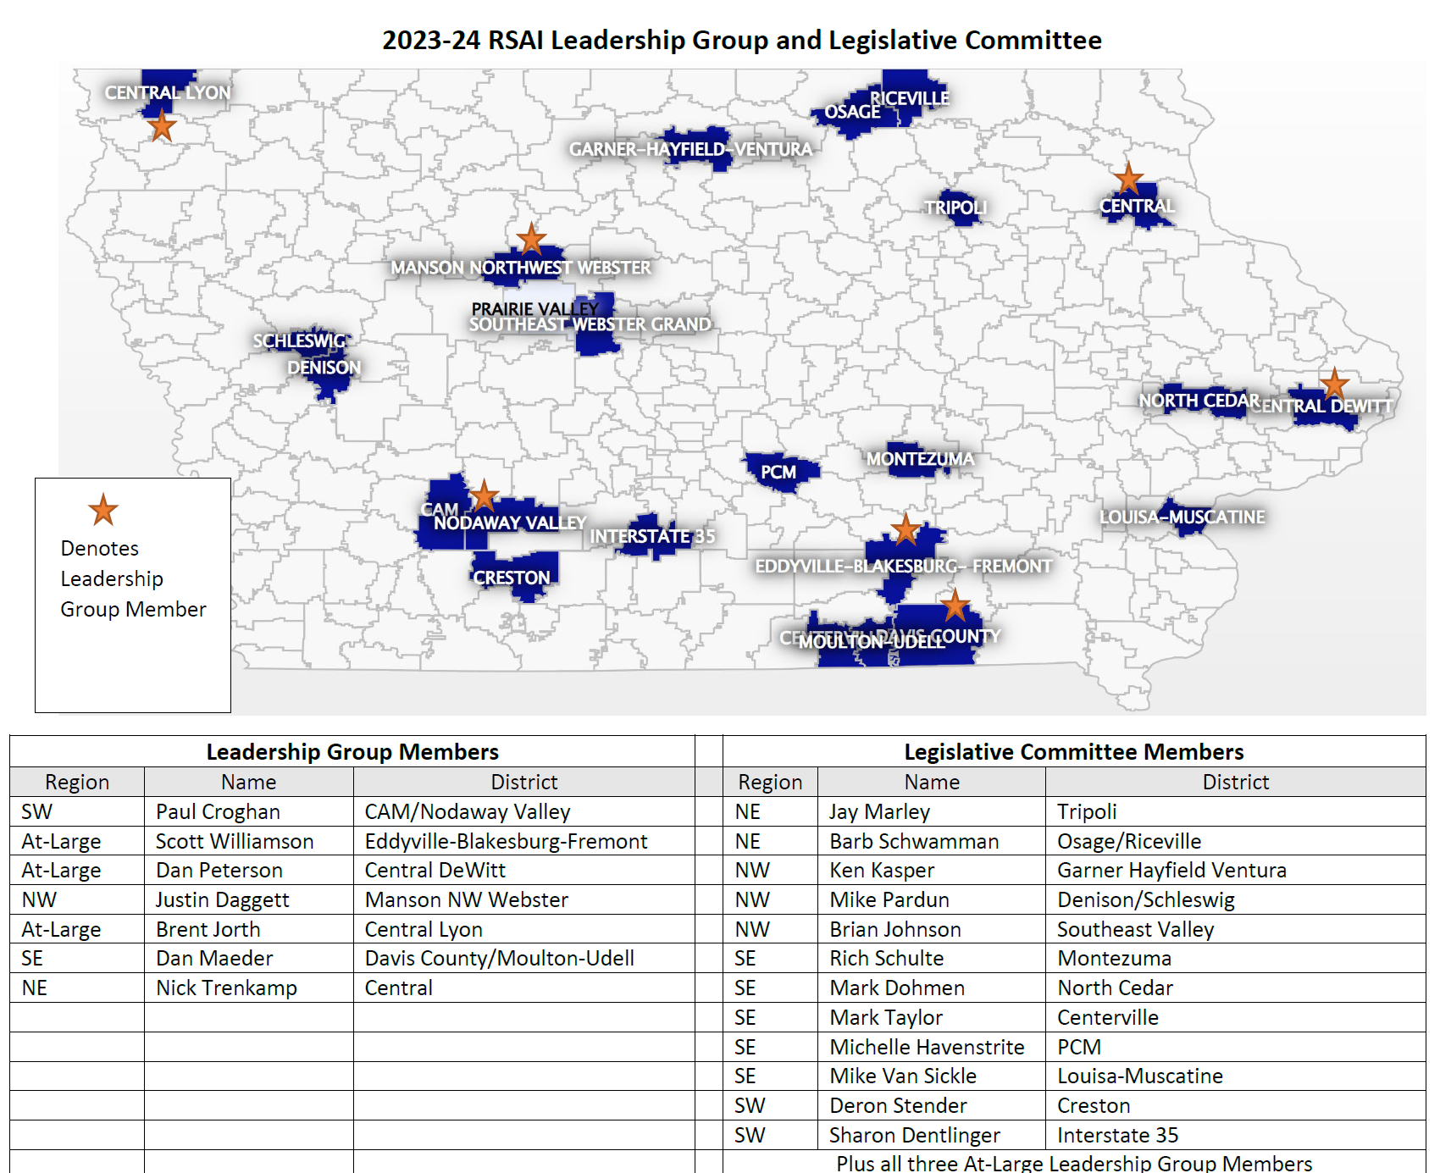

Slide 9



RSAI Relationships
RSAI is recognized as the Iowa affiliate of the National Rural Education Association (NREA) connecting members to rural school leaders nationwide, an annual conference focused on the needs and successes of rural schools
Lends Iowa’s voice to a collective effort in our nation’s Capitol through membership in the Rural Schools Collaborative.
Member of Iowa Rural Development Council to network and collaborative w/rural leaders across all areas of economic development.

Slide 10
Member Benefits
Advocacy presence at the Iowa Capitol focused on RSAI priority issues
Weekly legislative update reports and recap videos to share the latest news from the statehouse and calls to action when needed
A voice to advocate with the executive branch and represent rural schools on various task forces and stakeholder committees convened by DE.
Advocacy resources for local leaders to use, including position papers, advocacy tool kits, talking points, maps, and school finance estimates
Assistance with communications, letters to the editor or sample letters to legislators
Easy to share information, such as RSAI Legislative Priorities Video, to inform school boards, staff, and stakeholders.
RSAI is the state affiliate of the National Rural Education Association, which brings access to NREA research, updates about happenings in Washington, networking
Free Summer regional meetings and RSAI annual conference in October.
Authentic grassroots development of legislative priorities in a one district one vote democratic process.
Free access to NASDTEC teacher licensure checks with your RSAI membership. Learn more about the program here.
Discount on ISFIS Policy-hosting Service
Collective purchasing power as a group, attracting needed supports at discounted prices
Networking, Sharing, Best Practice Connections with other like districts

Slide 11








www.rsaia.org/corporate-sponsors

Slide 12
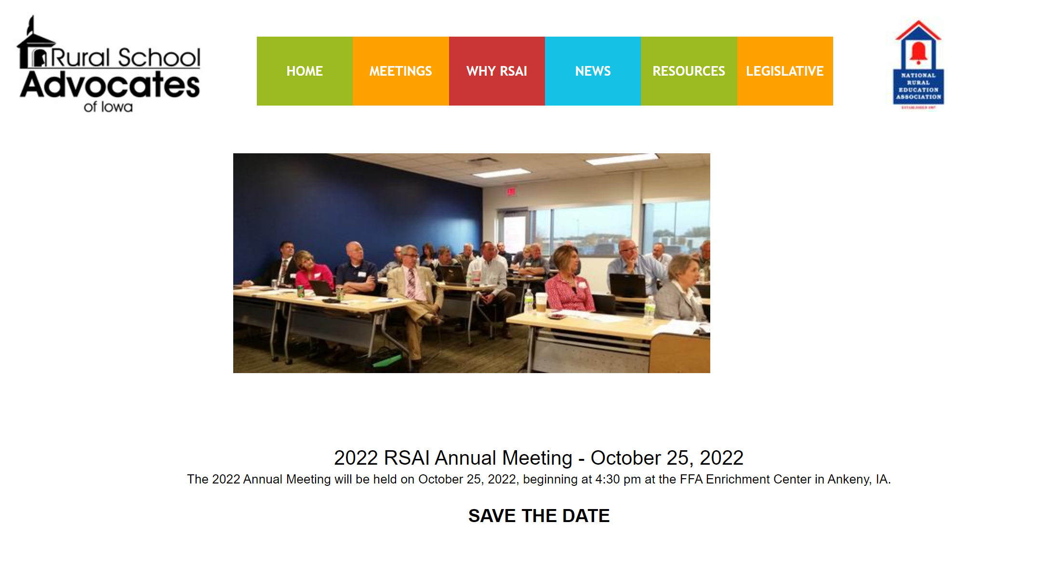
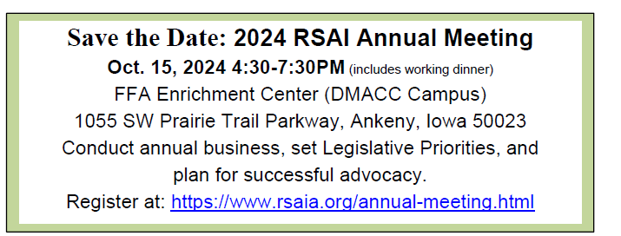
https://www.rsaia.org/annual-meeting.html

Slide 13
Election of RSAI Regional Representative to the Leadership Group.
Justin’s term expires Sept. 2026
No election necessary this year.

Slide 14
Election of RSAI Regional Representative(s) to the Legislative Committee.
Office is a 1-year appointment.
By-laws allow additional representatives so each AEA has at least one.
Thanks to those serving during the 2024 Session!
In addition to At-large members (Thanks Brent Jorth, Central Lyon CSD)
NW (Central Rivers AEA) – Ken Kasper, Garner Hayfield Ventura CSD, Superintendent
NW (Northwest AEA) – Mike Pardun Denison & Schleswig CSDs, Superintendent
NW (Prairie Lakes AEA) – Brian Johnson, Southeast Valley CSD, Superintendent
Representative attends Legislative Committee Meeting in Des Moines during August (date TBD), attends the Annual Meeting in Ankeny during October, and supports legislative advocacy efforts during the Legislative Session.
Maps in left side of packet show membership & current representation

Slide 15
Review of RSAI Bylaws
Any changes needed?
Comments/recommendations would be shared with the RSAI Bylaws Committee. Legislative Committee then makes final recommendation to members at the Annual Meeting, which requires a 2/3 vote for approval.

Slide 16
Summary of 2024 Legislative Session (so far)
RSAI Priority Action

Slide 17
Legislative Session 2024
Local Board Authority
Adequate Funding
Income Tax Reduction
Staff Shortages & Flexibility
Open Enrollment & $ Following Students
Priorities not Addressed

Slide 18
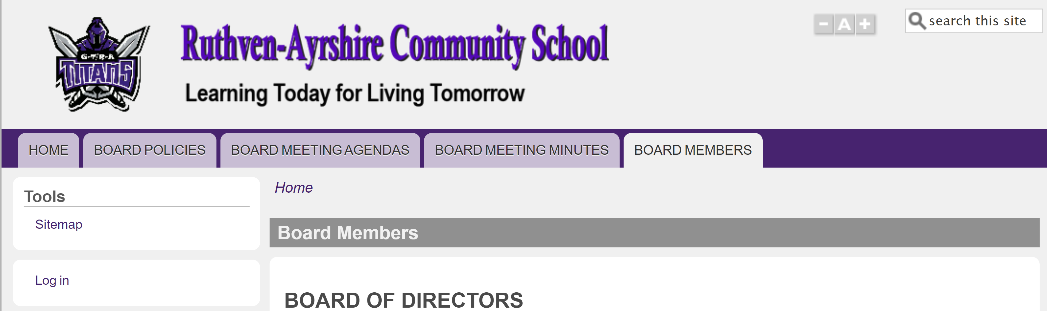
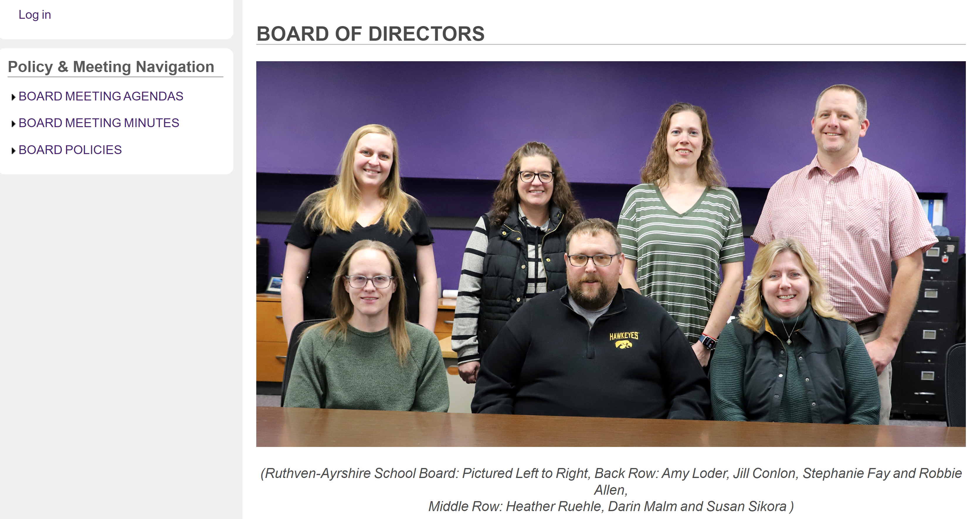
https://ruthven.iowaschoolfinance.com/

Slide 19
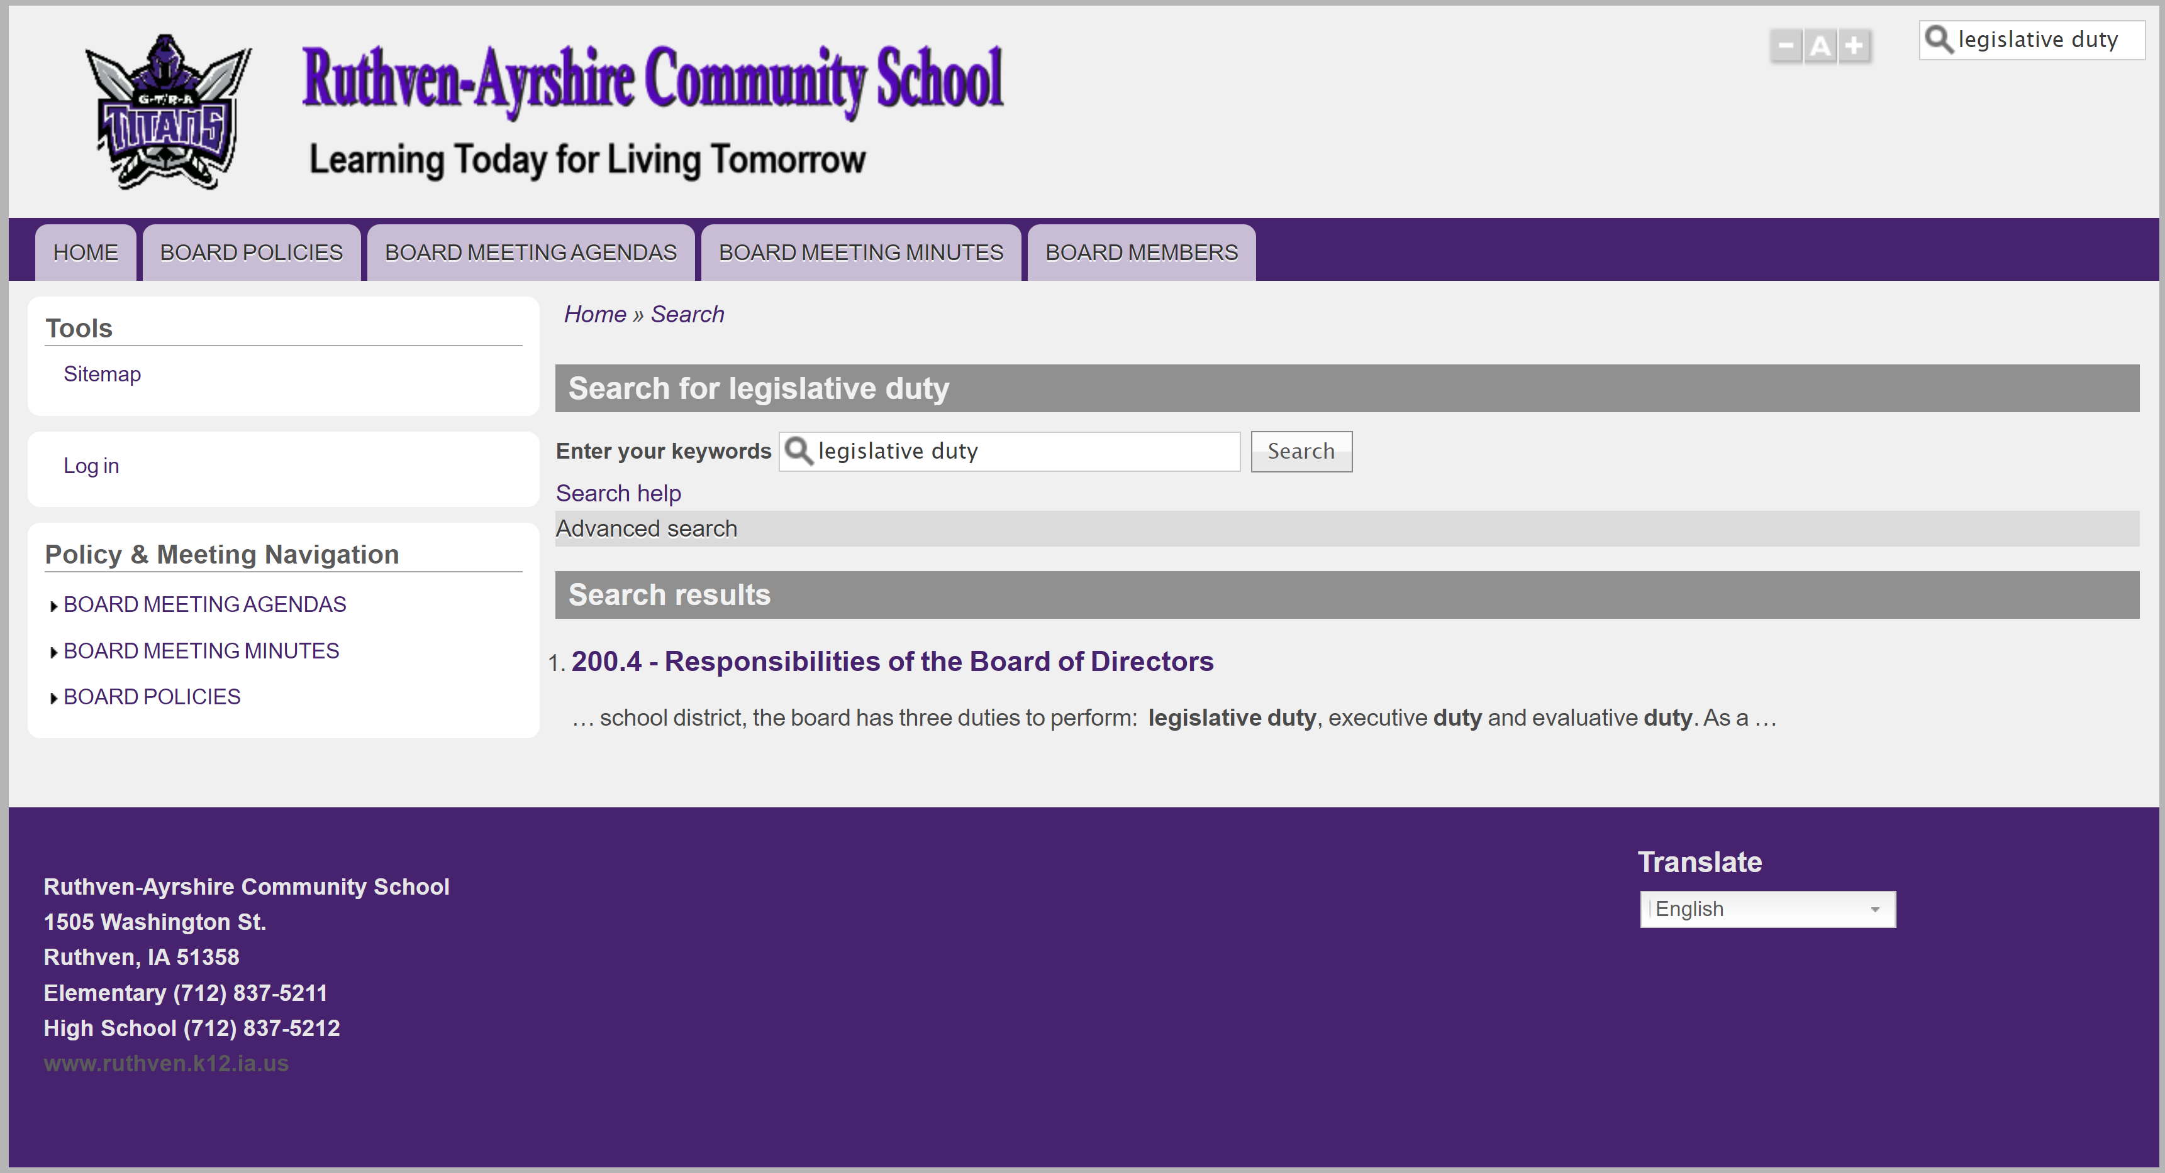
Local School Board Authority
https://ruthven.iowaschoolfinance.com/

Slide 20
Board Authority/Local Control
So many unfunded mandates were introduced this year, most did not progress, including 2367 new data collection/reporting tool and second enrollment count date. School start date proposals that would have expanded flexibility also died.
HF 2545 Core Curriculum Study (undecided) added some language from the House on social studies. The only mandate on schools is to add a civics component to 7th and 8th grade. RSAI undecided.
HF 2586 School Guards and Guns: original mandate language was removed, allowing school boards to opt out of the SRO requirement. Includes a component that mandates training before staff can carry, but retains school board authority to decide whether staff will be allowed to carry guns on school grounds. Grants liability protection for school district and employee. HF 2652 allows PD funds to pay for staff training. Eliminates liability for school or staff. RSAI undecided.
SF 2368 Charter Schools: Charter School funding, Open enrollment funding, and right of first refusal on school property. This bill requires the district to sell real property that is up for sale to an educational institution (charter, nonpublic, private or public college/university or another district if they are the highest bidder.) They did remove a provision that charter board members did not have to be Iowans. RSAI opposed.

Slide 21
Board Authority/Local Control
SF 2435 Education Appropriations Chronic Absenteeism:
Mandates board policy,
Requires parent notification and county attorney action,
Defines chronic absenteeism and truancy (includes exceptions),
Requires school engagement meetings to create an absenteeism prevention plan,
Specifies what must be in that prevention plan
Specifies that the county attorney is responsible for enforcement and allows county attorney to prosecute if any participants do not adhere to the plan
and states that since schools get state aid, it is not an unfunded mandate. “The state cost of requiring compliance with any state mandate included in this division of this Act shall be paid by a school district from state school foundation aid received by the school district under section 257.16.” Does this mean the county attorney bills the school district for their time?
HF 2618 Literacy Initiative: Requires prep programs to administer the Foundations in Literacy test and report scores, requires schools to notify parents if K-6 students are not proficient in reading (including parent’s right to retain in the notice) and requires districts to retain if parent asks. Requires an individualized reading plan which must be followed through 6th grade until student reaches proficiency.

Slide 22
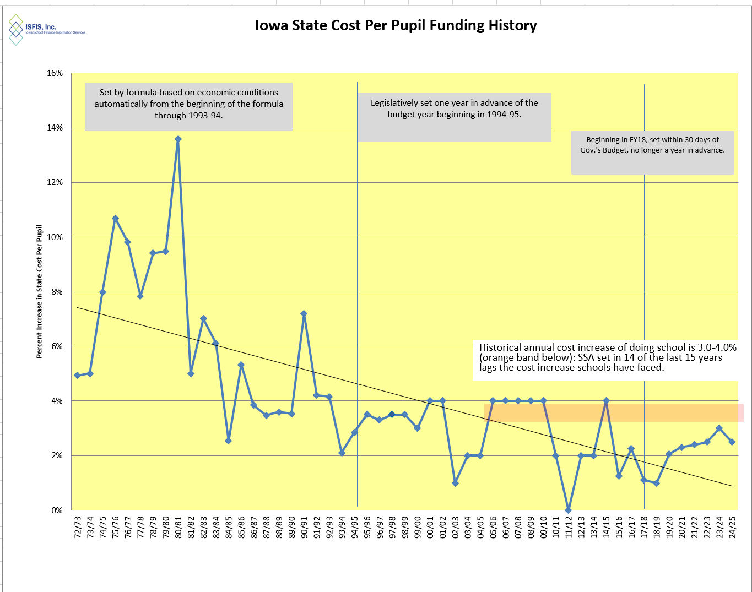
2.5% ties for the third highest in 15 years.
Inflation is higher.
Teacher and other staff pay is not keeping up (TSS and Ed support salary will help).
Resource challenge is felt more strongly in rural schools.
If SSA doesn’t keep up, will revisit TSS in another 10 years (or less)

Slide 23
Funding
HF 2612 SSA, Teacher Pay and AEAs
2.5% SSA
TSS adjustments to reach new minimums of $47,500 and $60,000 in FY 2025 and $50,000 and $62,000 in FY 2026.
Flexibility for media and educational services (double edged sword – exercising district flexibility means cuts to AEA)
SF 2443 Standings
Appropriates $14 million for education support personnel (no hourly minimum required). HF 2412 requires district to apply for the funding by submitting information to DE. Wait for application.
Applies AEA cuts to districts and AEAs proportionally.
Defines 12-year-experience as being completed by July 1, 2024 for $60K and completed by July 1, 2025 for $62K minimums. DOM is recalculating TSS based on this definition, which is estimated to increase FY 2025 funding by $5 million.
SF 2435 Education Appropriations:
New Approp of $10 million for Division of Special Education (62 FTEs) for general supervision, oversight, compliance, employee salaries, support, maintenance and miscellaneous purposes with AEA regions and DE main office.
$3.4 million to AEAs for mental health awareness training and to support MH needs of students.
Delays $10M appropriation for High Needs Schools Grants to July 1, 2025

Slide 24
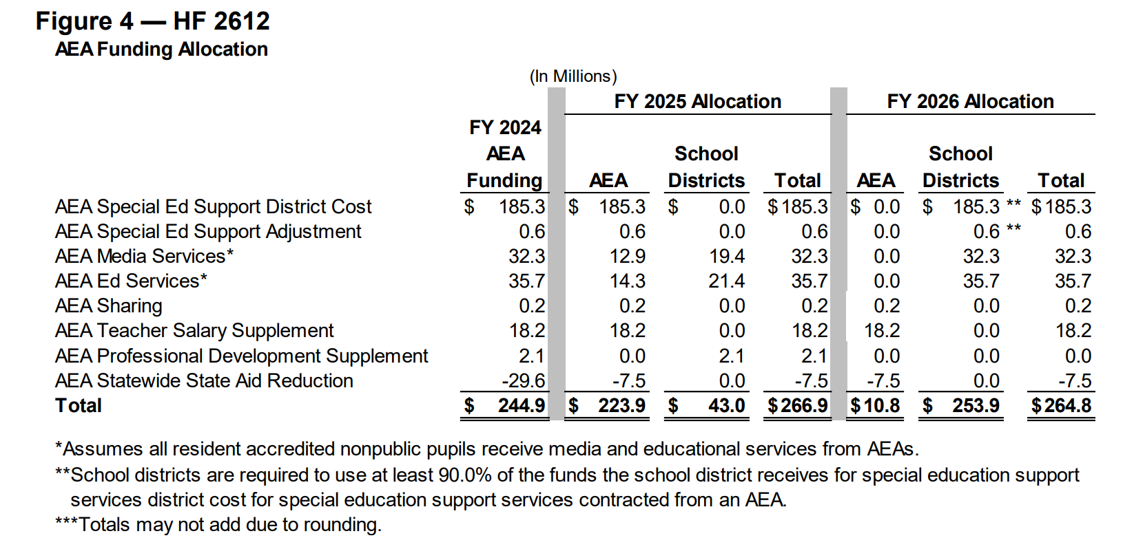
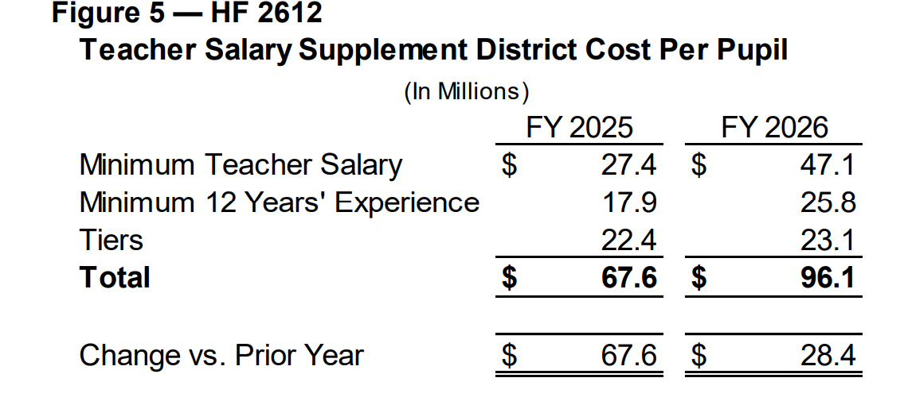
FN for HF 2612 shows AEA total funding up $24 million, but that was before the standings appropriation reduction ($25M reduction). Compare to cut of $29.6 in FY 2024, Total AEA reduction is now $32.5. (Remember PD shift to DE of $2.2 PD)
Total State Investment
SSA state: $119.2 M
TSS: 67.6 M
TSS 12-yrs* 5.0M
ESP: 14.0 M
Total state: $215.8M
SSA local: $50.6M

Slide 25
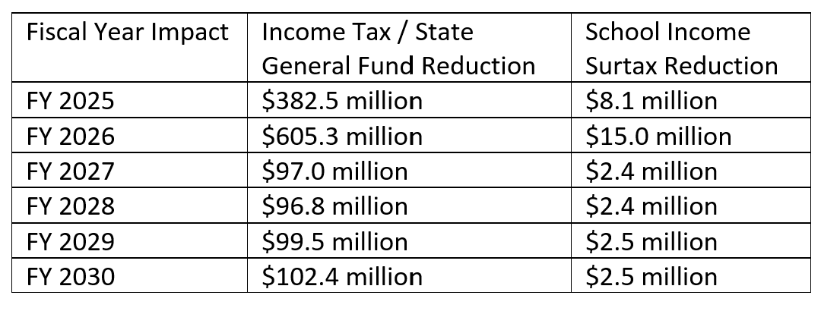
SF 2442 Income Tax Reduction
Accelerates the reduction of a flat tax rate for individual income tax and lowers the rate to 3.8%, which first applies to the 2025 Tax Year.
Action is expected to reduce income taxes and state General Fund revenues and school income surtaxes as reported in the Fiscal Note:
School Income Surtax: school boards will have the option of increasing the surtax rate to generate the same revenue or shifting some back to local property taxes for ISL and PPEL.

Slide 26
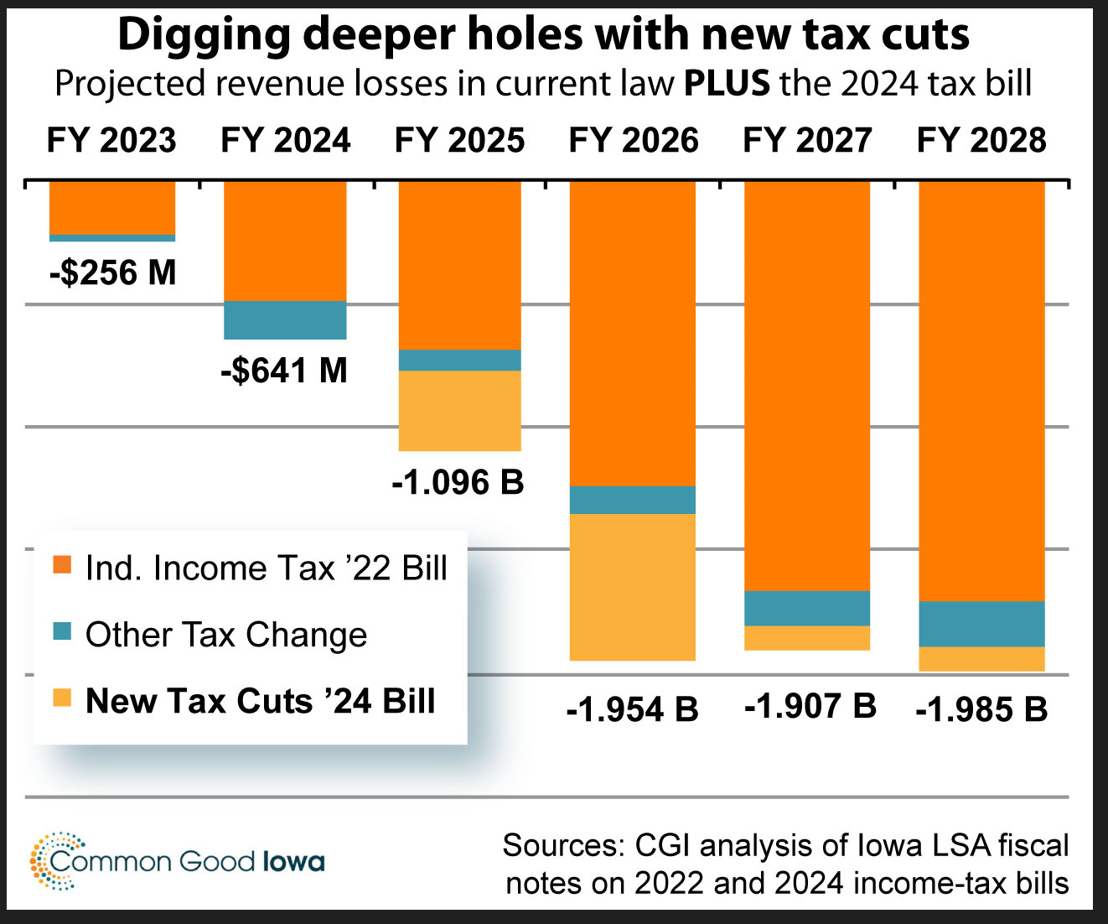
Fiscal Note only shows the net effect of SF 2442.
This CGI chart shows the total impact combined with prior tax cuts.

Slide 27
SF 2442 Tax Cuts
Certified Budget Changes:
Changes the deadline for political subdivisions to file report with DOM from March 15 at 4:00 p.m. to March 5 containing all necessary information for DOM to compile and calculate amounts required to be included in the statements sent out to property tax owners and taxpayers in that subdivision. If a city or county fails to meet the deadline, that city’s or county’s tax levy is limited to the previous year’s budget amount.
Changes the deadline for county auditors to send an individual statement containing information related to property taxes from March 20 to March 15.
Changes the property tax statements examples to require assessment value of $300,000 for residential property and 110% of residential and commercial property in the current fiscal year compared to budget year. Requires future statements to include a percent change in property taxes owed from the current fiscal year example to the budgeted year example. Requires all statements include a link to DOMs Internet site.
Mostly changes city and county requirements. Stay tuned for additional impact on school districts.

Slide 28
Staff Shortage/Flexibility
SF 2411 Work-based Learning: allows CTE to include WBL and may be provided when school is not in session. Allows 1-10 weeks of experience credited toward student teaching for significant para or substitute classroom time under certain conditions.
SF 2465 Agriculture Courses: allows up to 2 units to count toward math, science or CTE offer and teach requirements.
HF 2612 Retirees: allows hiring returning teachers after one month bond fide retirement period (limited to three years) and only for teaching.
HF 255 Teacher Intern License and CTE temporary license.
HF 2515 Therapist, Counselor, Social Worker Authorization from another jurisdiction.

Slide 29
SF 2435 Education Appropriations Division VIII: Open Enrollment Deadline
Reinstates the March 1 open enrollment application deadline for grades 1-12 and Sept. 1 for Kindergarten.
Reinstates Good cause exceptions, with process and DE mediation if there’s a dispute.
Allows parents to withdraw request at any time prior to the beginning of the school year. Allows the student to return to district of residence at any time.
Allows the receiving district to prohibit a truant student from open enrolling or from continuing open enrollment. Requires the district of residence to enroll the student. (Student can become home school at any time)
Exempts requests to open enroll to virtual schools from the March 1 application deadline.
Effective on enactment.

Slide 30
SF 2435 Education Appropriations Division XIV Open Enrollment State Aid
Creates the option for school districts if open enrollment is >45.0% of the total number of students enrolled in the school district, to request MSA (spending authority) from the SBRC.
School districts may be granted a modified FY 2025 supplemental amount (MSA) up to 50.0% of the net change in the following resulting from open enrollment: difference between the district’s regular program district cost per pupil minus the regular program State cost per pupil, TSS district cost per pupil, PD supplement district cost per pupil, and Early intervention/Class size supplement district cost per pupil.
Requires a public hearing and the publication of a notice of public hearing to be done prior to the request.
Prohibits districts from increasing the combined property tax rate for FY 2026 due to an MSA if doing so would cause the school district levies’ for the budget year to exceed the combined property tax rate for FY 2025.
A school district is not eligible for additional MSA if a majority of the students open enrolling into the district are students receiving online instruction from a private provider under Iowa Code section 256.43.
Specifies school districts are only eligible for the open enrollment MSA in FY 2025.
The LSA estimates granting MSA associated with this request would increase school district spending authority statewide by an estimated total of $1.9 million beginning with FY 2025.

Slide 31
SF 2368 Charter Schools $ Follows Students
Funding Formula: requires money to follow students to charter schools (Iowa Code 256.E8) and via open enrollment (Iowa Code 282.18), including
  Current year state cost per pupil (SCPP). Current law requires the prior year state cost per pupil.
  Current year categorical per pupil supplements of PD SCPP and early intervention supplement SCPP. (TLC per pupil categorical funds already follow students to charter school and receiving districts, but PD and EICS are new requirements in this bill.)
  Current ELL weighting generated by the student to be multiplied by the current year SCPP.
  Although the Governor’s bill also included a requirement for TSS to follow students, that was not included in the enacted version of the bill.

Slide 32
HF 2612 AEAs: Pending Action
Task Force to study everything and make recommendations by Dec. 30, 2024. Is there subsequent legislative action? Election in the meantime.
Development of new AEA Accreditation Standards
Proration of Standings Cuts to AEAs to determine district and AEA funding
Creation and staffing of DE’s new Division of Special Education, including Special Education Oversight Positions in AEAs
AEA quarterly reports to districts regarding funds spent and services received
AEA report to GA re progress towards goal of reducing administrative expenditures by 30%
Lots of unanswered questions: e.g., how do AEAs serve nonpublic students without school district flow-through?

Slide 33
RSAI 2024 Priorities without Significant Action
Full day or weighted PK – some initial conversations but not progress
No significant expansion or increased cap on Operational Sharing (except HF 2615 College Reporting exempts the shared College and Career Coordinator student weighting from the 21-student cap.)
SF 392 Recruitment and Retention Plan: allows management fund for R&R plan if not used for Early Retirement plan, died in Senate Ways and Means
Opportunity Equity or Student Mental Health – but for allowing transportation balances to Therapeutic Classroom grants in SF 2435. Unsure if new substance abuse and mental health state regions alignment will support student MH. No changes to state Medicaid plan to allow Medicaid claiming for low income students without IEPs.
Public School Priority (no clean-up on ESAs – but expect new application deadline next year)
Formula Equity (RPDD and SCPP) - no action
Bond Issue Dates – no action

Slide 34
Legislative Priorities Discussion: Tracking form in your packet
On your agenda see the 2024 list or on the RSAI website
https://www.rsaia.org/2024-legislative-session.html
RSAI 2024 Legislative Priorities
    1. Are there any that need to be removed?
    2. Any that need to be added?
    3. Any significant (or suggested) wording changes on those already on the list?
Small group or whole group discussion. We can go through them one at a time or consider the whole list with one vote. It’s completely up to the attendees to decide how to proceed.

Slide 35
RSAI 2025 Legislative Priorities
See the RSAI website meeting tab for more information such as RSAI Legislative Digest, Position Papers which will be updated after language is finalized during the process, Legislative Priorities, and this PPT and meeting minutes on the Regional Meeting tab. More information about the Oct. 15 Annual Meeting Coming later this Summer!
http://www.rsaia.org/

Slide 36
THANK YOU FOR YOUR VOICE on behalf of rural students!
Watch for RSAI Legislative Digest
RSAI Priority Survey later this Summer
SOS Info on Candidate Contact Information later this Summer
Stay connected through the Interim
Let us know what you need to beef up your advocacy efforts.
See you at the Oct. 15 Annual Meeting!
Professional Advocate
Margaret Buckton, margaret@iowaschoolfinance.com
1201 63rd Street, Des Moines, IA 50311 (515) 201-3755 cell
Grassroots Advocate
Dave Daughton, dave.daughton@rsaia.org
(641) 344-5205

