Slide 1
Louth CBD
Six stages of a geographical Investigation
Investigating land use in the CBD of Louth.

Slide 2
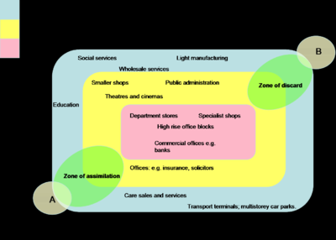
1. Identify a suitable geographical question/hypothesis
Our overall research investigated the ‘internal structure of the CBD’ to fully investigate this a number of hypotheses were formed, for example:
“Pedestrian densities will be highest in the centre of the CBD near the PLVI where there are more comparison shops selling high/middle order goods as these need more customers. Whereas pedestrian densities will decrease towards the outskirts/outer core where there are more convenience stores selling low order goods”

Slide 3
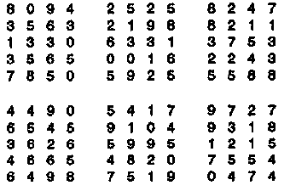
2. Developing a plan & strategy
Even though we would gain relevant and up to date information from our primary data, secondary data was also used to back this information up and ensure more confidence in any conclusions made.
Before the fieldwork was conducted retail outlets were chosen randomly through a ‘random numbers table’ (where numbers were matched to grid references) to ensure that a fair sample was used.

Slide 4
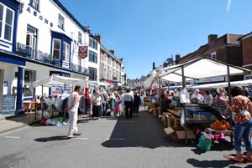
2. Developing a plan & strategy
The time the fieldwork took place was also carefully considered, it was carried out on a market day to ensure there were enough people to investigate aspects such as pedestrian densities.
In addition to the planning, a risk assessment was also carried out which was up to date and relevant to our study including necessary points such as ‘the bus breaking down’ and ‘becoming lost in Louth’s CBD’.

Slide 5
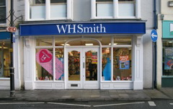
3. Collect and record appropriate data
Both primary and secondary data was collected in this study with most data being quantitative.
Primary
One of the first pieces of data collected was noting the shop (as to determine whether it was convenience/comparison) and then
a measure of shop frontage was take
(to later calculate the ‘Rate Index
per m shop frontage).

Slide 6
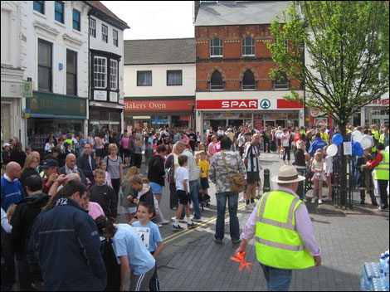
3. Collect and record appropriate data
Primary
In front of each shop a five minute pedestrian and traffic count was also taken (with pedestrians being split into male/female and all above school age) and traffic being split into various vehicle types (e.g. Bus, car, van etc.)
Each of these counts were recorded in a tally.

Slide 7
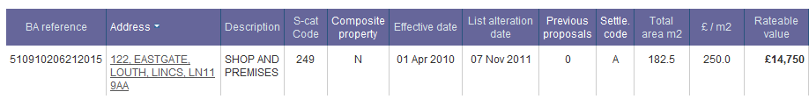
3. Collect and record appropriate data
Secondary
Through use of GIS we accessed the VOA site (which gave information on rateable values) which would eventually allow us to calculate the ‘rateable value per metre frontage’.
Another secondary source used was the GOAD land use map of Louth CBD from 2004.

Slide 8
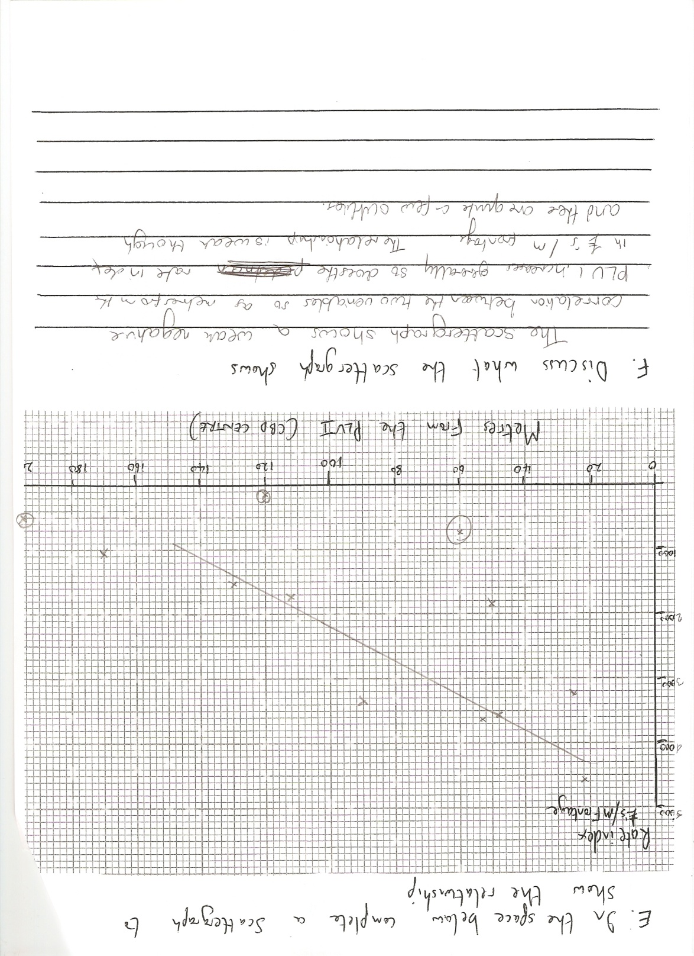
4. Present data in appropriate forms
Our findings were presented in various ways: through maps, tables and graphs.
1) Depicted below is a scattergraph to show the relationship between distance from the PLVI and the Rate Index

Slide 9
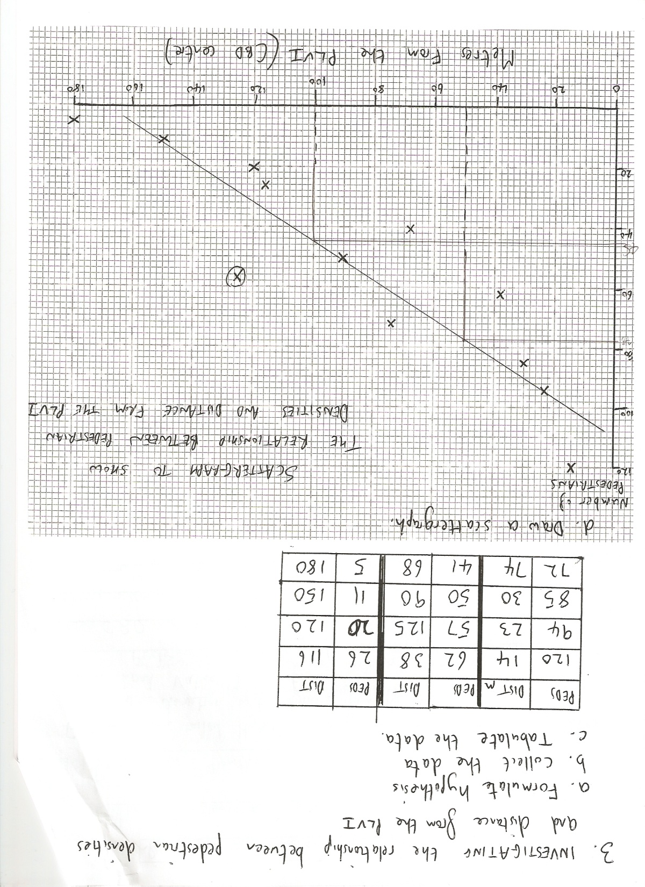
4. Present data in appropriate forms
2) Scattergraph to show the relationship between pedestrian densities and the distance from the PLVI.

Slide 10
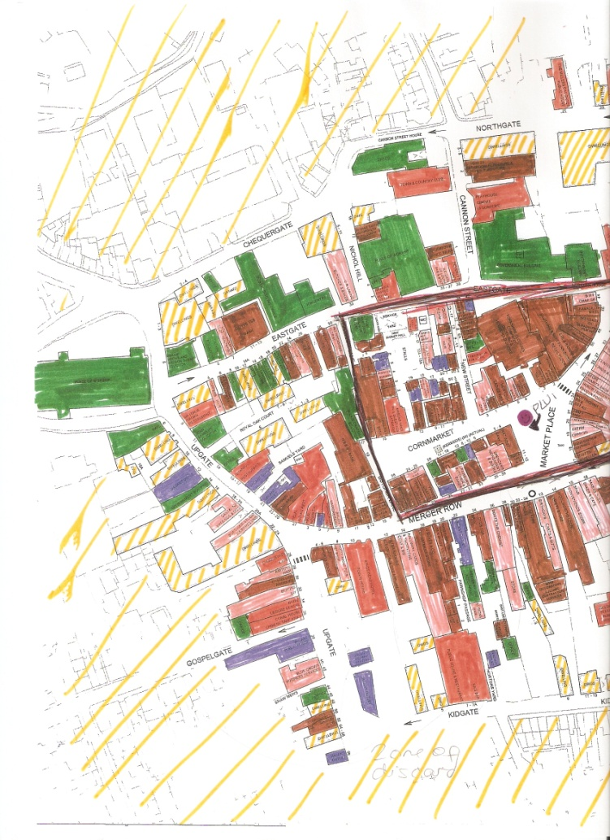
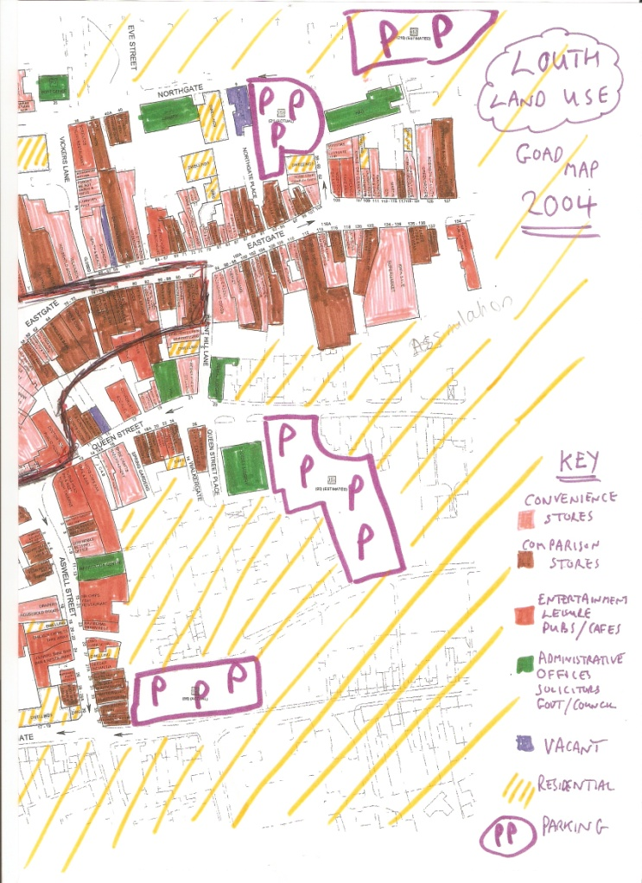
4. Present data in appropriate forms
Land use map to show the functions of Louth CBD

Slide 11
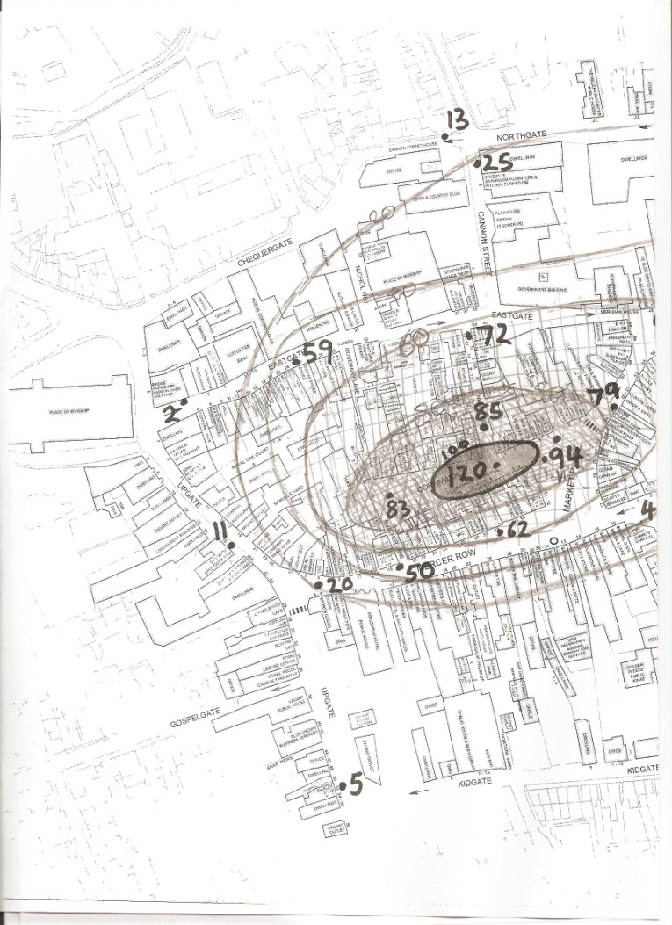
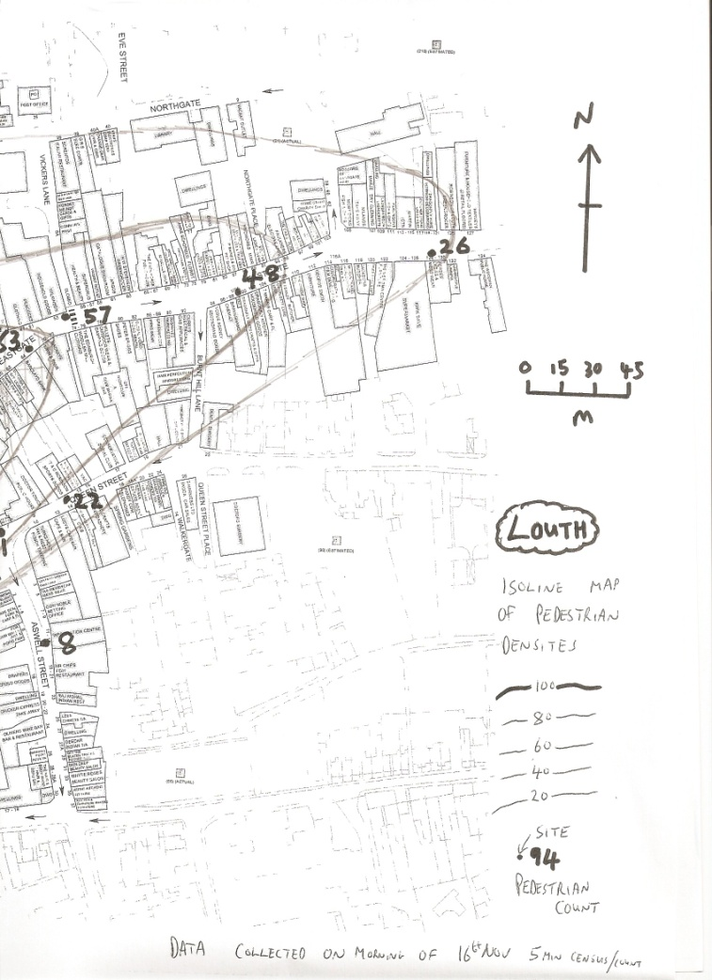
4. Present data in appropriate forms
Isoline map of pedestrian densities:

Slide 12
5. Analyse and interpret data
The first scattergraph shows that rateable values decrease the further from the PLVI you are indicating that competition for land is highest at the PLVI.
Our scattergraph shows that as distance from the PLVI increases pedestrian densities decrease as such as line of best fit was drawn to indicate this relationship. However there were outliers and the relationship between the two was not perfect.

Slide 13
5. Analyse and interpret data
To test the strengths of these relationships Spearman's Rank Correlation Coefficients were calculated.
Number of pedestrians and distance from PLVI:
-0.89
Proves at 99% confidence level, therefore significant.
Distance from PLVI and rateable values:
-0.71
Proved at 99% confidence level: relationship is significant.

Slide 14
5. Analyse and interpret data
The land use maps showed a higher concentration of comparison and middle/high order services in the inner core and more convenience and low order stores in the outer core/frame.
The west showed an area of discard where CBD functions were being lost to an increase in vacant shops and dwellings whereas the west showed an area of assimilation where comparison and high order services were expanding.

Slide 15
6. Summary and evaluation
CONCLUSIONS:
Negative correlation found between distance from PLVI and Rate Index showing values were higher towards centre of CBD.
Very strong negative relationship also found between distance from the PLVI and pedestrian densities.
Clustering of shops: Banks, Estate Agents and Offices concentrated in north and east with entertainment facilities in the outer core.
Comparison shops and high/middle order concentrated in the centre of the CBD. 56% of shops in the inner core were comparison (compared to only 15% in outer core/frame).

Slide 16
6. Summary and evaluation
LIMITATIONS
The study was conducted on a Market Day when pedestrian densities were high, any other time of week and the data collected could be vastly different (the same applies to the time of day, the research occurred in the morning whereas it could be much busier/quieter in the afternoon).
Only the shop frontages were measured and this does not take into account the depth of a shop or that it could have more than one floor.

Slide 17
6. Summary and evaluation
LIMITATIONS
Rateable values from the VOA site are not up to date.
STRENGTHS
Primary, up to date data was collected.
A lot of the data was more objective (e.g. Measurement of shop frontages) so not open to other interpretations.

Slide 18
6. Summary and evaluation
IMPROVEMENTS
Pedestrian counts should be done at the same time for all locations, for longer and at several different times in the week/day to gain a more accurate figure.
Calculate the area of a shop as opposed to just the frontage.
Choose sites systematically instead of randomly to give greater coverage of the whole of the CBD.
Access more up to date Rating data.

