Slide 1
MLCA
Board of Directors Meeting
February 9, 2021
7:30 pm

Slide 2
Robert’s Rules of Order (Current Edition)
Zoom Protocols:
5 Minute technical startup
Do not multi-task
Microphone on mute when not speaking
Limit use of Chat for side conversations
Commit to civility and respect
Wave hand or use virtual hand to ask questions

Slide 3
Roll Call

Slide 4
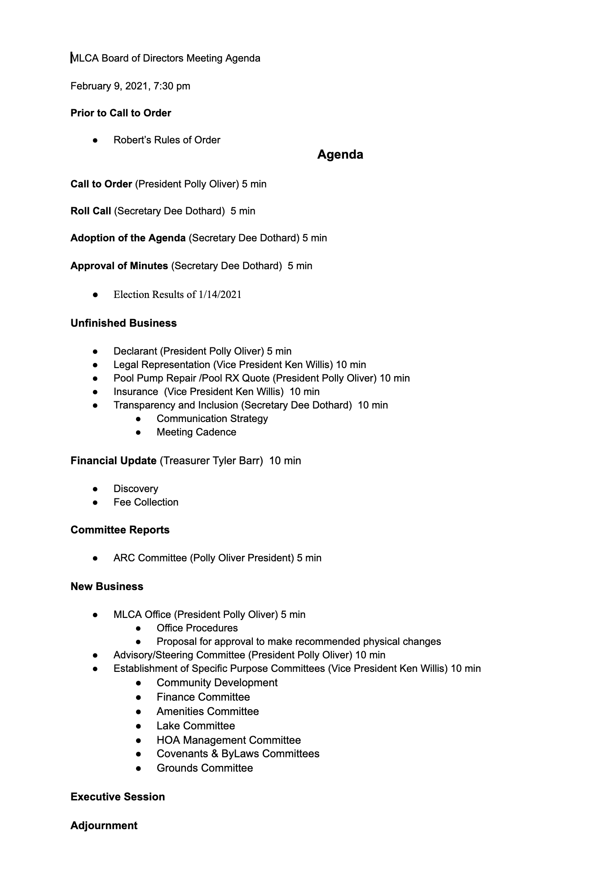
Adoption of the Agenda

Slide 5
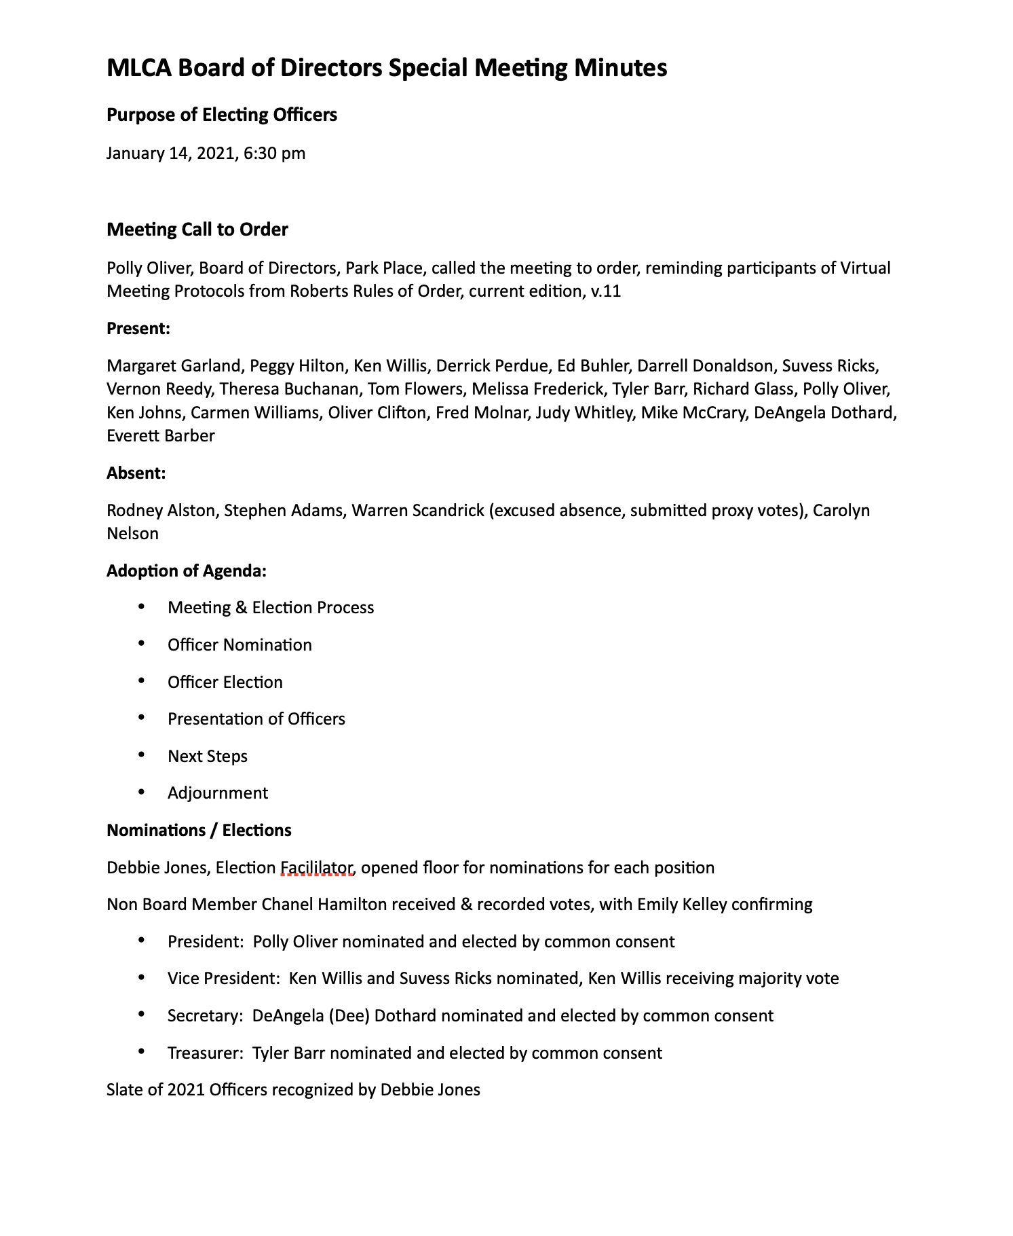
Approval of Minutes -Election Results

Slide 6
Unfinished Business
Declarant Update (Five Minutes)
President Polly Oliver
Joffe / Capstone
Status
Legal Representation (Ten Minutes)
Vice President Ken Willis
Presumed Need
Harrison Law Engagement Letter

Slide 7
Unfinished Business
Pool Repair (Ten Minutes)
President Polly Oliver
Pool Rx Estimate $1,182.78
Status
Insurance Obligations (Ten Minutes)
Vice President Ken Willis
Article 8, Insurance and Causality Loses
8.1, Insurance on Common Property
Article 13, General Provisions
13.14, Indemnification

Slide 8
Unfinished Business
Transparency and Inclusion (Ten Minutes)
Secretary Dee Dothard
Communication Strategy
HOA Website is authorized notice location
Use of Zoom for Director Meetings
Zoom account strategy and cost ($149.00 annually)
Up to 100 participants
Streaming Options
Cloud Recording
Intent to continue use of Zoom under current plan
Meeting Cadence
Standing Board Meeting Schedule, 3rd Tuesday of each month 6:30 pm
Executive Committee will meet biweekly
All meetings will occur through use of Zoom
Annual Home Owner Meeting date is TBD (Survey Monkey)

Slide 9
Unfinished Business
Financial Update (Ten Minutes)
Treasurer Tyler Barr
Account Balances
Fee Collection
Motion to Adopt a Resolution to Extend Annual Assessments
Executive Committee Authority to Conduct Business
Motion to Adopt a Resolution to Establish and Grant Authority to Executive Committee between Board Meetings

Slide 10
Motion to Adopt a Resolution to Extend Annual Assessments
For the year 2021, the Board of Directors of Mirror Lake Community Association, Inc. (“MLCA”) will maintain annual dues at $475.00 for this calendar year. Due to the circumstances during the COVID-19 pandemic, the annual assessment collection will be extended to February 28, 2021 for homeowners of MLCA to assist with payment delinquencies.

Slide 11
Motion to Adopt a Resolution to Establish and Grant Authority to Executive Committee between Board Meetings
The members of the executive committee shall be the President, Vice President, Secretary, and Treasurer. The executive committee shall exercise the authority of the board of directors between meetings of the board including but not limited to the extent to necessary act on unanticipated business that requires action between board meetings and action taken not contrary to the instructions of the board of directors. The executive committee shall perform other duties as assigned by the board of directors.

Slide 12
New Business
MLCA Office (Ten Minutes)
President Polly Oliver
Changes due to HOA Manager Departure
MLCA Executive Office
Advisory/Steering Committee (Ten Minutes)
President Polly Oliver
Motion to Absolve Committees
Establishment of Committees (Ten Minutes)
Vice President Ken Willis
Motion to Adopt Resolution to Establish Specific Purpose Committees

Slide 13
Motion to End Advisory/Steering Committee
The Declarant Advisory Committee and the MLCA Steering Committee have completed their missions. All authority and direction are now determined by a duly elected Board of Directors made up of Owner Occupants and therefore all actions of the Declarant Advisory Committee and the MLCA Steering Committee shall end effective immediately.

Slide 14
Motion to Adopt Resolution to Establish Specific Purpose Committees
The President and Executive Officers of the Mirrorlake Community Association shall be authorized to establish advisory committees as authorized by Article 5, of the Bylaws of Mirror Lake Community Association. This authorization envisions the establishment of six (6) standing committees with no expected limit of duration, and one (1) temporary assignment committee whose purpose and service will end with the completion of a recommendation to be reviewed and considered by the Board of Directors.
•Community Development (Standing Committee)
•Finance Committee (Standing Committee)
•Amenities Committee (Standing Committee)
•Lake Committee (Standing Committee)
•Covenants & Bylaws Committee (Standing Committee)
•Facilities and Grounds Committee (Standing Committee)
•HOA Management Review Committee (Temporary Committee)
Terms:
•Committee Chairs will be selected and assigned by the President of the Association and shall serve at the leisure of the President.
•Committees must be Chaired by a Director of the Association; however, membership may include participation of non-director owner/occupants of the community.
•Committees will consist of no less than five (5) members and no more than seven (7) members.
•Upon initial establishment, Committees must develop a Charter and list of objectives to be reviewed and approved by the Board of Directors. The initial Charter and list of objectives must be made available for review within thirty (30) days of the selection of the Committee Chair.
•Standing Committees must review and update/confirm Charter and objectives no less than annually.
•Committees will be expected to provide budget recommendations and budget oversight for expenses supporting the Committee’s Charter and objectives. Such oversight shall not supersede or replace the authority granted to the Treasurer and elected Executive Officers of the Association.
•Committees must provide regular updates of actions and activities to the Board of Directors at each meeting of the Board.

Slide 15
Begin Executive Session

Slide 16
Executive Session Rules
Executive Sessions are highly confidential
Discussion / information cannot be shared outside of the Executive Session
We can only share facts
We are in the discovery phase for all matters concerning the HOA management
Check your emails regularly

