Slide 1

Hot Topic:
Sustainable Food Supply
Achieving Sustainability &
Food Security
Christine McCullum-Gomez, PhD, RD, LD
Food and Nutrition Consultant
October 20th 2013
2013 AND FNCE
Houston, TX

Slide 2
DISCLOSURE
Christine McCullum-Gomez, PhD, RD, LD
Board Member/Advisory Panel
  Journal of Hunger and Environmental Nutrition
  (Editorial Review Board - Current)
  Field to Plate (Creative Advisor - Current)

Slide 3
OBJECTIVES
Define key terms including: “sustainability” “sustainable intensification” and “sustainable diets.”
Describe global trends that challenge the achievement of sustainability and food security.
Recognize how a perspective on sustainable development that includes both planetary and social boundaries is crucial to achieving sustainability and food security.
…

Slide 4
Definitions
Sustainability –
“To live within the ecological carrying capacity of Earth.” (Moore and Rees, 2013)
“Sustainability creates and maintains conditions under which humans and nature can exist in productive harmony and fulfills the social, economic, and other requirements of present and future generations.” (Nordin et al., 2013)

Slide 5
Definitions
Food security –
“Food security exists when all people, at all times, have physical, social and economic access to sufficient, safe and nutritious food, which meets their dietary needs and food preferences for an active and healthy life.”
Based on this definition, four food security dimensions can be identified: food availability, economic and physical access to food, food utilization and stability over time.
Source: The State of Food Insecurity in the World 2013. The Multiple Dimensions of Food Security.
Rome: FAO; 2013; pp. 16-17.

Slide 6
Global Trends Challenging Sustainability & Food Security
Climate Change
Human Population Growth & Consumption Patterns (Resource Consumption)
Pollution
Extinctions
Loss of Diverse Ecosystems
Source: Scientific Consensus on Maintaining Humanity’s Life Support Systems in the 21st Century. Information for Policy Makers. Millennium Alliance for Humanity & the Biosphere. May 2013. Available at:
http://mahb.stanford.edu/wp-content/uploads/2013/05/Consensus-Statement.pdf
Notes:
A consensus statement issued in May 2013 by scientists at Stanford University (and signed by more than 1,000 scientists worldwide) warn that Earth is rapidly approaching a “tipping point.” Scientific evidence confirms that 5 interconnected negative trends of major concern have emerged over the past several decades.
Climate Disruption – People are changing the Earth’s climate by adding greenhouse gases to the atmosphere primarily through the burning of coal, oil (and its byproducts like gasoline and diesel), and natural gas. In its 5th major assessment published last month (Sept. 2013), the U.N. Intergovernmental Panel on Climate Change said that it was “extremely likely” that human influence has been the dominant cause of warming since the mid-century, in large part due to fossil fuels and deforestation. Events linked with a high likelihood to human output of greenhouse gases include: 1) half of the warming on land since 1951, b) sea-level rise and ocean warming since the 1970s, c) ocean acidification, d) loss of Arctic seas ice and Greenland glacier melt, and e) extreme temperatures. In a new report by Oxfam entitled, “Growing Disruption: Food and the Fight Against Hunger,” it is concluded that failure to tackle climate change threatens all 4 aspects of food security – availability, access, utilization, and stability. Today, one in 8 persons is hungry. However, their analysis suggests that the risk of hunger is projected to increase by 10-20 percent by the year 2050 as a result of climate change. In addition to lost crops, other anticipated impacts of climate change include: higher food prices, lower earnings, lower quality food and more health problems. Emissions from burning fossil fuels are also both heating up the oceans and making them more acidic (ocean acidification), reducing the amount of seafood that can be caught and threatening ocean-based food security. In the report titled “Ocean-Based Food Security Threatened in a High-CO2 World,” it is observed that seafood is the primary source of protein for more than a billion of the poorest people in the world. The State of the Oceans report , which was released earlier this month (October 2013), reinforced the notion that marine ecosystems are being degraded as a direct result of human activities.
Extinctions – Biological extinctions cannot be reversed and therefore are a particular destructive kind of global change. Even the most conservative analyses indicate that human-caused extinction of other species (plants, animals, fungi, and microbes) is now proceeding at rates that are 3-80 times faster than the extinction rate that prevailed before people were on the Earth.
Loss of Diverse Ecosystems – Humans have transformed large parts of the Earth’s surface from their pre-human natural state. As of 2012, somewhat more than 41% of Earth’s ice-free lands have been commandeered for farms, ranches, cities, suburbs, roads and other human constructs.
Pollution – There are few, if any places on Earth where human-produced environmental contaminants are not being deposited. Traces of pesticides and industrial pollutants are routinely found in samples of soil, in the blubber of whales, in fish from most rivers and oceans, and in the umbilical cords of newborn babies. Herbicides, pesticides, and various chemicals used in plastic production contaminate many waterways directly and then are taken up by organisms and bioamplified throughout the food chains.
Human Population Growth and Consumption Patterns – There are two aspects of the problem. One is how many people are on Earth – today there are more than 7 billion people on the planet and it is projected that some 2.5 billion more people may be added to the planet by 2050. The other issue is the wide disparity in the ‘ecological footprint’ among different countries and societal sectors, with a relatively small proportion of humanity inefficiently using and impacting a large portion of ecological resources. The ecological footprint compares a population’s demand on productive ecosystems – its footprint – with biocapacity, the ability of those ecosystems to keep up with this demand. There are only 11.9 billion hectares of productive ecosystem area on the planet (where a global hectare represents a hectare of global average biological productivity).

Slide 7
More on Global Trends…
“Over the last decade, world grain reserves have fallen by one third. World food prices have more than doubled, triggering a worldwide land rush [“land grabs” or “land acquisitions”] and ushering a new geopolitics of food. Food is the new oil.
Land is the new gold [emphasis added].”
Fearing they might not be able to buy the needed grain from the market, some more affluent countries have taken the unusual step of buying or leasing land in other countries that grow food for themselves. These land acquisition deals have grown rapidly in number. Most of them are in Africa.
Source: Brown L. Full Planet, Empty Plates: The New Geopolitics of Food Scarcity. New York: W.W. Norton and Company. 2012.
Notes:
A consensus statement issued in May 2013 by scientists at Stanford University (and signed by more than 1,000 scientists worldwide) warn that Earth is rapidly approaching a “tipping point.” Scientific evidence confirms that 5 interconnected negative trends of major concern have emerged over the past several decades.
Climate Disruption – People are changing the Earth’s climate by adding greenhouse gases to the atmosphere primarily through the burning of coal, oil (and its byproducts like gasoline and diesel), and natural gas. In its 5th major assessment published last month (Sept. 2013), the U.N. Intergovernmental Panel on Climate Change said that it was “extremely likely” that human influence has been the dominant cause of warming since the mid-century, in large part due to fossil fuels and deforestation. Events linked with a high likelihood to human output of greenhouse gases include: 1) half of the warming on land since 1951, b) sea-level rise and ocean warming since the 1970s, c) ocean acidification, d) loss of Arctic seas ice and Greenland glacier melt, and e) extreme temperatures. In a new report by Oxfam entitled, “Growing Disruption: Food and the Fight Against Hunger,” it is concluded that failure to tackle climate change threatens all 4 aspects of food security – availability, access, utilization, and stability. Today, one in 8 persons is hungry. However, their analysis suggests that the risk of hunger is projected to increase by 10-20 percent by the year 2050 as a result of climate change. In addition to lost crops, other anticipated impacts of climate change include: higher food prices, lower earnings, lower quality food and more health problems. Emissions from burning fossil fuels are also both heating up the oceans and making them more acidic (ocean acidification), reducing the amount of seafood that can be caught and threatening ocean-based food security. In the report titled “Ocean-Based Food Security Threatened in a High-CO2 World,” it is observed that seafood is the primary source of protein for more than a billion of the poorest people in the world. The State of the Oceans report , which was released earlier this month (October 2013), reinforced the notion that marine ecosystems are being degraded as a direct result of human activities.
Extinctions – Biological extinctions cannot be reversed and therefore are a particular destructive kind of global change. Even the most conservative analyses indicate that human-caused extinction of other species (plants, animals, fungi, and microbes) is now proceeding at rates that are 3-80 times faster than the extinction rate that prevailed before people were on the Earth.
Loss of Diverse Ecosystems – Humans have transformed large parts of the Earth’s surface from their pre-human natural state. As of 2012, somewhat more than 41% of Earth’s ice-free lands have been commandeered for farms, ranches, cities, suburbs, roads and other human constructs.
Pollution – There are few, if any places on Earth where human-produced environmental contaminants are not being deposited. Traces of pesticides and industrial pollutants are routinely found in samples of soil, in the blubber of whales, in fish from most rivers and oceans, and in the umbilical cords of newborn babies. Herbicides, pesticides, and various chemicals used in plastic production contaminate many waterways directly and then are taken up by organisms and bioamplified throughout the food chains.
Human Population Growth and Consumption Patterns – There are two aspects of the problem. One is how many people are on Earth – today there are more than 7 billion people on the planet and it is projected that some 2.5 billion more people may be added to the planet by 2050. The other issue is the wide disparity in the ‘ecological footprint’ among different countries and societal sectors, with a relatively small proportion of humanity inefficiently using and impacting a large portion of ecological resources. The ecological footprint compares a population’s demand on productive ecosystems – its footprint – with biocapacity, the ability of those ecosystems to keep up with this demand. There are only 11.9 billion hectares of productive ecosystem area on the planet (where a global hectare represents a hectare of global average biological productivity).

Slide 8
Consumption Patterns in Fair Share, World Average, & High Consumption Countries
(Global Footprint Network & Moore and Rees, 2013)
Selected Consumption Measures | Fair Earth-Share: 1 Planet | World Average: 1.5 Planets | High-Consumption: 3 Planets
Daily calorie supply | 2,424 | (per person) 2,809 | 3,383
Meat consumption (kilograms/year) | 20 | 40 | 100
Motor vehicle travel (kilometers per year) | 582 | 2,600 | 6,600
Home energy use in kilowatt-hours (per year) | 2,300 | 3,500 | 9,300
Notes:
The ecological footprint compares a population’s demand on productive ecosystems – its footprint – with biocapacity, the ability of those ecosystems to keep up with this demand. There are only 11.9 billion hectares of productive ecosystem area on the planet (where a global hectare represents a hectare of global average biological productivity). In 1961, humanity’s Ecological Footprint was about two thirds of global biocapacity; today humanity is in ecological overshot – requiring the equivalent of 1.5 planets to produce the renewable resources we use and to absorb our mostly carbon wastes. Global overshoot began in the mid-1970s. It cannot continue indefinitely; ultimately productive ecosystems will become depleted (Moore and Rees, 2013).
1.7 gha (global hectare) per capita is considered to be each person’s equitable or “fair Earth-share” of global biocapacity (by distributing the 11.9 billion hectares among the 7 million people on Earth today). Most of the world’s population lives at or below a fair Earth-share. These persons are mostly in Latin America, Asia and Africa. Examples of high-consumption societies used in this analysis are Australia, Canada, Germany, Spain, Norway, Kuwait, the United Kingdom and the United States (Moore and Rees, 2013).
The city of Vancouver recently calculated and found that 51% of its ecological footprint came from food. Animal protein production constituted most of the food footprint, due mostly to cropland used to produce livestock feed (Moore and Rees, 2013).

Slide 9
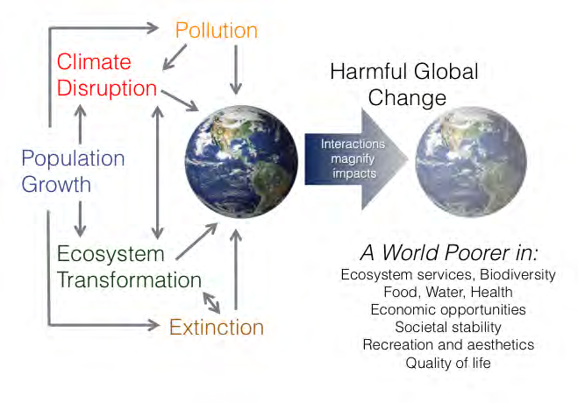
Global Trends: Interactions
Source: Scientific Consensus on Maintaining Humanity’s Life Support Systems in the 21st Century. Information for Policy Makers. Millennium Alliance for Humanity & the Biosphere. May 2013. Available at:
http://mahb.stanford.edu/wp-content/uploads/2013/05/Consensus-Statement.pdf
ADD FIGURE HERE!
Notes:
Ecosystem services are attributes of ecological systems that serve people. Examples of ecosystem services include the production of goods (such as crops and seafood), air and water quality, pollination of plant species (agricultural and horticultural crops), and maintenance of productive soils.

Slide 10
A Safe Operating Space for Interconnected Food & Climate Systems
Improve Crop Yields [Sustainable Intensification]
Change Diets [Sustainable Diets]
Reduce Waste
Adapt to Climate Change
Reduce Agricultural Greenhouse Gas Emissions (GHGs)
Sources: http://bit.ly/SafeSpaceClimateFood and Beddington J, et al. Achieving Food Security in the Face of Climate Change. Final Report from the Commission on Sustainable Agriculture and Climate Change. CGIAR Research Program on Climate Change, Agriculture, and Food Security (CCAFS), Copenhagen, Denmark. 2012. Available at: www.ccafs.cgiar.org/commission
Notes:
Through collective actions and decisions, we need to transition into a “Safe and Operating Space” (SOS) for interconnected food and climate systems.
“When implemented appropriately, sustainable intensification uses suitable technologies to increase production per hectare, without negative environmental consequences on site or off site, and while maintaining other ecosystem services.” (Beddington et al., 2012)
“Increase food production from existing farmland in ways that place far less pressure on the environment and that do not undermine our capacity to continue producing food in the future.” (Garnett et al., 2013)
Reduce Waste – a recent report by the FAO titled “The Food Wastage Footprint,” (2013) estimated that the carbon footprint of wasted food was equivalent to 3.3 billion tonnes of carbon dioxide per year. In fact, if food waste were a country, it would be the world’s third biggest emitter of GHGs after China and the U.S. Food wastage reduction would not only avoid pressure on scarce natural resources (e.g., land, water) but also decrease the need to raise food production. Every year, it is estimated that about 1/3 of all food for consumption is wasted (FAO, 2013).
In the industrialized world, much of the waste comes from consumers buying too much and throwing away what they don’t use. In developing countries, it is mainly the result of inefficient farming and lack of proper storage facilities (FAO, 2013).

Slide 11
Sustainable Intensification (SI)
When implemented appropriately, sustainable intensification uses suitable technologies to increase production per hectare, without negative environmental consequences on site or off site, and while maintaining other ecosystem services.” (Beddington et al., 2012)
“Increase food production from existing farmland in ways that place far less pressure on the environment and that do not undermine our capacity to continue producing food in the future.” (Garnett et al., 2013)
Sources: Beddington J, et al. Achieving Food Security in the Face of Climate Change. Final Report from the Commission on Sustainable Agriculture and Climate Change. CGIAR Research Program on Climate Change, Agriculture, and Food Security (CCAFS), Copenhagen, Denmark. 2012. Garnett T, et al. Sustainable intensification in agriculture: premises and policies. Science; 2013:341:33.
Notes:
Four underpinning premises of SI (situating it within a broader framework of priority actions for the food system):
Increase production – yield increases are required in many developing countries today. Elsewhere, the goal may not be required today (immediately) but rather to develop the potential to respond to future increases in demand (Garnett et al., 2013).
SI does not mean “business as usual food production” moderated by only marginal improvements in sustainability. (Garnett et al., 2013) The National Research council - in its publication titled “Toward Sustainable Agricultural Systems in the 21st Century” (2010) - noted examples of farming system types for improving sustainability to include: organic cropping systems, alternative livestock systems, and perennial agriculture systems.
With regarding to SI, in some areas, increases in yield will be compatible with environmental improvements. In other areas, yield reductions or land reallocation may be necessary to ensure sustainability. Bottom line: an overall increase in production does not mean yields should increase everywhere or at any cost. The challenge is context- and location-specific (Garnett et al., 2013).
Agroecology is the application of ecological science to the design and management of sustainable agro-ecosystems (it was created by the convergence of two scientific disciplines: agronomy and ecology). Agroecology is both a science and a set of practices. It shows strong connections with the principles to the right to adequate food. Agroecology is linked to the “ecosystem approach to sustainable crop production intensification” recently supported by the FAO Committee on Agriculture. It is seen as a way to improve the resilience and sustainability of food systems and is supported by a wide range of experts and organizations such as the FAO, UNEP, and Biodiversity International. See www.agroecology.org for more information.
Other policy goals interfacing with SI include: biodiversity & land use (land sharing and land sparing), animal welfare, human nutrition, support for rural economies and sustainable development (Garnett et al., 2013).
For example, -with regard to animal welfare – we need to recognize “that there are limits on our ability to meet projected future livestock product demand while also achieving animal welfare and environmental goals – limits that signal the need for urgent action to reduce overconsumption and escalating demands “(Garnett et al., 2013, p. 34).

Slide 12
Sustainable Intensification (SI)
- The need to increase production;
Increased production must met through higher yields because increasing the area of land in agriculture requires major environmental costs;
Food security requires as much attention to increasing environmental sustainability as to raising productivity; and
SI denotes a goal but does not specify a priori how it should be attained or which techniques to use. Merits of diverse approaches – e.g., conventional, “high tech,” agro-ecology, or organic – should be rigorously tested and assessed, taking biophysical and social contexts into account.
Source: Garnett T, et al. Sustainable intensification in agriculture: premises and policies. Science; 2013:341:33.
Notes:
Four underpinning premises of SI (situating it within a broader framework of priority actions for the food system):
Increase production – yield increases are required in many developing countries today. Elsewhere, the goal may not be required today (immediately) but rather to develop the potential to respond to future increases in demand (Garnett et al., 2013).
SI does not mean “business as usual food production” moderated by only marginal improvements in sustainability. (Garnett et al., 2013) The National Research council - in its publication titled “Toward Sustainable Agricultural Systems in the 21st Century” (2010) - noted examples of farming system types for improving sustainability to include: organic cropping systems, alternative livestock systems, and perennial agriculture systems.
With regarding to SI, in some areas, increases in yield will be compatible with environmental improvements. In other areas, yield reductions or land reallocation may be necessary to ensure sustainability. Bottom line: an overall increase in production does not mean yields should increase everywhere or at any cost. The challenge is context- and location-specific (Garnett et al., 2013).
Agroecology is the application of ecological science to the design and management of sustainable agro-ecosystems (it was created by the convergence of two scientific disciplines: agronomy and ecology). Agroecology is both a science and a set of practices. It shows strong connections with the principles to the right to adequate food. Agroecology is linked to the “ecosystem approach to sustainable crop production intensification” recently supported by the FAO Committee on Agriculture. It is seen as a way to improve the resilience and sustainability of food systems and is supported by a wide range of experts and organizations such as the FAO, UNEP, and Biodiversity International. See www.agroecology.org for more information.
Other policy goals interfacing with SI include: biodiversity & land use (land sharing and land sparing), animal welfare, human nutrition, support for rural economies and sustainable development (Garnett et al., 2013).
For example, -with regard to animal welfare – we need to recognize “that there are limits on our ability to meet projected future livestock product demand while also achieving animal welfare and environmental goals – limits that signal the need for urgent action to reduce overconsumption and escalating demands “(Garnett et al., 2013, p. 34).

Slide 13
Sustainable Diets
“Sustainable Diets are those diets with low environmental impacts which contribute to food and nutrition security and to healthy life for present and future generations. Sustainable diets are protective and respectful of biodiversity and ecosystems, culturally acceptable, accessible, economically fair and affordable; nutritionally adequate, safe and healthy; while optimizing natural and human resources.”
Source: Sustainable Diets and Biodiversity. Directions and Solutions for Policy, Research, and Action. Rome: FAO and Biodiversity International; 2012; p. 7. Available at: http://www.fao.org/docrep/016/i3004e/i3004e00.htm

Slide 14
The Double Pyramid
Source: Ciati R, Ruini L. Double pyramid: Healthy food for people and sustainable for the planet. In: Sustainable Diets and Biodiversity. Directions and Solutions for Policy, Research, and Action. Rome: FAO and Biodiversity International;2012; pp. 280-293. Available at: http://www.fao.org/docrep/016/i3004e/i3004e00.htm
Notes:
Note: even though the environmental pyramid has been represented through the ecological footprint, for synthetic reasons the food environmental impact was measured by water and carbon footprint indicators, to avoid partial and sometimes misleading ideas of this phenomena.
The environmental pyramid’s layout (on right) is based on re-classification of the foods’ environmental impact, represented through their ecological footprints.

Slide 15
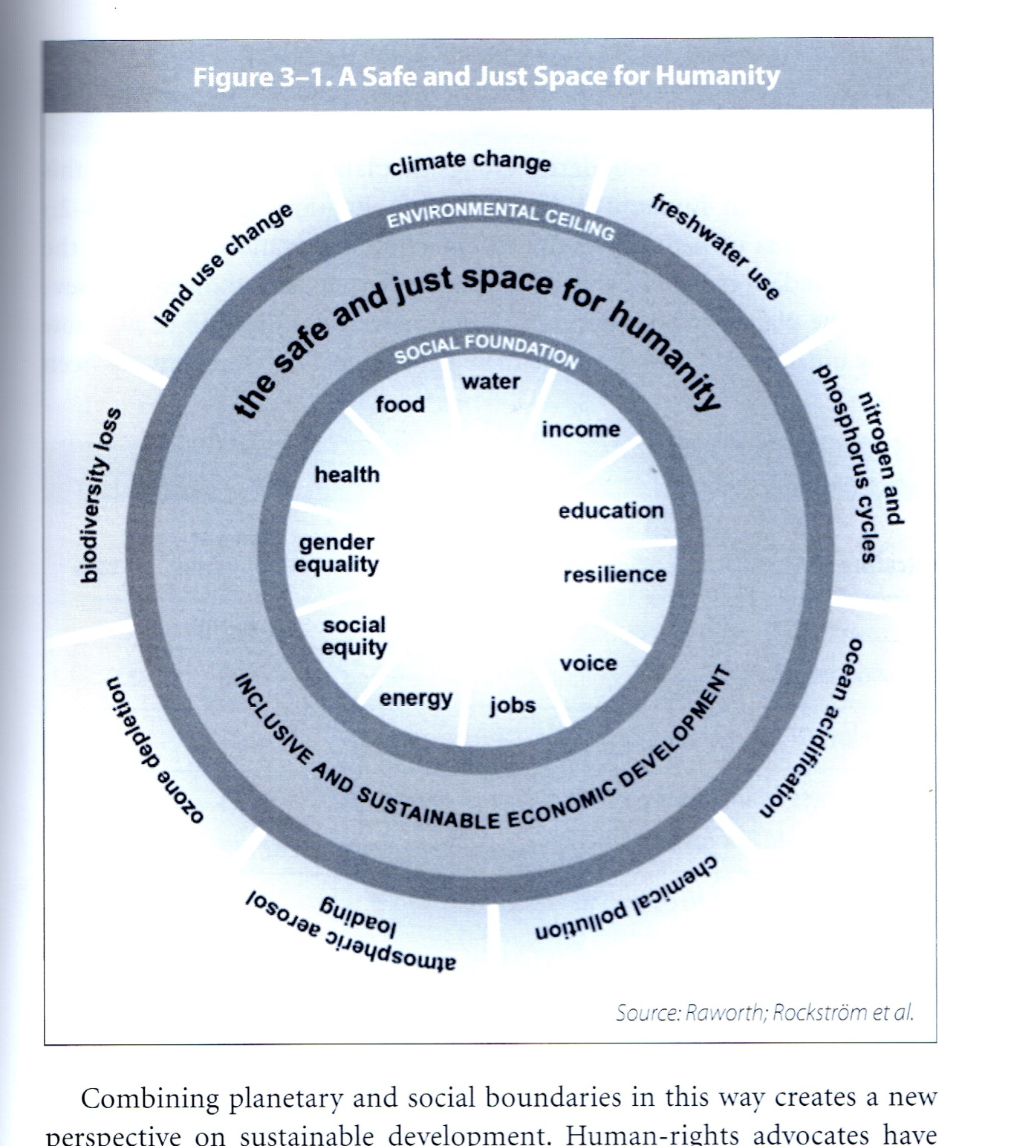
Sustainable Development
(Planetary and Social Boundaries – Raworth, 2013)
Notes:
In 2009, a group of leading Earth-system scientists brought together by Johan Rockstrom of the Stockholm Resilience Centre put forth the concept of “planetary boundaries.” In doing so, they proposed a set of nine interrelated Earth System processes (see above) that are critical for keeping the planet in a relatively stable state known as the Holocene – a state that has been beneficial to the humanity over the past 10,000 years. Together, they represent an envelope for a “safe operating space for humanity.”
Under too much pressure from human activity, these nine processes could be pushed over biophysical thresholds – some on global scales others on regional scales – into abrupt and even irreversible changes, dangerously undermining the natural resource base on which humanity depends for well-being. To avoid this, the scientists made a first proposition of a set of boundaries below these danger zones. Their first estimates indicated that at least three of these nine boundaries have already been crossed – for climate change, the nitrogen cycle (amount of nitrogen removed from the atmosphere for human use), and biodiversity loss (extinction rate = number of species per million species per year) – and that resource pressures are moving rapidly toward the estimated global boundary for several others too.
These planetary boundaries are inter-dependent, because crossing one of them may shift the position of other boundaries, or cause them to be transgressed.
Just as there is an outer boundary of resource use, an “environmental ceiling” beyond which lies unacceptable environmental degradation, so too there is an inner boundary of resource use, a “social foundation” below which lies unacceptable human deprivation. Eleven social priorities make up this social foundation including: food security, water, income, education, resilience to shocks, voice (political participation or freedom of expression), jobs, energy, social equity, gender equality, and health care (regular access to essential medicines).
Between the social foundation of human rights and the environmental ceiling of planetary boundaries, lies a space that is both safe and socially just for humanity – allowing inclusive and sustainable economic development.

Slide 16
Sustainable Development
(cont’d)
“Only if issues such as equity, access, and distribution are addressed can increases in production improve food security. Addressing these issues offers other important benefits. For example, improved gender equality and education have been related to reduced population growth as well as increased food production and food security.”
Source: Hanspach J, Abson DJ, Loos J, et al. Develop, then intensify (letter). Science. 2013;341:713.

Slide 17
Hot Topic: Sustainable Food Supply
Is Biotechnology a Solution to Food Insecurity?
It depends on how the technology is used…
Address the current intellectual property rights regime
A change in the direction of research - more focus on “orphan crops”
Notes:
Two things need to happen at a minimum, IF various forms of modern biotechnology, including genetic engineered seeds, are to play a role in a multi-pronged approach to alleviating food insecurity (via use of sustainable intensification):
1.) address the current intellectual property rights regime
According to the UN Special Rapporteur on the Right to Food – Prof. Oliver De Schutter, the “current intellectual property rights regime is suboptimal to ensure global food security today.” The marked increase in intellectual property protection has led to the rise in patenting activity and in plant breeding. He argues that the current intellectual property regime needs to be placed within a larger human rights framework (based on the right to food). This requires that we place the needs of the most marginalized groups, including in particular smallholders in developing countries, at the center of our efforts. “Seed policies must be guided, not by a preconceived view about the benefits a technology can bring to farming, but by a careful examination of their impacts on food security, and specifically, on the ability of the most vulnerable farmers to improve their livelihoods. “ In the long-term, a procedure may need to be set up to allow the granting of non-exclusive licenses to any requesting party for the use of any patented tool of biotechnology in order to ensure food security in developing countries (De Schutter, 2009) Also, the issue of GURTS – or genetic use restriction technologies (GURTs) - in genetically engineered seeds need to be addressed. Although the reliance on GURTs has been halted due to adverse publicity, the Special Rapporteur has received information that this de facto moratorium may be only temporary (De Schutter, 2009).
2) A change in the direction of research - more focus on “orphan crops”
The marked increase in IP protection has led to a rise in patenting activity but it has also created an imbalance between the private and public sectors in agriculture research. According to one estimate, only 6 percent of privately funded agricultural research is focused on developing country research. Very little research has been benefited crops that are important to famers in developing countries such as tropical maize, sorghum, millet, banana, cassava, oilseed, potato and sweet potato. These crops are referred to as “orphan crops.” Public research centers have not made up for the lack of interest in the private sector in these crops (De Schutter, 2009).

Slide 18
“
Furthermore:
Improving crops is one thing, designing productive and resilient farming systems is another... It requires a broader approach. Agro-ecological practices such as agroforestry & intercropping represent a huge untapped potential.
We must scale up systems such as farmers’ seed banks (local seed exchange systems promoting agro-biodiversity), farmer field schools, and participatory plant breeding if we want to cope with climate change & reduce hunger at the same time.
- Oliver De Schutter, UN Special Rapporteur on the Right to Food
Source: De Schutter, O. Seed Policies and the Right to Food: Enhancing Agrobiodiversity and Encouraging Innovation; October 2009. Available at: http://www.srfood.org/images/stories/pdf/officialreports/20091021_report-ga64_seed-policies-and-the-right-to-food_en.pdf
Notes:
Holistic approach – agro-ecological practices such as agroforestry (can be practiced as a part of organic agriculture) and intercropping represent a huge untapped potential.
Agro-ecology =
Crop breeding and agro-ecology are complementary. For example, breeding can improve the level of drought resistance in plant varieties. However, agro-ecology is more overarching as it supports building drought-resistant agricultural systems (e.g., including soils, plants, agro-biodiversity, etc.) not just drought-resistant plants.
Betting of farmers as innovators also makes economic sense. These systems put science at the service of farmers: these systems support farmers’ varieties and associated knowledge. Participatory plant breeding programs can start in Farmer Field Schools, which aim to make farmers experts in their own fields. Farmer Field Schools also enable farmers to reduce their use of pesticides and rely instead on endogenous skills, knowledge and resources (De Schutter, 2009).

Slide 19
As the Oromo of Ethiopia say, “You can’t wake a person who’s pretending to sleep.” We need to wake up to the fact that we live on a finite planet.
- Jason Clay, World Wildlife Fund
Source: Clay, J. Externalities: The costs of natural resource degradation. In: A Sustainability Challenge: Food Security for All, Report of Two Workshops. Washington DC: National Academies Press; 2012, p.197.

Slide 20
PRACTICE APPLICATIONS
Use the Meat Eater’s Guide to Climate Change and Health
http://www.ewg.org/meateatersguide/
Choose sustainable seafood
http://wwf.panda.org/what_we_do/how_we_work/conservation/marine/sustainable_fishing/sustainable_seafood/seafood_guides/
(e.g., Environmental Defense Seafood Selector, Monterey Bay Aquarium Seafood Watch, Marine Stewardship Council-Certified Sustainable Seafood)
Take steps to make choices for a healthful, sustainable diet
Mary Meck Higgins, PhD, RD. Making Everyday Choices for a Healthy, Sustainable Diet (Kansas State University, August 2012)
http://www.ksre.ksu.edu/HumanNutrition/p.aspx?tabid=232
Review info. within Oxfam America’s Behind the Brands Campaign
http://www.behindthebrands.org/en-us
Notes:
EWG’s Meat Eater’s Guide to Climate Change and Health (2011) - compares the greenhouse gas emissions of twenty commonly consumed foods. There is also a wallet guide for this guide.
Choose sustainable seafood – go toward the bottom of this WWF link (Other Seafood Guides) – which serves as a repository of information.
Mary Meck Higgin’s resource – includes both a fact sheet and leader’s guide.
Behind the Brands Campaign - Oxfam assessed publically available information on the policies and commitments of the Big 10 food companies towards the sourcing of agricultural commodities from developing countries. The scorecard that was developed looks at 7 themes, weighing each theme equally (land, women, farmers, workers, climate, transparency and water).

Slide 21
OTHER SELECTED RESOURCES
Position of the Academy of Nutrition and Dietetics: Nutrition Security in Developing Nations: Sustainable Food, Water and Health. J Acad Nutr Diet. 2013;113-581-595.
Practice Paper of the Academy of Nutrition and Dietetics: Promoting Ecological Sustainability within the Food System. J. Acad Nutr Diet. 2013;113;464.
AND’s Hunger and Environmental Nutrition Dietetic Practice Group –
http://www.hendpg.org
Sustainable, Resilient and Healthy Food and Water Systems Glossary
http://www.hendpg.org/page/professional-development

Slide 22
OTHER SELECTED RESOURCES (cont’d)
Oliver De Schutter, U.N. Special Rapporteur on the Right to Food -
http://www.srfood.org/en
Worldwatch Institute’s Nourishing the Planet - http://www.worldwatch.org/nourishingtheplanet
Toolkit: Reducing the Food Wastage Footprint (FAO, 2013) -
http://www.fao.org/docrep/018/i3342e/i3342e.pdf
Notes:
Right to Food website – includes information on a wide variety of topics including Production and Resources (e.g., agroecology, land rights, seeds, biofuels, climate change, fisheries); Food Chains, Trade, & Aid; Adequacy and Access; Food Policy Making; and Addressing Violations.
FAO toolkit on reducing food loss and waste – the toolkit classified food waste reduction strategies according to the categories of an inverted ‘food wastage pyramid’ – which represents the most to least environmentally-friendly categories [landfill, recycle and recover, reuse, and reduce] (FAO, 2013).

Slide 23
OTHER SELECTED RESOURCES (cont’d)
23 Mobile Apps Changing the Food System (Foodtank) -
http://foodtank.org/news/2013/10/twenty-three-mobile-apps-changing-the-food-system
Sustainable Food Systems for Security and Nutrition: The need for social movements (Eric Holt-Giménez, 2013) -
http://www.worldfooddayusa.org/sustainable_food_systems_for_security_and_nutrition_the_need_for_social_movements?utm_source=twitter&utm_medium=social%20media&utm_campaign=FAOnews&utm_content=gk
Notes:
Right to Food website – includes information on a wide variety of topics including Production and Resources (e.g., agroecology, land rights, seeds, biofuels, climate change, fisheries); Food Chains, Trade, & Aid; Adequacy and Access; Food Policy Making; and Addressing Violations.
FAO toolkit on reducing food loss and waste – the toolkit classified food waste reduction strategies according to the categories of an inverted ‘food wastage pyramid’ – which represents the most to least environmentally-friendly categories [landfill, recycle and recover, reuse, and reduce] (FAO, 2013).

