Slide 1
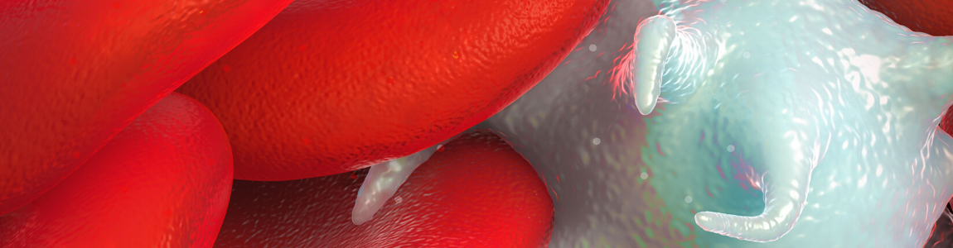
Immune Thrombocytopenia: Evolving Treatment Paradigms and Patient-Centered Care
Allison Imahiyerobo, APN
Advanced Practice Nurse
Hematology and Oncology Physicians of Englewood

Slide 2
Accreditation: i3 Health is accredited with distinction as a provider of nursing continuing professional development by the American Nurses Credentialing Center's Commission on Accreditation. A maximum of 1.0 contact hour may be earned by learners who successfully complete this nursing continuing professional development activity. Provider approved by the California Board of Registered Nursing, Provider Number 15824, for 1.0 contact hour.
How to Claim NCPD Credit: Your certificate of attendance will be emailed to you within 7 days. Please also complete an evaluation online at www.i3Health.com/GLAONS-ITP
Commercial Support: This activity is supported by an independent educational grant from Dova Pharmaceuticals. Aggregate participant data will be shared with commercial supporters of this activity.
Unapproved Use Disclosure: i3 Health requires NCPD faculty (speakers) to disclose to attendees when products or procedures being discussed are off-label, unlabeled, experimental, and/or investigational (not FDA approved), as well as any limitations on the information that is presented, such as data that are preliminary or that represent ongoing research, interim analyses, and/or unsupported opinion. Faculty may discuss information about pharmaceutical agents that is outside of U.S. Food and Drug Administration approved labeling.
This information is intended solely for continuing education and is not intended to promote off-label use of these medications. If you have questions, contact the medical affairs department of the manufacturer for the most recent prescribing information.
Disclaimer: The information provided at this NCPD activity is for continuing education purposes only and is not meant to substitute for the independent medical/clinical judgment of a healthcare provider relative to diagnostic and treatment options of a specific patient’s medical condition.

Slide 3
Disclosures
Ms. Imahiyerobo discloses the following commercial relationships:
  Speaker’s Bureau: Amgen
  Consultant: Amgen

Slide 4
Learning Objectives
Discuss the pathogenesis of ITP and mechanisms of therapeutic strategies
Differentiate the efficacy and safety profiles of current and emerging ITP therapies
Develop evidence-based strategies to optimize treatment experiences and ensure patient-centered ITP care
ITP = immune thrombocytopenia.

Slide 5
Pretest Assessment: Question 1
Mrs. LS is a 65-year-old woman with a history of diabetes and hypertension. She presents to the emergency department with a platelet count of 9,500/µL, oral mucosal blisters, and severe epistaxis.
Which of the following first-line treatment options for immune thrombocytopenia (ITP) would be least likely to impact Mrs. LS’s diabetes and hypertension?
  Anti-D immune globulin
  Dexamethasone
  Prednisone
  Rituximab

Slide 6
Pretest Assessment: Question 2
Which of the following second-line ITP treatments is a Syk inhibitor?
  Avatrombopag
  Eltrombopag
  Fostamatinib
  Romiplostim

Slide 7
Pretest Assessment: Question 3
Mr. EL is a 40-year-old man with ITP that is refractory to dexamethasone. He has a history of chronic alcoholism and cirrhosis.
Eltrombopag would be a better second-line treatment option than avatrombopag for this patient.
  True
  False

Slide 8
Pretest Assessment: Question 4
Mr. BM is a 75-year-old man with ITP that is refractory to intravenous immune globulin. He has a past history of deep vein thrombosis (DVT).
Which of the following second-line treatment options would be preferred for this patient?
  Avatrombopag
  Eltrombopag
  Rituximab
  Romiplostim

Slide 9
Pretest Assessment: Question 5
Mrs. DR is a 60-year-old woman with ITP and a past history of hepatitis B. She experienced an inadequate response to dexamethasone and is now starting treatment with eltrombopag.
On what topic should you counsel Mrs. ER?
  Potential for dizziness
  Potential for reactivation of hepatitis B
  Need for dietary restrictions
  Need to avoid sun exposure

Slide 10
Pathophysiology
Reduction in platelet production—thrombopoietin mediated
Increased destruction
  Impaired T regulatory cells
  Antiplatelet antibodies
  In 60% of all ITP patients, autoantibodies are found, predominantly against platelet glycoprotein (GP) IIb/IIIa
  Splenic uptake
Rodeghiero et al, 2009.

Slide 11
Who Develops ITP?
Primary: ~80%
  Majority idiopathic
  Majority women
  Older age
Secondary: ~20%
  Infection
  Stressful trigger
  History of autoimmune disease: lupus, RA, thyroid
  Family history of autoimmune disease
RA = rheumatoid arthritis.
Lambert & Gernsheimer, 2017.
Notes:
Primary is without a known cause, whereas secondary has a cause. For example, children developing ITP following MMR vaccination would be secondary.

Slide 12
Disease Burden
Bruising
Petechiae
Oral blood blisters, ie mouth sores
Hematuria
Epistaxis
Trotter & Hill, 2018.

Slide 13
Initial Work-Up
CBC with peripheral smear
Hepatitis serology
HIV
CBC = complete blood count; HIV = human immunodeficiency virus.
Provan et al, 2019.
Notes:
Bone marrow biopsy is not routinely completed, more to consider for refractory cases
The smear is looked at to rule out other causes of thrombocytopenia:
Pseudothrombocytopenia
Thrombotic thrombocytopenic purpura (TTP), which would show schistocytes
If you see very large platelets, you may consider inherited thrombocytopenia (Provan et al, 2019)
Many would do Helicobacter pylori (H. pylori) stool antigen or breath test
Also can consider:
Immunoglobulin levels to rule out immune deficiency
Epstein-Barr virus (EBV) and cytomegalovirus (CMV)
Direct antiglobulin test (DAT), thyroid stimulating hormone (TSH), antiphospholipid antibodies
Broader autoimmune workup, including antinuclear antibodies (ANA)
Antiplatelet antibodies are not recommended to be tested (Nomura, 2016)

Slide 14
Defining the Disease
Newly diagnosed: 0-3 months
Persistent: >3-12 months
Chronic: >12 months
Provan et al, 2019.
Notes:
There are different definitions of classifying ITP, which help us decide how we plan treatment.

Slide 15
Case Study 1
Mrs. Lui is a 65-year-old female who was diagnosed with ITP 2 months ago
Is on a prednisone taper; current dose is 15 mg daily
However, she presented to her hematologist with epistaxis and a platelet count of 12,000/µL

Slide 16
Case Study 1 (cont.)
How would you treat this patient?
  Increase corticosteroid dose
  Start the patient on rituximab
  Start TPO agent
  Give IVIg
TPO = thrombopoietin; IVIg = intravenous immune globulin.
Notes:
I do think there is a wrong answer here. While Corticosteroids would work in the short term we already know that this patient is refractory to this treatment and is having a high side effect burden. Data supports shorter courses of steroids than longer. Rituximab is approved in the second line setting, and romiplostim is approved for patient in the 2nd line setting that are refractory to steroids. IVIG is another first line therapy so that is a reasonable option as well.

Slide 17
Case Study 1 (cont.)
The patient is worried about the side effects of steroids
Her face is puffy, she is not sleeping well, and she has gained 14 pounds since starting on therapy
She is worried about the current COVID epidemic and wants to know how this will factor into treatment
Notes:
ASH has produced guidelines recommending against use of rituximab during COVID
The main reason for this is rituximab can cause hypogammaglobulinemia, though rarely increase in infections, which could make an ITP patient more at risk for infections
Another consideration is that post-rituximab, it’s difficult to respond to vaccinations without B cells, so this may be more applicable in the future (ASH, 2020)
Corticosteroids have long-term risks, including diabetes, cataracts, and pneumocystis pneumonia (PCP) with prolonged use
Keep in mind that having a platelet count <20,000/µL is used by experts to determine when treatment is needed. Observation is often OK if the platelet count is >20,000/µL

Slide 18
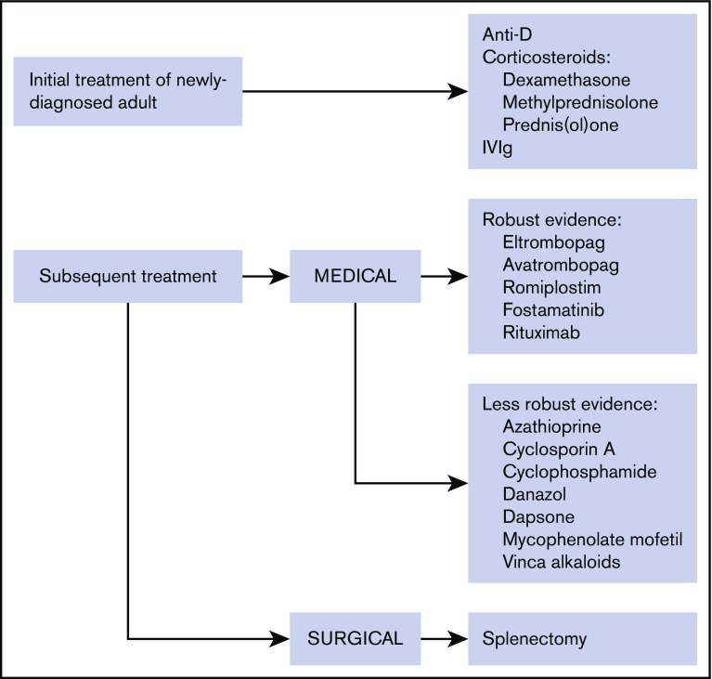
ITP Treatment Protocol: Summary
Provan et al, 2019.

Slide 19
First-Line ITP Therapies: Overview
Agent | Dose | Response (Initial/Peak) | Response Rate | Adverse Events
Prednisone | 0.5-2.0 mg/kg daily for 3-4 wks | 4-14 d/ 7-28 d | 70%-80% | Insomnia, hypertension, hyperglycemia, mood disorders, weight gain, dizziness, edema
Dexamethasone | 40 mg daily for 4 consecutive days every 2-4 wks, 1-4 cycles | 2-14 d/ 4-28 d | Up to 90% | Same as prednisone, but less frequent
Intravenous immune globulin | 1 g/kg daily for 1-2 d | 1-3 d/ 2-7 d | Up to 85% | Infusion-related reactions, nephrotoxicity, fever, chills, body aches
Anti-D immune globulin | 50-75 mcg/kg | 1-3 d/ 3-7 d | 70%-80% | Hemolysis
Khan et al, 2017.

Slide 20
Second-Line ITP Therapies: Overview
Agent | Dose | Response (Initial/Peak) | Response Rate | Adverse Events
Rituximab | 375 mg/m² IV over 4 h once weekly for 4 wks | 7-56 d/ 14-180 d | 60% | Infusion reactions, fever, infections, serum sickness reaction, reactivation of PML, hypogammoglobulinemia
Eltrombopag | 50-75 mg daily | 7-28 d/ 14-90 d | 80% | Hepatotoxicity, thrombotic events, transaminitis, headache
Romiplostim | 1 mcg/kg SQ once weekly | 5-14 d/ 14-60 d | 79%-88% | Arthralgia, thrombocytopenia, thrombotic events, headache
Avatrombopag | 20 mg daily (adjusted to 5-40 mg based on response) | Not reported | 56.3% | Headache, thrombotic events
Fostamatinib | 100 mg BID for 24 wks (increase to 150 mg based on response) | 15 d/ Not reported | 43% | Diarrhea, hypertension, nausea, dizziness, elevation in lipid panel
IV = intravenous; h = hours; SQ = subcutaneous; PML = progressive multifocal leukoencephalopathy; BID = twice daily.
Khan et al, 2017; Jurczak et al, 2018; Bussel et al, 2018.

Slide 21
Case Study 1 (cont.)
How would you treat this patient now?
  Start romiplostim 1 mcg/kg SC weekly
  Start eltrombopag 50 mg PO daily
  Start avatrombopag 20 mg PO daily
SC = subcutaneous; PO = oral.
Notes:
Either A or C is correct. B is not correct as starting dose in Asian pt is 25 mg.

Slide 22
Nursing Considerations in ITP
Reduction in HRQOL regardless of platelet count
Fatigue is the most commonly reported symptom
Take the patient’s age into consideration when determining treatment
Activity restrictions in sports
HRQOL = health-related quality of life.
Sestøl et al, 2018; Trotter & Hill, 2018.
Notes:
Treatment or disease? We know that even with treatment, ITP patients still have fatigue.
Steroid side effects contribute to:
Missing work/school due to treatment
Fear of bleeding in public
Side effects of treatment (Trotter & Hill, 2018)
Younger patients are more likely to have spontaneous remission.

Slide 23
First-Line Therapy
Corticosteroids
  Prednisone 1 mg/kg; max 80 mg
    Weaned over weeks to months
  Dexamethasone 40 mg x 4 days, up to 3 cycles
    Given 1 week on, 1 week off
Equal effect at 6 months
  Dexamethasone has fewer AEs and bleeding, quicker onset
AE = adverse events.
Neunert et al, 2019.
Notes:
ASH guidelines recommend limiting steroid use to 6 weeks. Trend toward using less corticosteroids
Both help boost production and reduce destruction

Slide 24
First-Line Therapy (cont.)
IVIg
  1 g/kg
  Steroid premed to prevent headache, premed for reaction
  Effect 1-3 days
  Expensive
Anti-D
  Hemolytic response
  Rh+
Premed = premedication; Rh = rhesus.
Neunert et al, 2019.

Slide 25
Second-Line Therapy
Rituximab
375 mg/m²
Weekly x 4 weeks
Up to 8 weeks from start to response
May need rescue therapy during
More effective when given with dexamethasone pulses
60% initial response, wanes to about 20%-30% after a year
  Women, given within 1 year of diagnosis, hx of autoimmune disease: improved response
AEs: fever, chills, serum sickness reaction, reactivation of hepatitis B
Hx = history.
Provan et al, 2019; Lucchini et al, 2019.
Notes:
There are dosing alternatives: 1,000 mg on Days 1 and 15 or 100 mg weekly x 4 weeks
Vaccination response impaired due to B cell clearance

Slide 26
Second-Line Therapy
TPO
Mimics endogenous thrombopoetin
Increases platelet production
3 agents approved
  Romiplostim
  Eltrombopag
  Avatrombopag
80% clinical response
Side effect profile: headache, fatigue, myalgia, thrombosis, reticulin fibrosis, diarrhea
May be needed long term
Cuker & Neunert, 2016; Kuter et al, 2009; Neunert et al, 2019; Al-Samkari & Kuter, 2019.

Slide 27
Second-Line Therapy
Romiplostim
Peptide TPO-RA
1-10 mcg/kg SC weekly
Initial starting dose of 1 mcg/kg
  Increase by 1 mcg/kg/week
Side effects: thrombosis, reticulin fibrosis
TPO-RA = TPO receptor agonist.
Nplate® prescribing information, 2019.

Slide 28
Second-Line Therapy
Eltrombopag
TPO-RA, small molecule
Starting dose of 50 mg daily
  25 mg in liver disease and Asian descent
  Increase dose up to 75 mg to maintain platelet count of 50,000/µL
  Can reduce dose to 12.5 mg to maintain lower platelet count
Significant dietary restrictions
  Cannot be taken with calcium-rich foods (eg, dairy products)
Monitor for hepatotoxicity
Risk of thrombosis
Al-Samkari & Kuter, 2019; Promacta® prescribing information, 2020 .
Notes:
Empty stomach; avoid calcium minerals for 4 hours around a dose. This is significant, especially in children
To consider intermittent dosing

Slide 29
Second-Line Therapy
Avatrombopag
Small-molecule TPO-RA
Recently approved (2019)
Also approved for thrombocytopenia in liver disease
Starting dose of 20 mg QD PO, not to exceed 40 mg QD
Lower rate of thrombosis, no dietary restrictions
Common side effect: headache
Doptelet® prescribing information, 2019.

Slide 30
Second-Line Therapy
Splenectomy
60%-80% effective
Need to be vaccinated against streptococcus pneumoniae, neisseria meningitidis, and Haemophilus influenzae
Risks: infections, thrombotic events, pulmonary hypertension, and others
Neunert et al, 2019.
Notes:
Consider waiting a year for splenectomy (Neunert et al, 2019)
Patients should be informed of the long-term risks of splenectomy (increased rates of thrombosis, infection, and cancer) and educated to follow advice aimed at mitigating these complications (Grade C recommendation)
Older age may be less likely to respond
Children are often on antibiotic prophylaxis
Concern in children due to need to provide antibiotic coverage for encapsulated bacteria; children often get fevers

Slide 31
Second-Line Therapy
Fostamatinib
Syk inhibition, prevents phagocytosis of platelets
Trialed in an extremely refractory group
  1/3 of TPO nonresponders will respond
  Phase 3 study: 146 pts received drug
    Median platelet count prior to treatment: 16,000
    Median platelet count on treatment: 63,000
    Median response duration: 28 months
Dosing: 100-150 mg BID
Side effects: diarrhea, hypertension, elevated LFTs
SYK = spleen tyrosine kinase; BID = twice a day; LFT = liver function test; pts = patients.
Bussel et al, 2019; Newland et al, 2017.

Slide 32
Second Line Therapy
Less Robust Data
Danazol
Dapsone
Cyclosporine A
MMF
Azathioprine
Vinca alkaloids
MMF = mycophenolate mofetil.
Provan et al, 2019.
Notes:
These are immunosuppressive agents that can be used with thrombopoietin (TPO) or other combination therapies
Vincristine effective but not durable, concern for neuropathy (Witkowski et al, 2019)

Slide 33
Future Directions
BTK inhibitors
FcRN inhibitors
BTK = Bruton’s tyrosine kinase; FcRn = neonatal Fc receptor.
Miltiadous et al, 2020.
Notes:
Including Bruton’s tyrosine kinase inhibitors (works on B cell), neonatal Fc receptor (FcRn) inhibitors, proteasome inhibitors, and complement inhibitors

Slide 34
Special Populations
Pregnancy
If presenting early in pregnancy, more likely ITP
Later in pregnancy is more likely gestational
Platelet count of 20,000-30,000/µL is safe early in pregnancy
  Goal: >50,000/µL for delivery (70,000/µL for epidural)
  Consider anesthesia consultation prior to delivery
Provan et al, 2019.
Notes:
Special consideration should be given to rule out hypertensive, microangiopathic, coagulopathy, and hepatic disorders associated with pregnancy
Recommended tests should be based on the clinical features and may include review of the blood smear, reticulocyte count, coagulation screen, liver function, thyroid function, ANAs, and antiphospholipid antibodies (APLAs) (Grade C recommendation)
Intravenous immune globulin (IVIg) may used when rapid increase needed
Corticosteroids are first line
Prednisone 20 mg is often used
However, account for blood glucose, hypertension, and weight gain
TPO agents cross the placenta and therefore are not recommended but have been used in extreme cases
Umbilical cord platelet count recommended at delivery (Provan et al, 2019)

Slide 35
Anticoagulation and ITP
OK when platelet count >50,000/µL
Single antiplatelet agent: 30,000-50,000/µL adequate
Dual antiplatelet agent: platelet count goal >50,000/µL
Provan et al, 2019.
Notes:
Do not stop TPO when develop thrombosis

Slide 36
Special Populations (cont.)
Surgery
Procedure | Platelet Count
Dental prophylaxis | 20,000-30,000/µL
Dental extractions | 30,000-50,000/µL
Minor surgery | 50,000/µL
Major surgery | 80,000/µL
Neurologic surgery | 100,000/µL
Provan et al, 2019.
Notes:
Take into account patient age and comorbidities
Cataract repair is also a very common surgery. This is very low bleeding risk (Provan et al, 2019)

Slide 37
Special Populations (cont.)
Children
Occurs in 5-10 per 100,000 children per year
69% of children: spontaneous remission at 6 months
  Those with chronic ITP: 28% develop remission at 2 years
91% of children present with bleeding symptoms
ICH is rare
Observation is often recommended, given low risk of bleeding
Similar treatment options to adults
ICH = intracranial hemorrhage.
Despotovic & Grimes, 2018; Elalfy et al, 2010; Provan et al, 2019.
Notes:
Children are less likely to have comorbidities
<5% have clinically severe bleeding
<1% risk of intracranial hemorrhage (ICH)
Risks of ICH: eg, head trauma or unexplained headaches
Patients at higher risk for ICH include those with a history of moderate or severe bleed in the preceding 28 days, recent administration (within 8 hours) of nonsteroidal anti-inflammatory drugs (NSAIDs), and another clinically significant coagulopathy (eg, von Willebrand disease). In the case of head trauma, treatment should precede a head computed tomography (CT) scan (Provan et al, 2019)
For ITP in children, education is key
Proper counseling of parents can alleviate misconceptions and improve health-related quality of life (HRQOL)

Slide 38
Key Takeaways
ITP is a heterogeneous disease
Patience and persistence are key to obtaining response
Recently approved treatments such as TPO and fostamatinib have changed the disease landscape
Nurses play a key role in monitoring and educating patients with ITP

Slide 39
Thank you for joining us!
Please submit an online evaluation at:
i3Health.com/GLAONS-ITP

Slide 40
References
Al-Samkari H & Kuter DJ (2019). Optimal use of thrombopoietin receptor agonists in immune thrombocytopenia. Ther Adv Hematol, 10:1-13. DOI:10.1177/2040620719841735
American Society of Hematology (2020). COVID-19 and ITP: Frequently Asked Questions. Version 3.0; June 15 2020. Available at: https://www.hematology.org
Bussel JB, Arnold DM, Grossbard E, et al (2018). Fostamatinib for the treatment of adult persistent and chronic immune thrombocytopenia: results of two phase 3, randomized, placebo-controlled trials. Am J Hematol, 93(7):921-930. DOI:10.1002/ajh.25125
Bussel JB, Arnold DM, Boxer MA, et al (2019). Long-term fostamatinib treatment of adults with immune thrombocytopenia during the phase 3 clinical trial program. Am J Hematol, 94(5):546-553. DOI:10.1002/ajh.25444
Cuker A & Neunert CE (2016). How I treat refractory immune thrombocytopenia. Blood, 128(12):1547-1554. DOI:10.1182/blood-2016-03-603365
Despotovic, JM & Grimes AB (2018). Pediatric ITP: is it different from adult ITP? Hematology Am Soc Hematol Educ Program, 2018(1): 405-411. DOI:10.1182/asheducation-2018.1.405
Elalfy M, Elbarbary N, Khaddah N, et al (2010). Intracranial hemorrhage in acute and chronic childhood immune thrombocytopenic purpura over a ten-year period: an Egyptian multicenter study. Acta Haematol, 123(1):59-63. DOI:10.1159/000262293
Jurczak W, Chojnowski K, Mayer J, et al (2018). Phase 3 randomised study of avatrombopag, a novel thrombopoietin receptor antagonist for the treatment of chronic immune thrombocytopenia. Br J Haematol, 183(3):479-490. DOI:10.1111/bjh.15573
Khan AM, Mydra H & Nevarez A (2017). Clinical practice updates in the management of immune thrombocytopenia. P T, 42(12):756-763.
Kuter DJ, Mufti GJ, Bain BJ, et al (2009). Evaluation of bone marrow reticulin formation in chronic immune thrombocytopenia patients treated with romiplostim. Blood, 114(18):3748-3756. DOI:10.1182/blood-2009-05-224766
Lambert MP & Gernsheimer TB (2017). Clinical updates in adult immune thrombocytopenia. Blood, 129(21):2829-2835. DOI:10.1182/blood-2017-03-754119
Lucchini E, Zaja F & Bussel J (2019). Rituximab in the treatment of immune thrombocytopenia: what is the role of this agent in 2019? Haematologica, 104:1124-1135. DOI:10.3324/haematol.2019.218883
Miltiadous O, Hou M & Bussel JB (2020). Identifying and treating refractory ITP: difficulty in diagnosis and role of combination treatment. Blood, 135(7):472-490. DOI:10.1182/blood.2019003599
Neunert C, Terrell DR, Arnold DM, et al (2019). American Society of Hematology 2019 guidelines for immune thrombocytopenia. Blood Adv, 3(23):3829-3866. DOI:10.1182/ bloodadvances.2019000966
Newland A, Lee EJ, McDonald V & Bussel JB (2017). Fostamatinib for persistent/chronic adult immune thrombocytopenia. Immunotherapy, 10(1):9-25. DOI:10.2217/imt-2017-0097
Nomura S (2016). Advances in diagnosis and treatments for immune thrombocytopenia. Clin Med Insights Blood Disord, 9:15-22. DOI:10.4137/CMBD.S39643
Provan D, Arnold DM, Bussel JB, et al (2019). Updated international consensus report on the investigation and management of primary immune thrombocytopenia. Blood Adv, 3(22):3780-3817. DOI:10.1182/bloodadvances.2019000812
Notes:
fds

Slide 41
References
Rodeghiero F, Stasi R, Gernsheimer T, et al (2009). Standardization of terminology, definitions and outcome criteria in immune thrombocytopenic purpura of adults and children: report from an international working group. Blood, 113(11):2386-2393. DOI:10.1182/blood-2008-07-162503
Sestøl HG, Trangbæk SM, Bussel JB & Frederiksen H (2018). Health-related quality of life in adult primary immune thrombocytopenia. Expert Review of Hematology, 11(12):975-985. DOI:10.1080/17474086.2018.1548930
Trotter P & Hill QA (2018). Immune thrombocytopenia: improving quality of life and patient outcomes. Patient Relat Outcome Meas, 9:369-384. DOI:10.2147/PROM.S140932
Witkowski M, Witkowska M & Robak T (2019). Autoimmune thrombocytopenia: current treatment options in adults with a focus on novel drugs. Eur J Haematol, 103(6):531-541. DOI:10.1111/ejh.13319

