Slide 1
Chapin Area Rescue Squad: 2017 EMR
Chapter 9: Medical Emergencies

Slide 2
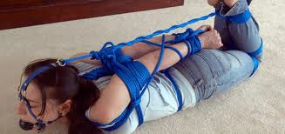
Objectives
Identify when a patient is a medical or trauma patient
Name the various ailments that fall into medical complaints
Demonstrate the ability to identify the NOI
Identify transport decisions
Discuss and preform medical patient assessments

Slide 3
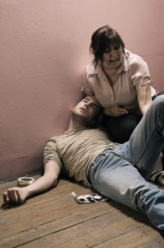
Introduction
Most Patients will fall into either Medical or Trauma categories
  MOI/NOI will be used to identify those patients
There are numerous medical problems for which we will get called for
The patient assessment becomes the most important tool in identifying what is wrong with our patient

Slide 4
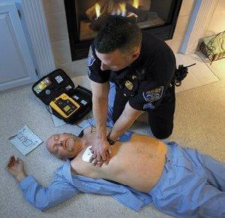
Types of Medical Emergencies
Respiratory
Cardiovascular
Neurologic
Gastrointestinal
Urologic
Endocrine
Hematologic
Immunologic
Toxicologic
Psychiatric
Gynecologic

Slide 5
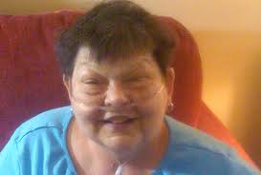
More Types of Medicals
Can be given information while enroute from Control
Always ensure scene safety
Using the NOI, formulate your index of suspicion on what is wrong with the patient

Slide 6
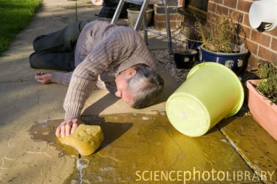
General Medical Conditions
Altered Mental Status
  Use AVPU
Seizures
  Generalized
  Absence

Slide 7
Specific Medical: Heart/Lungs/Brain
Heart
  Angina Pectoris
  Heart Attack
  Congestive Heart Failure
Lungs
  Dyspnea
  COPD
  Asthma
Brain
  Stroke
  Diabetes

Slide 8
Specific Medical: Abdominal
Kidney Dialysis
Abdominal Pain
  AAA

Slide 9
Assessment Sequence
Secondary Assessment
  Physical Exam
  Vital Signs
    If not already completed
  Patient Monitoring Devices
Reassessment
  Check on interventions
  Communicate with other agencies
Transport
  If not already enroute
Scene Size-Up
  Safety
  MOI/NOI
Primary Assessment
  General Impression
    Sick/Not Sick
    AVPU
  ABC
  Transport Decision
History Taking
  S/S
  Chief Complaint
  SAMPLE

Slide 10
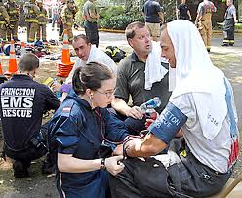
Protecting Yourself
Bloodbourne Pathogens
  Always wear PPE
  DO not eat or drink in the back of a rig
Clean up the rig after each call. Use bleach if at all possible or other cleaner

Slide 11

Review
Trauma patients can have far worse outwardly appearing conditions, but medical calls can be just as deadly
Medical patients may pose a greater challenge for treatment
Quick action on the part of an EMT can save a patient, initial scene clues are important

