Slide 1
Enrollment Forecasting
Changes from the old methodology to the new

Slide 2
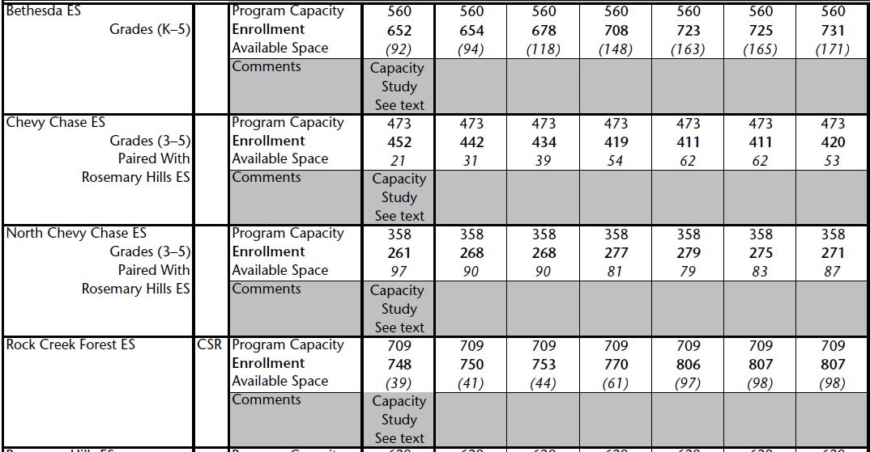
This is the forecast we see every year in the CIP, and in At-A-Glance sheets.

Slide 3
Prior model calculated the impact of development and demographic trends on observable class sizes.
Generation Rates
Incoming Kindergarteners
Approved Development
Cohort Survival

Slide 4
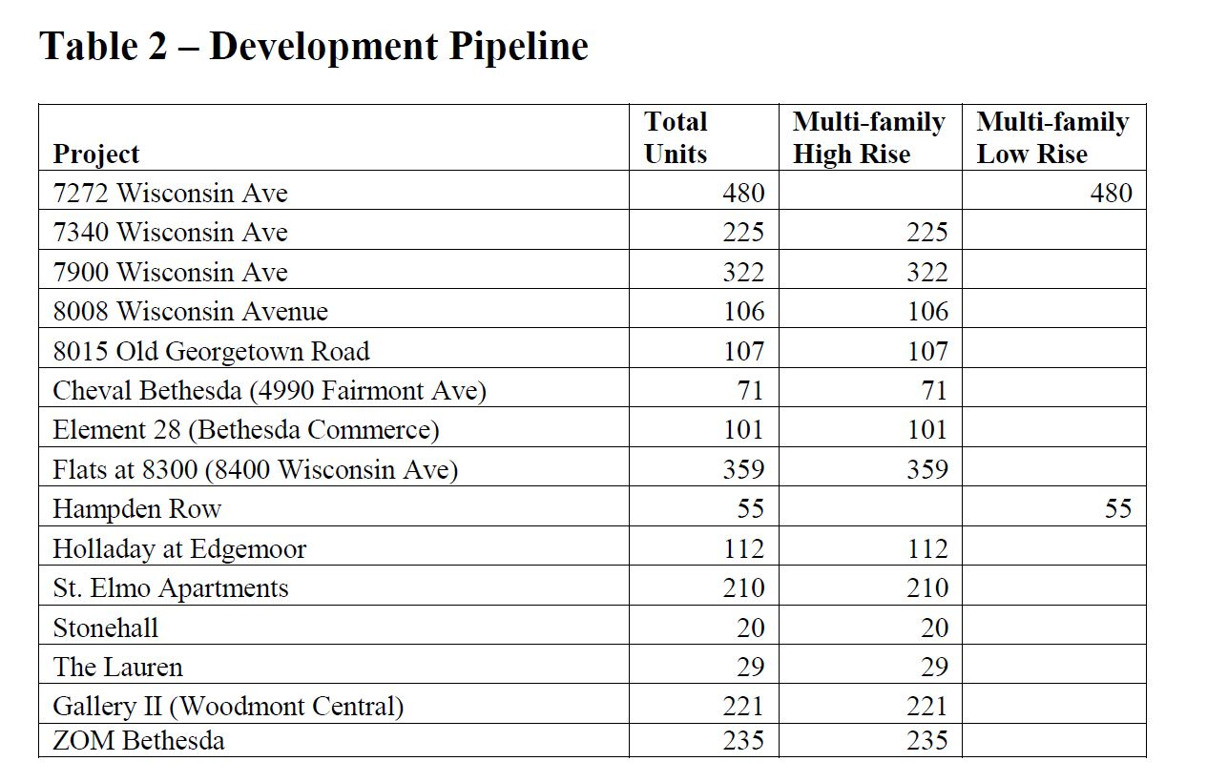
Prior model – Development

Slide 5
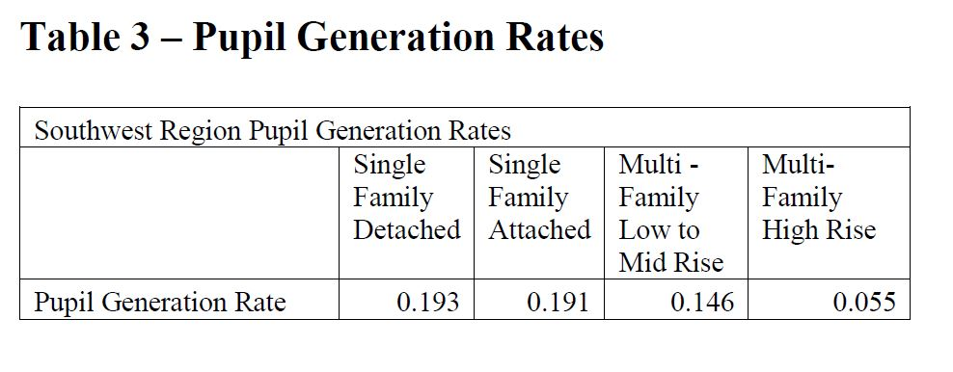
Prior model - Generation Rates

Slide 6
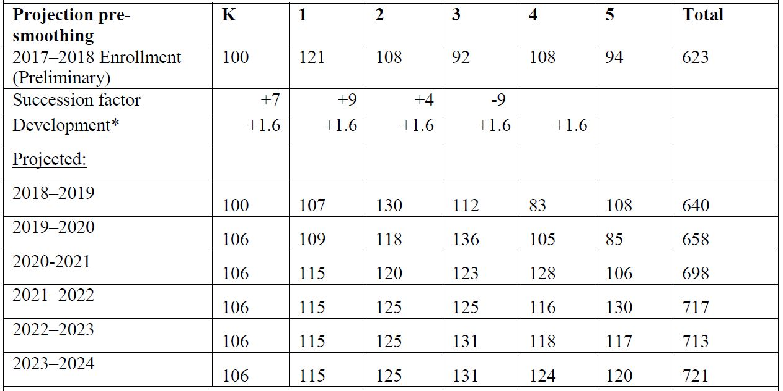
Prior model - Projection

Slide 7
We moved from a Cohort Survival model to one that blends four submodels.
Old methodology
New Methodology
Generation Rates
Cohort Survival
Approved Development
Incoming Kindergarteners
Students Per Household
Cohort Survival
Linear Regression
Average Percentage Increase

Slide 8
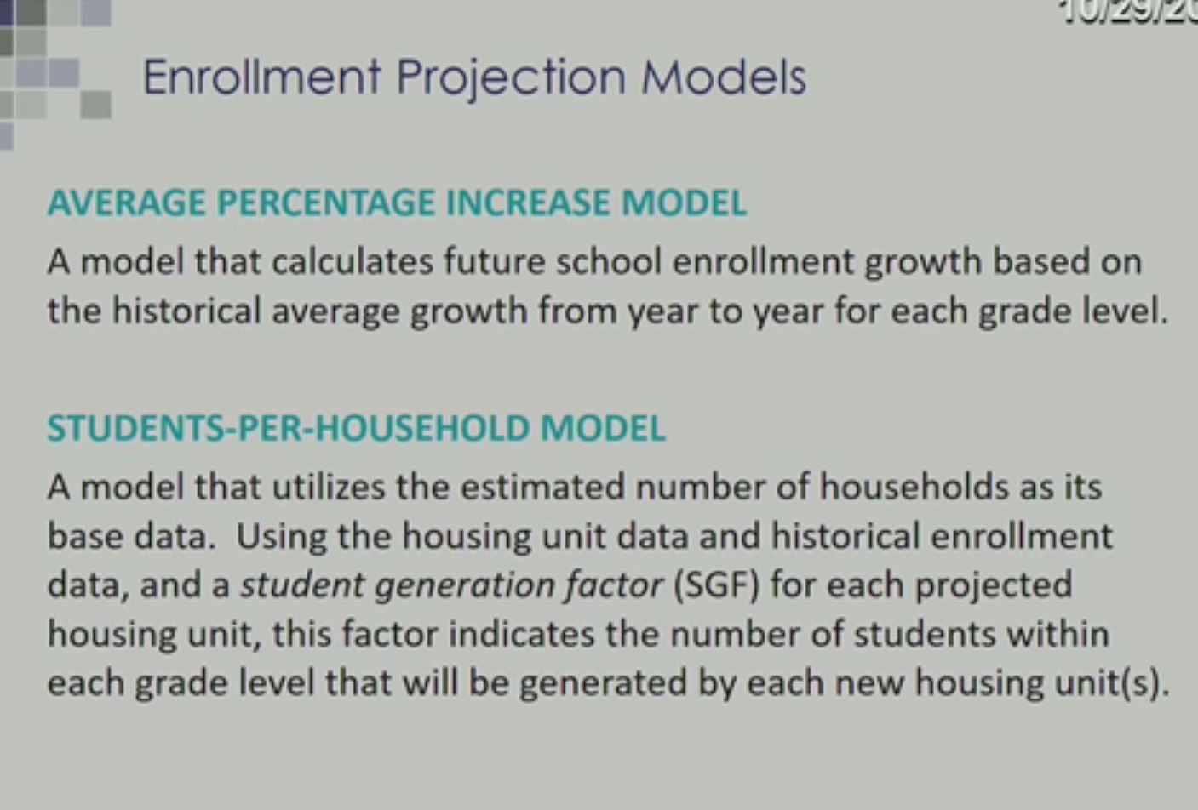
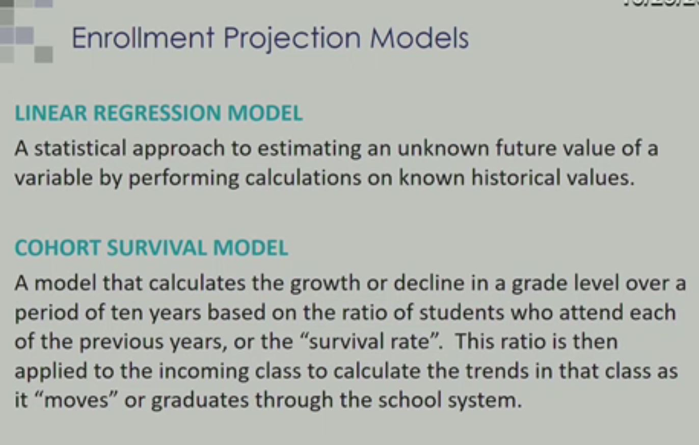
New - Four Weighted Models

Slide 9
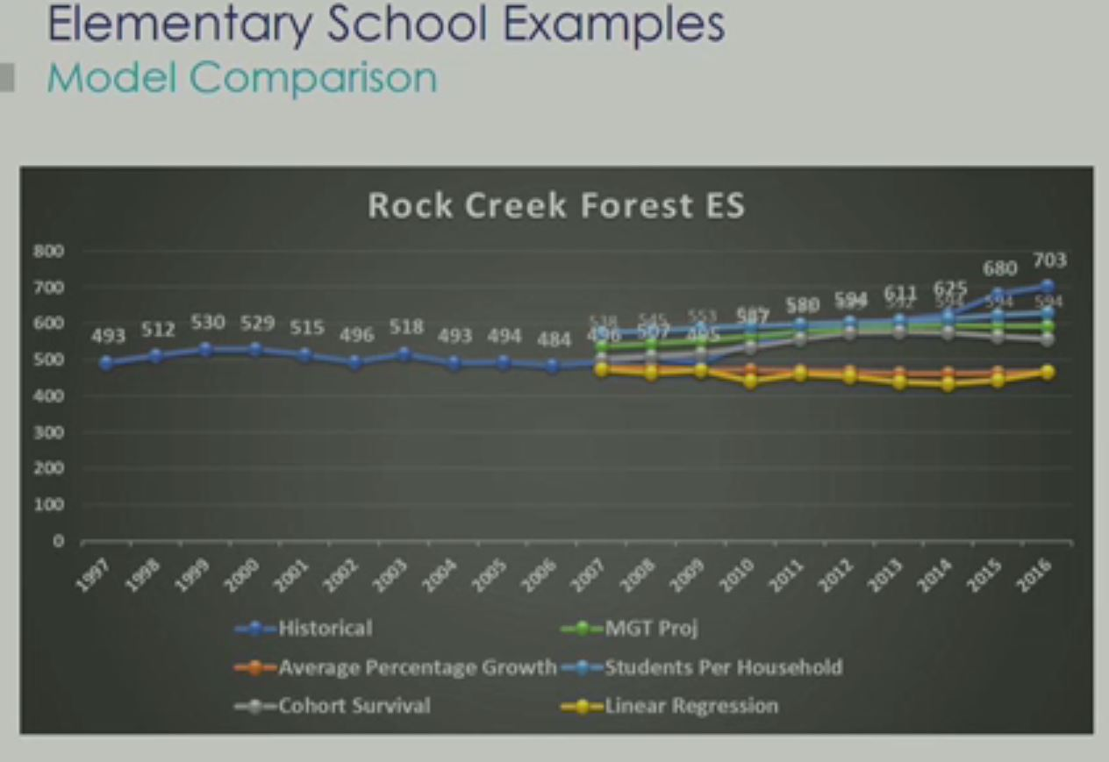
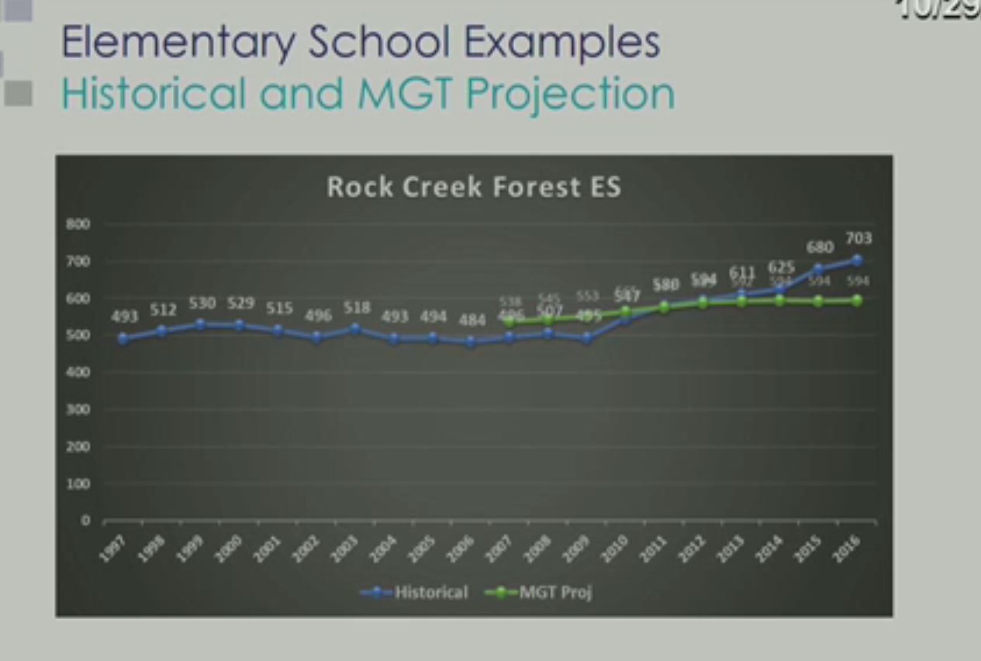
ES Example
4 models are represented by different colored lines.
But final projection selectively discounts some data.

Slide 10
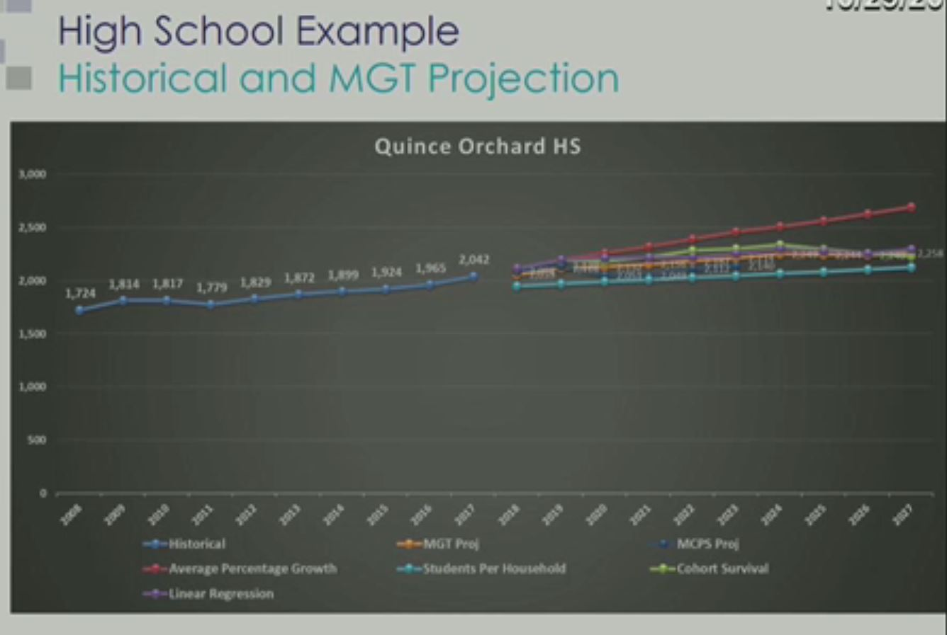
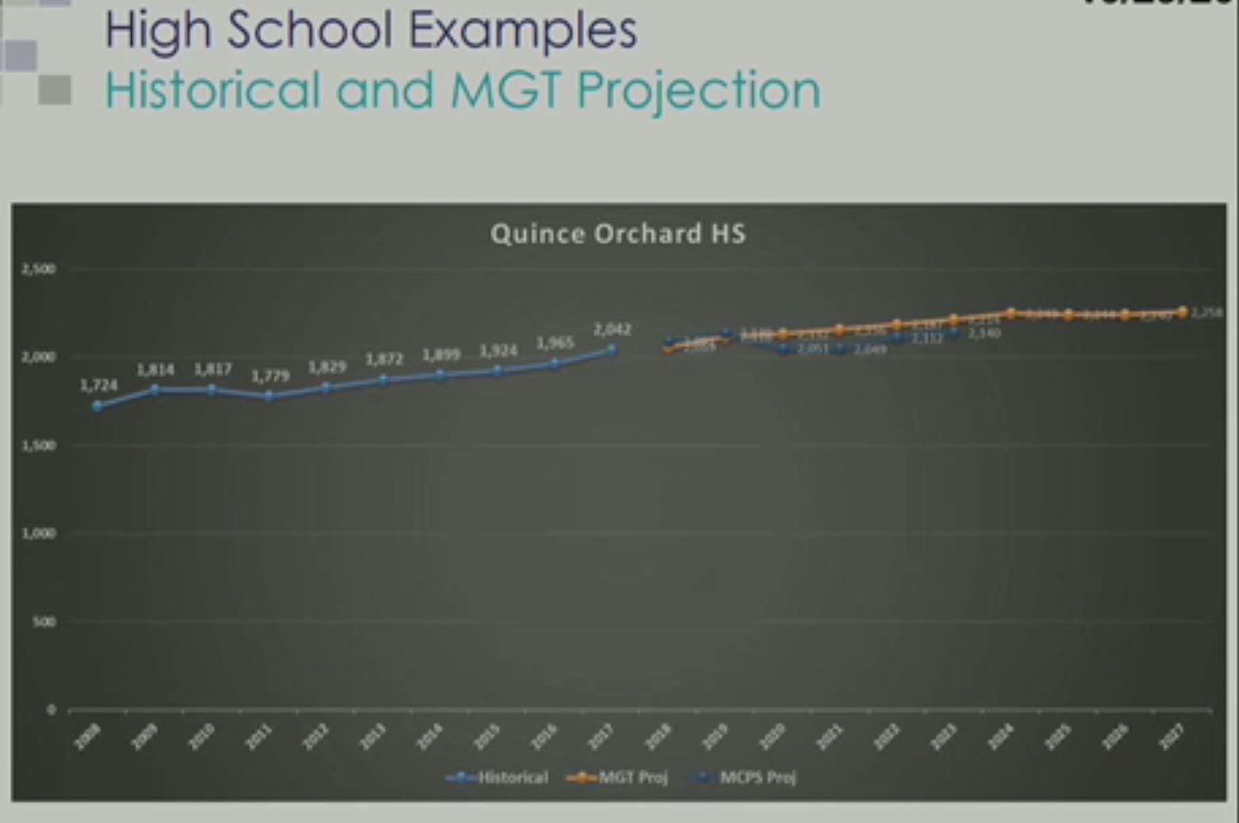
HS Example
4 models are represented by different colored lines.
But final projection selectively discounts some data.

Slide 11
Additional Comparisons

Slide 12
Primary Concerns
Weightings and Validation
Housing Growth
Approved Development
Model validation would have consisted of 1) generating weights to optimize forecasts of historical enrollment, and then 2) applying those same weights to yield the final projections.
Instead, MGT/MCPS applied new weights subjectively (e.g. to make things “look right,” or to achieve a
“gentler trajectory of growth.”
MGT identifies High, Low/Medium and No growth areas in their 2018 growth management report.
M-NCPPC provided housing growth rates by cluster ranging from 0% to 4.2%
In spite of this, MGT applies a flat 1% housing growth assumption for every school in the county.
MGT was provided 2016 housing numbers.
Specific approvals since then have not been included, and anything in excess of 1% is missing.

Slide 13
What You Can Do
          Check your forecasts
          Write to the BoE
          Ask to review and participate
          Ask for detailed forecasts and assumptions
          Email me: CIP@MCCPTA.ORG

