Slide 1
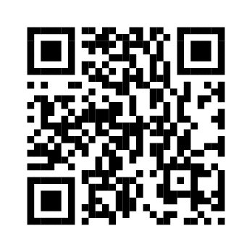
Leading the Next Chapter of
Myeloma Care
Oncology Nurse Stewardship in the Era of
Innovative Antibodies and Cellular Therapies
Beth Faiman, PhD, MSN, APN-BC, AOCN, BMTCN, FAAN, FAPO
Cleveland Clinic Taussig Cancer Institute
Department of Hematology and Medical Oncology
Member, Population and Cancer Prevention Program
Case Comprehensive Cancer Center
Cleveland, Ohio

Slide 2
Housekeeping Notes
Thank you to PeerView for providing this session and AbbVie, GSK, and
Johnson & Johnson for providing the educational grants for this activity
To receive NCPD credit, you must complete the online post-test and evaluation at the conclusion of the meeting
Post-test and evaluation: PeerView.com/MM-Survey-ZNS
Your evaluation of the activity is important in helping us to better meet your educational needs—we welcome your opinions and comments
We want this session to be interactive—asking and answering questions provides an optimal learning experience

Slide 3

Accreditation Information
In support of improving patient care, this activity has been planned and implemented by PVI, PeerView Institute for Medical Education, and HealthTree Foundation for Multiple Myeloma. PVI, PeerView Institute for Medical Education, is jointly accredited by the Accreditation Council for Continuing Medical Education (ACCME), the Accreditation Council for Pharmacy Education (ACPE), and the American Nurses Credentialing Center (ANCC), to provide continuing education for the healthcare team.
Nurses
Successful completion of this nursing continuing professional education activity will be awarded 1.0 contact hour(s) and 1.0 contact hour(s) in the area of pharmacology.
Supporter Statement
This educational activity is supported by independent medical education grants from AbbVie, GSK, and Johnson & Johnson.

Slide 4
Disclosure Policy
PVI, PeerView Institute for Medical Education, disclosure policy adheres to The Standards for Integrity and Independence in Accredited Continuing Education. All individuals in a position to control the content of a CE activity, including faculty, planners and reviewers are required to disclose all financial relationships with ineligible companies (commercial interests) that as an entity produces, markets, re-sells or distributes healthcare goods or services consumed by or used on patients. All relevant conflicts of interest have been mitigated prior to the commencement of the activity.
Planning Committee and Reviewer Disclosures
Planners, independent reviewers, and staff of PVI, PeerView Institute for Medical Education, and HealthTree Foundation for Multiple Myeloma do not have any relevant financial relationships related to this CE activity unless listed below.
Chair/Planner
Beth Faiman, PhD, MSN, APN-BC, AOCN, BMTCN, FAAN, FAPO
Cleveland Clinic Taussig Cancer Institute
Department of Hematology and Medical Oncology
Member, Population and Cancer Prevention Program
Case Comprehensive Cancer Center
Cleveland, Ohio
Beth Faiman, PhD, MSN, APN-BC, AOCN, BMTCN, FAAN, FAPO, has a financial interest/relationship or affiliation in the form of:
Consultant and/or Advisor for Bristol Myers Squibb; GSK; Janssen Pharmaceuticals, Inc.; Karyopharm Therapeutics; and Sanofi.
For PVI-accredited regional meetings, we need to include the following disclosure slides:
Disclosure Policy and Planning Committee and Reviewer Disclosures
Faculty disclosures
Condense housekeeping slides into as few slides as possible. You may go down to 8 points if needed
All relevant conflicts of interest have been mitigated prior to the commencement of the activity.

Slide 5
Leading the Next Chapter of
Myeloma Care
Oncology Nurse Stewardship in the Era of
Innovative Antibodies and Cellular Therapies
Beth Faiman, PhD, MSN, APN-BC, AOCN, BMTCN, FAAN, FAPO
Cleveland Clinic Taussig Cancer Institute
Department of Hematology and Medical Oncology
Member, Population and Cancer Prevention Program
Case Comprehensive Cancer Center
Cleveland, Ohio

Slide 6
What You’ll Learn Today
CD38 antibodies can be safely delivered as part of four-drug regimens in NDMM, including for older patients
Planning for referral and safety considerations can help facilitate early use of CAR-T
BCMA ADCs may once again be available and offer an alternative treatment pathway for some patients with RRMM
Bispecific antibodies are effective options in RRMM, which can increasingly be delivered in the outpatient setting, with attention to dosing, infections, and CRS

Slide 7

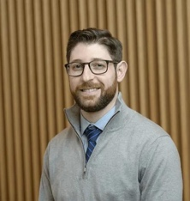

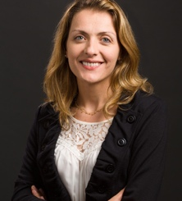
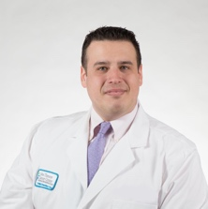
Let HealthTree help educate your patients on ……
Dr. Benjamin Diamond emphasizes the shift from a "one-size-fits-all" treatment approach for multiple myeloma to a more individualized, precision medicine model.
https://healthtree.org/myeloma/community/events/oct2024-relapsed-refractory-myeloma-treatment
Dr. Natalia Neparidze discusses real-world data on CAR-T and BiTE therapies, highlighting treatment patterns, safety, and clinical outcomes.
https://healthtree.org/myeloma/community/events/apr2025-myeloma-car-t-treatment
HealthTree University breaks down everything a patient needs to know about immunotherapy, taught by leading experts including, Dr. Joshua Richter.
https://healthtree.org/myeloma/university/modules/lI71uYJaYs7LjCIIdxLD

Slide 8



We’re creating a dedicated space for nurses passionate about blood cancer patient care, access to treatment, and research collaboration.
Bridge Gaps Between Academic and General Oncology Settings
Foster Collaboration
Provide Valuable Insights that Improve Patient Care
© All Rights Reserved HealthTree Foundation 2024

Slide 9
A Timeline of Progress: Developments With CD38 Antibodies, BCMA, and Non-BCMA Immunotherapy
2020: Belantamab mafodotin (belamaf), a BCMA ADC granted accelerated approval in RRMM; withdrawn from the market in 2022
2015
Initial approval
of mAbs
By 2020
Daratumumab combination therapy; split dosing; SC
In 2021
More CD38 antibody indications; the first BCMA antibody
Daratumumab and elotuzumab approved
Isatuximab approved March 2020
Expanded
isatuximab indication

Slide 10
Progress With Quadruplets, BCMA and Non-BCMA Immunotherapy
2021-2022
CAR-T arrives
2022-2023
BCMA and GPRC5D x CD3 bispecific antibodies
2024
In 2025
Ide-cel and
cilta-cel approved in RRMM/later relapse (5L+)
Teclistamab, elranatamab, and talquetamab approved
Ide-cel (3L), cilta-cel (2L+) approved in early relapse
Reappraisal of belamaf
Approval of linvoseltamab in the EU and US
Also in 2024-2025: CD38 quads (PERSEUS, IMROZ)

Slide 11
Setting Standards
Core Nursing Principles for Patient Care in MM

Slide 12
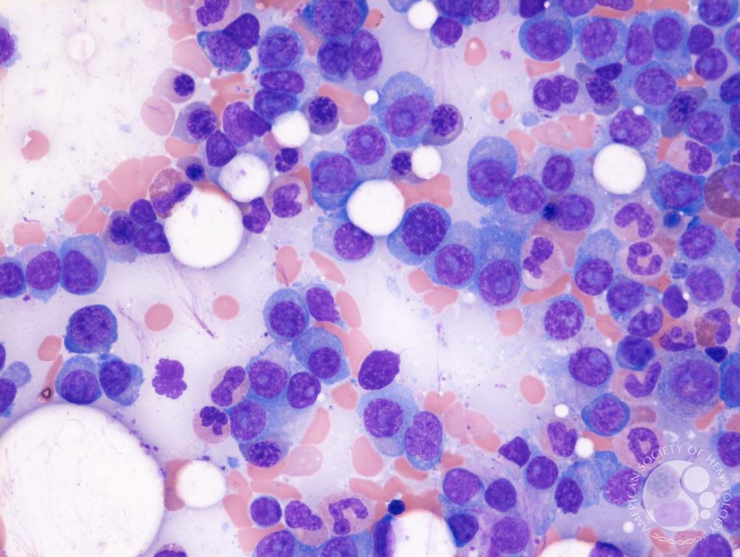
What Is Myeloma?
A cancer of plasma cells in the bone marrow
  Affects blood cell production
  Weakens bones: leading to bone pain, fractures, osteoporosis-like damage
  Other complications: anemia, renal dysfunction, infections

Slide 13
Test Before You Treat: Wide Range of Tests,
Including Labs, Biopsy, and Imaging
Tests Used to Determine and Monitor Multiple Myeloma
Laboratory Testing | Bone Marrow Biopsy | Radiologic Imaging
CBC + diff Blood chemistry tests (eg, β2 microglobulin, creatinine, albumin, calcium) Quantitative immunoglobulins SPEP, UPEP FLC ratio of free kappa/lambda light chains (plasma) MPA | IHC Flow cytometry Cytogenetics Clonal plasma cell percentage FISH (plasma cell enrichment) | Whole body low-dose CT scan PET scan MRI/CT ECHO (prior to cardiotoxic therapy or to rule out AL amyloidosis if suspected) Bone survey (low sensitivity)
High risk: t(4;14), t(14;16), t(14;20), del(17p), 1q gain with 1p deletion
Standard risk: trisomies, t(11;14), t(6;14)

Slide 14
Understanding The Spectrum of MM: Diagnostic Testing to Inform Diagnosis, Prognosis, and Therapy^{1,2}
Premalignant |  |  |  | Malignant
MGUS |  | SMM |  |  | Active MM
Low-risk MGUS | High-risk MGUS | Low-risk SMM | High-risk SMM | Ultra-high-risk SMM | Early active | Active
Subcategories
SPEP/UPEP spike from normal; abnormal free light chain results; bone marrow plasma cells <10%
SPEP/UPEP
spike of ≥2 g/dL; free light chain ratio ≥20; bone marrow plasma cells ≥20%
Myeloma-defining events; free light chain ratio ≥100; bone marrow plasma cells ≥60%; CrCl
<40 mL/min; ≥2 lesions
CRAB criteria:
Calcium elevation
Renal dysfunction
Anemia
Bone lesions
Testing
Treating
Monitor
Clinical trial
Treat

Slide 15

Nursing Strategies for Management of
Patients With Multiple Myeloma^{1,2}
Renal complications
Avoid renal-toxic agents; 24-hour urine albumin (bone-modifying agents)
Consider dose reduction of antibiotics, antiviral agents, and other medications
VTE/DVT Risk
Patients who receive IMIDs, with or without carfilzomib are at an increased risk for VTE
GI complications
    Diarrhea and constipation; antiemetics prior to proteasome inhibitors; select newer therapies
Bone health changes
Monitor; vitamin D, calcium supplements
Determine if bone-modifying agents are needed

Slide 16
Nursing Strategies for Management of
Patients With Multiple Myeloma^{1,2}
Infectious diseases
Assess risk for infections; monitor for neutropenia and myelosuppression
Shingles prophylaxis; seasonal inactivated influenza
CV complications
An echocardiogram should be considered
Neurologic effects
    Monitor for PN when treating with bortezomib, rule out secondary causes (eg, uncontrolled diabetes, vitamin deficiency)
Monthly labs and periodic imaging; recommend healthy behaviors, smoking cessation
Counsel patients on follow-up with primary care and sub-specialists, secondary cancer screenings
Disease monitoring & health maintenance

Slide 17
Visualizing the Role of the Oncology Nurse as a
Partner of the MM Management Team
🩺 Assessment & Monitoring
Baseline & serial assessments
Side-effect surveillance
📣 Patient Education
Treatment expectations
Self-care training
🔄 Care Coordination
MDs, APPs, pharmacists, labs, infusion suites
🌐 Care Navigation
Transitions (eg, CAR-T)
Insurance/financial
💉 Symptom & Toxicity Management
Peripheral neuropathy, CRS, cytopenias, infections
🤝 Psychosocial Support
Listening & guidance
Family/caregiver support

Slide 18
Delivering New 1L Care
Nursing Insights for Patients Receiving CD38 Antibody Quads

Slide 19
CD38 Quads Are Now Included as Primary Therapy in NCCN Guidelines for NDMM^{1,a}
Primary Therapy for HCT Candidates
Preferred Daratumumab/VRd (category 1) Isatuximab/VRd (category 1) | Other Recommended Bortezomib/lenalidomide/dex (category 1) Carfilzomib/lenalidomide/dex Daratumumab/KRd Isatuximab/KRd
Major trials supporting quads included PERSEUS, IMROZ, BENEFIT, and CEPHEUS
Primary Therapy if HCT Is Deferred or Not Indicated
Preferred Daratumumab/Rd (category 1) Daratumumab/RVd (patients aged <80 years who are not frail; category 1) Isatuximab/RVd (patients aged <80 years who are not frail; category 1) | Other Recommended Carfilzomib/lenalidomide/dex Bortezomib/lenalidomide/dex (category 1) Isatuximab/KRd

Slide 20
A Case to Think About—A Patient Preparing for Quadruplet Therapy
Think about Martin, a 72-year-old patient with ISS-II myeloma who is preparing for D-VRd induction/consolidation and is unsure about pursuing transplant
He presents with a PS of 2, bone pain, and GI discomfort
Consider: Martin wants to pursue a quad but asks about tolerability
Can dosing be adjusted to ensure safe delivery of care?

Slide 21
Principles for Safe Delivery of CD38 Antibody Therapy¹⁻³
Oral HSV prophylaxis (regardless of zoster vaccination status)
Appropriate premedication (acetaminophen, diphenhydramine, dexamethasone and/or methylprednisolone, and montelukast)
Pretherapy blood screening: type and cross match, screen for HBC antibody and surface Ag prior to treatment initiation and every 6 mo; initiate prophylaxis with entecavir if HBC antibody+
SC vs IV administration; observation period required after first dose to assess infusion reaction
  3 hours for SC and 6 hours for IV; average infusion time is >4 hours
Treat infections aggressively
  Consider immunoglobulin replacement for IgG levels <400 mg/dL and if there is a history of infection with hypogammaglobulinemia

Slide 22
Review of CD38 Antibody Dosing¹⁻⁵
Daratumumab | SC | IV
Dosing | 1,800-mg flat dose (15 mL) | 16 mg/kg in 1,000 mL (dose 1), then 500 mL
Administration Weekly for 8 wk, then every other week for 16 wk, then monthly | SC push over 3 to 5 min | Infusion rates vary based on dose; range from ~1.5 to 8 h Potential to split dose for cycle 1 and give 8 mg/kg over d 1 and 2
Isatuximab | SC | IV
Dosing | Fixed flat dose of 1,400 mg SC via OBDS (IKRALIA) C1: Weekly for 4 weeks C2 onward: Every two weeks on d 1 and 15 Not yet approved | 10 mg/kg every week for 4 wk followed by every 2 wk until disease progression or unacceptable toxicity Infusion rate: ~3.5 h (75 min rapid infusion after first 2 are tolerated)

Slide 23
Dosing Strategies to Consider for Safe Delivery of Quadruplets in Unfit or Frail Patients
Daratumumab
Isatuximab
Consider reduced frequency (eg, monthly) after initial cycles in very frail/elderly patients
For elderly/frail patients, consider slowing infusion rate for early doses or extending infusion to >3-4 hours if needed
Lenalidomide
Bortezomib
Dexamethasone
Use a lower dose (10-15 mg/day) and/or shortened schedule in older patients, those with renal dysfunction
Use SC over IV to reduce neuropathy; switch to weekly dosing; limit total cycles (eg, 4-6)
Reduce to 20 mg/week or lower; split dosing across
2 days if needed

Slide 24
Early Relapse in MM
The CAR-T Pathway

Slide 25
In Current Guidelines, CAR-T Therapies Are
Recommended for Early Relapse MM¹
Therapy for Previously Treated RRMM After 1-3 Prior Therapies Preferred Regimensª
Anti-CD38–refractory: KRd, KPd, Pom-Vd, EloPd, IxaPd Bortezomib-refractory: KRd, KPd, triplets with daratumumab or isatuximab, Elo-Pd Lenalidomide-refractory: triplets with daratumumab or isatuximab, KPd, Elo-Pd, IxaPd
CAR-T Cell Therapy After 1 prior LOT including an IMiD and a PI, and refractory to lenalidomide Ciltacabtagene autoleucel (category 1) After 2 prior LOT including an IMiD, a PI, and an anti-CD38 mAb Idecabtagene vicleucel (category 1)
Supported by CARTITUDE-4
Supported by KarMMa-3

Slide 26
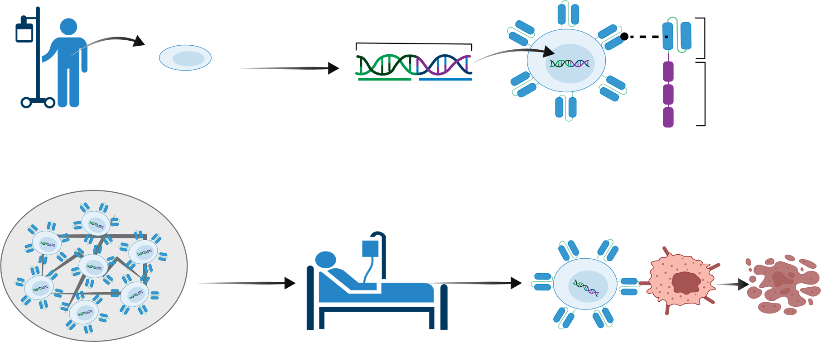
The Patient’s CAR-T Journey (Macro View)¹
Collected T cells are enriched, then genetically modified using a lentiviral vector to express a CAR that targets BCMA , a protein found on myeloma cells
Manufacturing
(17-28 days)
Leukapheresis
CAR-T cell
Chimeric antigen
receptor (CAR)
T cell
Insert gene for CAR
Antigen-
recognition
domain
Signaling
domains
Collect patient’s blood and acquire T cells
Create CAR-T cells;
isolate, activate, and engineer T cells
1
2
Manufacturing
Death of cancer cells
Expand CAR-T cells
Infuse CAR-T cells into patient
5
3
4
CAR-T cells attack cancer cells

Slide 27
The Patient’s CAR-T Journey (Micro View)
Bridging therapy = between leukapheresis BUT before infusion (usually 4-6 weeks duration)
Leukapheresis
  ± bridging chemotherapy
CAR-T cell infusion
  ± ~7-day admission
>30 days
  Long-term management
  Hypogammaglobulinemia
  Cytopenia
  Infection
Lymphodepletion (3 days starting at day -5)
First 30 days
Acute toxicity management (CRS and neurotoxicity)
T-cell manufacturing (~28 days)
IVIG
Bactrim, PJP
Acyclovir
Monitor CD4 counts

Slide 28
A Case to Think About—Early Use of CAR-T
You are caring for Dina, a 66-year-old woman with MM (ISS-III) and an early relapse after D-VRd induction/consolidation, ASCT, and
R maintenance
She presents with rising free kappa and M spike after 1.5 years on maintenance
Consider: You have preplanned for CAR-T during the maintenance phase, but Dina asks what she can expect for toxicity
How do you reply?

Slide 29
Be Aware of the Major Toxicities Associated With CAR-T in MM¹⁻⁵
Toxicity | Ide-Cel | Cilta-Cel
CRS | ~85%, mostly grade 1-2 Median onset: day 1 | ~95%, mostly grade 1-2 Median onset: day 7
ICANS | ~18%, mostly mild/moderate | ~20%
Infections | ~20%-30% (grade ≥3) Viral and bacterial risk | ~20%-30% (grade ≥3) Monitor for late infections
Cytopenias | Common; prolonged neutropenia (~30%) | Common; prolonged cytopenias (~40%-50%)
Note: cilta-cel may cause delayed neurotoxicity (eg, movement disorders, CN palsies)
Monitoring: vigilant supportive care and early intervention critical for both products
Ensure tocilizumab availability for CRS; corticosteroids are indicated for ICANS

Slide 30
Take-Homes on Managing CRS With CAR-T in MM^{1,2}
Goal: prevent multisystem organ failure, early identification and intervention
Treatment
  Dexamethasone +/- tocilizumab prevention, treatment
Fever
Cardiac and/or renal dysfunction
Fatigue,
myalgia, arthralgia
Talking to patients about CRS
Explain it is common but manageable
Use easily understood examples: “It’s like the flu shot, but worse”
Reassure patients that early intervention for CRS is possible
CRS
Hypoxia
Headache
Capillary leak, coagulopathy
Anorexia, nausea, vomiting
Hypotension

Slide 31
Take-Homes on Managing Neurotoxicity With CAR-T in MM^{1,2}
Cause: unclear
  Cytokine mediated
  T-cell mediated
Risk factors: unclear
  High disease burden
  Concurrent CRS
Treatment
  Corticosteroids first line for ICANS
  (eg, dexamethasone, methylprednisolone)
  Tocilizumab only if CRS is also present
  Supportive care
  Levetiracetam
Confusion, delirium
Difficulty finding words
Neurotoxicity
Expressive aphasia
Encephalopathy
Seizure
Decreased LOC, hallucinations
Tremor

Slide 32
The NCCN Also Recommends CAR-T for More Heavily Pretreated MM (Late Relapses)^{1,a}
Therapies for Patients With Late Relapses (>3 Prior Therapies)
CAR-T cell therapy: cilta-cel or ide-cel (preferred)
After at least 4 prior therapies, including an anti-CD38 monoclonal antibody, a PI, and an IMiD | Bispecific antibodies (preferred) Elranatamab-bcmm Linvoseltamab-gcpt Talquetamab-tgvs Teclistamab-cqyv
 | Useful under certain circumstances Belantamab mafodotin (if available through compassionate use program)
Supported by CARTITUDE-1 & KarMMa-2

Slide 33
CARTITUDE-1: Long-Term Outcomes Show
Sustained Clinical Efficacy With a Single Infusion^{1,2}
33% of the patients remained progression-free for ≥5 years following a single cilta-cel infusion with no maintenance therapy
Approximately half of patients were alive for ≥5 years
Serial MRD assessments were conducted on 12 progression-free patients at a single center
All were MRD-negative (≥10^{–5}) and PET/CT imaging-negative (suggestive of potential cure)
MRD negativity threshold
10⁻⁵
All patients (12/12) achieved MRD negativity
at 10⁻⁵
10⁻⁶

Slide 34
Four Key Take-Homes for Delivery of CAR-T in MM
Adequate planning and referral to a certified healthcare facility is required
  Start the process with at least 1 LOT before use
  Consider implications when planning for use in earlier LOTs (eg, bridging)
  Nurses are critical to support patients in the decision for treatment
Avoid prophylactic dexamethasone or other systemic corticosteroids;
avoid prior-line alkylators (if possible)
Be familiar with CRS and ICANS management; early use of tocilizumab for grade ≥2, dex for grade ≥2 ICANS
Be familiar with infection management and long-term follow-up
New CAR-T therapies on the horizon: anito-cel and others!

Slide 35
BCMA ADC Therapy
What Is the Next Step?

Slide 36
A Case to Think About—Other BCMA Options in Early Relapse
Think about Matthew, a 77-year-old man with high-risk RRMM
and a PS of 2 progressing after D-VRd, ASCT, and R maintenance
Several comorbidities, including renal dysfunction
Matthew is in a rural location and though he can travel, he lives alone and does not have a full-time caregiver
Consider: Can off-the-shelf BCMA therapy be considered here if CAR-T is not optimal?

Slide 37
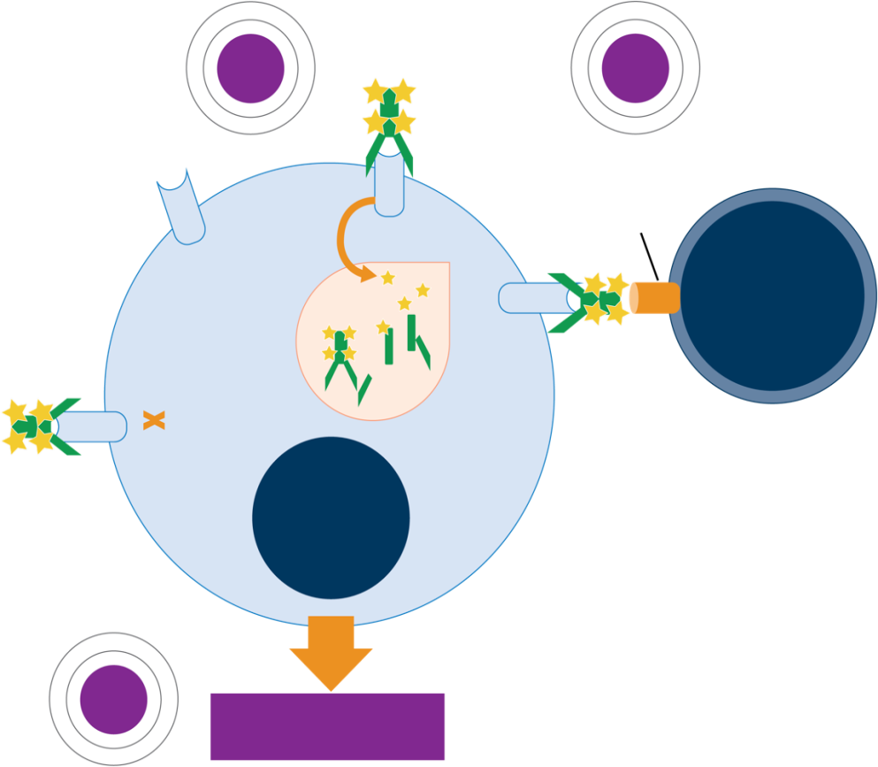
Belantamab Mafodotin (Belamaf): MOA¹
BCMA-targeting antibody conjugated with a cytotoxic payload (MMAF)
Payload induced direct cell death
Antibody engineered to have ADCC, while MMAF induces immunogenic cell death, eliciting an immune response
An “off-the-shelf” BCMA option that is useful for patients unable to receive CAR-T (eg, because of frailty or mobility issues)
1
ADC
2
ADCC/ADCP
Fc
receptor
BCMA
Lysosome
BCMA
Effector
cell
BCMA
BCMA
Malignant
plasma
cell
3
Markers of ICD

Slide 38
Recent Evidence Has Proven the Efficacy of Combination Therapy With Belamaf in RRMM¹
Take home: Adding belamaf to Vd improved PFS and OS compared with DVd
DREAMM-7: Belamaf, bortezomib, and dexamethasone (BVd) vs daratumumab/Vd (DVd) in RRMM
Median PFS (primary endpoint) was nearly tripled with BVd vesus DVd | 36.6 mo vs 13.4 mo HR = 0.41; P <.001
BVd increased OS at 2 years … | 79% vs 67% HR = 0.58; P = .00023
… as well as OS at 3 years | 74% vs 60%
Median OS not reached in either arm

Slide 39
Insights on Safety With Belamaf From DREAMM-7¹
Eye-related side effects with BVd were manageable and reversible
  Dose modifications did not impact efficacy
79% of patients experienced eye-related events
Blurred vision was the most frequent eye-related side effect
  24% of grade 3/4
Discontinuation due to eye-related side effects was 10%

Slide 40


When Discussing Belamaf With Patients,
Prepare to Share and Explain Eye Examination Schedule¹
Based on DREAMM-7: ocular examinations at baseline and every 3 weeks prior to each dose to at least the sixth dose
First
dose
Second
dose
Third
dose
…
Sixth dose
Baseline eye exam
Eye exam
Eye exam
Eye exam
Use preservative-free lubricant eye drops (no benefit with steroid drops)
If no ocular findings, ocular exam every 3 months
1. Hungria V et al. N Engl J Med. 2024;391:393-407.

Slide 41
Dosing Principles With BVd Based on DREAMM-7¹
Belantamab mafodotin
Bortezomib
Dexamethasone
2.5 mg/kg IV on day 1 of 21-day cycles (Q3W) until the occurrence of disease progression
Dose could be reduced to 1.9 mg/kg or dose delay to manage AEs
1.3 mg/m² SC on days 1, 4, 8, and 11 of cycles 1-8
(21-day cycles)
20 mg (IV or PO) on the day of and the day after bortezomib in cycles
1-8 (21-day cycles)ª
Allows for effective BCMA targeting, reversible ocular AEs, no CRS, ICANS

Slide 42
Off-the-Shelf in Later Relapse
BCMA Bispecifics and Beyond

Slide 43
The NCCN Also Recommends Bispecifics for More Heavily Pretreated MM (Late Relapses)^{1,a}
Therapies for Patients With Late Relapses (>3 Prior Therapies)
CAR-T cell therapy: cilta-cel or ide-cel (preferred)
After at least 4 prior therapies, including an anti-CD38 monoclonal antibody, a PI, and an IMiD | Bispecific antibodies (preferred) Elranatamab-bcmm Linvoseltamab-gcpt Talquetamab-tgvs Teclistamab-cqyv
 | Useful under certain circumstances Belantamab mafodotin (if available through compassionate use program)
Supported by MagnetisMM, MajestTIC, Linker-MM1, and MonumenTAL trials

Slide 44
A Case to Think About—A Heavily Pretreated Patient
Pamela is a 78-year-old woman with triple-class refractory MM and high-risk cytogenetics who is progressing after 4 lines of prior therapy (BCMA naïve).
She has limited family support but is able to access her local clinic
Her most recent progression was very rapid (DOR = 3 months)
Consider: Assuming she cannot wait for CAR-T but has questions about inpatient/outpatient treatment with a bispecific antibody, how do you respond?

Slide 45
Step-Up and Subsequent Dosing With Teclistamab¹
Step-up dosing schedule
Dosing QW
Dosing Q2W
Step-up dose 1: 0.06 mg/kg
Step-up dose 2: 0.3 mg/kg
Treatment dose 1: 1.5 mg/kg
1.5 mg/kg
Patients achieving and maintaining ≥CR for a at least 6 mo
1.5 mg/kg
Minimum 2 days
Day 1
Day 3-5
Day 5-9
Week 3
Month 6
Notes
Step-up dose 2 may be given between 2 to 4 days after step-up dose 1; may also be given up to 7 days after step-up dose 1 to allow for resolution of AEs
First treatment dose may be given between 2 to 4 days after step-up dose 2; may be given up to 7 days after step-up dose 2 to allow for resolution of AEs
Minimum 2 days between step-up doses
48-hour hospitalization after each step-up dose

Slide 46
Step-Up and Subsequent Dosing With Elranatamab¹
Step-up dosing schedule
Dosing QW
Dosing Q2W
Step-up
dose 1: 12 mg
Step-up
dose 2: 32 mg
Treatment
dose 1: 76 mg
Week 3 though week 24
76 mg
Week 25 and Q2W thereafter
76 mg
Day 1
Day 4
Day 8 (week 2)
Week 3
Week 25
At week 25, dose frequency can be reduced to every other week in patients who have maintained PR or better for at least 2 mo
Minimum 2 days between step-up doses
Minimum 3 days between step-up dose 2 and first treatment dose
Minimum 6 days between subsequent treatment doses
48-hour hospitalization after step-up dose 1
24-hour hospitalization after step-up dose 2

Slide 47
Talquetamab Step-Up Dosing and Administration Principles^{1,a}
0.4 mg/kg QW
Treatment dose 1: 0.4 mg/kg
Subsequent treatment doses: 0.4 mg/kg QW
Step-up dose 1: 0.01 mg/kg
Step-up dose 2: 0.06 mg/kg
1 week after first dose
0.8 mg/kg Q2W
Step-up dose 3:
0.4 mg/kg
Treatment dose 1: 0.8 mg/kg
Subsequent treatment doses:
0.8 mg/kg Q2W^{d}
Day 1
Day 4^{b}
Day 7^{b}
Day 10^{c}
2 weeks after first dose
Patients should be hospitalized for 48 hours after all doses within the step-up dosing schedule

Slide 48

Dosing With Linvoseltamab¹
Weeks 1-2
Step-up doses
Weeks 3-13
200 mg
Weeks 14-23
200 mg
Weeks 24 onwards
200 mg
5 mg
Day 1
25 mg
Day 8
24-hour
hospitalization
Once a week
Every 2 weeks
≥VGPR → Every 4 weeks
<VGPR → Every 2 weeks
Predictable timing and low rate of CRS allows for an inpatient monitoring schedule of 1 day at week 1 and week 2
Customized dosing based on depth of response

Slide 49
Principles of CRS Management With Bispecifics^{1,2}
Monitor for CRS (especially during step-up and first full doses)
Grade 1 (fever only) | Grade 2 (hypotension needing fluids/low-flow O2) | Grade ≥3 (vasopressors, high-flow O2, ICU care)
Supportive care Consider tocilizumab Continue TCE therapy | Hold bispecific dose Tocilizumab ± corticosteroids (restart when resolved) | Tocilizumab + corticosteroids Resume based on clinical judgment
In the MM setting, tocilizumab prophylaxis can significantly reduce rates of CRS³

Slide 50
Key Principles for Infection Management With Bispecifics^{1,2}
Strategy to Consider | Recommendations
Vaccination | If possible, vaccinate before start of therapy
Viral testing | If history of latent HBV, specific antiviral therapy is recommended If positive baseline CMV Ab level, then consider monitoring during therapy vs preemptive therapy per local guidelines
Prophylaxis | PJP and varicella-zoster virus prophylaxis recommended Entecavir prophylaxis as indicated
Hypogammaglobulinemia: Monitor immunoglobulin levels and recommend IV immunoglobulin replacement for individuals IgG <400 mg/dL regardless of history of infections

Slide 51






Be Prepared to Address Unique AEs With GPRC5D Bispecifics
Dysgeusia
• Baking soda/salt water/magic mouth rinse
• Add flavor with citrus, herbs, spices, marinades
• Alternative protein sources if averse to meat
Dry Mouth
• Hydration, bland/cool foods, moist food with broth
• Limit caffeine/alcohol, tart drinks or frozen fruit
• Monitor for candidiasis; dental exams
Dysphagia
• Small, frequent soft meals
• Avoid dry foods, sip liquids between bites
• Food purees or mashed options
Weight Loss
• Frequent nutrient-dense meals/snacks with protein
• Calorie-boosting foods (eg, olive oil, nut butter)
• Consider appetite stimulants
Skin Toxicity
• Hydration, emollients, lukewarm/cold showers
• Sensitive soaps, oatmeal baths
• Topical steroids or antihistamines
Nail Toxicities
• Nail/finger cots, file nails smooth, nail hardeners
• Vitamin E oil, biotin supplement
• Monitor for secondary infections

Slide 52
On the Cusp
Preparing for New Bispecifics in MM

Slide 53
Get Ready: More T-Cell Engagers Are on the Way
Emerging BCMA x CD3 bispecifics
  Etentamig (ABBV-383)
Trispecifics (BCMA and GPRC5D x CD3)
  JNJ-5322
Other targets (FcRH5 x CD3)
  Cevostamab

Slide 54
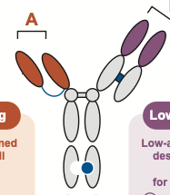
How Emerging BCMA Bispecifics May Differ
Considerations With Etentamig
Etentamig: BCMA x CD3¹
MOA is designed to: Induce lower cytokine release Provide an extended half-live with convenient dosing
In early testing, 2 mg of SUD and modified dexamethasone premedication resulted in CRS incidence of 30%, almost all grade 1
Only 1 grade 2 event managed with hydration
No grade ≥3 CRS

Slide 55
How Emerging BCMA Bispecifics May Differ
Considerations With Etentamig (Cont’d)
Etentamig dosing being assessed in a phase 3 trial (optional step-up, once monthly therapeutic dosing)¹
Cycle 1, day 1
Optional step-up (2 mg IV)
Cycle 1, day 4
60 mg IV
Cycle 2+
60 mg IV Q4W (± premedication)

Slide 56
Four Key Take-Homes
Upfront quads are now standard-of-care and can offer patients improved outcomes, including older individuals
Early planning, referral, and partnership are key to exposing patients to CAR-T therapy (nurses can lead this process)
BCMA ADCs, pending regulatory re-assessment, will offer another option in relapsed myeloma
Bispecifics should be a part of your treatment planning/counseling strategies for RRMM
In all cases, supportive care, AE management, and education on
infection risk are core aspects of nursing practice

Slide 57
Questions Previously Submitted
If a patient is interested in CAR-T, at what point should we start thinking about preparing them for referral to a specialized center?
What are the key early warning signs of CRS that bedside nurses should watch for with bispecifics?
When you are considering outpatient bispecific antibody step-up dosing, what monitoring infrastructure or tools do you put in place to make sure events are captured or reported?
How do you handle patients with low health literacy who might balk at the rage of infection prevention practices with bispecifics—vaccines, antimicrobial prophylaxis, etc.?
Many of our patients live far from tertiary centers—how do we coordinate care and follow up for patients receiving bispecifics to make sure access is consistent?

Slide 58
Visit us at PeerView.com/MM-Survey-ZNS
Please remember to complete and submit your
post-test and evaluation for CE credit
Thank you for joining us!

Slide 59
Abbreviations
1L: first line
2L: second line
3L: third line
4L: fourth line
5L: fifth line
ADC: antibody-drug conjugate
ADCC: antibody-dependent cellular cytotoxicity
ADCP: antibody-dependent cellular phagocytosis
AL: amyloid light-chain
ASCO: American Society of Clinical Oncology
ASCT: autologous stem cell transplant
ASH: American Society of Hematology
BCMA: B-cell maturation antigen
BVd: belantamab mafodotin, bortezomib, and dexamethasone
CAR-T: chimeric antigen receptor T cell
CD: cluster of differentiation
cilta-cel: ciltacabtagene autoleucel
CMV: cytomegalovirus
CR: complete response
CrCl: creatinine clearance
CRS: cytokine release syndrome
D-VRd: daratumumab, bortezomib, lenalidomide
and dexamethasone
del(17)p: chromosome 17 deletion
dex: dexamethasone
DOR: duration of response
DVd: daratumumab, bortezomib, and dexamethasone
EHA: European Hematology Association
EHR: electronic health record
Elo-Pd: elotuzumab, pomalidomide, and dexamethasone
Fc: fragment crystallizable
FISH: fluorescence in situ hybridization
FLC: serum free light chain
GPRC5D: G protein-coupled receptor class C group 5 member D
HBC: hepatitis B core
HCT: hematopoietic stem cell transplant
HSV: herpes simplex virus
ICANS: immune effector cell–associated neurotoxicity syndrome
ide-cel: idecabtagene vicleucel
IHC: immunohistochemistry
IMiD: immunomodulatory drug
Isa-Vrd: isatuximab, bortezomib, lenalidomide, and daratumumab
ISS: International Staging System
IVIG: intravenous immunoglobulin
IxaPd: ixazomib, pomalidomide and dexamethasone
KPd: carfilzomib, pomalidomide, and dexamethasone
KR: carfilzomib and lenalidomide
KRd: carfilzomib, lenalidomide, and dexamethasone
LOC: level of consciousness
LOT: line of treatment
mAb: monoclonal antibody
MGUS: monoclonal gammopathy of undetermined significance
MM: multiple myeloma
MMAF: monomethyl auristatin F
MPA: mycophenolic acid
MRD: minimal residual disease
N/A: not applicable
NCCN: National Comprehensive Cancer Network
NDMM: newly-diagnosed multiple myeloma
OBDS: on-body delivery system
PI: protease inhibitor
PJP: Pneumocystis jiroveci pneumonia
PN: peripheral neuropathy
Pom-Vd: pomalidomide plus bortezomib and dexamethasone
PS: performance status
QW: every week
Q2W: every 2 weeks
Q3W: every 3 weeks
Q4W: every 4 weeks
R: lenalidomide
Rd: lenalidomide and dexamethasone
RRMM: relapsed/refractory multiple myeloma
SC: subcutaneous
SMM: smoldering multiple myeloma
SPEP: serum protein electrophoresis
SUD: step-up dose
TCE: T-cell engager
TEAE: treatment-emergent adverse event
UPEP: urine protein electrophoresis
VC: bortezomib and cyclophosphamide
Vd: bortezomib and dexamethasone
VRd: bortezomib, lenalidomide, and dexamethasone

Slide 60
EXTRA SLIDES

Slide 61
CD38 Quadruplets Have a Consistent Safety Profile¹
Most Common AEs With D-VRd From the PERSEUS Study (Safety Population)
Event, n (%) | D-VRd (n = 351) |  | VRd (n = 347)
 | Any Grade | Grade 3 or 4 | Any Grade | Grade 3 or 4
Any AE | 349 (99.4) | 321 (91.5) | 344 (99.1) | 297 (85.6)
Hematologic AE
Neutropenia | 243 (69.2) | 218 (62.1) | 204 (58.8) | 177 (51)
Thrombocytopenia | 170 (48.4) | 102 (29.1) | 119 (34.3) | 60 (17.3)
Anemia | 78 (22.2) | 21 (6.0) | 72 (20.7) | 22 (6.3)
Febrile neutropenia | 34 (9.7) | 33 (9.4) | 38 (11) | 35 (10.1)
Second primary cancer | 37 (10.5) | N/A | 25 (7.2) | N/A
Any infusion-related reaction | 21 (6.0) | 3 (0.9) | N/A | N/A

Slide 62
CD38 Quadruplets Have a Consistent Safety Profile¹
Most Common AEs With Isa-VRd From the IMROZ Study
Safety, % | Isa-VRd (n = 263) | VRd (n = 181)
Grade ≥3 TEAE | 91.6 | 84.0
Serious TEAE | 70.7 | 67.4
Discontinued due to AE | 22.8 | 26.0
Grade 5 TEAE | 11.0 | 5.5
Grade ≥3 AE (≥20% patients in any arm)
Lymphopenia | 60.1 | 53.0
Neutropenia | 54.4 | 37.0
Leukopenia | 31.6 | 16.0
Thrombocytopenia | 30.0 | 27.6
Infections | 44.9 | 38.1

Slide 63


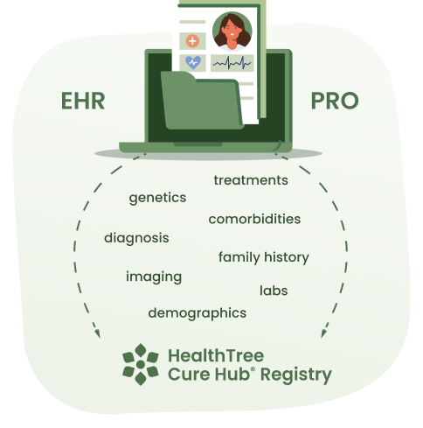

Innovation that powers lifesaving research
Direct-to-patient approach
EHR Connections to 3,000+ hospitals
Single patient record from multiple centers
PRO and demographic data
Facilitates surveys and studies
healthtree.org/curehub

Slide 64




Save time in the clinic answering basic multiple myeloma questions
World’s largest online multiple myeloma video curriculum
Basic to complex multiple myeloma topics
Multiple myeloma specialists as faculty
Expert discussion with animated videos to help simplify learning
Visit us at:
healthtree.org/myeloma/university

Slide 65
Despite Advances, Progress in MM Has Lagged
Behind the Science¹
Flatiron Health analysis of EHR-derived data collected during routine care in US oncology clinics from
2016-2023 (primarily community clinics), N = 1,544
Note: All regimens are assumed to include dexamethasone
Results showed very limited used of the most recent therapeutic developments in MM
VRd and Rd accounted for 69.7% of all 1L regimens
Many patients who underwent SCT in 1L did not receive a subsequent LOT
Among the subset who did receive a subsequent LOT, clinical outcomes worsened with each additional LOT

