Slide 1
Vegetables and Fruits

Slide 2
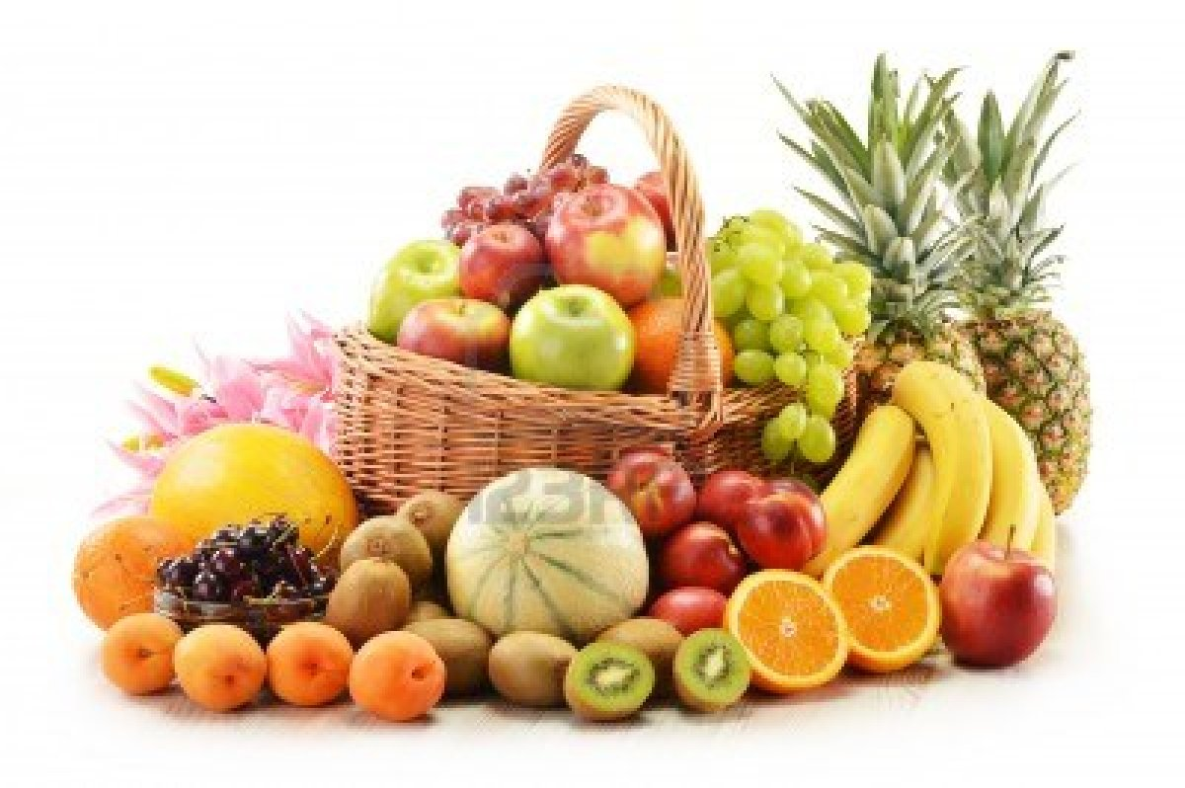
Fruits
FRUIF
Fruits
Phal

Slide 3
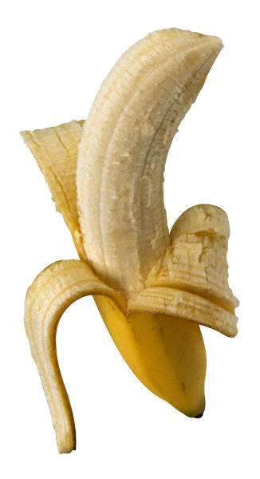
Banana
Kela
Banana
Kela

Slide 4
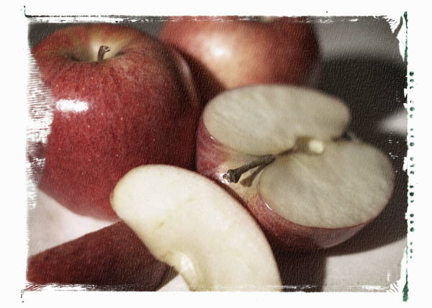
Apple
Seb
Seb
Apple

Slide 5
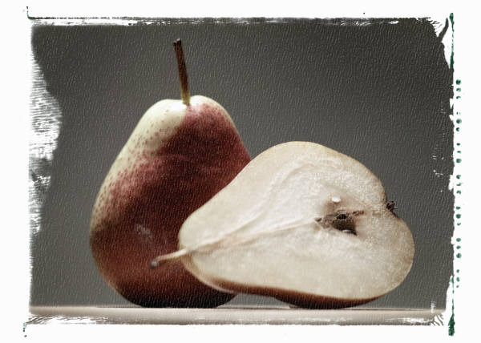
Pear
Nashpati

Slide 6
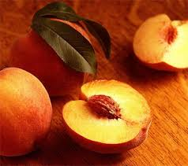
Peach
Arhoo

Slide 7
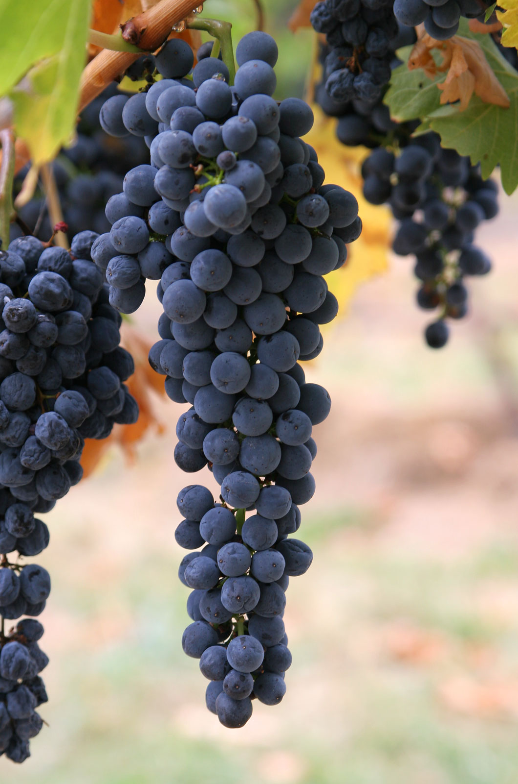
Grapes
Angoor

Slide 8
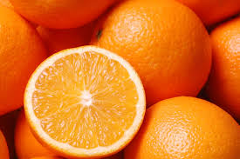
Orange
Santara

Slide 9
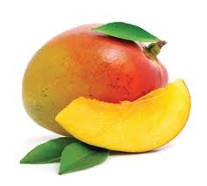
Mango
Aam

Slide 10
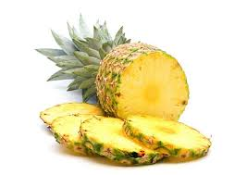
Pineapple
Ananas

Slide 11
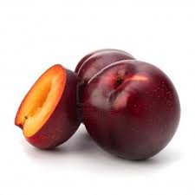
Plum
Aloobukhara

Slide 12
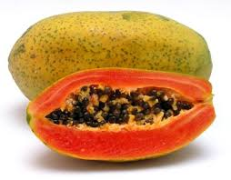
Papaya
Papita

Slide 13

Vegetables
Vegetables
Subziyan

Slide 14
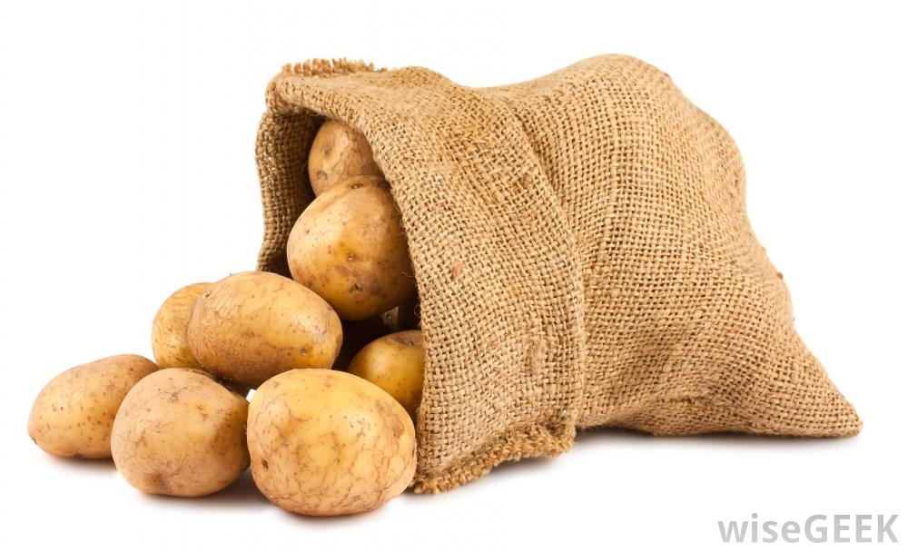
Potato
Aloo
Potato
Aloo

Slide 15
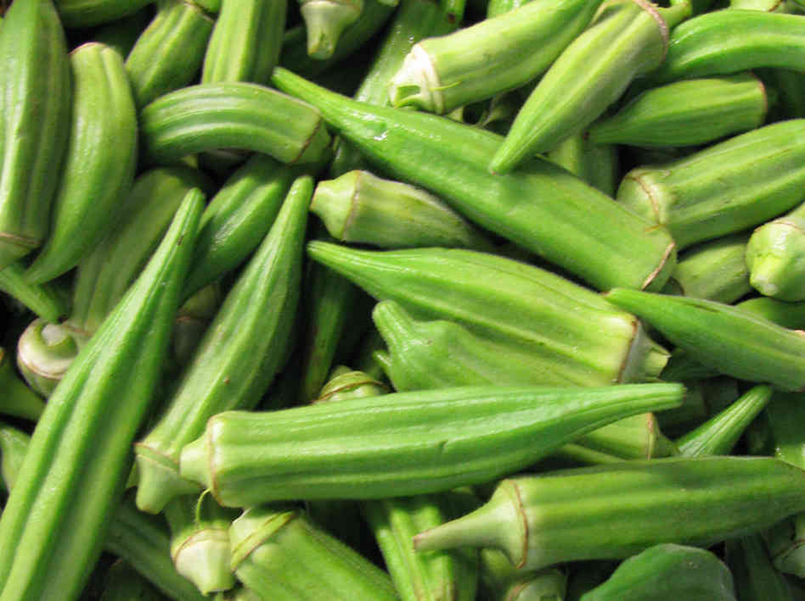
Okra
Bhindi

Slide 16
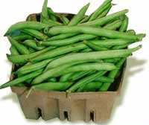
Green Beans
Phaliyan

Slide 17
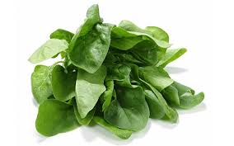
Spinach
Paalak

Slide 18
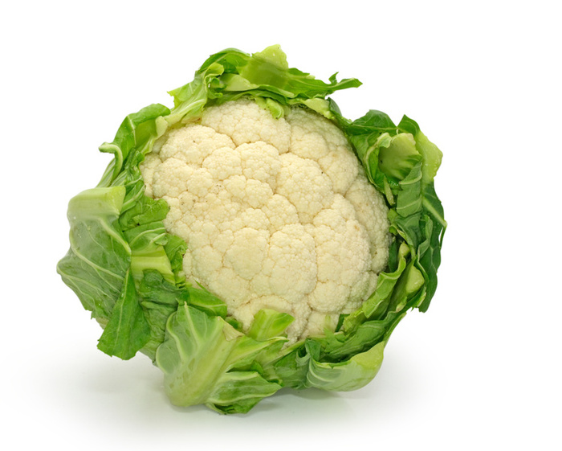
Cauliflower
Gobhi

Slide 19
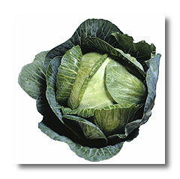
Cabbage
Bandgobhi
C

Slide 20
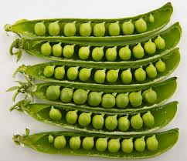
Peas
Matar

Slide 21
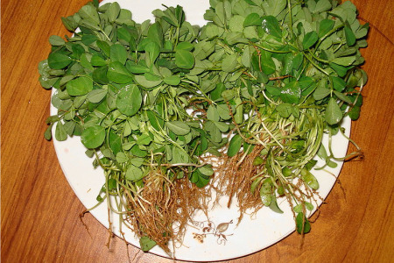
5
Fenugreek Leaves
Methi

Slide 22
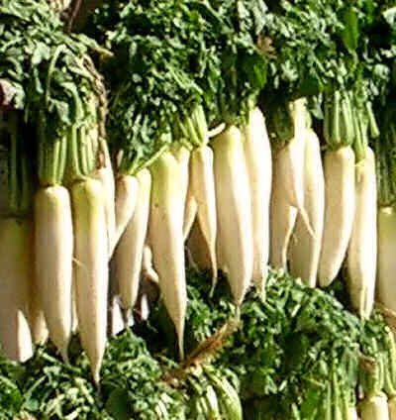
Radish
Muli

Slide 23
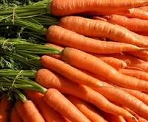
Carrots
Gaajar

