Slide 1
RAISE RIGHT FUNDRAISING
WHAT IS RAISERIGHT?
RaiseRight is a way to fundraise, simply by purchasing gift cards to places you already shop...
Walmart, Home Depot, Panera, Carnival, Disney, Target, Starbucks, and hundreds of other places!
HOW DOES IT WORK?
You will create an account through RaiseRight (formally known as ShopWithScrip). Each merchant sends a portion of your purchase (anywhere from 2%-20%) back to MHS Band as a rebate. The entire rebate goes towards your student's band/guard account.

Slide 2
GETTING STARTED ________________________________ ACCOUNT SETUP

Slide 3
raiseright.com

Slide 5
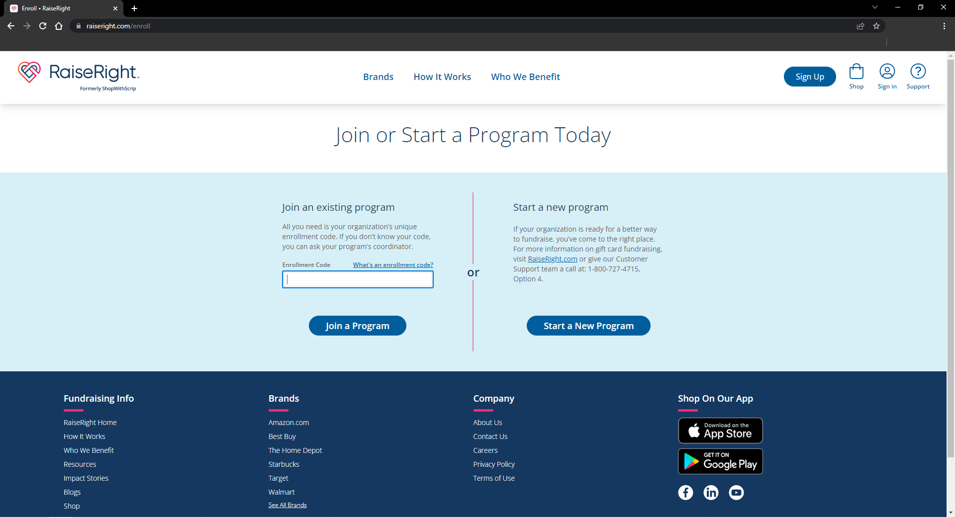
41C71LD155146

Slide 6
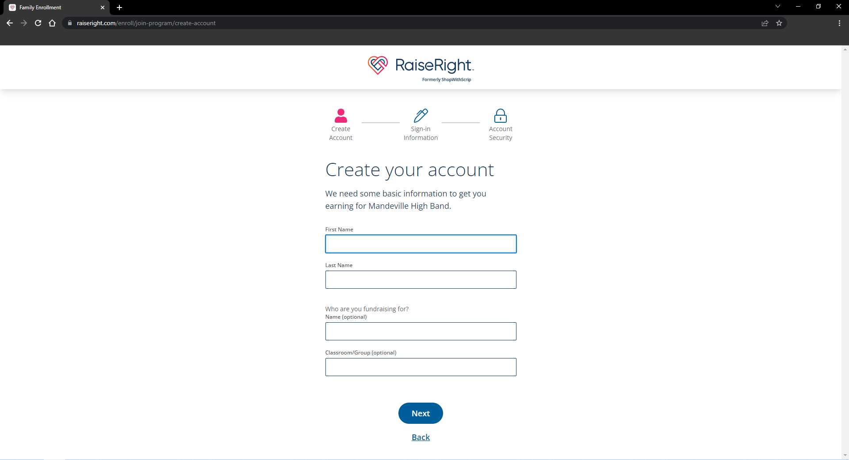
Jane
Doe
Timmy Doe
MHS Instrument

Slide 7
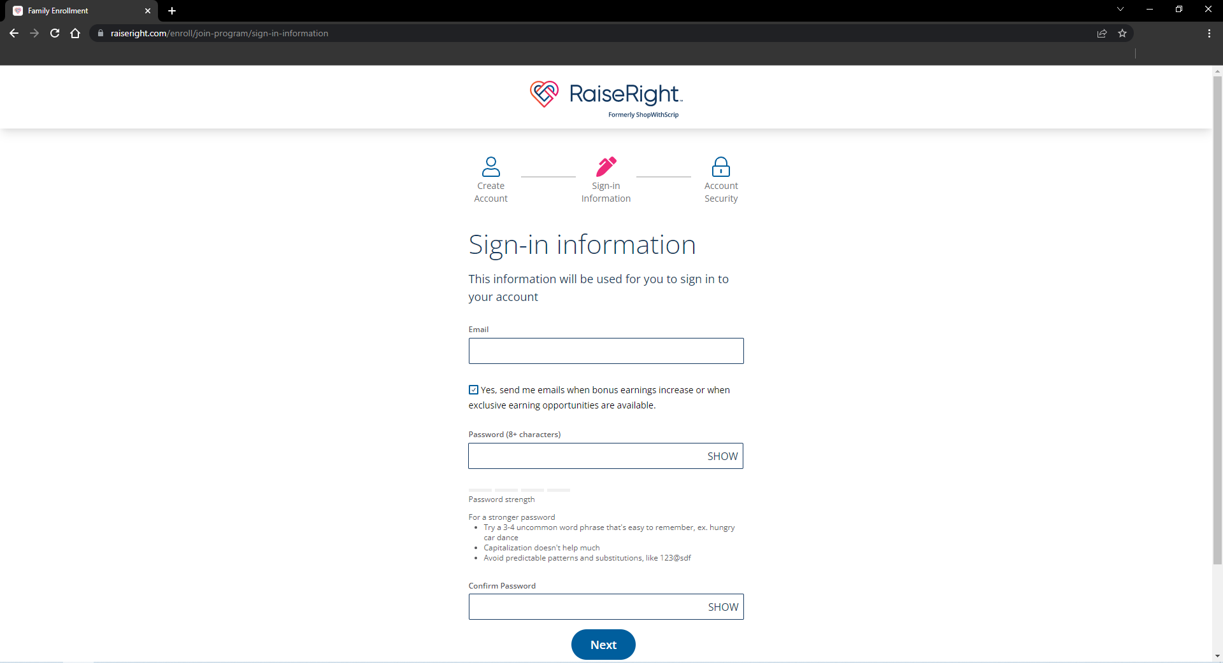
Jane.Doe@gmail.com
**********
**********

Slide 8
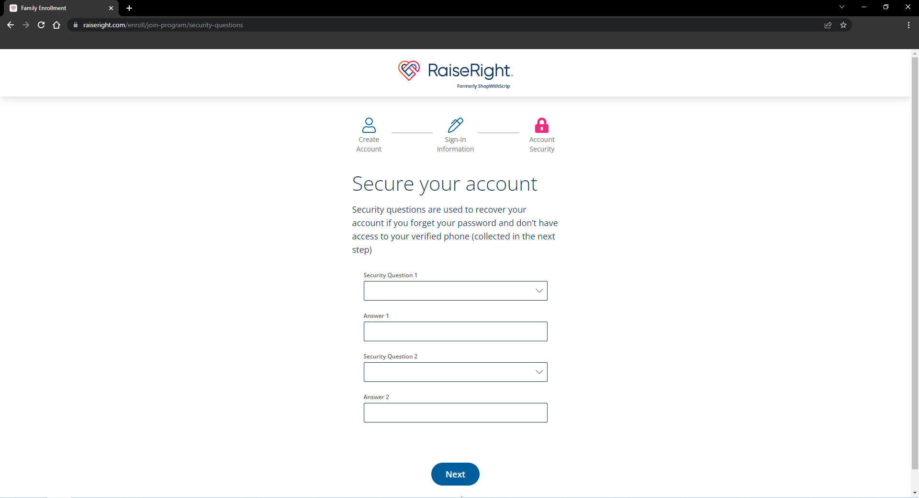
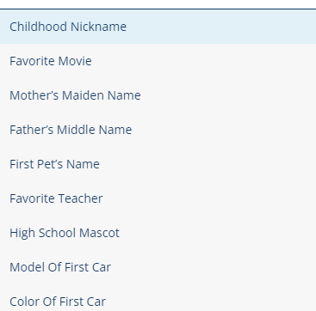
Childhood Nickname
Janey
Color of First Car
Red

Slide 9
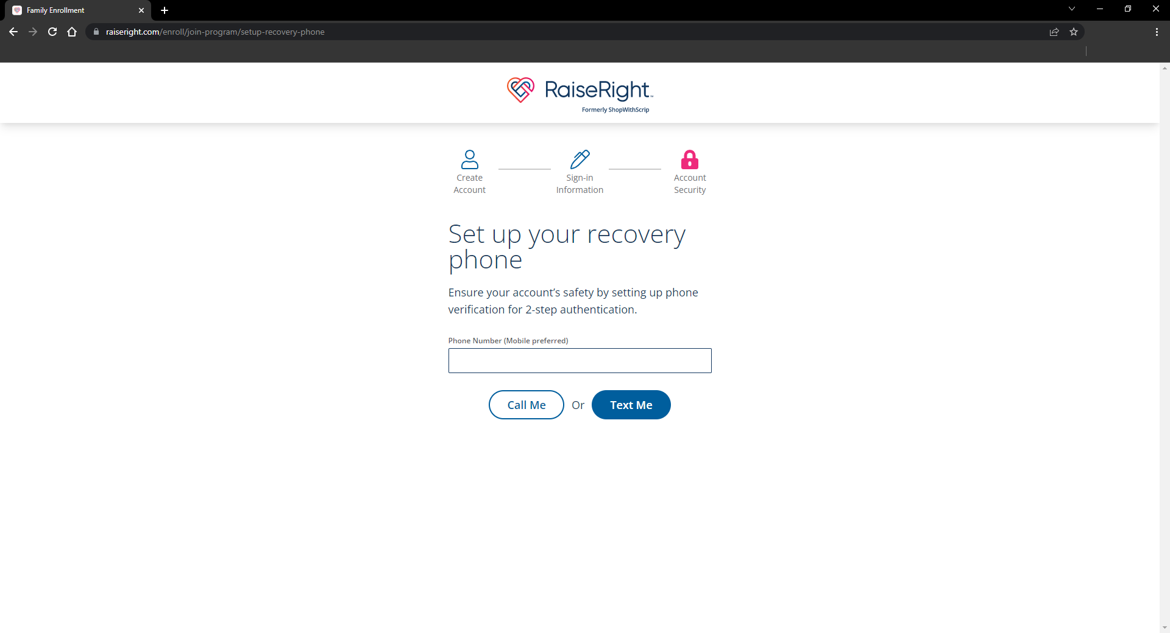
555-555-1234

Slide 10
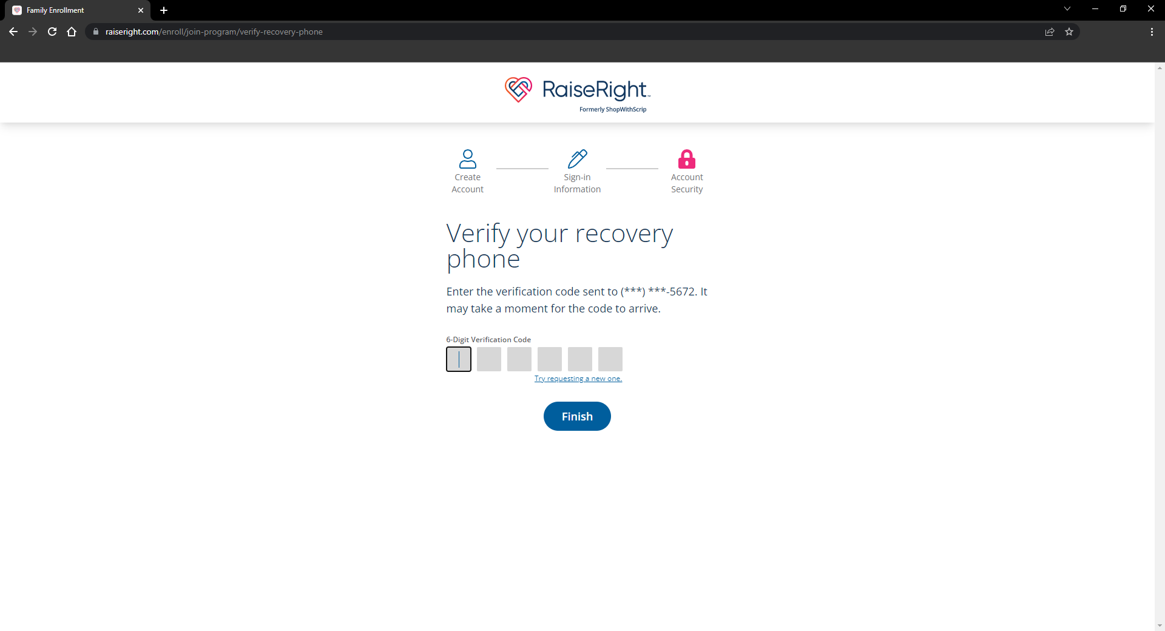
(***)***-1234
1
2
3
4
5
6

Slide 11
GETTING STARTED ________________________________ PAYMENT - BANKING SETUP

Slide 12
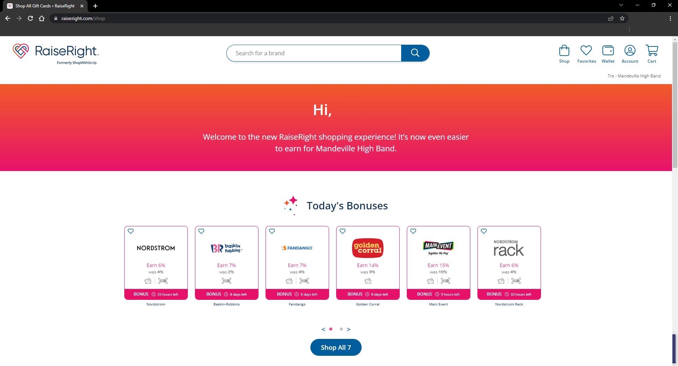
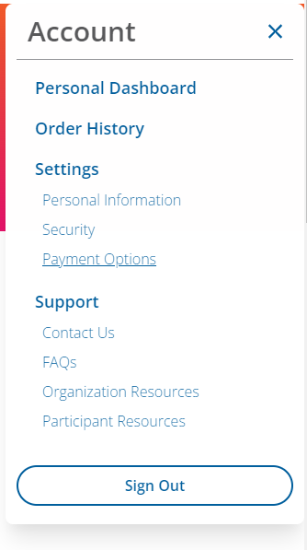
Jane

Slide 13
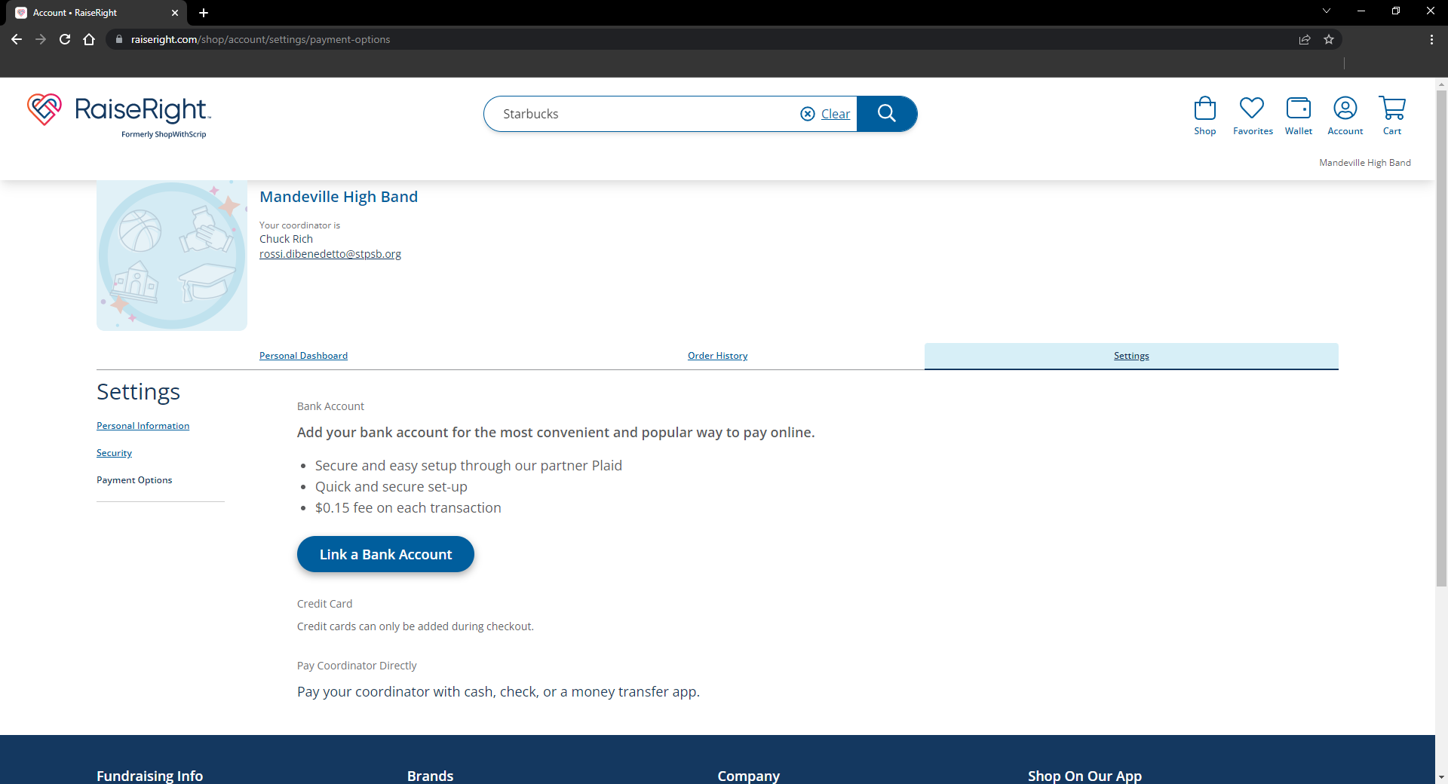

Slide 14
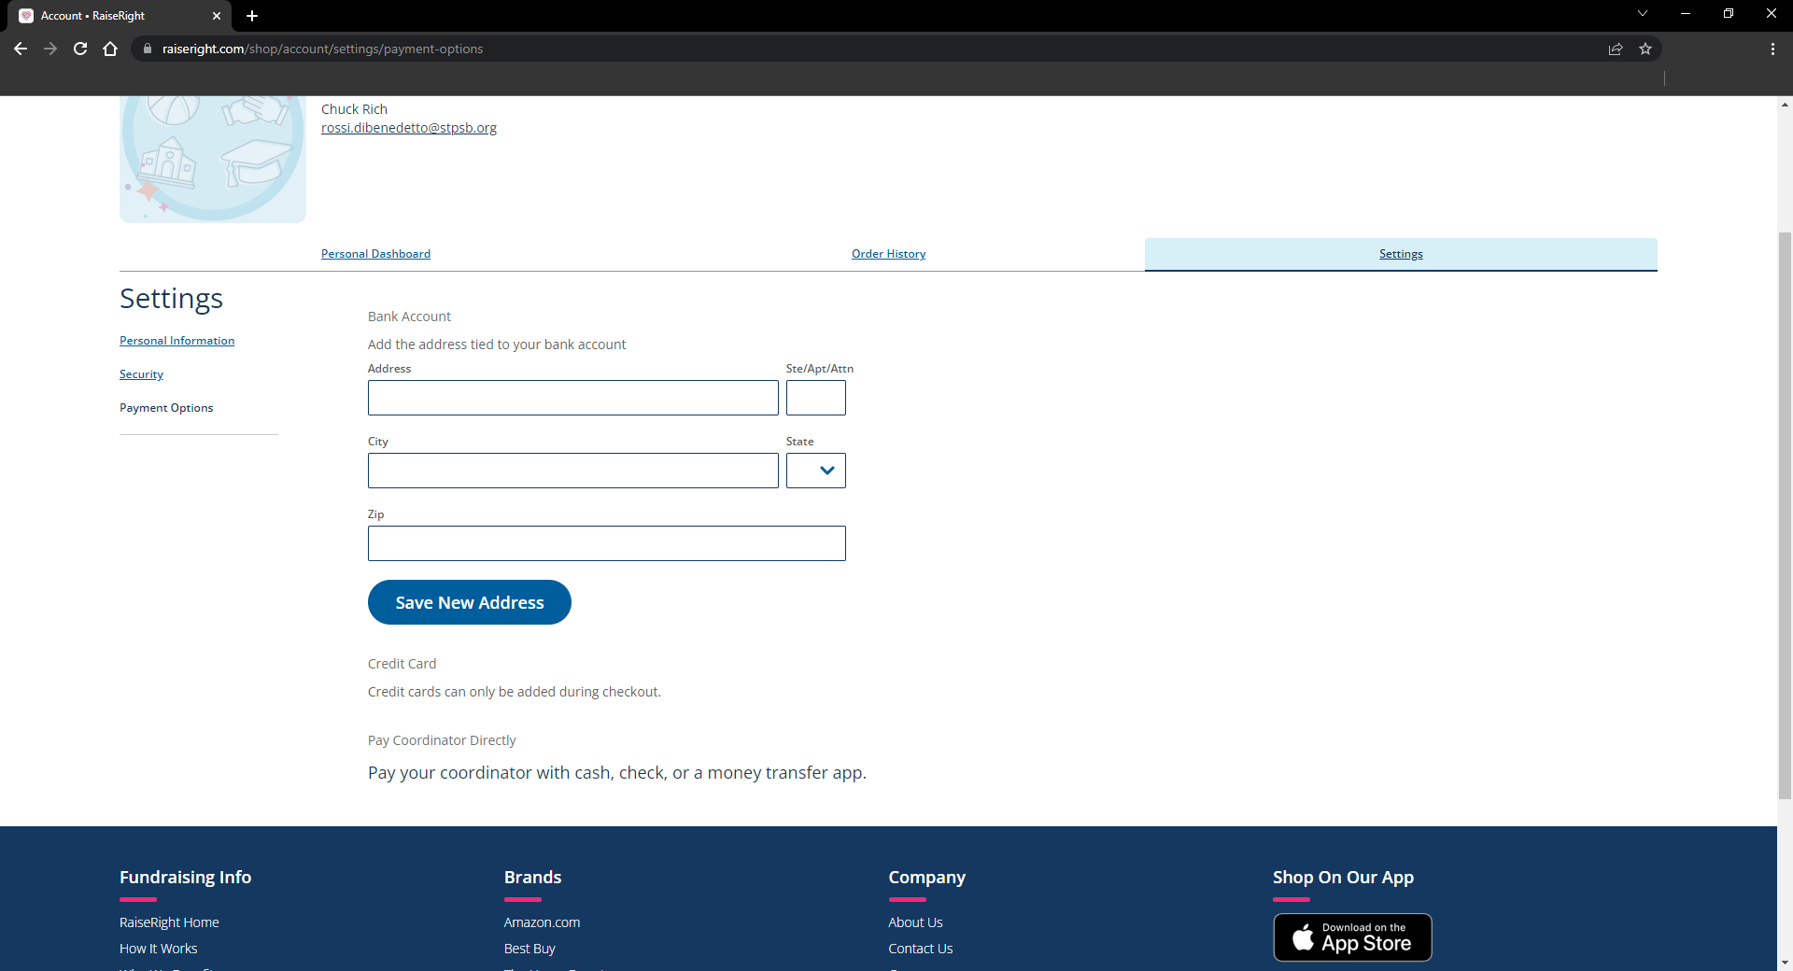
55 Broadway St
Mandeville
LA
70444

Slide 15
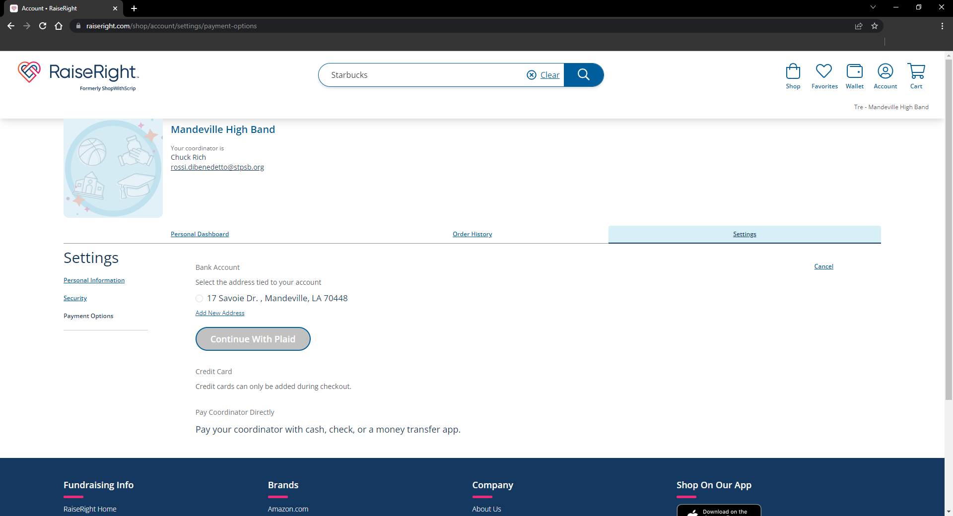
55 Broadway St, Mandeville LA 70444

Slide 16
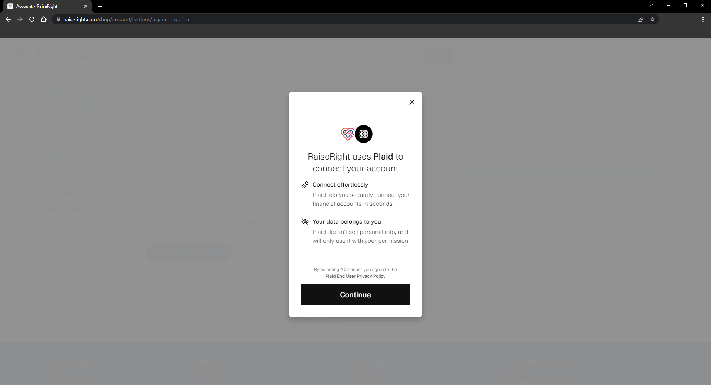

Slide 17
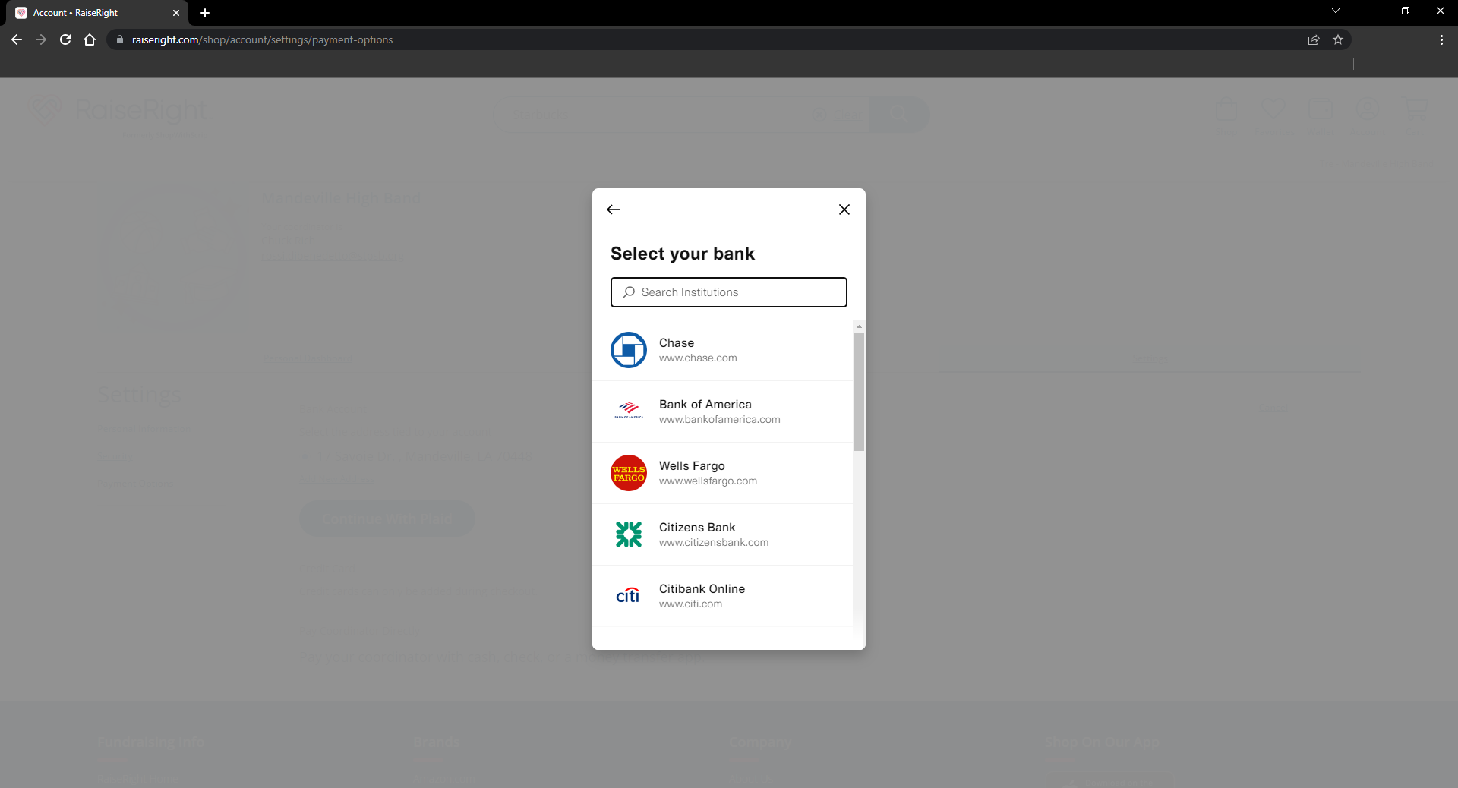
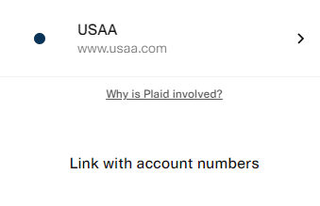
USAA

Slide 18
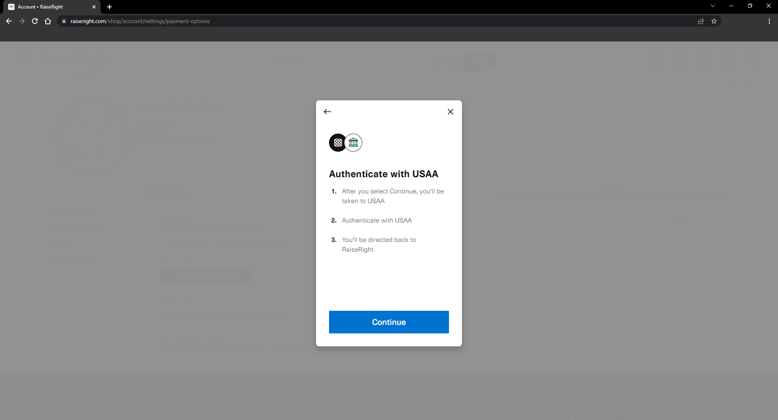

Slide 19
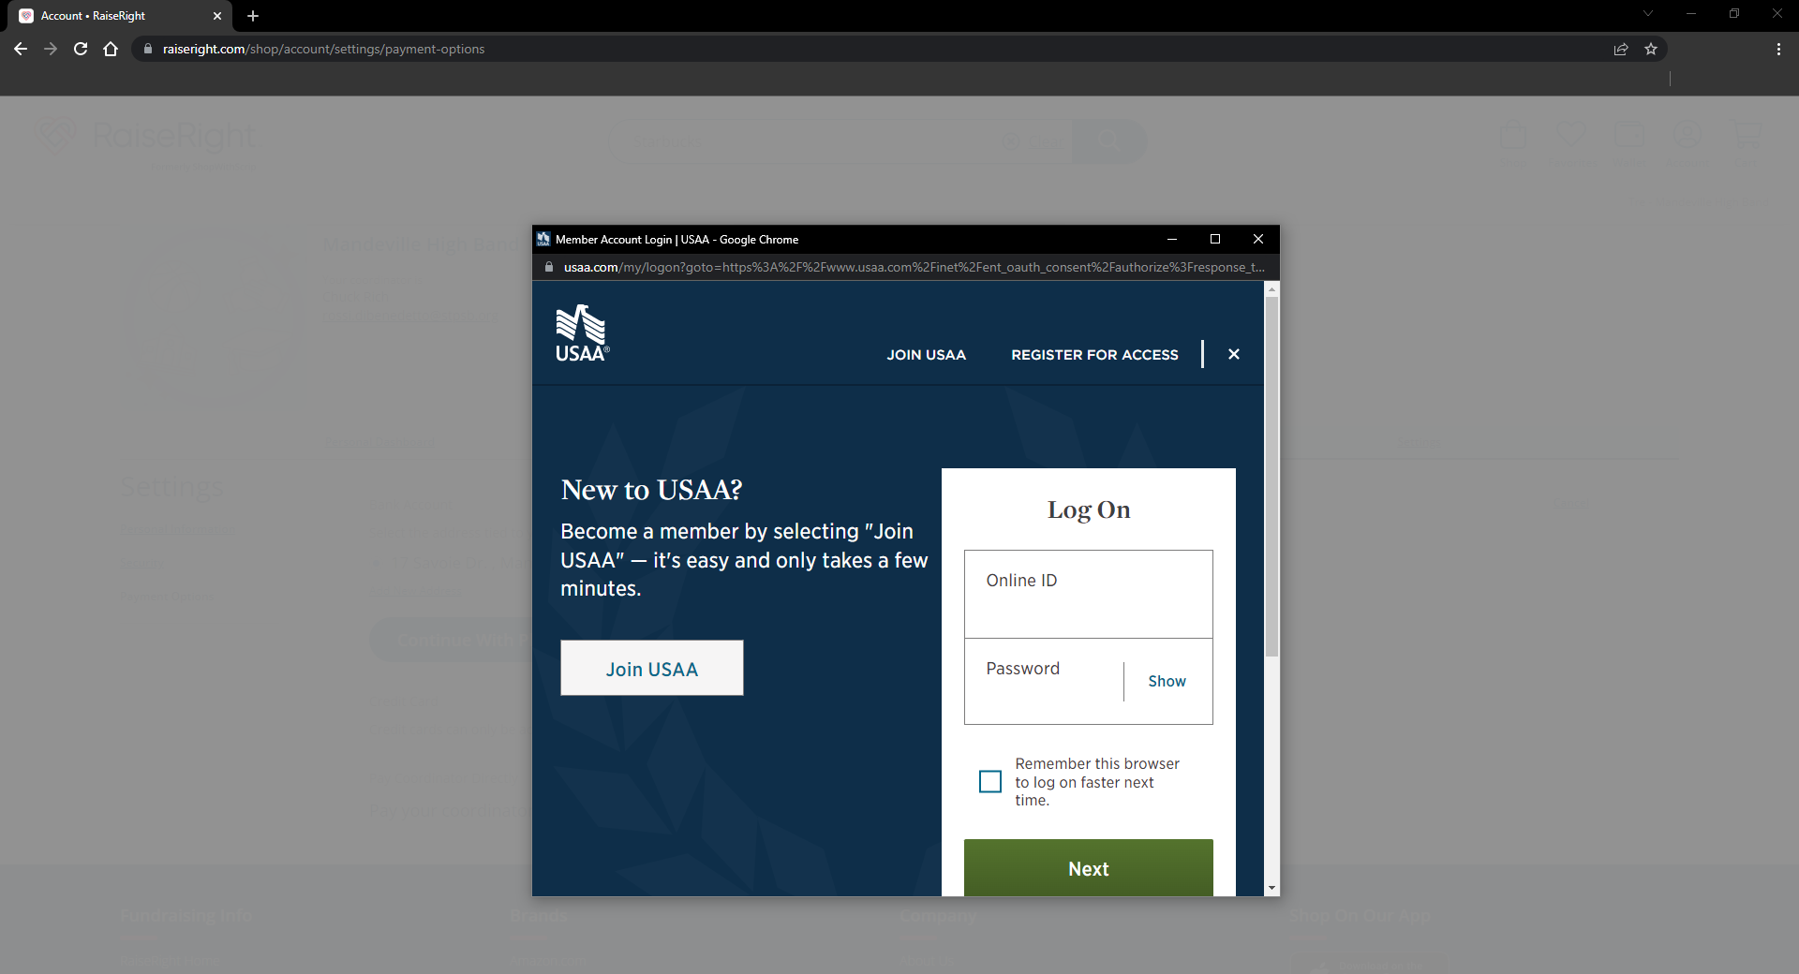
Jane.doe
*******

Slide 20
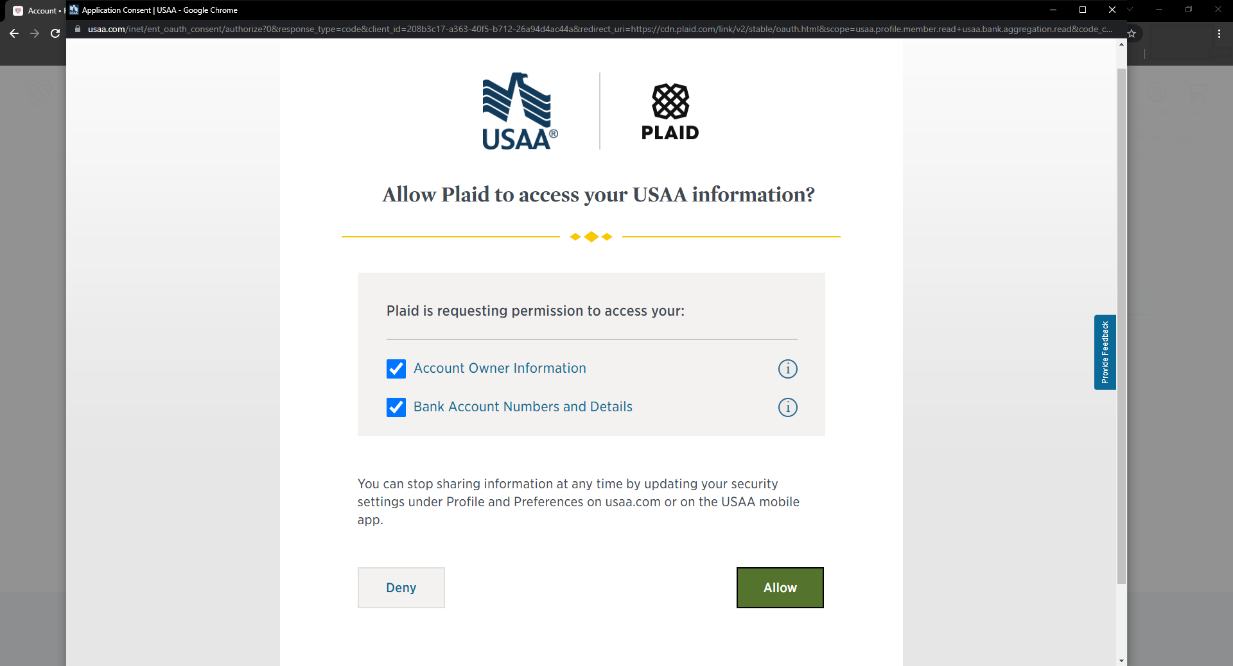

Slide 21
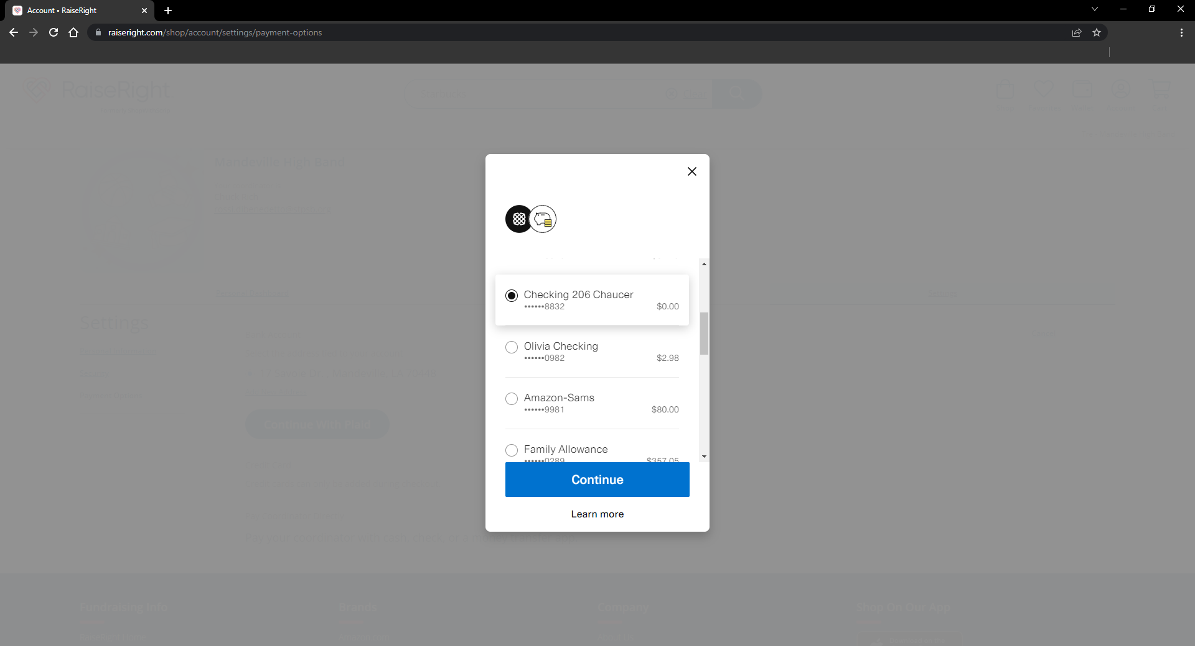
Checking
*****1234

Slide 22
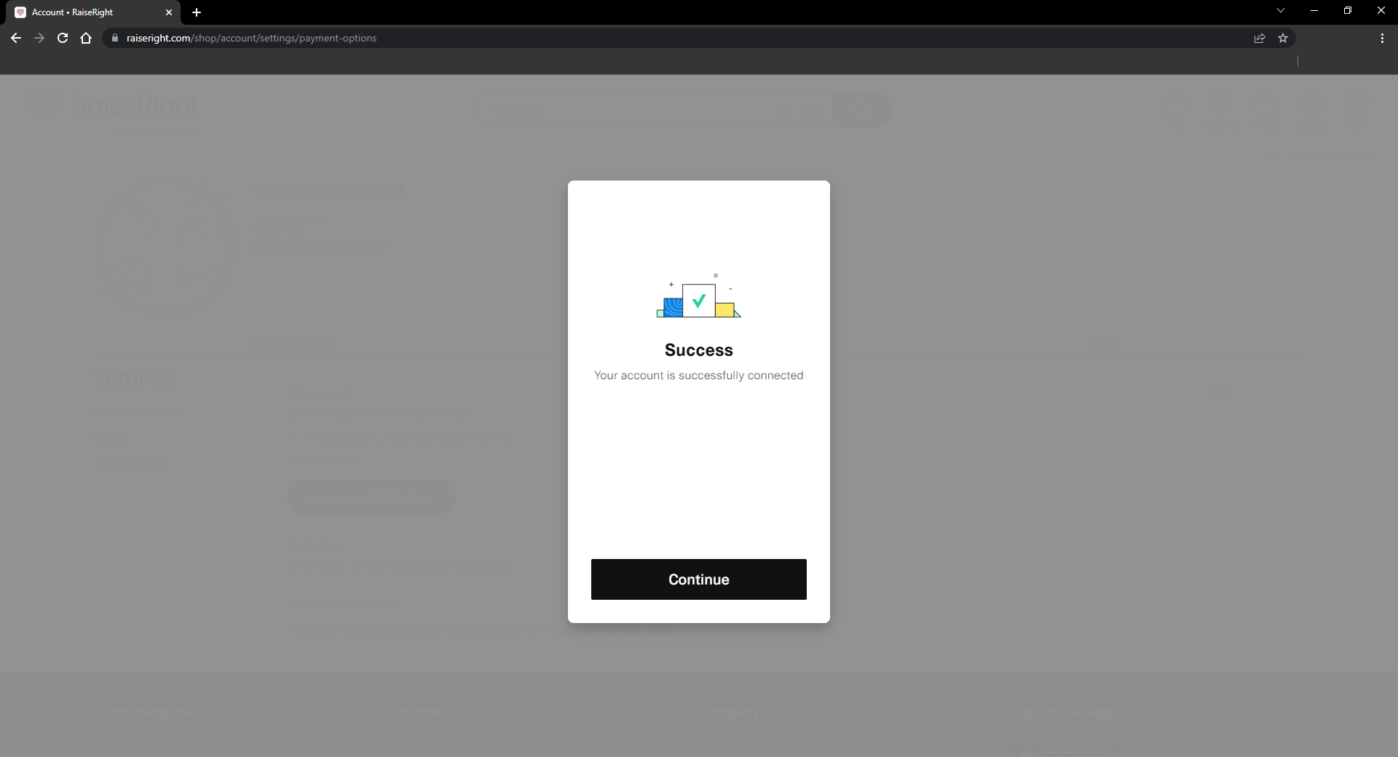

Slide 23
PURCHASING ELECTRONIC GIFT CARD

Slide 24
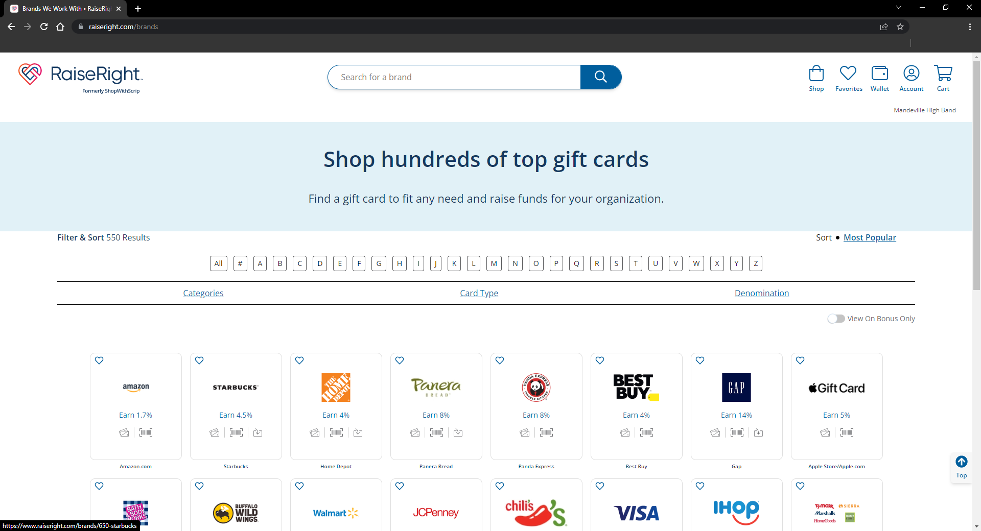
Starbucks

Slide 25
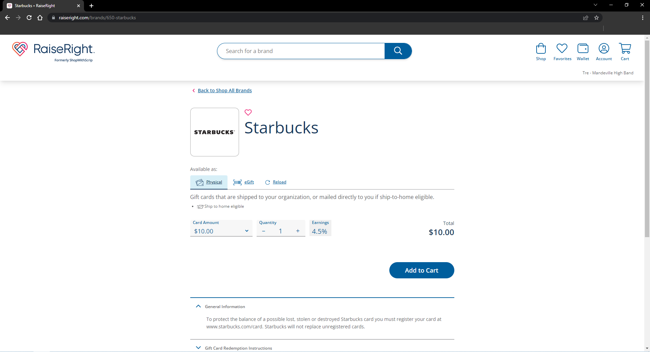
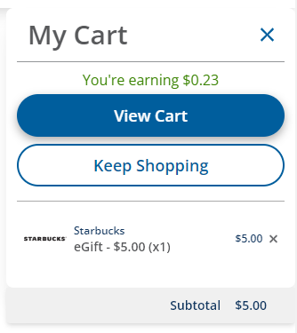

Slide 26
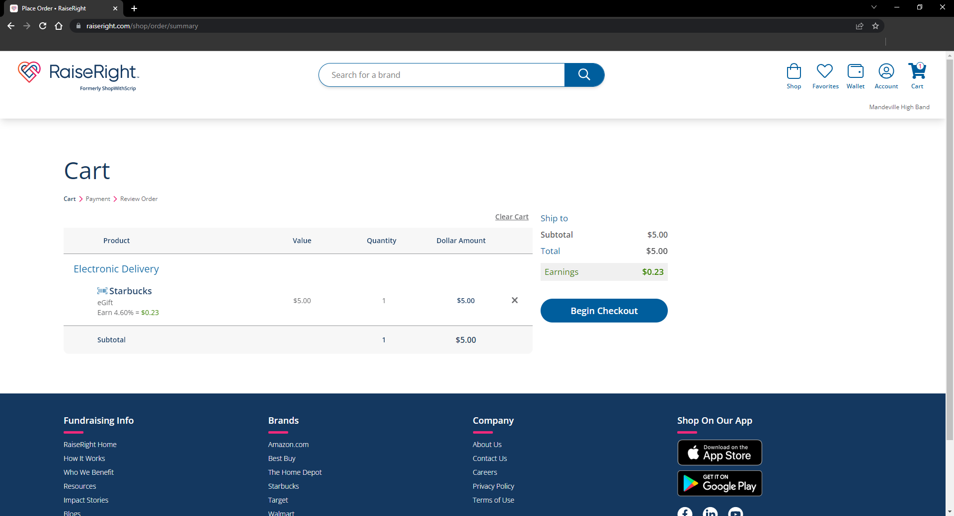

Slide 27
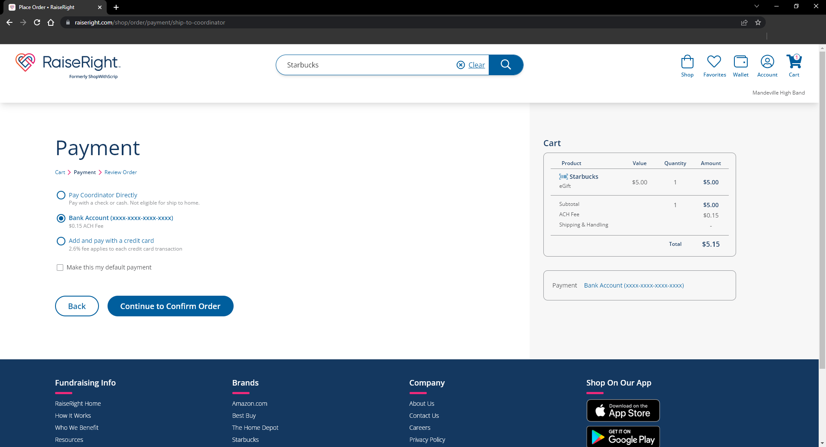

Slide 28
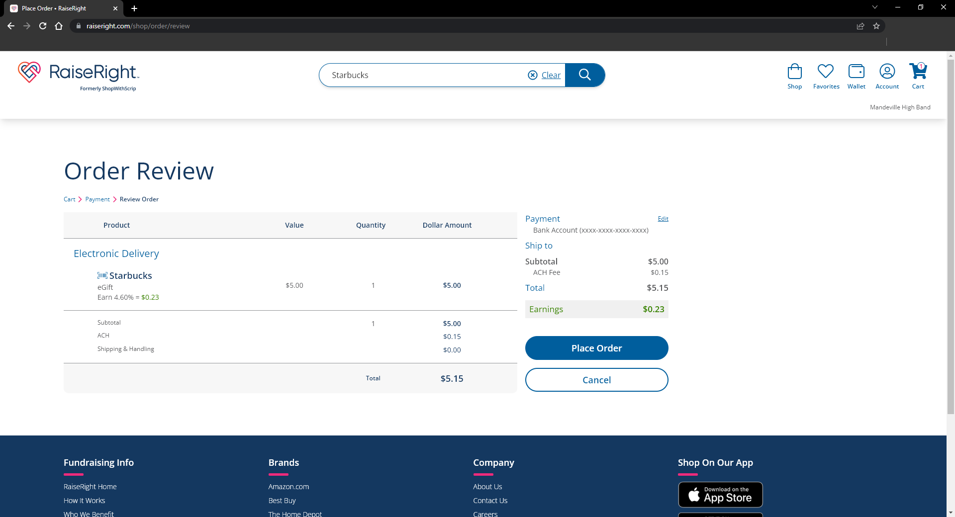

Slide 29
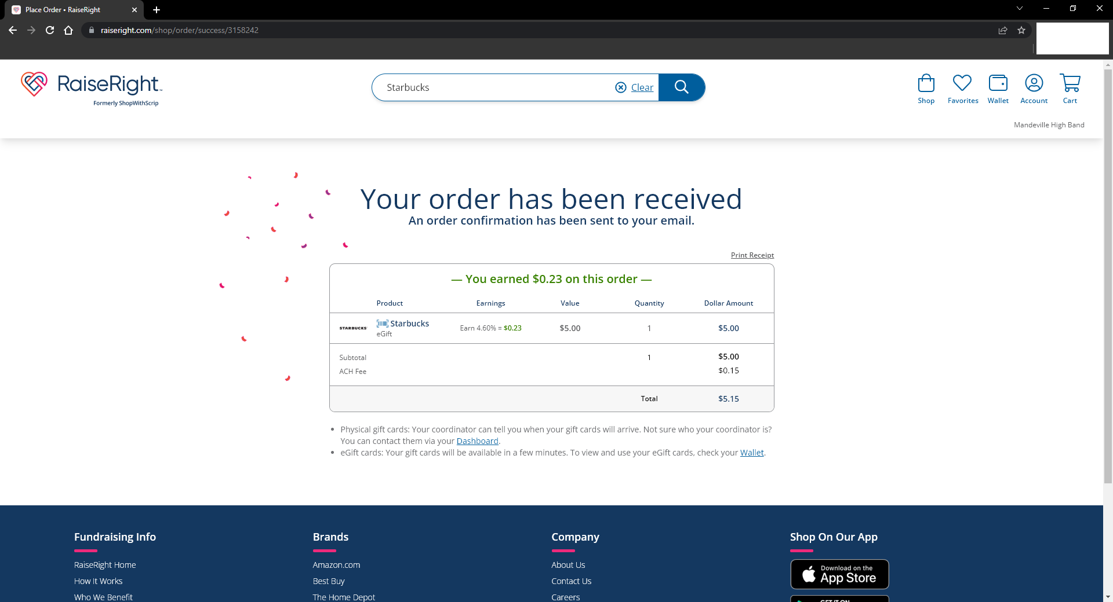

Slide 30
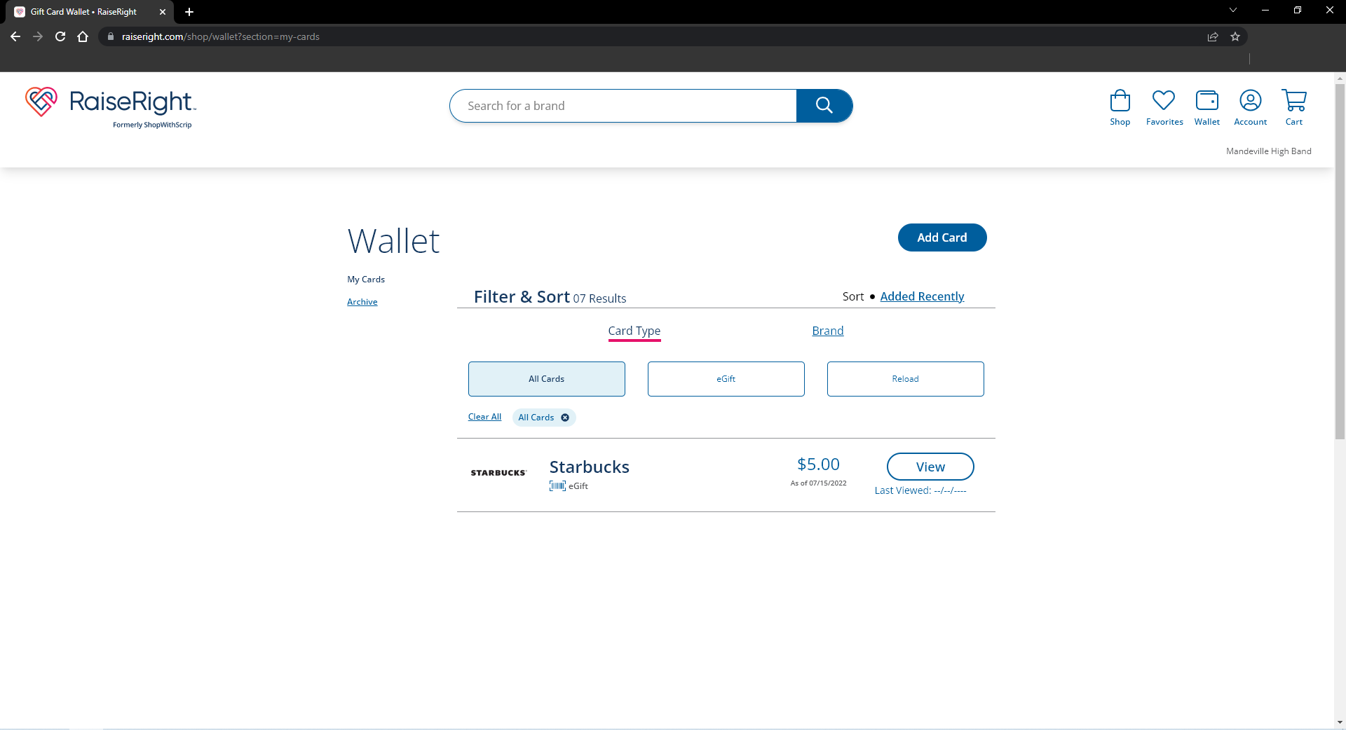

Slide 31
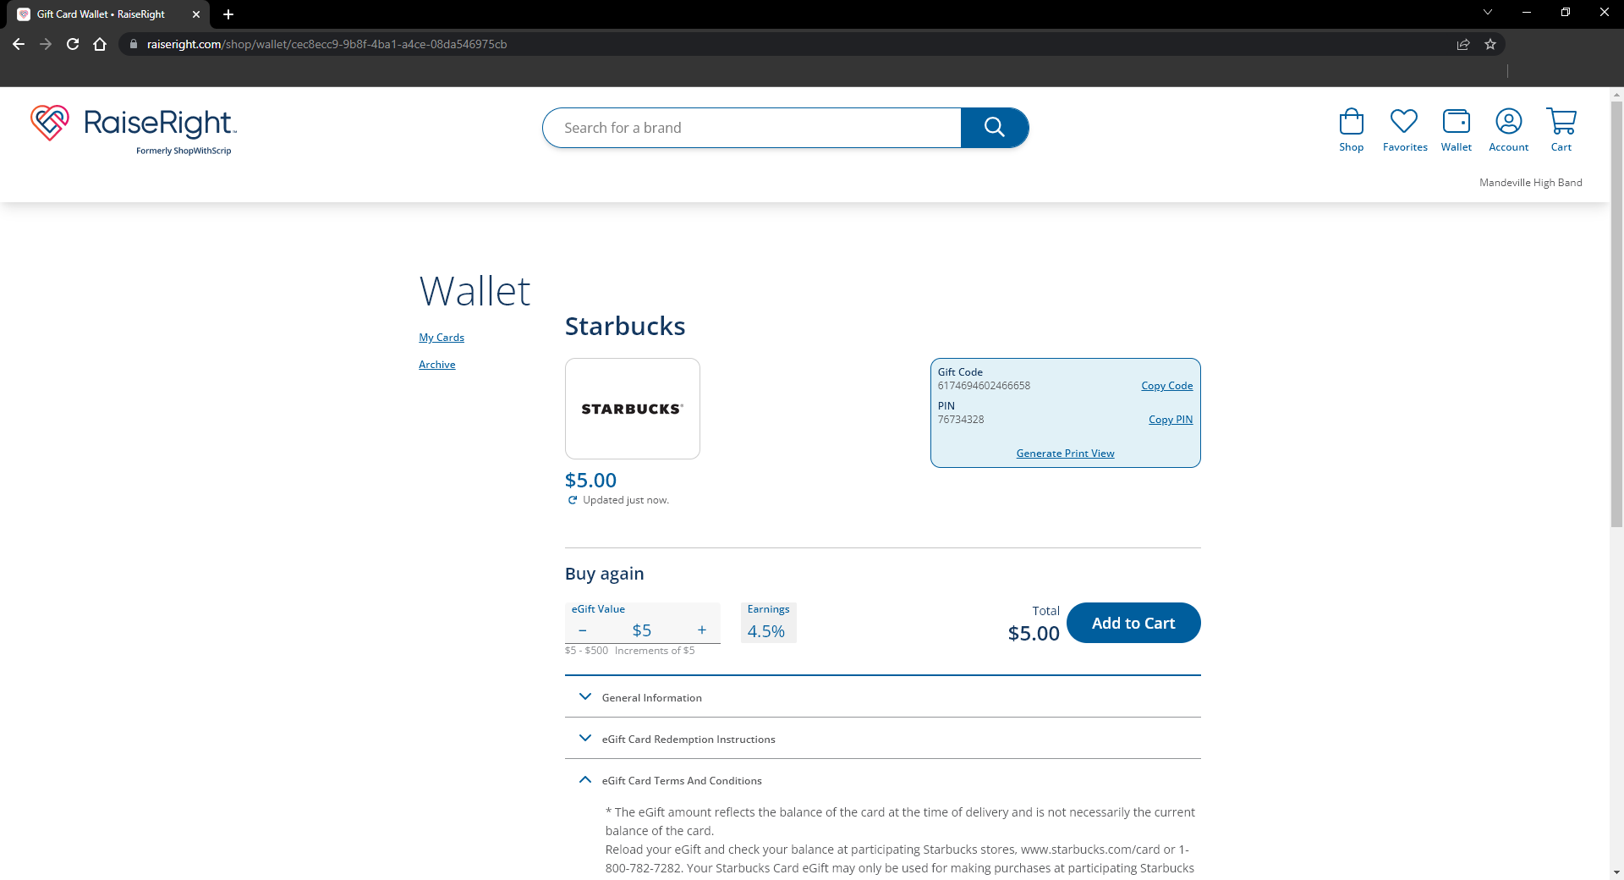

Slide 32
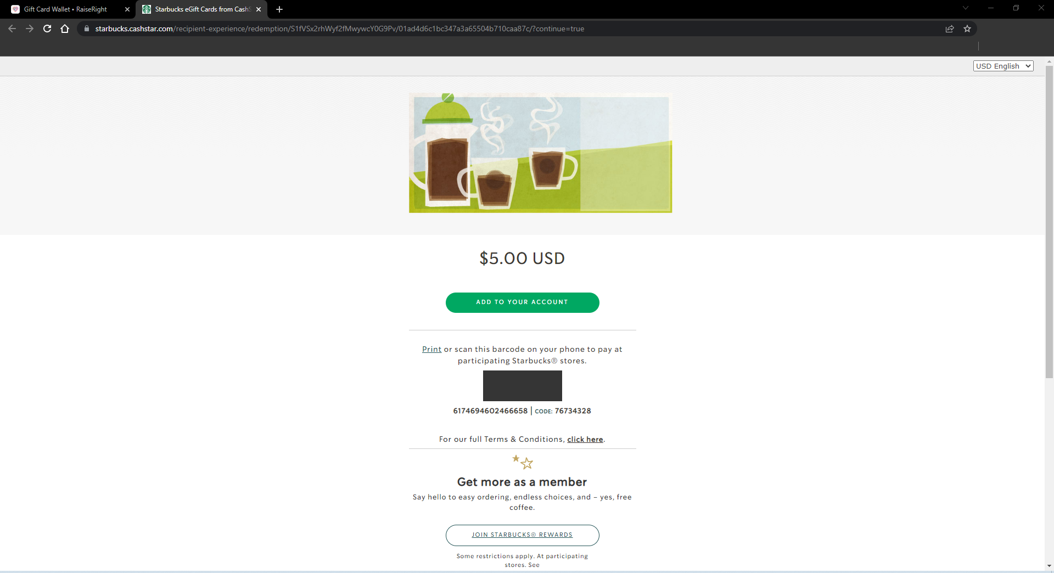
123456789900
123456789900

Slide 33
PURCHASING PHYSICAL GIFT CARD

Slide 34
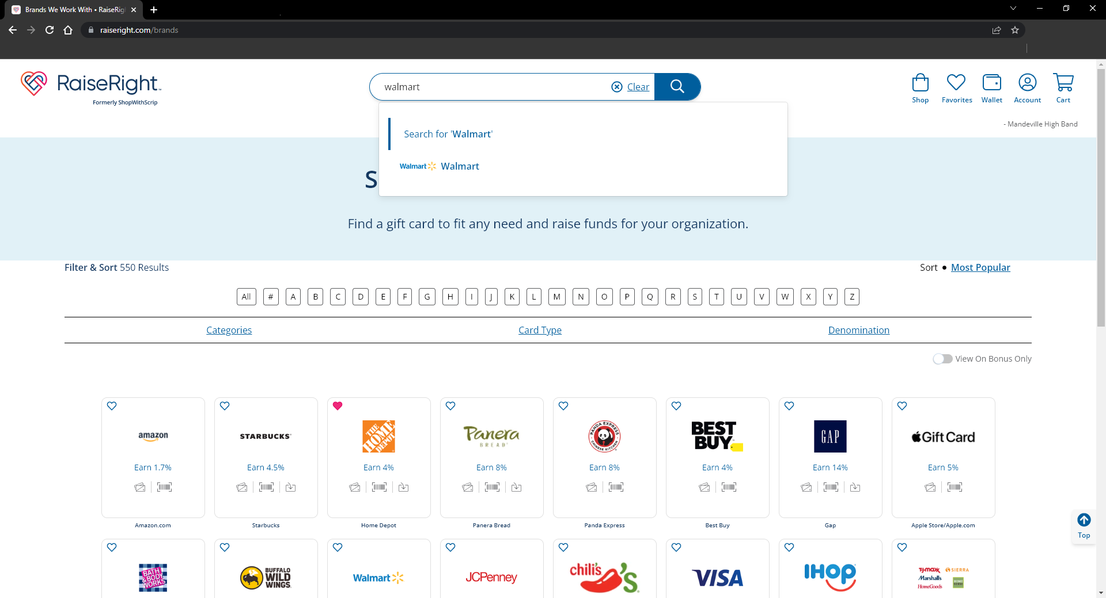

Slide 35
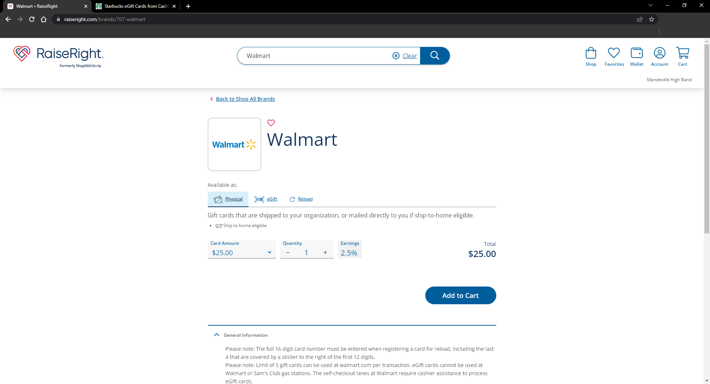
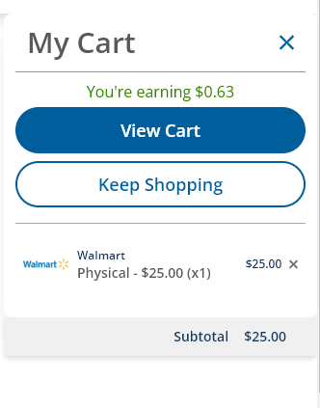

Slide 36
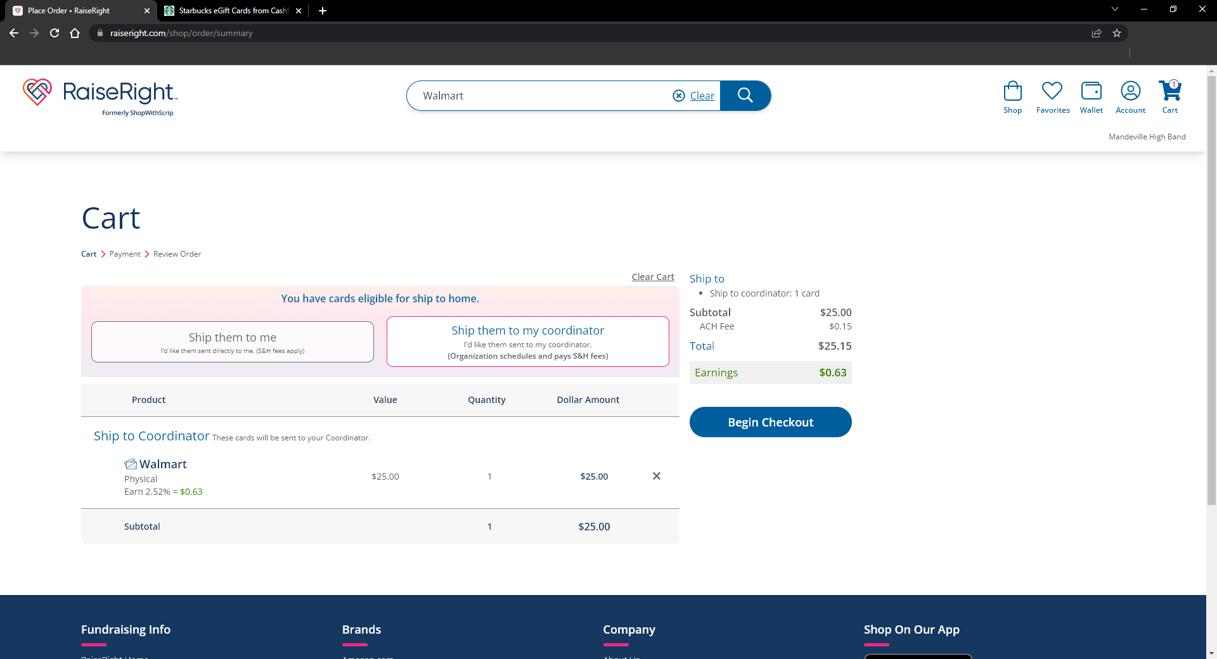

Slide 37
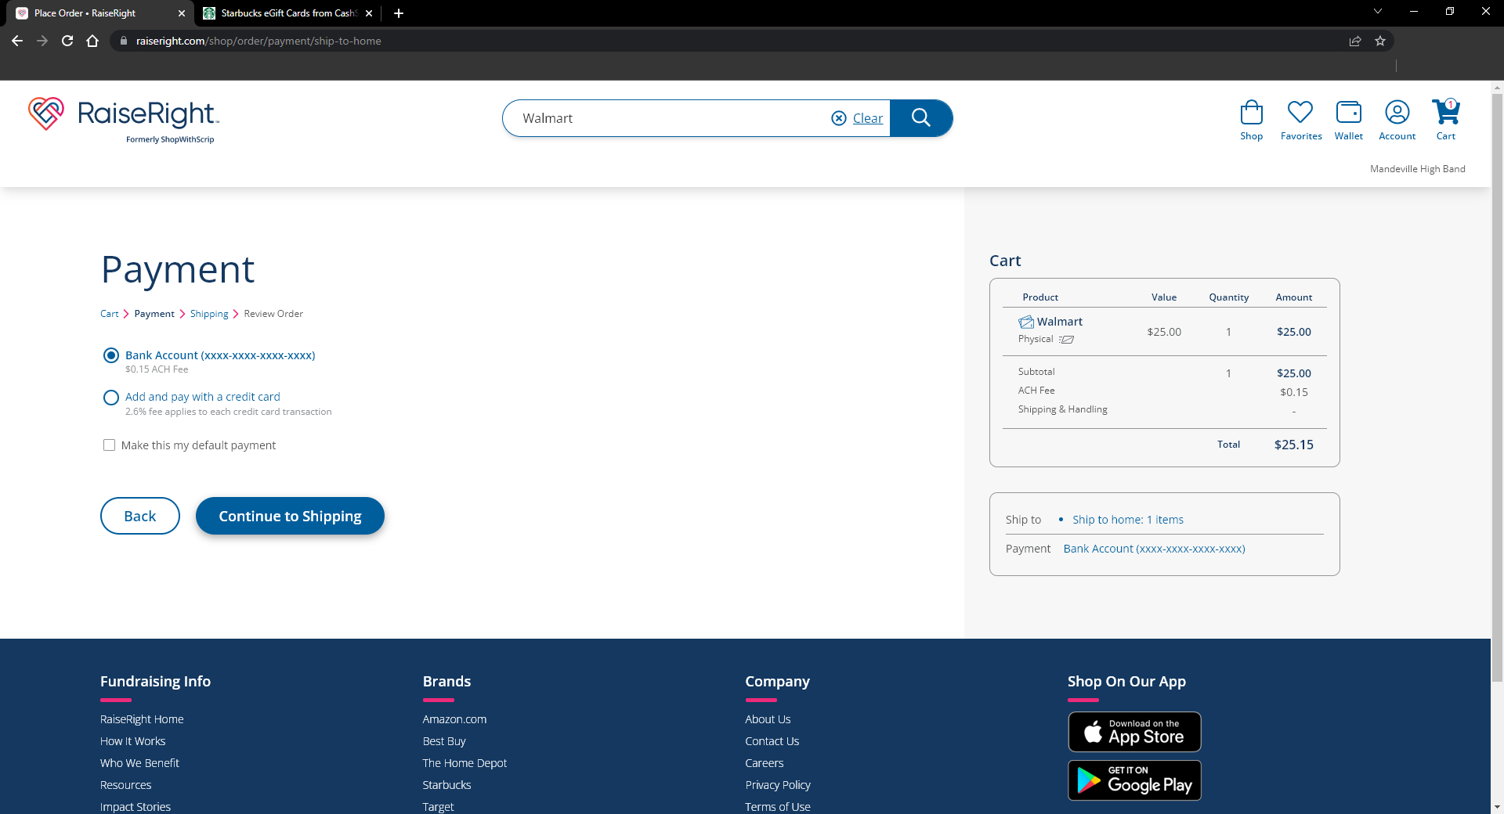

Slide 38
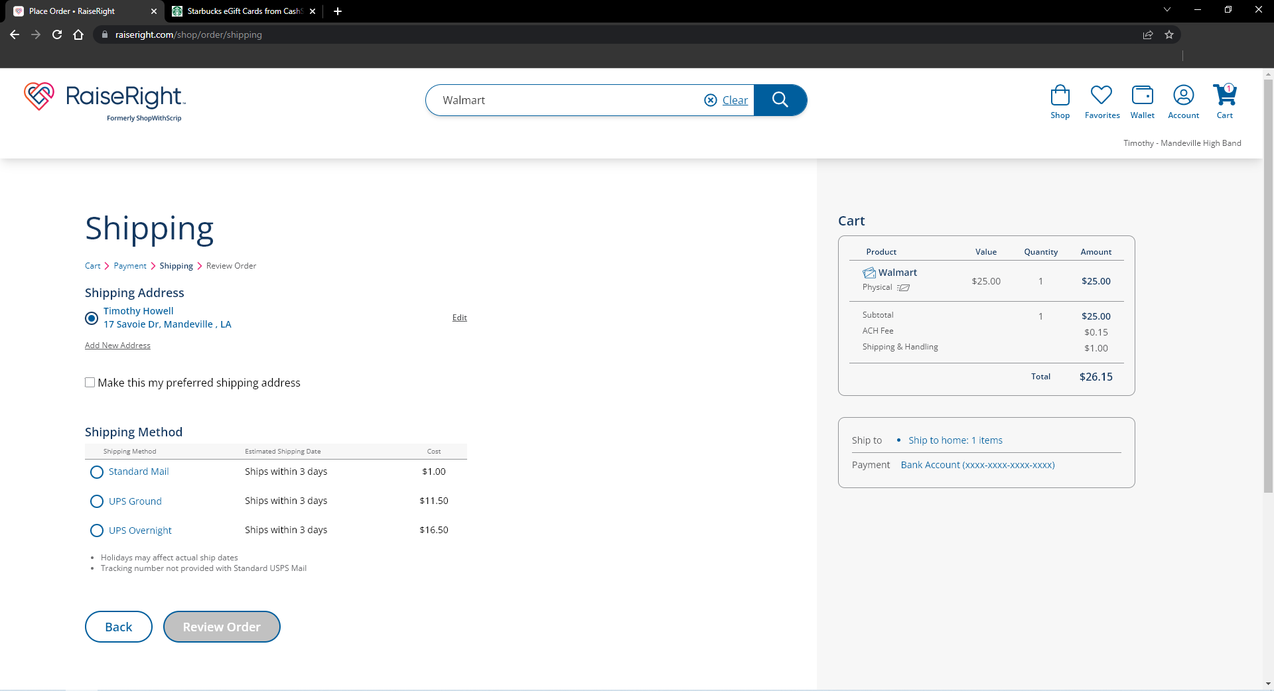
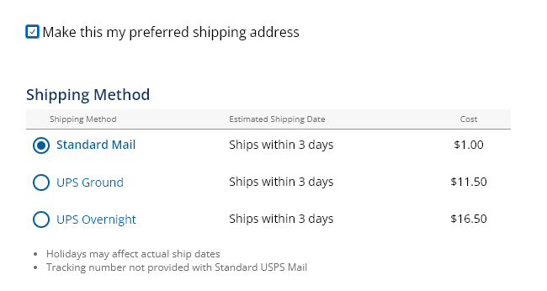
Jane Doe
55 Broadway, Mandeville La 70444

Slide 39
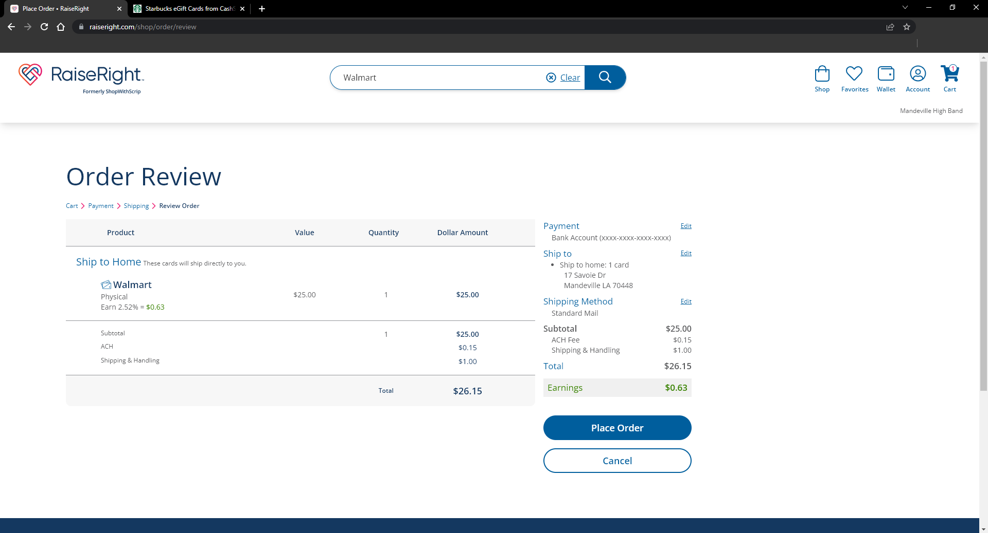

Slide 40
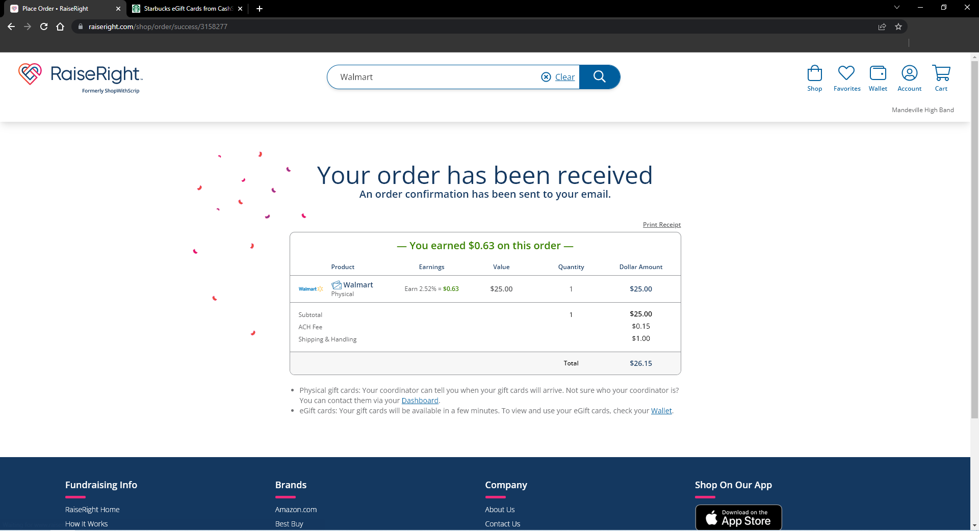

Slide 41
REVIEWING CREDIT SUMMARY & UPDATING ACCOUNT INFORMATION

Slide 42
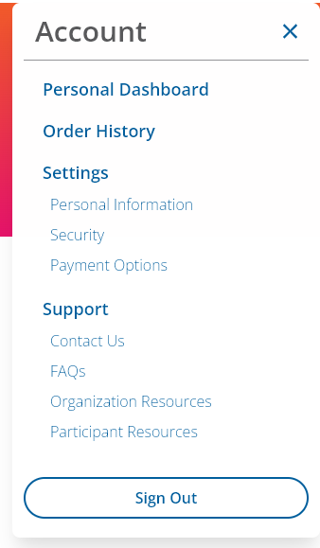
Jane

Slide 43
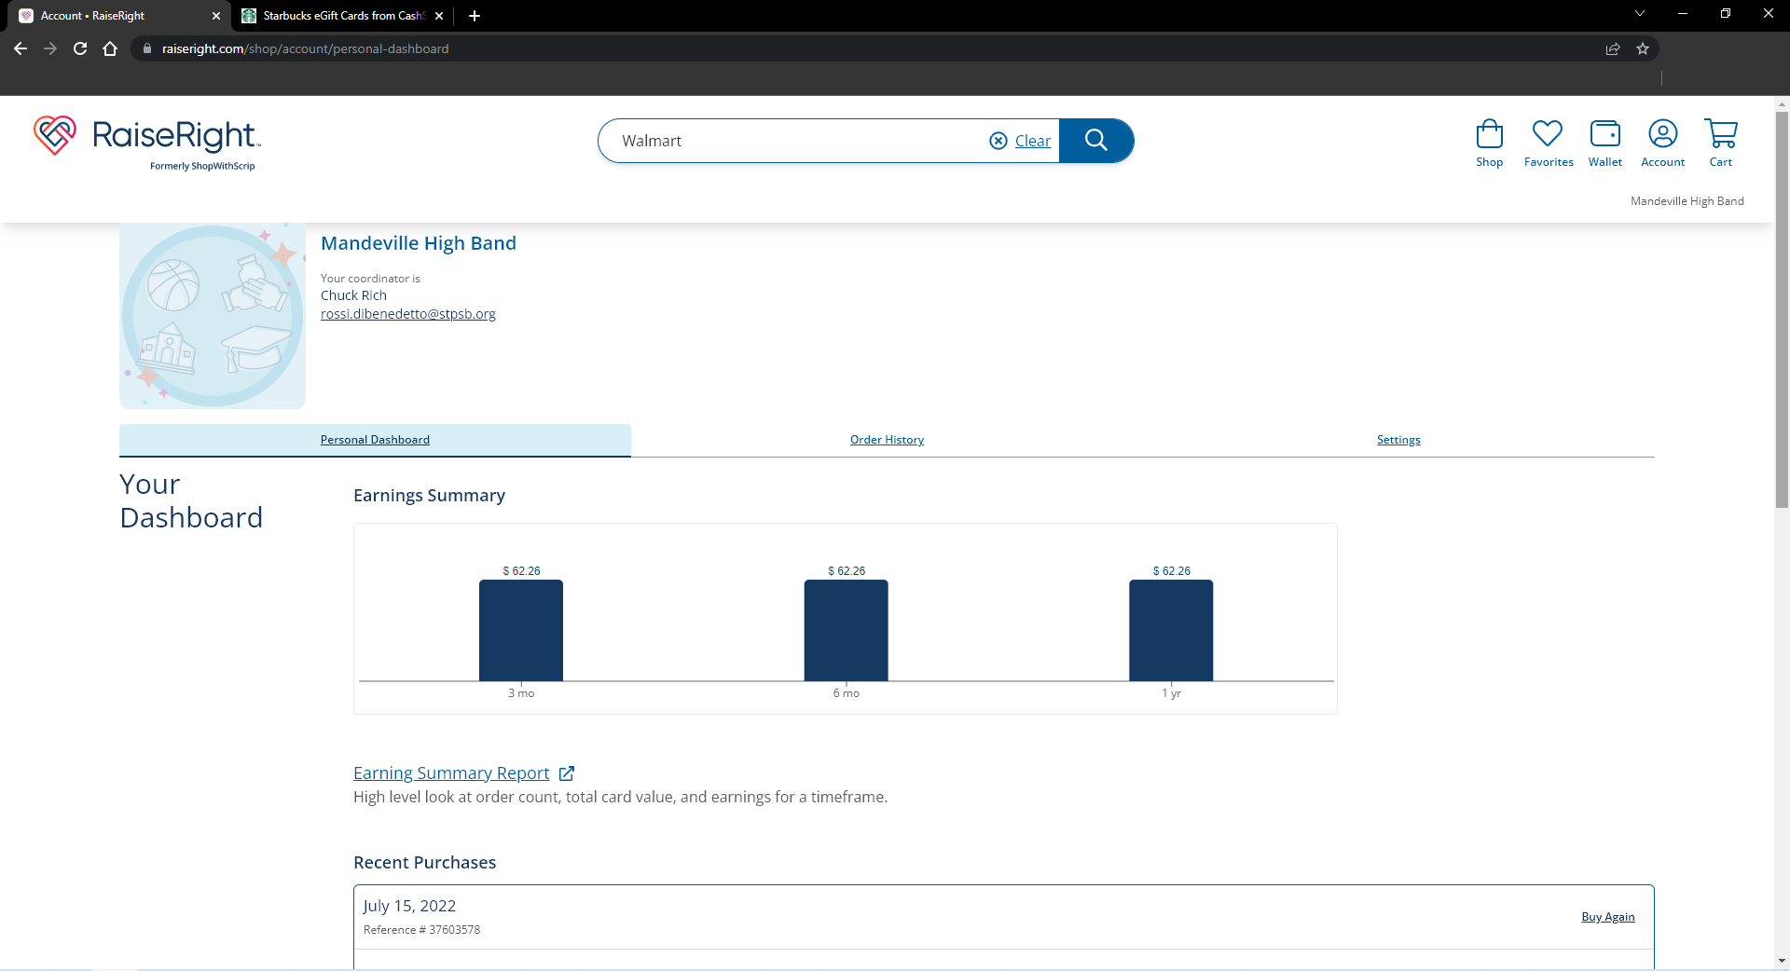

Slide 44
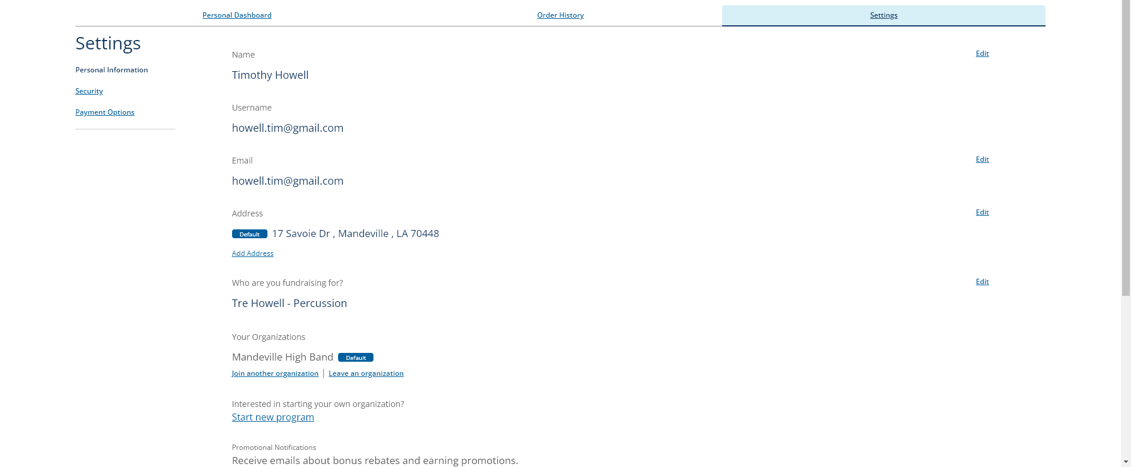
Jane Doe
Jane.Doe@gmail.com
Jane.Doe@gmail.com
55 Broadway St., Mandeville, La, 70444
Timmy Doe – MHS Instrument

