Slide 1
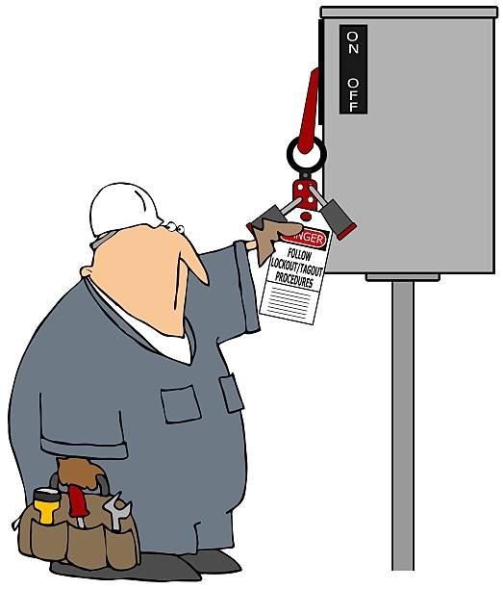
GROUP LOCK BOX USE DURING LOTO

Slide 2
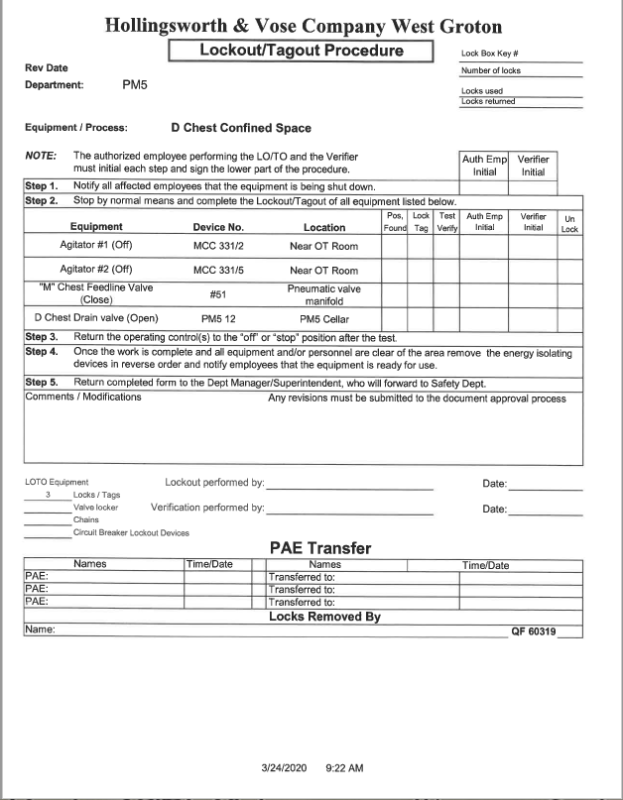
GROUP LOCK BOXES
A group box is used when an equipment lockout requires more than one lock (2 or more).
A written procedure for a LOTO is required when the equipment has 2 or more sources of hazardous energy.
NOTE:
  If a LOTO Procedure does not exist for a piece of equipment then one must be developed.

Slide 3
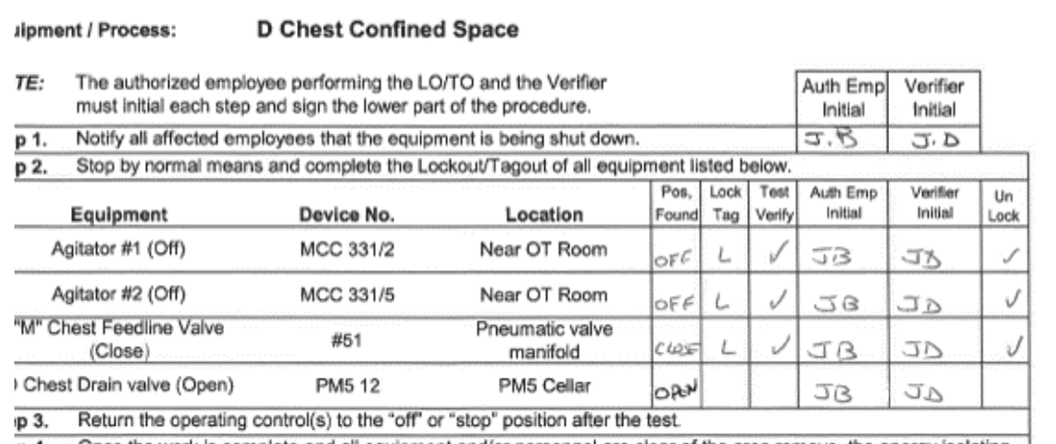
NOTIFICATION OF SHUT DOWN
Before performing the LOTO
  Notify all affected employees that the equipment is being shut down.
  Stop equipment by normal means.
  Note the position the equipment was found.
Example: Open or Closed. On or Off

Slide 4
Placing Locks on Power Sources
Control energy by placing a lock on each source of energy in the position indicated on the LOTO procedure.
Example:
Power is off.
Valve is closed.

Slide 5
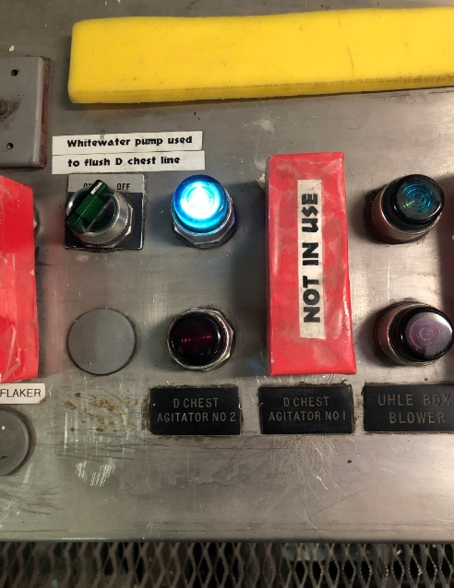
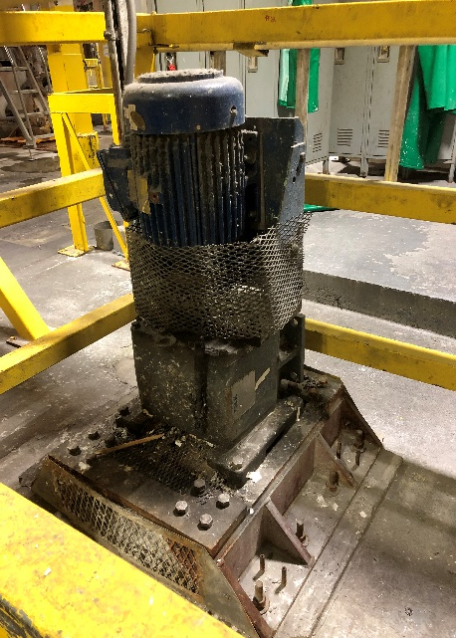

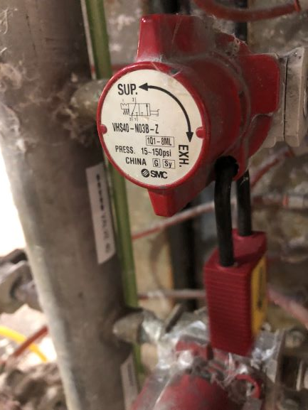
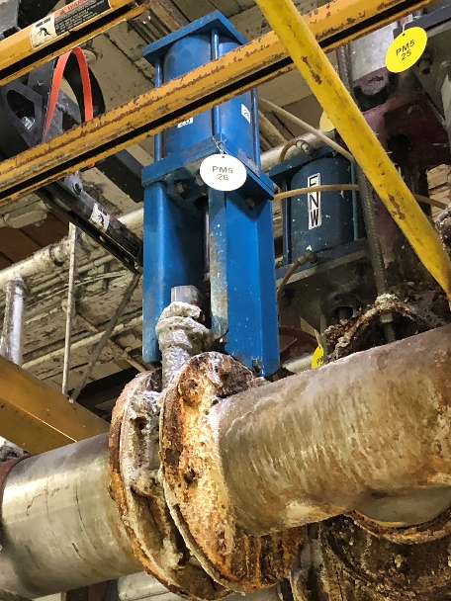
Verification of De-Energization
Press the start button on, go to the equipment location and verify that the equipment is not running. When confirmed, press the off button to insure that the equipment does not start immediately when re-energized.
When locking out a valve, make sure that the switch is in the closed position and go to the valve and verify that the valve is closed.

Slide 6
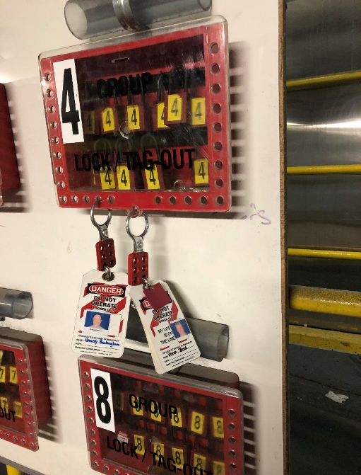
GROUP LOCK BOXES
The LOTO procedure will be initialed by the Primary Authorized Employee (PAE) and the verifying employee during all steps.
The PAE places all the locks on the Identified Sources of Energy.
  NOTE: The PAE shall always be identified by a “RED TAG” on their personal LOTO lock.
  The PAE is always the FIRST LOCK ON and the LAST ONE OFF.
The Verifier shadows the PAE assuring that the locks have been placed correctly.
All additional employees working on equipment that has been locked out using the group lock box method, must review the completed LOTO procedure before placing their personal lock on the lockbox.

Slide 7
LOTO EXTENDED DURATION
Where lockouts extend beyond one shift, one of the following systems may be employed to ensure continuity of the lockout.
  The PAE lock is permitted to remain in place for the duration of the work.
  The lock box may be transferred to a new PAE to maintain the continuity of the lock box.
    The new primary locker will review the integrity of the lock box and the items locked on the LOTO before becoming primary locker.
    The new PAE will apply their lock before the old PAE removes their lock ensuring lock box continuity and the chain of custody.

Slide 8
Removal of Locks
Each person will remove their personal lock when they stop working on the equipment or when their part of the job is complete.
The PAE will always be the last lock removed from the group lock box.
Notify the affected employees that the equipment is ready for use.
Upon completion of the job, the lock out/ tag out procedure must be forwarded to the department supervisor/superintendent. After review, it will be forwarded on to the safety department.

