Slide 1

Summary of 2019 Legislative Session
RSAI Priority Action

Slide 2
Themes of Rural School Needs
Resources: $$$$$$$$$$$$$$ state, local, federal, other (partnerships, sharing, grants, incentives)
Flexibility: One size does not fit all. Especially in local schools, staff where many hats. Strict expenditure and legal requirements do not always work with very small economies of scale.
Student needs: Changing demographics have significantly impacted rural schools. Poverty, Mental Health, Immigration and Aging resident population, bigger farms with fewer kids, transportation and other barriers to participation, population sparsity

Slide 3
Recent Accomplishments Benefiting Rural Districts
Before 2018:
  Management fund authority to pay for retirements over age 65 and costs of arbitration
  PPEL flexibility to pay for repairs over $1,500
  DoP Flexibility
  Home Rule Statute
  Categorical Fund Flexibility
In 2018 Session
  Even more DoP Flexibility
  Even more Categorical Fund Flexibility
  Staff Flexibility – CTE options for hard-to-staff content and local offerings of on-line learning
  Progress on Transportation (grants) and Formula Equality
  Extension of Operational Sharing Incentives
In 2019 Session
  Transportation in the Formula
  Formula Equity
  Extension of WGS/reorganization Incentives
  State Penny Extension
  Teacher shortage flexibility: Praxis waiver, concurrent enrollment STEM offer and teach, online learning flexibility

Slide 4
Legislation in the 2019 Session
2,067 pieces of legislation introduced, some actually considered
169 agreed to by the House and Senate in the same form and sent to the Governor
Of those 169, 78 were finished the last week of Session
Governor vetoed sparingly, nothing that impacted schools.

Slide 5

Priorities Status on Page 4

Slide 6

State Penny Extension

Slide 7
Action Comments
HF 546 was approved by 95 House members and 48 Senators sending it to the Governor.
Extends through Jan. 2051.
Increased contribution to property tax equity and relief over time to 30% of the total revenue.
Specifically for RSAI, expanded the criteria for certificate of need for smaller schools to include impact on student learning and did not increase the enrollment category for CON requirements.
Added safety and security equipment as an allowable expense. No other action on funding for security staff.
Increase in PTR will make it harder to repeal in 2051.
See specifics in the Legislative Digest.

Slide 8
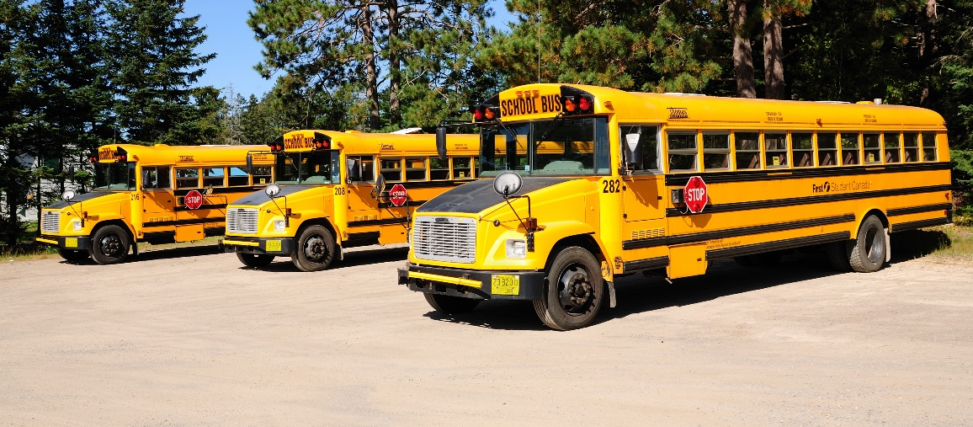
Transportation Equity

Slide 9
Action Comments
HF 307 was enacted. $19 M in transportation in the formula for FY 2020.
Also, state Board of Education administrative rules are proposed to extend ride times by 15 minutes with local process following a public hearing.
Formula supplement instead of a grant – much more secure.
Reimbursement is based on prior year’s expenditures (and other factors in a formula)
Brings all districts down to $381 per pupil enrolled (state average was $330 per pupil enrolled in 2017-18)
DE is required to review usage and the formula.
See specifics in the Legislative Digest.

Slide 10
Formula Equity

Slide 11
Action Comments
HF 307 was enacted. $2.9 M in the formula for FY 2020.
Closes the gap by another $5 per pupil.
$1.7 million reduces property taxes in those districts with higher DCPP
$1.2 million increases DCPP by $5, closing the gap to $165 from highest to lowest DCPP
At this rate, it will take 33 more years to eliminate the gap.
See specifics in the Legislative Digest.

Slide 12

Teacher Shortage and Quality Instruction
Rural school districts require maximum flexibility to provide great instruction to all Iowa students. There was some progress in 2019 but rural districts will still struggle with enough applicants to fill needed positions, in some cases none at all, and in keeping great people when other districts pay more. Loan forgiveness and grow-your-own strategies will have to be on the list. Much of this goes back to adequate funding, too.

Slide 13
Action Comments
SF 603 Concurrent Enrollment for 1 math or 1 science course to meet offer and teach.
SF 394 allows several online learning options to meet offer and teach.
SF 159 Praxis requires DE to set score and creates conditional license for a new teacher with a job offer.
Some flexibility will certainly help all districts, including rural schools, attract and retain great teachers.
No where near being done: still need some work through resources for loan forgiveness, incentives for teachers to work in shortage area schools, CTE strand to recruit students into teaching, and additional offer and teach flexibilities.

Slide 14
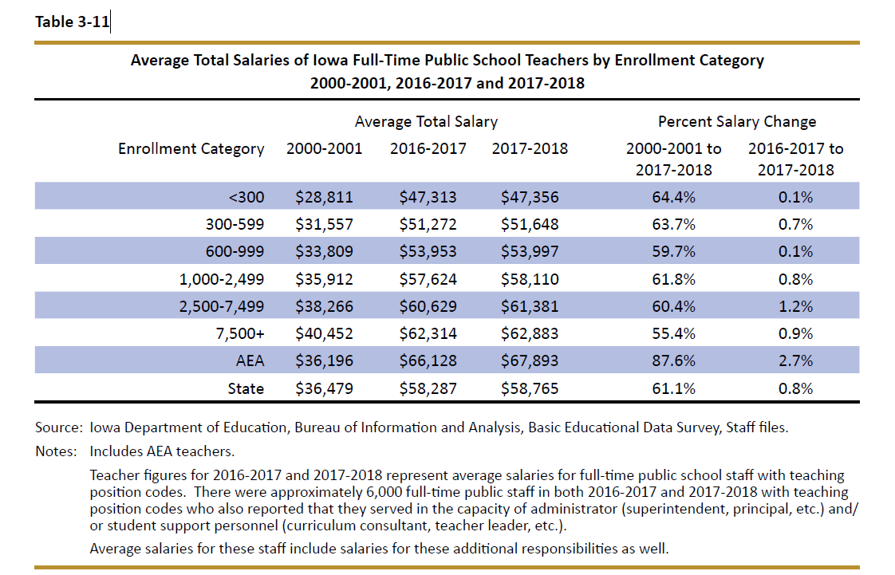
DE’s Annual Condition of Education Report shows average salary by school size (which is a good but not perfect predictor of rural districts), showing a growing difference in pay between the averages of the smallest and largest category of school size, now at $15,527.

Slide 15
Geography Impacts Rural Schools and Students
Distance from Services – transportation takes time. Making up minutes for snow days even becomes difficult if there’s two+ hours on either side of the day. Transportation equity funding is HUGE, but there are still barriers.
Fewer Collaboration Partners – whether that’s private sector businesses for internships in CTE programs or Mental Health services providers for students
Young teachers are not willing to locate in a community with long commutes to amenities, so something has to make up for the lack of access to entertainment, housing, and other services.

Slide 16
Funding / SSA / Formula Changes

Slide 17
Action Comments
HF 306 set 2.06% increase in SSA, Was signed on Feb. 19, 2019, pretty close to Feb. 14, 2019, 30‐day deadline.
Third highest increase in a decade.
Exceeds the REC revenue estimate for FY 2020.
Completed on time based on new deadlines (within 30 days of the Governor’s budget for the upcoming school year, so essentially four months before the school fiscal year begins.)
Other funds (transportation and formula equity, state penny extension) must be considered in total package.
But SSA is the bread and butter of school district budgets. Some data:

Slide 20
State Revenue Policy
School funding adequacy is a function of sufficient state revenues and mix of revenue sources for schools.
Continued property tax relief focus confuses the issue – state investment increases to make up for a reduced property tax dollar but schools don’t receive those funds as additional revenue.
Check out the Legislative Digest for additional information on tax cuts, policy decisions limiting state revenue, and increased tax credit thresholds of private school scholarships (STOs)

Slide 21
Student Mental Health

Slide 22
Action Comments
HF 690 Children’s Mental Health System set up a system but did not provide funds.
HF 758 Education Appropriations included $2.1 million to AEAs for MH training of educators and a resource clearinghouse.
SF 376 MH content in High School health curriculum, did not get approved in the Senate.
SSB 1240 in Senate Human Resources Committee: telehealth screening and treatment in school setting.
HF 690 is a good structural start, but may not overcome the geography limitation of service location. Just like attracting teachers, there are MH services deserts without services.
AEA training is a good start, but it’s not a one-time thing. Must be ongoing.
Both SF 376 and SSB 1240 are in committee and alive for further action as the 2020 Session begins.

Slide 23
Reorganization and Whole Grade Sharing Incentives Extension

Slide 24
Action Comments
HF 596 extends WGS and Reorganization incentives for five years
For reorganizations effective on or before July 1, 2024.
5-year extension was the goal
As the leadership in the legislature become more urban, this will not become easier down the road.
Both the operational sharing and reorg/WGS incentives are critical to rural schools, so keep legislators apprised of the benefits along the way.

Slide 25
Funding/Equity for At-risk Students

Slide 26
Student Inequities and Needs
Funding Equity for At-risk Students: Resources for serving at-risk students should be based on need, such as the percentage of students eligible for Free and Reduced Price Lunch, in addition to enrollment of the district.
The current disparity in dropout prevention capacity ceiling, with some districts held to 2.5% and others allowed to access up to 5% of regular program district cost is unfair, arbitrary, and based on old history no longer relevant to supporting student needs.
Poverty is now a significant factor in many rural schools.

Slide 27
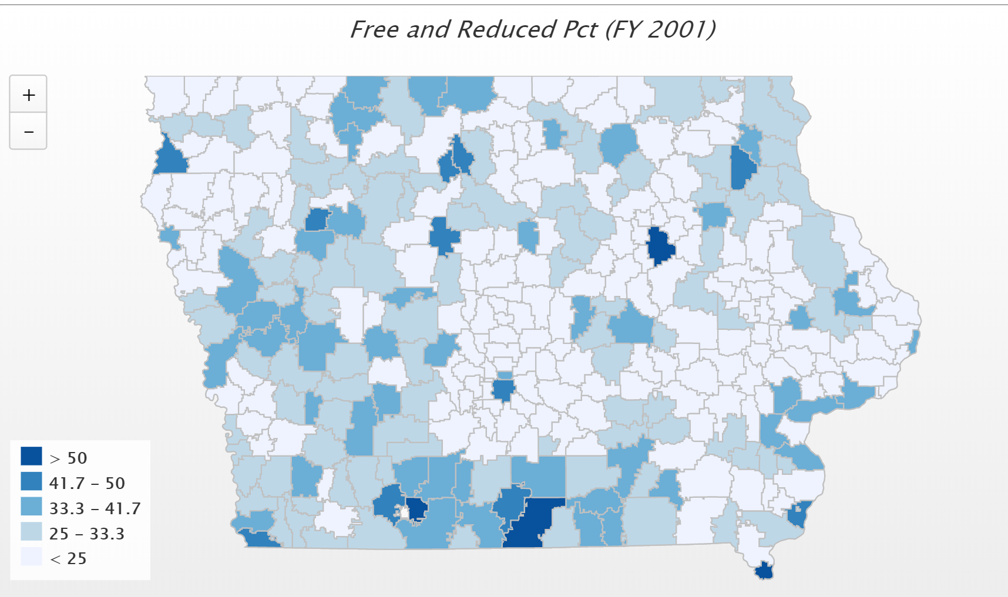
In 2001, only 4 districts had more than 50% of students eligible for FRPL. IFYI – Diagonal was the state high at 60.2%)

Slide 28
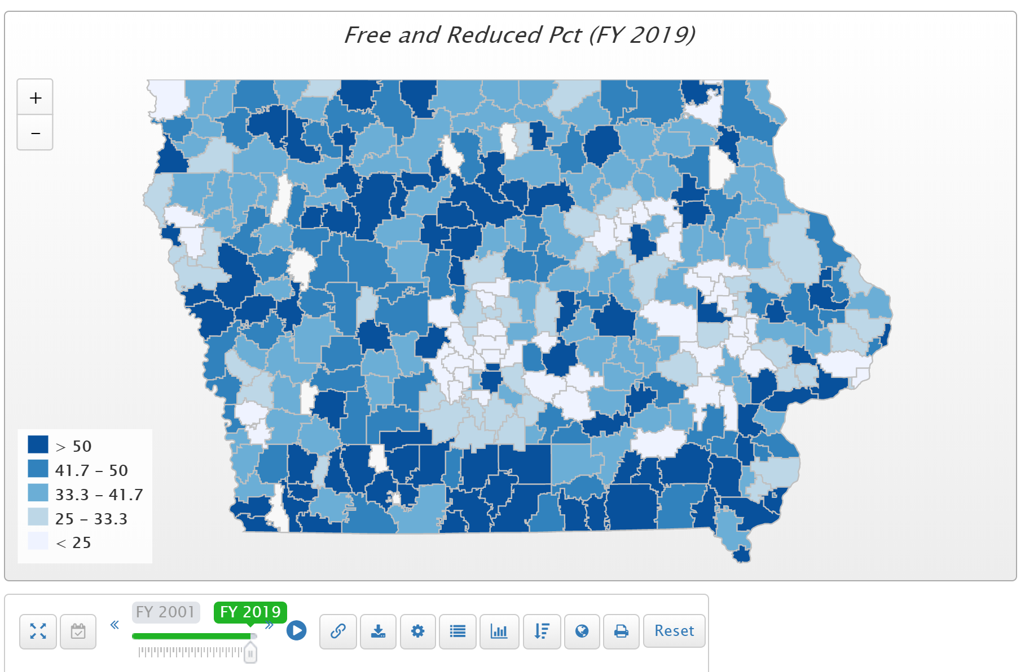
Children from families with incomes at or below 130% of the poverty level are eligible for free lunch those 130-185% eligible for reduced lunch. Districts in the largest and smallest enrollment categories had the highest percentage of students eligible for free or reduced price lunch (Table 1-7). (FYI – Postville is at 100% in FY 2019)

Slide 29
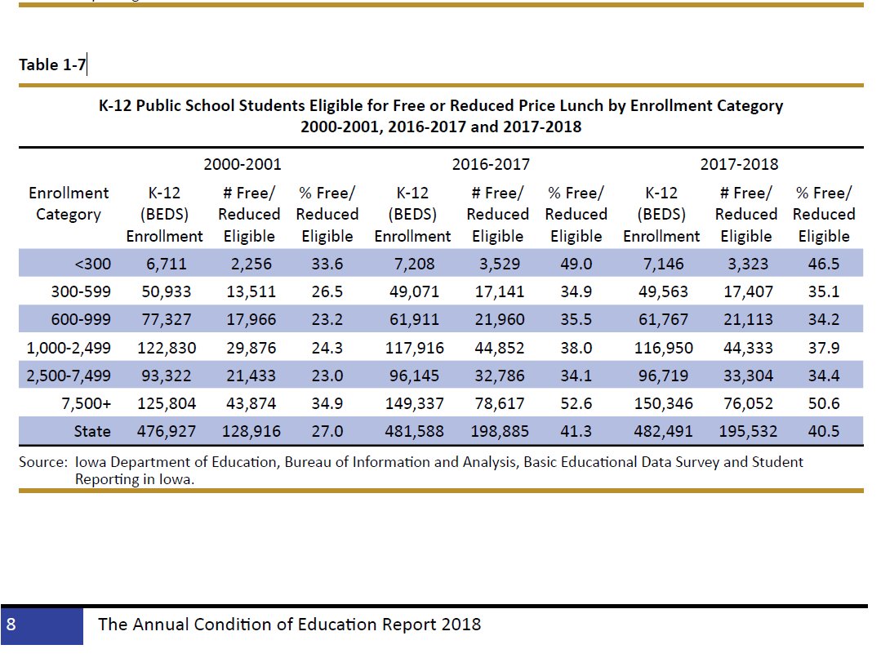

Slide 30
Dropout Prevention Flexibility
Has grown increasingly more flexible due to legislative action in the last several years.
Nothing legislatively this year
DE administrative rules did remove transportation as a prohibited expenditures of DoP / At-risk funds at RSAI request.

Slide 31
Quality Preschool at 1.0 Weighting

Slide 32
Action Comments
none
HF 758 Education Appropriations increased shared visions grants, but no action was taken to increase PK weighting.
HF 783 would have allowed districts to serve and count young 5‐year‐olds but did not advance beyond the House Appropriations Committee. RSAI registered undecided. 5-years olds currently count for 1.0 weighing, even if in transitional K, so this recommended policy is a two-edged sword.

Slide 33
School Choice Defense
Important to Rural schools since it will consume funds needed for public education
Bills for ESA’s/vouchers in 2018 and 2019 Sessions did not advance through a chamber, but did get through Senate Education Committee in 2019
Tax bills did expand STOs in 2018 and again 2019
Costly – tight budget applies to this issue too

Slide 34
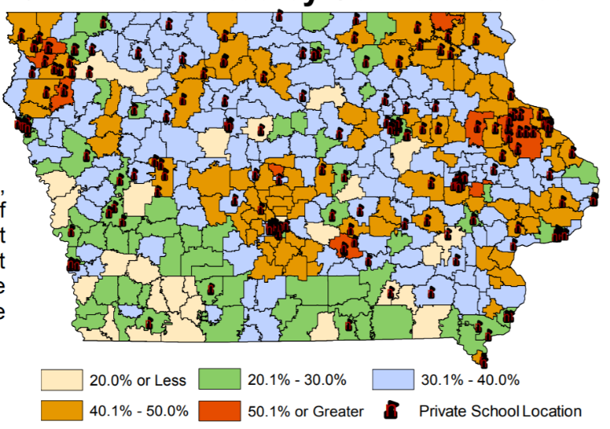
Map from Legislative tax Expenditure Committee DOR Report (in RSAI School Choice Position Paper)
Note location of existing private schools related to legislative seats

Slide 35
RSAI Leadership Group and Terms
Robert Olson, Clarion-Goldfield/Dows, Superintendent, robert.olson@rsaia.org (Sept. 2020)
Laurie Noll, Fairfield, Superintendent, laurie.noll@fairfieldsfuture.org (Sept. 2020)
Dennis McClain*, Clay Central Everly through June 30, Superintendent, moves to Adair-Casey and Guthrie Center effective July 1) (Sept. 2019)
Duane Willhite*, North Fayette Valley, Superintendent, dwillhite@nfv.k12.ia.us (Sept. 2020)
Nick Trenkamp, Central, Superintendent, nicholas.trenkamp@rsaia.org (Sept. 2020)
Paul Croghan, Essex/East Mills Superintendent through June 30, 2019, and Nodaway Valley & CAM beginning July 1, 2019, Superintendent, paul.croghan@rsaia.org (Sept. 2019)
Dan Smith*, Van Buren County, Board Member, dan.smith@rsaia.org (Sept. 2021)

Slide 36
Thanks to the RSAI Legislative Group (one-year term) who supported
RSAI’s policy development and advocacy during the 2019 Session!
includes at large members from Leadership Group plus:
SW – Tim Mitchell / Riverside Superintendent
NE – Darrin Strike /West Fork Superintendent
SE – Sandy Dockendorff / Danville Board Member
NW – Dan Frazier / Belmond-Klemme Superintendent

Slide 37
RSAI 2020 Legislative Priorities
The Legislative Group reviews and refines the Regional meeting activity, then submits to the RSAI members at the annual meeting.
The members at the annual meeting discuss, amend and approve the slate of priorities at the annual meeting.
The RSAI 2019 Annual Meeting is scheduled for Oct. 16, 2019, at the FFA Enrichment Center, DMACC Ankeny Campus, 4:30 p.m., including a working dinner. No cost to attend, but RSVP ensures enough food and materials are on hand. Walk-ins are welcome.
See the RSAI website meeting tab for more information: http://www.rsaia.org/

Slide 38
THANK YOU FOR YOUR VOICE on behalf of rural students!
Stay connected through the Summer and Interim.
Let us know what you need to beef up your advocacy efforts.
Professional Advocate
Margaret Buckton, margaret@iowaschoolfinance.com 1201 63rd Street, Des Moines, IA 50311 (515) 201-3755 cell

