Slide 1
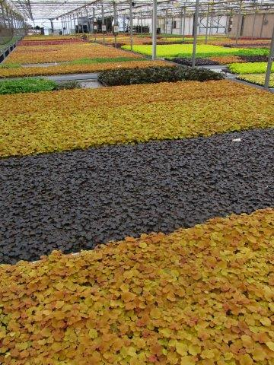
Heuchera, Always available in large quantities
Pioneer Gardens, Inc. – 2017 – 2018

Slide 2
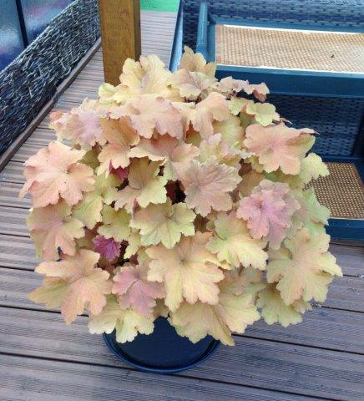
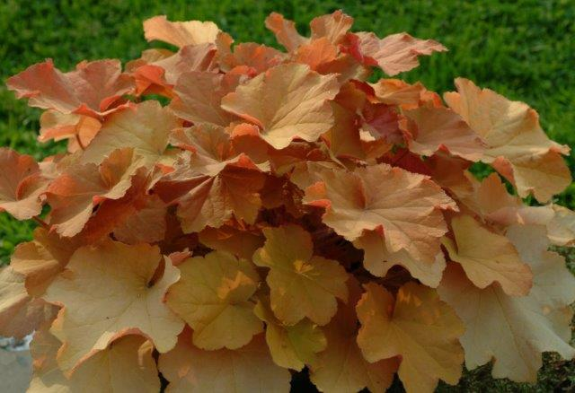
Heuchera ‘Caramel’
‘Caramel’ Spring colors
‘Caramel’, late summer/fall colors
Pioneer Gardens, Inc. – 2017 – 2018

Slide 3
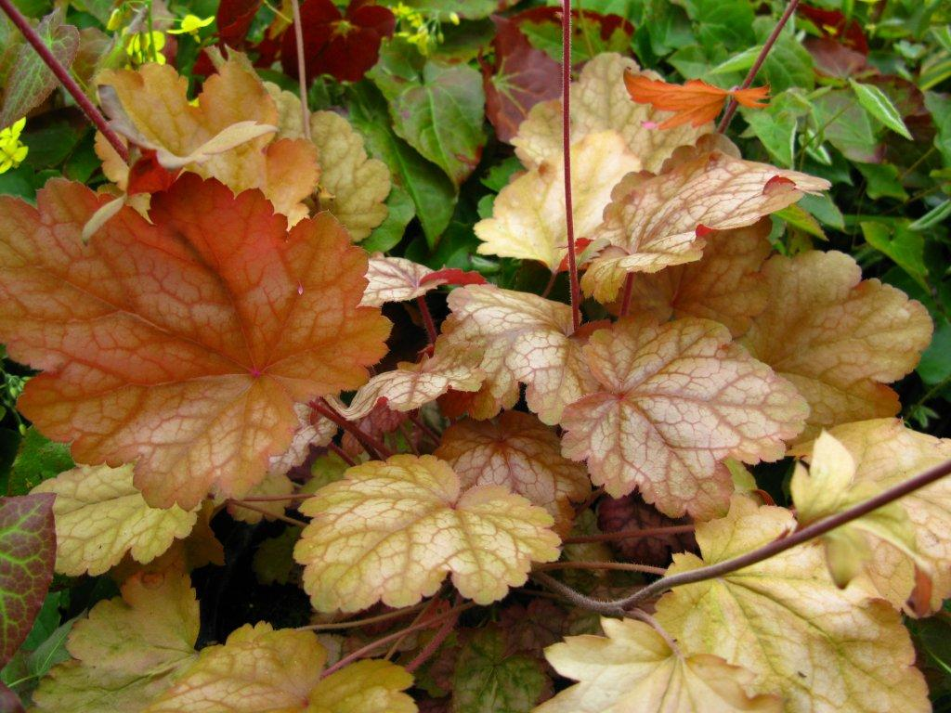
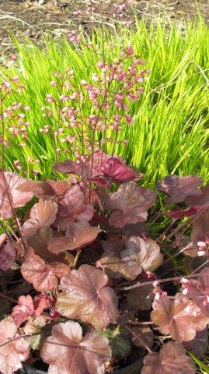
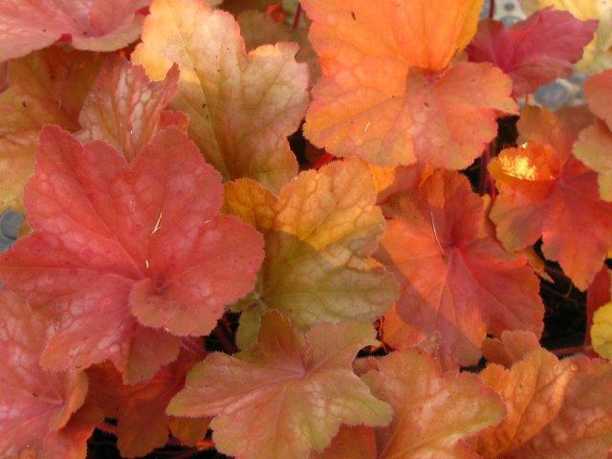
Heuchera (Orange – Gold)
Vulcano
Orange Dream (NEW)
Brown Sugar
Pioneer Gardens, Inc. – 2017 – 2018

Slide 4
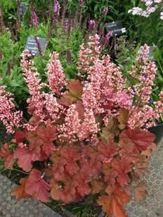
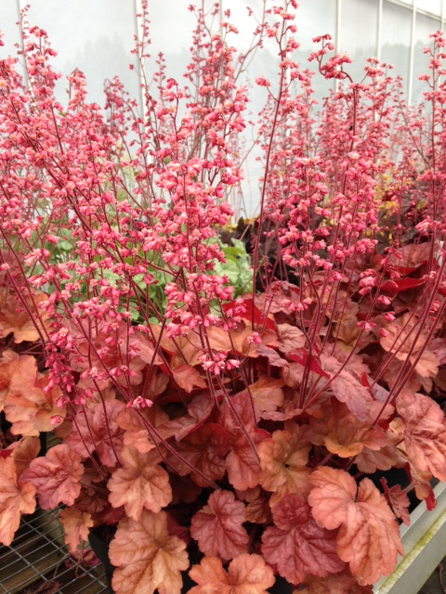
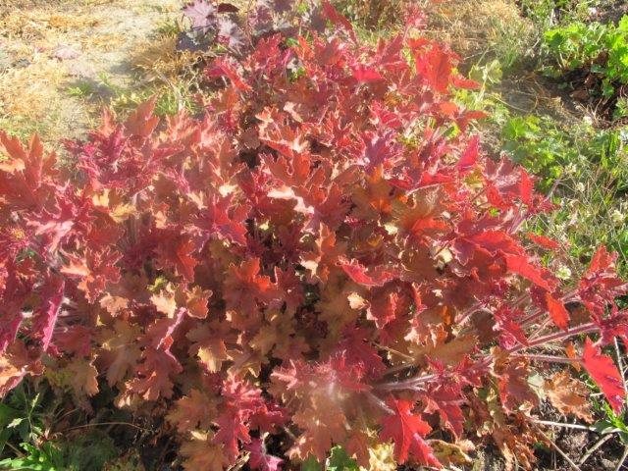
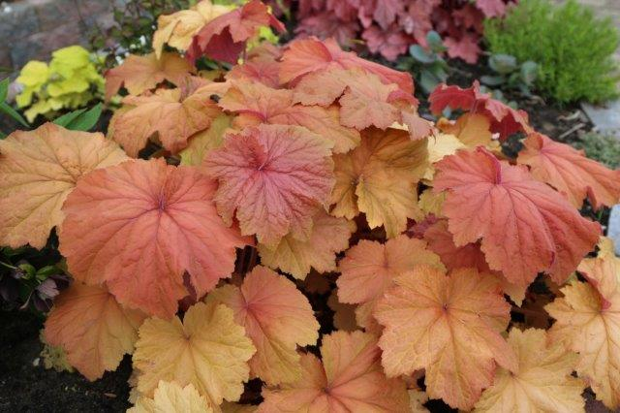
Heuchera (Orange-Gold continued)
< Pink Pearls (NEW)
Apricot (NEW) >
Mega Caramel (NEW)
‘Mango’ (NEW, extremely hardy, tough and drought-resistant. Only spreading groundcover Heuchera!)
Pioneer Gardens, Inc. – 2017 – 2018

Slide 5
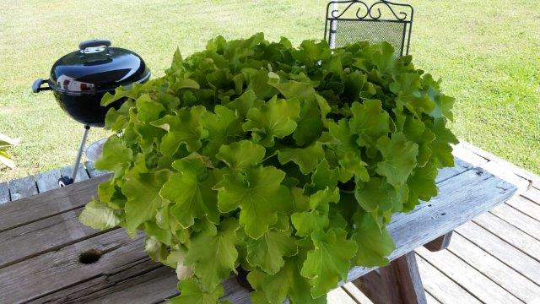
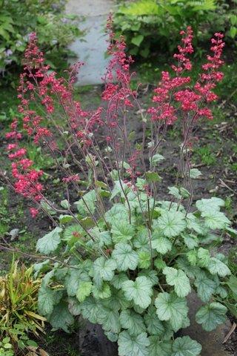
Heuchera (Lime-Green Types)
Guacamole (NEW)
Pistache
Pioneer Gardens, Inc. – 2017 – 2018
Silver Dollar (NEW)

Slide 6
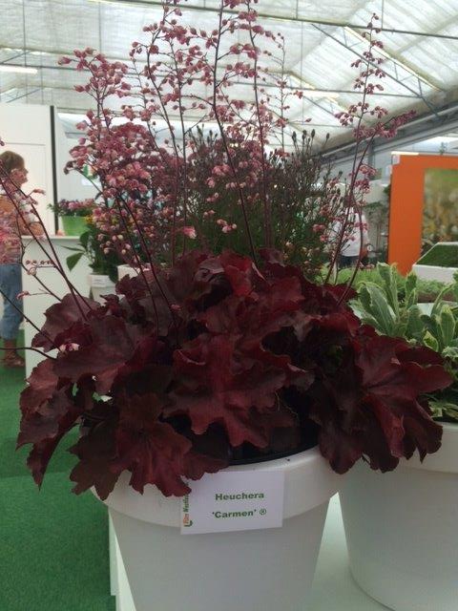
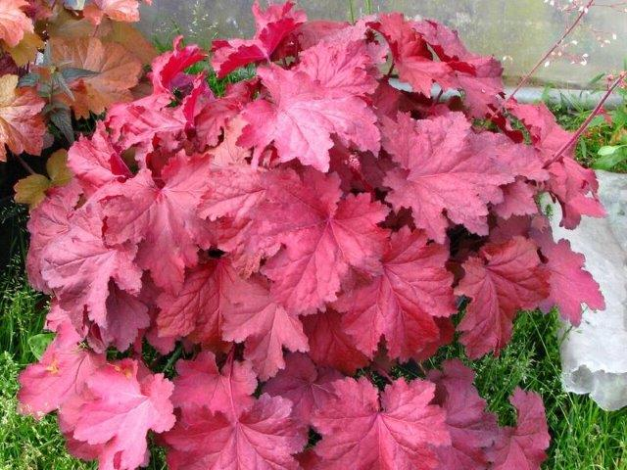
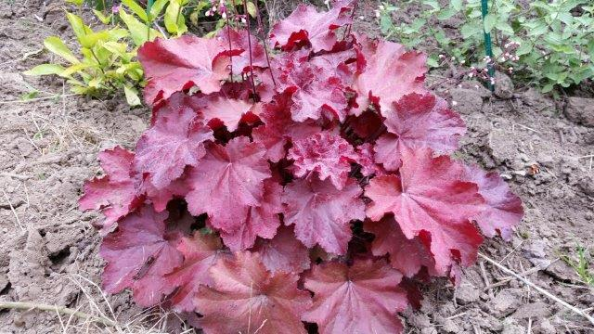
Heuchera (Pink-Red Types)
Carmencita (NEW) >
Magma (Arjen’s favorite new Heuchera)
Carmencita in the landscape >
Pioneer Gardens, Inc. – 2017 – 2018

Slide 7
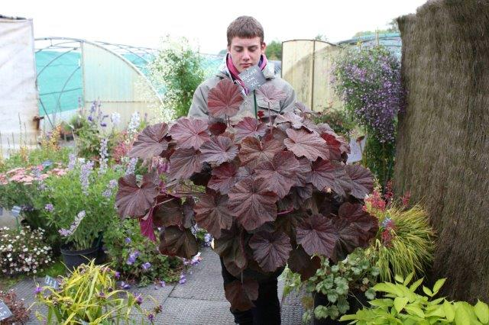
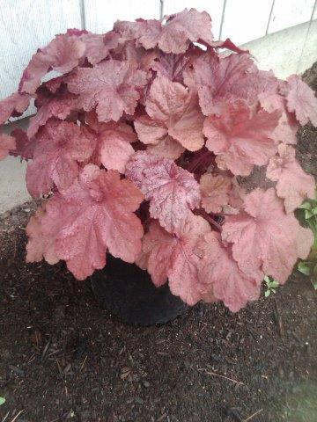
Heuchera Pink-Red Types (continued)
Cloud Nine (XXL)
Pinot Gris >
Beaujolais
Pioneer Gardens, Inc. – 2017 – 2018

Slide 8
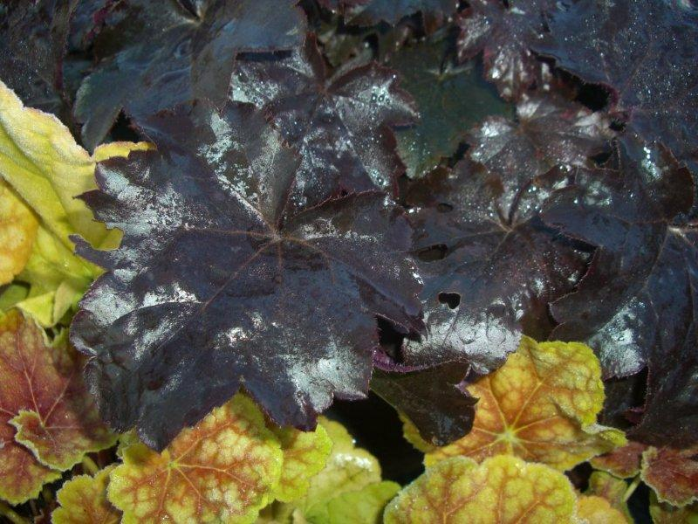
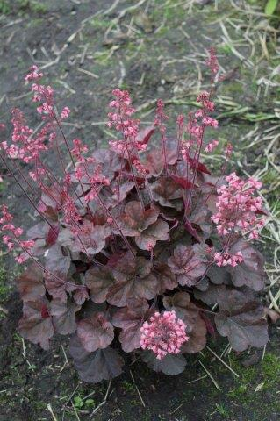
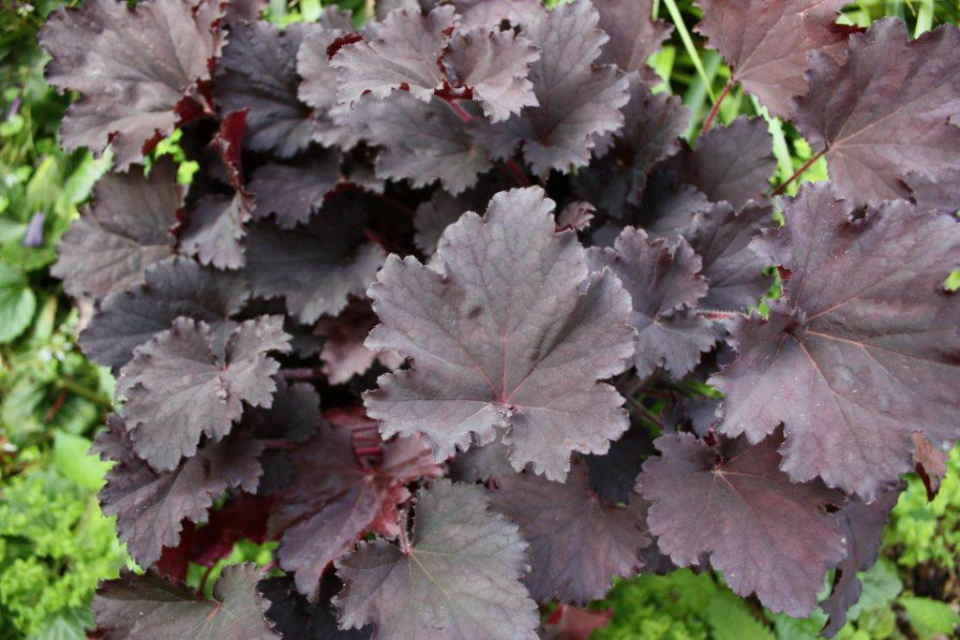
Heuchera (dark colors)
Blackout
Cassis (NEW)
Binoche
Pioneer Gardens, Inc. – 2017 – 2018
Frosted Violet

Slide 9
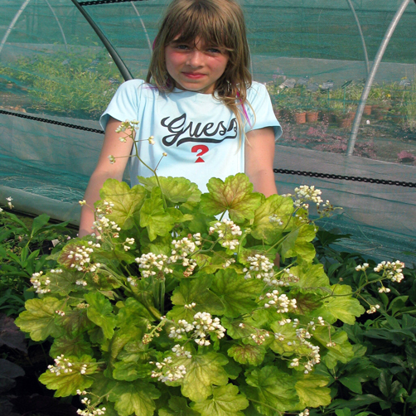
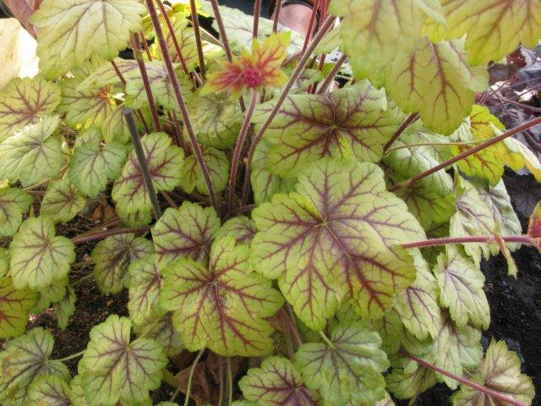
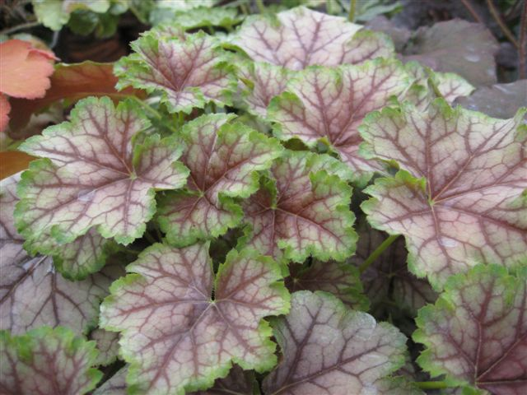
Heuchera (Multi-Color Types)
Pretty
Perrine
Miracle
Birkin
Circus
Pioneer Gardens, Inc. – 2017 – 2018

Slide 10
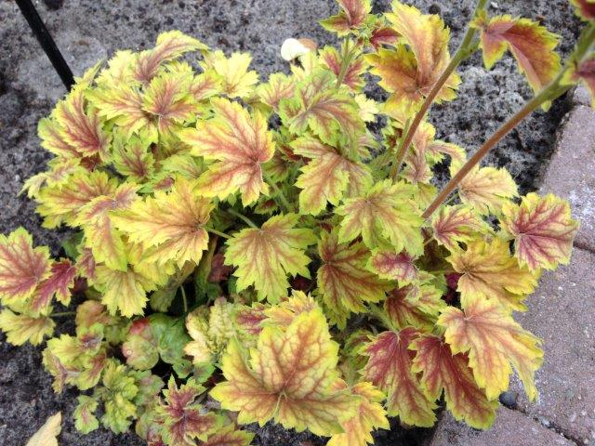
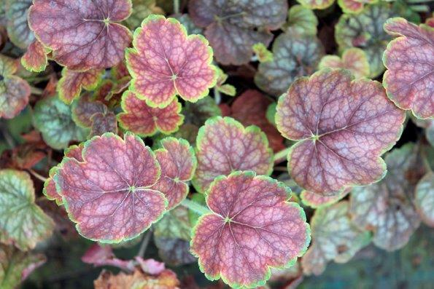
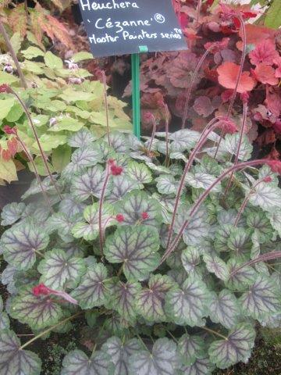
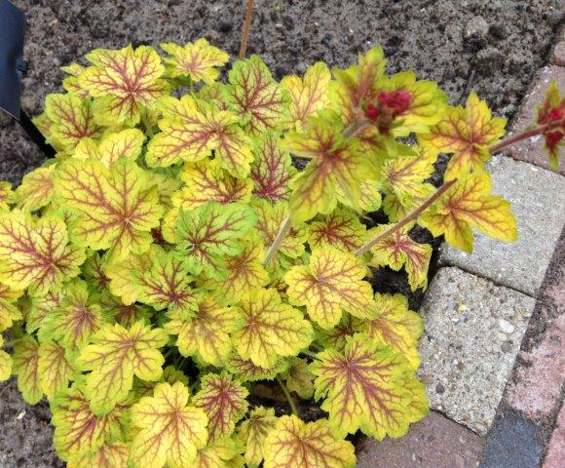
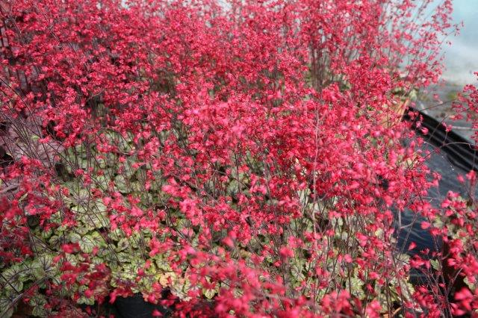
Heuchera Master Painters Series
Gauguin
Renoir
Van Gogh
Cezanne in Bloom
Cezanne (NEW) >
Pioneer Gardens, Inc. – 2017 – 2018

Slide 11
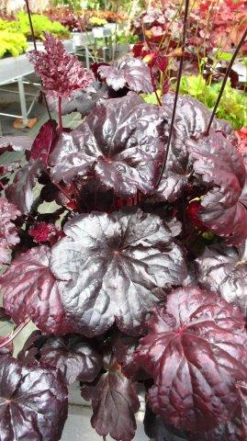
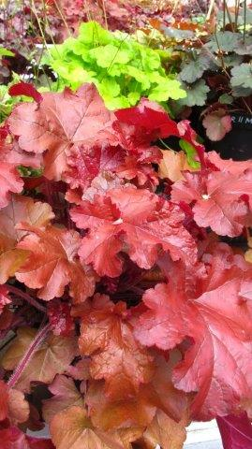
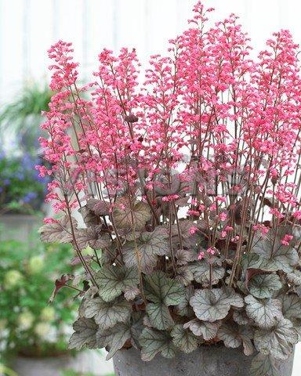
‘Black Sea’ – ‘Red Sea’ (NEW) – ‘Flores Sea’ (NEW)
Pioneer Gardens, Inc. – 2017 – 2018

Slide 12
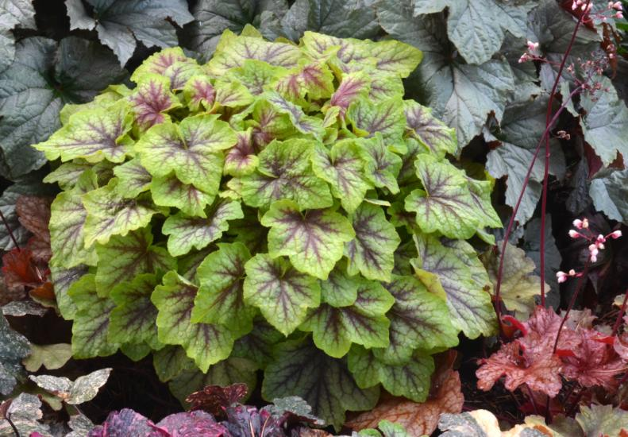
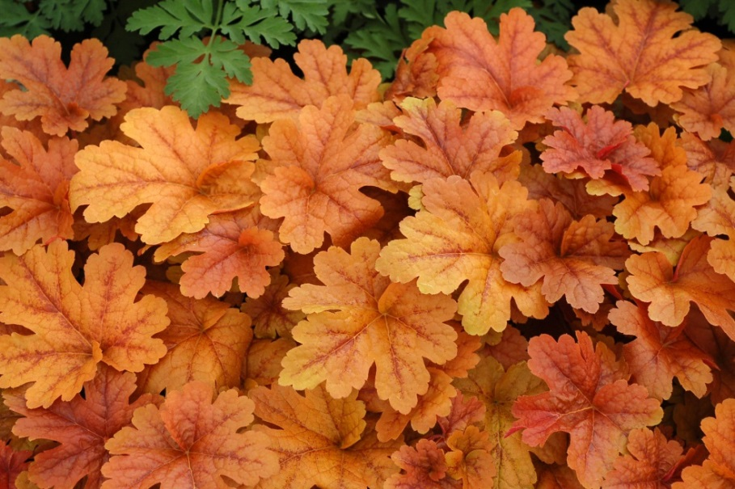
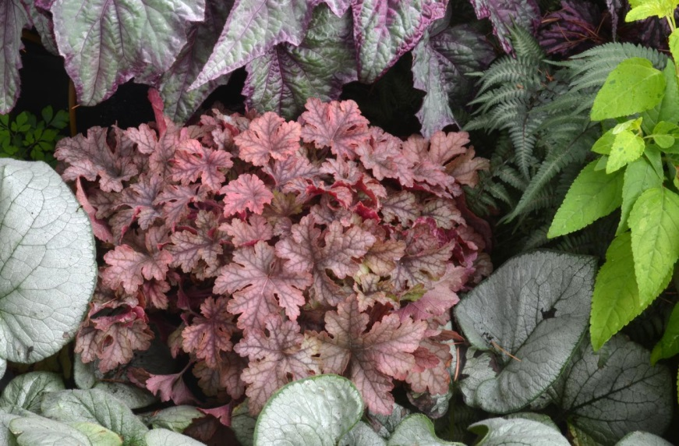
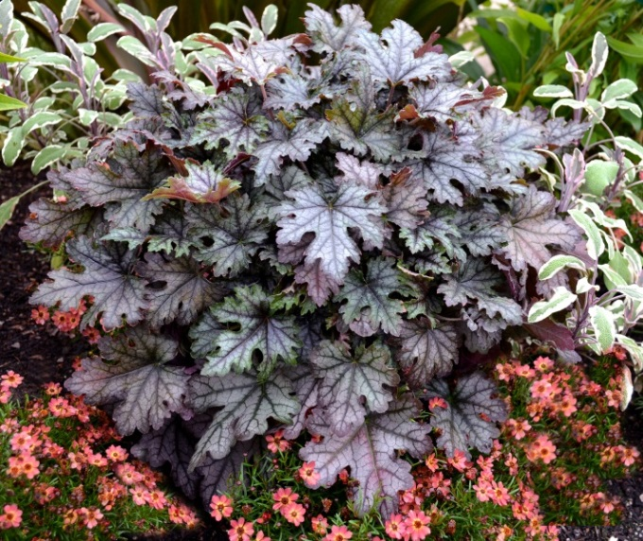
Heucherella
‘Fire Frost’
‘Buttered Rum’
‘Honey Rose’
‘Cracked Ice’
Pioneer Gardens, Inc. – 2017 – 2018

Slide 13
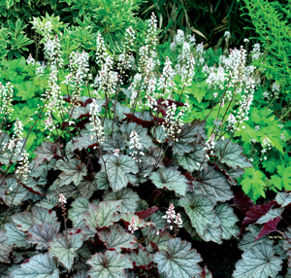
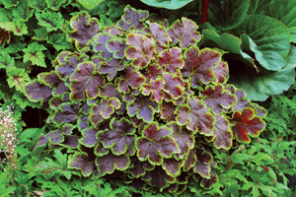
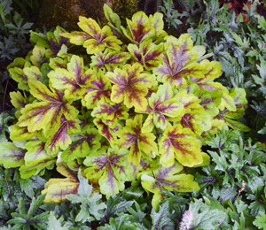
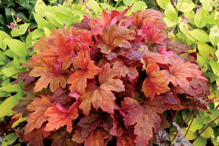
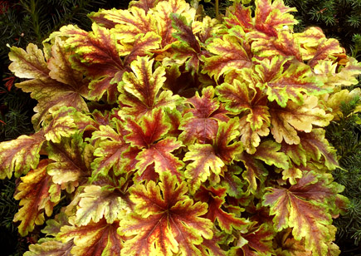
Heucherella
‘Twilight’
‘Solar Eclipse’
‘Mojito’
‘Sweet Tea’
Pioneer Gardens, Inc. – 2017 – 2018
‘Gold Zebra’

Slide 14
The Giants! Heuchera
Mega Caramel
Cloud Nine
Pretty Perrine
Magma
Guacamole
Pioneer Gardens 2017 – 2018

Slide 15
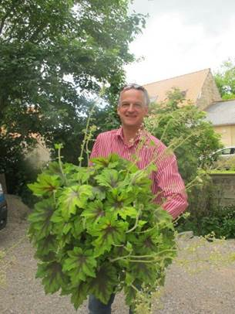
Heucherella ‘Art Nouveau’
Pioneer Gardens, Inc. – 2017 – 2018

