Slide 1

Scobey K-12 School
307 Resolution
FY2027

Slide 2
What is SB 307 and Why Do We Have It?
Senate Bill 307 (2017 legislative session)
  **Transparency in the levying process
    Trustees must adopt a resolution in the Spring each year, estimating the increase/decrease in revenue and mills from permissive (non-voted) levies in each of the following funds: Transportation, Bus Depreciation, Tuition, Adult Ed, Flexibility and Building Reserve
  **New Permissive (non-voted) levy authority to address school facilities maintenance & repair
  **Track the Building Reserve Fund
  **School facility maintenance amount

Slide 3
What Does the Law Actually Say
20-9-116, MCA. Resolution of intent to increase non-voted levy -- notice. (1) The trustees of a school district shall adopt a resolution no later than March 31 of each fiscal year and provide notice pursuant to subsection (2) whenever the trustees intend to impose an increase in a non-voted levy in the ensuing school fiscal year for the purposes of funding any of the funds listed below:
  (a) the tuition fund under 20-5-324;
  (b) the adult education fund under 20-7-705;
  (c) the building reserve fund under 20-9-502 and 20-9-503;
  (d) the transportation fund under 20-10-143 and 20-10-144; and
  (e) the bus depreciation reserve fund under 20-10-147, and
  (f) the flexibility fund established in 20-9-543 for the purposes in 20-7-1602.
(2) The trustees shall provide notice of intent to impose an increase in a non-voted levy for the ensuing school fiscal year by:
  (a) adopting a resolution of intent to impose an increase in a non-voted levy that includes, at a minimum, the estimated number of increased or decreased mills to be imposed and the estimated increased or decreased revenue to be raised compared to non-voted levies under (1)(a) through (1)(f) imposed in the current school fiscal year and, based on the district's taxable valuation most recently certified by the department of revenue under 15-10-202, the estimated impacts of the increase or decrease on a home valued at $100,000 and a home valued at $200,000; and
  (b) publishing a copy of the resolution in a newspaper that will give notice to the largest number of people of the district as determined by the trustees and posting a copy of the resolution to the school district's website.

Slide 4
What Must the Notice Include
Resolution/Notice requirements:
  Dollar and mill increases in non-voted levies in:
    Transportation Fund
    Bus Depreciation Fund
    Tuition Fund
    Adult Ed Fund
    Flexibility Fund
    Building Reserve
  Using prior year taxable value
  Publish notice in newspaper by March 31st
  NEW FOR 2026 RESOLUTION:
  Show the impact on homes with the value of $100,000, $300,000 and $600,000 to match ballot language
  To be completely transparent – best practice WAS to disclose changes to ALL budgeted funds. However with new legislation and taxation/mill calculations in the General Fund – the number we can disclose is incomplete as this is just the schools’ taxable value and mills – not the county portion.
  NOTE: THESE ARE ESTIMATES

Slide 5
DEFINITIONS
General Fund – cost to run the school. Budget Set by State
Reserves – Amount you keep back estimated by NEXT year’s budget to pay for bills at the beginning of the year. (Operating Cash)
Re-appropriation – Amount you can give back to the taxpayers to “save” taxes for the next year
Reversion to the State – any cash above the 10% Reserve and money given back to the taxpayers OVER 15% - must be given back to the State
Interlocal Transfer – Money from any fund (excluding Retirement & Debt Service) can be transferred to this fund to be used for any purpose. Must have both Budget Authority & Cash to be able to make this transfer.

Slide 6
Budget Authority vs Cash
BUDGET AUTHORITY
CASH
Budget amounts are estimates of what you intend to receive in revenue and what you intend to spend to operate the school for the year. The school may spend less than the adopted budget, but must never spend more, regardless of cash balance.
20-9-133, MCA:
  Trustees must formally approve an expenditure budget in order to spend money during the fiscal year.
  Total expenditures made during the year must be within the approved budget.
The actual amount of money you have on hand in the bank to spend.
Why is there a difference?
  Not everyone pays their tax bill on time, which means the amount you budgeted may not equal the amount of revenue you actually receive.
  There will most likely always be some protested &/or delinquent taxes.
If at the close of the fiscal year, budget authority remains and the District has adequate cash balance, those funds may be “re-appropriated” for the next year’s budget.
Should the district choose and have both the budget authority and cash – these funds can be transferred to the Inter-local fund to be spent any way the board chooses.

Slide 7
So Where Do the Numbers Come From
** Prior year Budget submitted to OPI
** Prior year Taxable Value from the Department of Revenue
** OPI Budgeting Spreadsheets
(General, Transportation, Bus Depreciation and Tuition)
** Preliminary Budget Data Sheet – Provided by OPI by March 1st
** SB307 OPI Worksheet

Slide 8
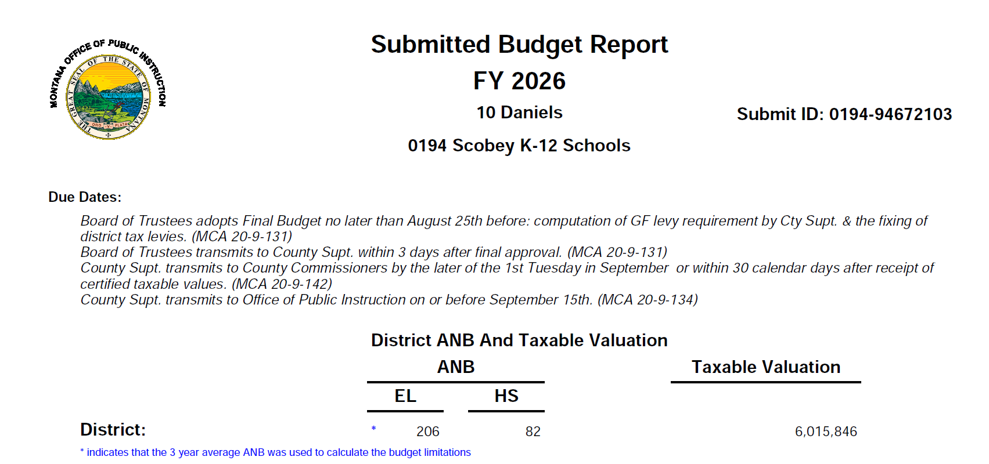
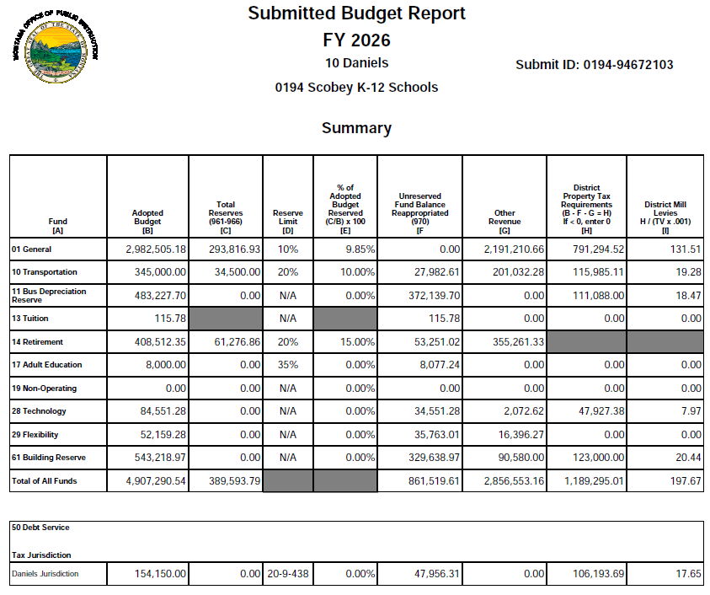
FY26 OPI Budget

Slide 9
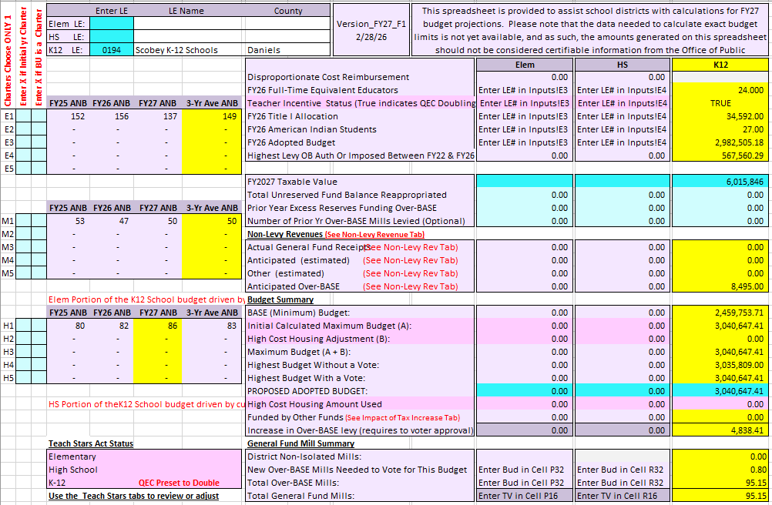
OPI General Fund Spreadsheet
1. ANB numbers used to calculate entitlement. Fall count+spring count x187/180
Calculated budget amount

Slide 10
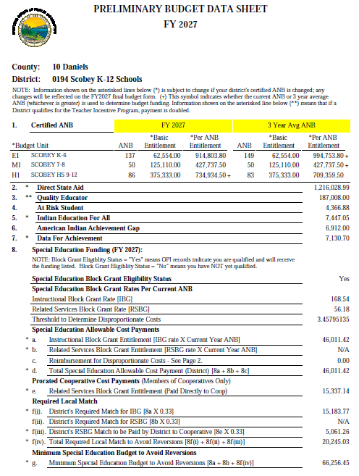
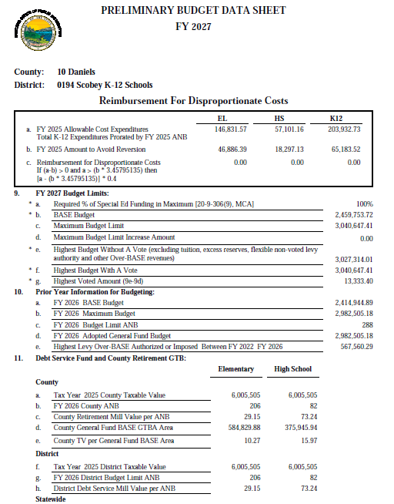
Enrollment has steadily decreased reducing the amount of funds we receive to drive our budget.
Highest Budget with or without a vote defines whether you can run a mill levy election and the amount to ask for
The Preliminary Budget Data Sheets are provided to districts by March 1st of each year. This year they are Pre-session which means they do not have 3% inflation amount figured in or the 2026 QEP payment.

Slide 11
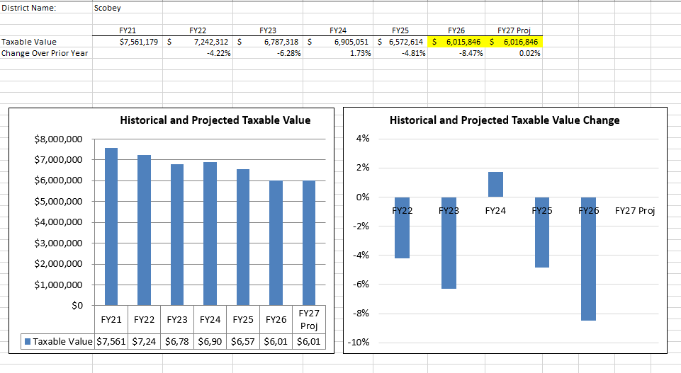
TAXABLE VALUE COMPARISON

Slide 12
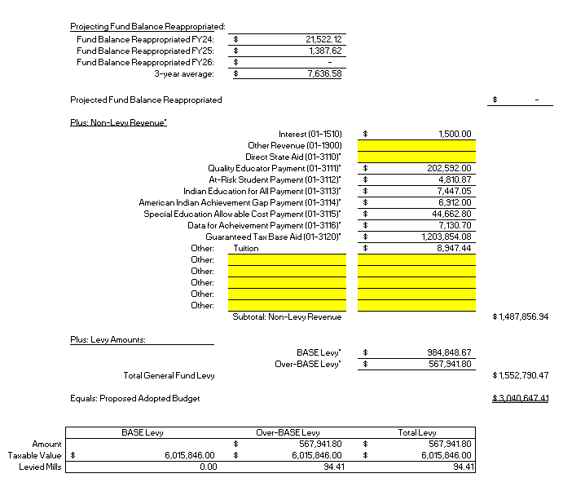
201 – GENERAL FUND
Fund Balance Re-appropriated is the remaining amount of budget that can be given back to the county. Beginning in June 2021 we established the Inter-local fund and now all remaining funds can be transferred to this account for use at a later time.
Entitlement payments (State)
Projected “payment” from schools for students who live out of our district but attend Scobey School
Levy Amount from tax payers

Slide 13
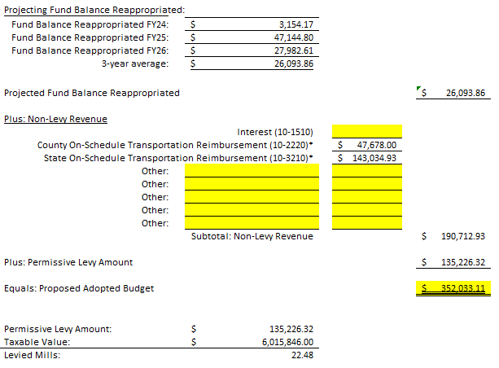
210 - TRANSPORTATION
State and County payments – based on:
Number of Routes
Size of Bus
Number of Miles

Slide 14
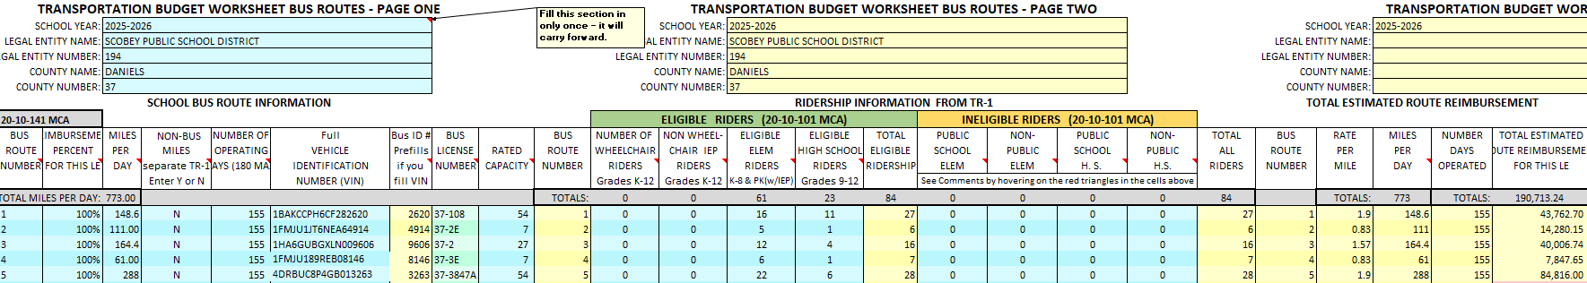
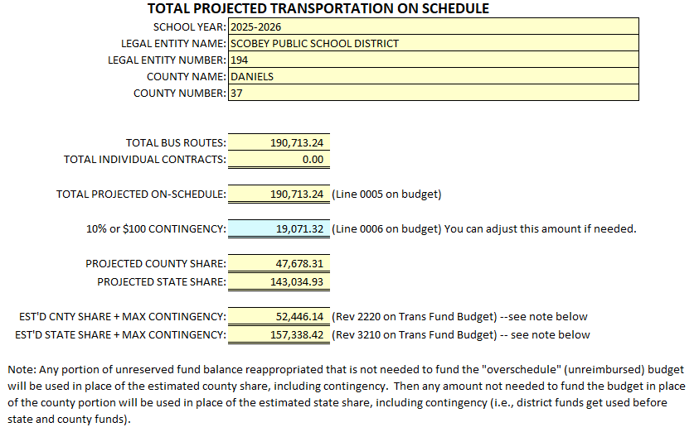

Slide 15
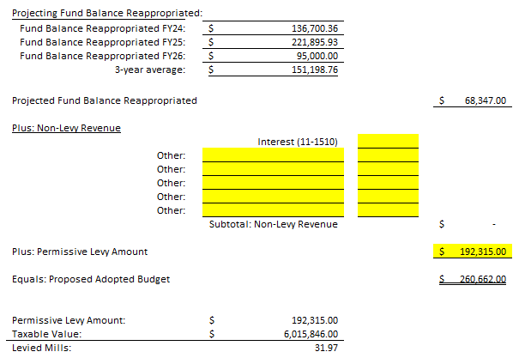
211 – BUS DEPRECIATION
Levy driven by currently owned buses, purchase price and can levy 150% of the value of the bus

Slide 16
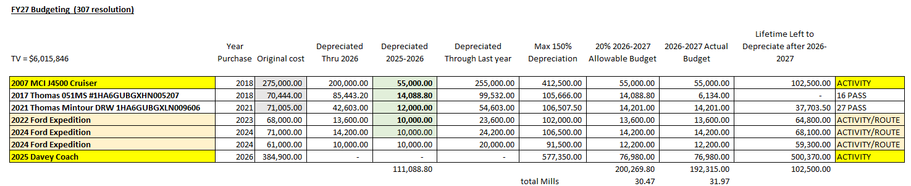
Depreciation amounts can be manipulated from $0.00 up to the maximum allowable amount to determine mills.
Depending on replacement needs – this amount can be raised or lowered.

Slide 17
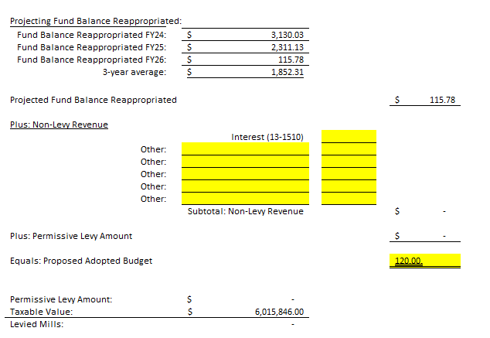
213 – TUITION
The amount that can be levied is dependent upon expenditures for 1:1 aides and amount of Special Education funds we receive from the State.
These funds can be levied to cover the cost of employing Aides/Paraprofessionals for students with IEP’s requiring One-on-One assistance. This is also where we would levy if we had students who lived within the district – but chose to attend school in another district. Currently, we we receive too much in our SPED funds and do not have any students going to other schools so we don’t qualify for assistance in this fund.

Slide 18
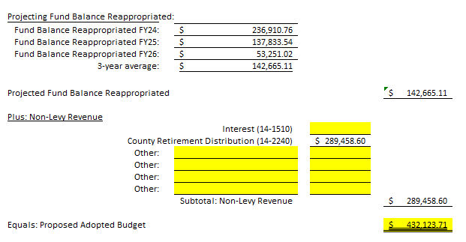
214 – RETIREMENT
This amount covers TRS, PERS, Social Security and Unemployment costs to the District based on current salaries. Additional dollars can be levied to cover employee retirement payouts. The County calculates mills for this budget item.

Slide 19
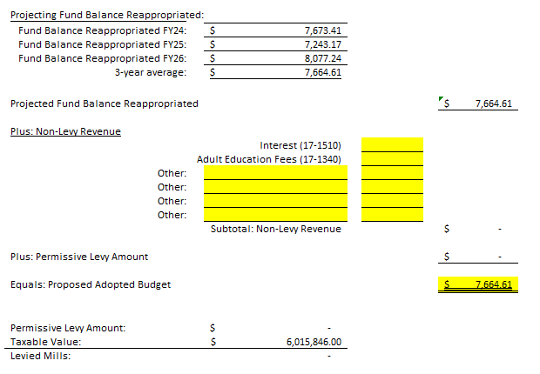
217 – ADULT ED
We haven’t had anyone teach classes in the past few years. We do pay a portion of Mr. Hardy’s salary from this account as the Adult Education coordinator.

Slide 20
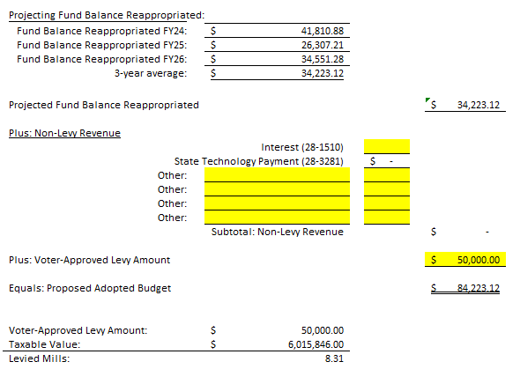
228 - TECHNOLOGY
The 10 year levy for technology passed in 2024. The majority of the expenditures for this account is to pay for Schoolhouse IT’s technology services.

Slide 21
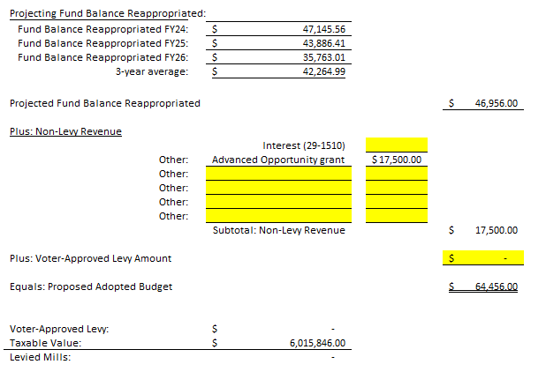
229 - FLEXIBILITY
The District does not levy any dollars in this fund. Recent revenue for this account came from the Advanced Opportunities grant of $16,500.00 in FY26 and we have been awarded another $17,500 for FY27. This money can be used to help parent defray costs associated with online classes or other out-of-pocket expenses.

Slide 22
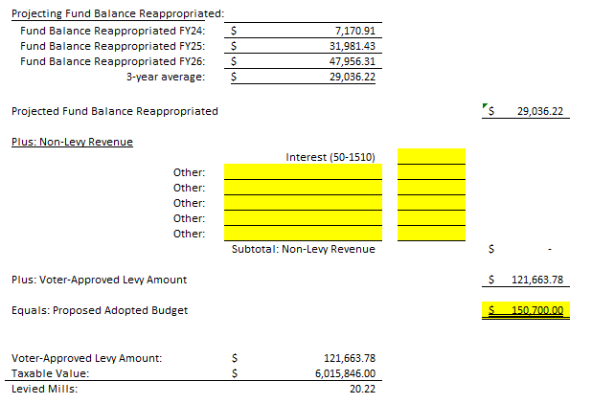
250 – DEBT SERVICE
Amount of Levy is based on the payment schedule for the outstanding bond amount for the Boiler System.

Slide 23
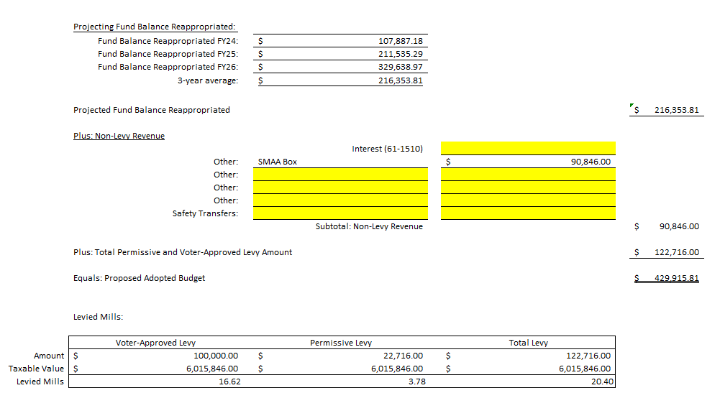
261 – BUILDING RESERVE
This amount is what we feel will be given back from the State to offset local taxes.
$100,000 5 year voted levy & amount calculated by the State that can be permissively levied
Voters approved the $100,000 levy for an additional 5 years in May 2025. Under Senate Bill 307, the District is granted a permissive levy in the BR Fund based off a calculation called “SMMA”. The District’s SMMA ( School Major Maintenance Amount) is calculated by $15,000 + (100*Prior Year Budget Limit ANB).

Slide 24

PROJECTS TO SPEND BUILDING RESERVE
***Repair/replace Commons and old gym roof
***Commons bathrooms upgrade
***Replace ventilation system in shop
***Sidewalk on west side of school
Replace new gym roof – can be put off for 3-5 years
Repair/replace roof over old elementary
Jr. High Locker Room renovations
Jr. High Lockers
Windows
Update sound system in main gym
The Commons bathrooms, Commons/old gym roof and Shop ventilation systems are NEEDED projects and will be completed within the year. Other projects will be completed as we can get someone to do them for us.

Slide 25
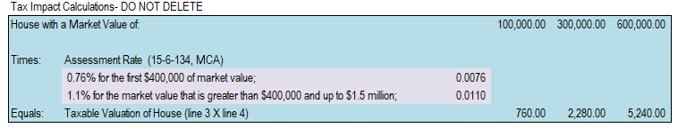
CHANGES TO THE RESOLUTION
Due to legislative changes, the notice will look different than in years’ past. We as a district have chosen to notice all funds for full disclosure and transparency. However, due to legislation, the COUNTY will be figuring mills for the BASE budget based on their taxable value. The OVERBASE levy will be calculated on the School’s taxable value which could be very different. This isn’t a number that we will know as this is calculated in the fall when our actual budget is set and sent to OPI.
Another change is that we must disclose on houses with values of $100,000, $300,000 and $600,000 to match the ballot language if we run an election.
The notice also uses the calculations for the changes in the assessment rates for houses above and below the $400,000 market value.
The Commons bathrooms, Commons/old gym roof and Shop ventilation systems are NEEDED projects and will be completed within the year. Other projects will be completed as we can get someone to do them for us.

Slide 26
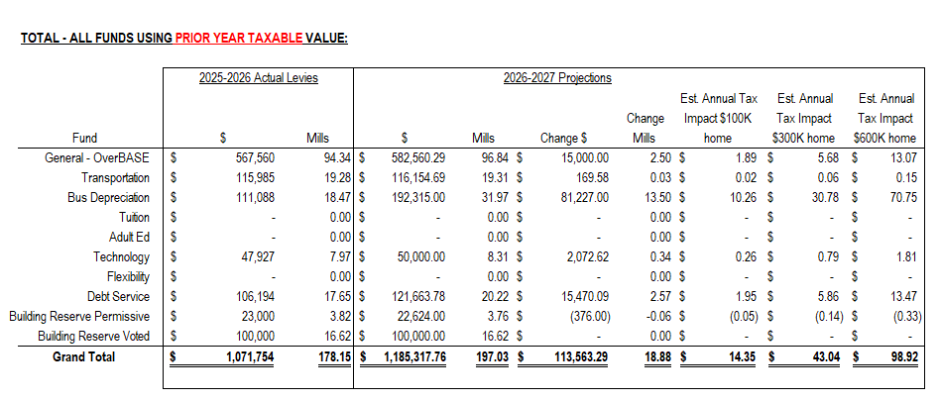
WHAT DOES IT ALL LOOK LIKE
This is the notice using ALL funds that can be levied in.

Slide 27
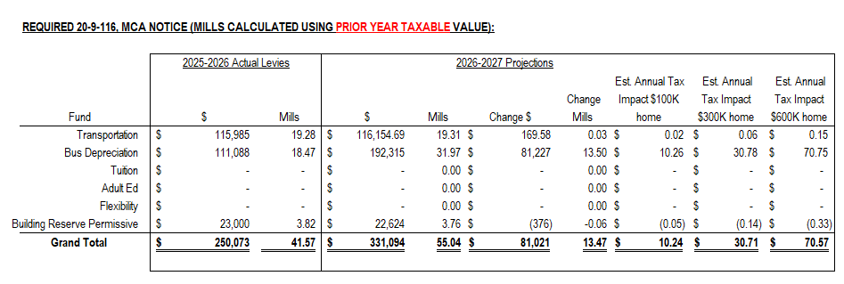
WHAT DOES IT ALL LOOK LIKE
This is what then notice would look like if we just use the REQUIRED funds.

Slide 28
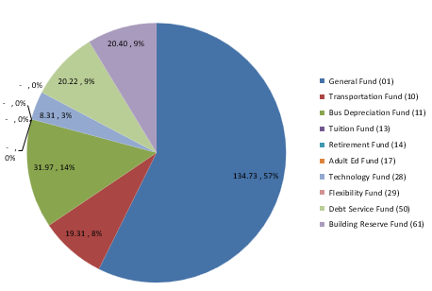
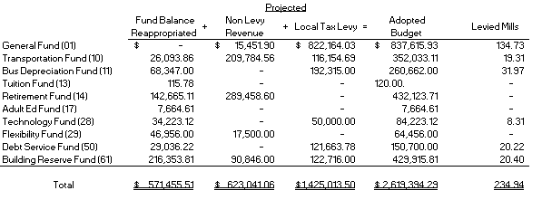

Slide 29
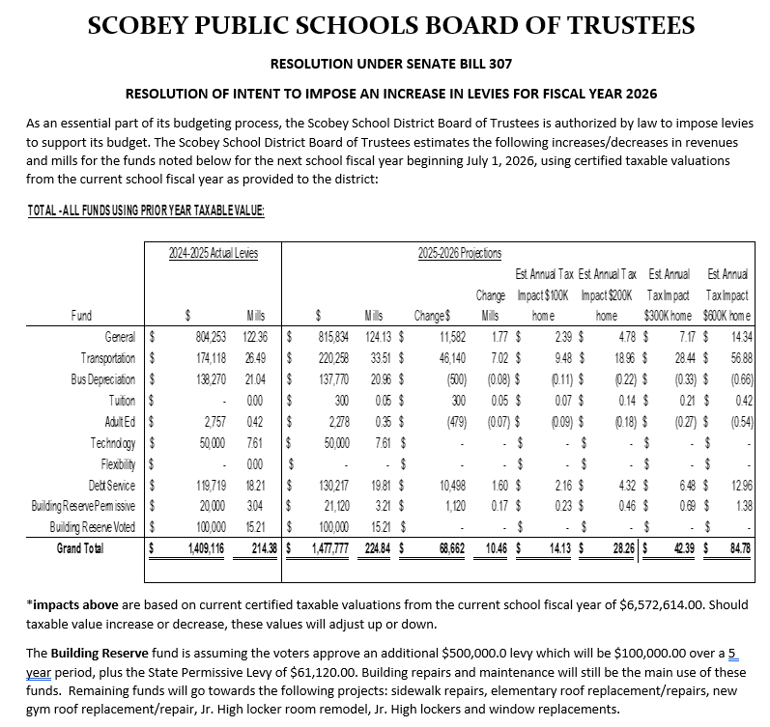
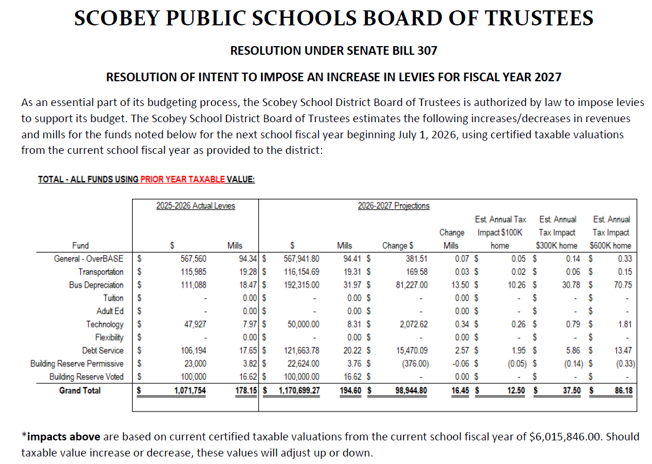
FY26 VS FY27 Projections

