Slide 1
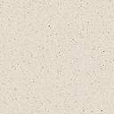
MUSIC VOCABULARY
DYNAMICS
TEMPO
ARTICULATION
INSTRUMENTS

Slide 2
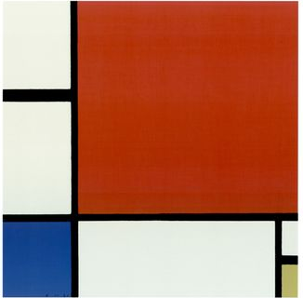

1
MONDRIAN

Slide 3
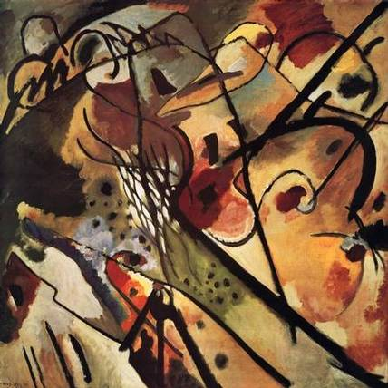
2
KANDINSKY

Slide 4
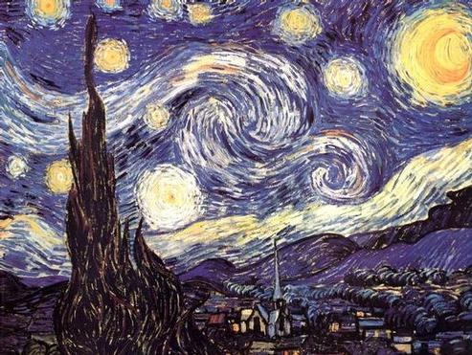
3
VAN GOGH

Slide 5
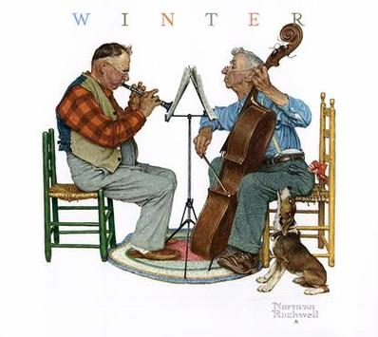
4
ROCKWELL

Slide 6
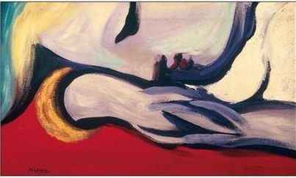
5
PICASSO

Slide 7
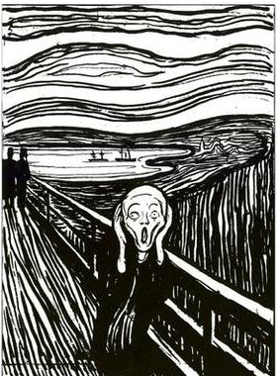
6
MUNCH

Slide 8
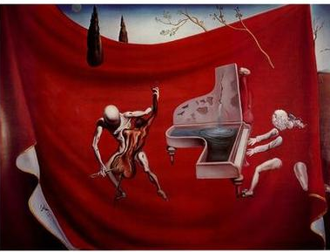
7
DALI

Slide 9
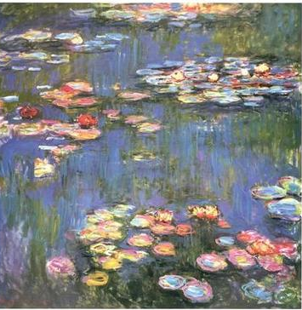
8
MONET

Slide 10
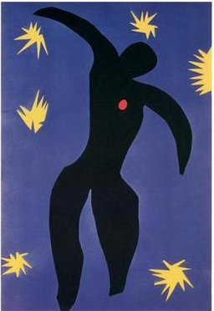
9
MATISSE

Slide 11
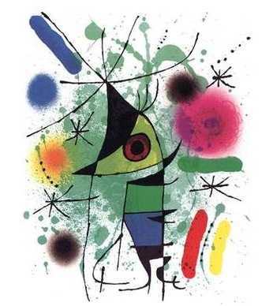
10
MIRO

Slide 12

ART VOCABULARY
SHAPE
MOVEMENT
SPACE
COLOR
TEXTURE
LINE
PATTERN

