Slide 1
Ten Things you will need for future employment

Slide 2
Institute for the Future
The slides to follow are based upon a study did by the Institute for the Future (IFTF) on what they believe will be the skills needed over the next ten years. There findings were not based upon the type of job but the skills that will needed in the workforce.

Slide 3
1. Sense-making
Definition: ability to determine the deeper meaning or significance of what is being expressed

Slide 4
2. Social intelligence
Definition: ability to connect to others in a deep and direct way, to sense and stimulate reactions and desired interactions

Slide 5
3. Novel & adaptive thinking
Definition: proficiency at thinking and coming up with solutions and responses beyond that which is rote or rule-based

Slide 6
4. Cross -cultural competency
Definition: ability to operate in different cultural settings

Slide 7
5. Computational thinking
Definition: ability to translate vast amounts of data into abstract concepts and to understand data-based reasoning

Slide 8
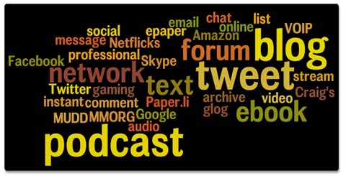
6. New-media literacy
Definition: ability to critically assess and develop content that uses new media forms, and to leverage these media for persuasive communication

Slide 9
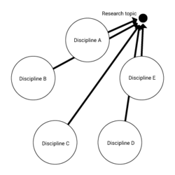
7. Transdisciplinarity
Definition: literacy in and ability to understand concepts across multiple disciplines

Slide 10
8. Design mindset
Definition: ability to represent and develop tasks and work processes for desired outcomes

Slide 11
9. Cognitive load management
Definition: ability to discriminate and filter information for importance, and to understand how to maximize cognitive functioning using a variety of tools and techniques

Slide 12
10. Virtual collaboration
Definition: ability to work productively, drive engagement, and demonstrate presence as a member of a virtual team.

Slide 13
We ARe
BBV2M-BrothersBrooksVision2MissionLLC.com
BBV2MLLC@gmail.com

