Slide 1

Public Infrastructure
How Do We Address National Needs in a Collaborative Way?
Dr. Mark Watson, City Manager
Oak Ridge Tennessee

Slide 2
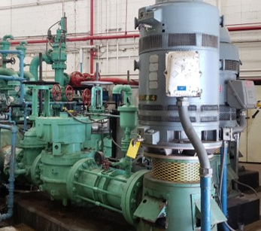
Defining Needs
Where are critical failure points?
Where does public external infrastructure meet industry, commercial, and residential needs?
How is the “end of life” defined for infrastructure?
Can local government assist with advancing infrastructure replacement?

Slide 3
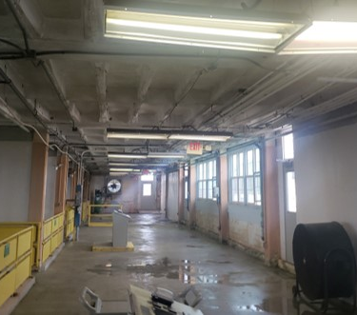
Cooperative Ventures
Shared Fire Station with K-25 Museum in Oak Ridge
Partnership for Advanced Manufacturing Facility with DOE University of South Carolina and City of Aiken
Provision of options for non-critical facilities such as Badging Office in Los Alamos outside of critical space
Exchange of land with City of Oak Ridge to create new science museum with 15 year free rent through private sector

Slide 4
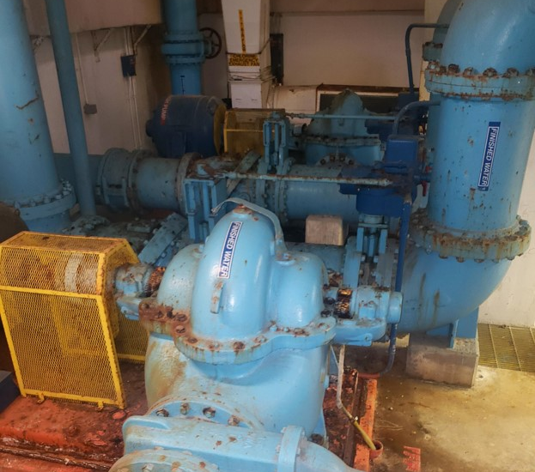
The Oak Ridge Water Plant
The 75 year old Manhattan Project water treatment facility operations was assumed by the City of Oak Ridge in May of 2000. The original plant is positioned up on a high ridge with significant slopes and the intake structure is located at the edge of Melton Hill Lake.
Renewals & Upgrades
Following the assumption of the plant the City has made upgrades to certain portions of the facilities.
Examples:
  Storage tank upgrades
  Chemical feed equipment replacements
  Computerized operations

Slide 5
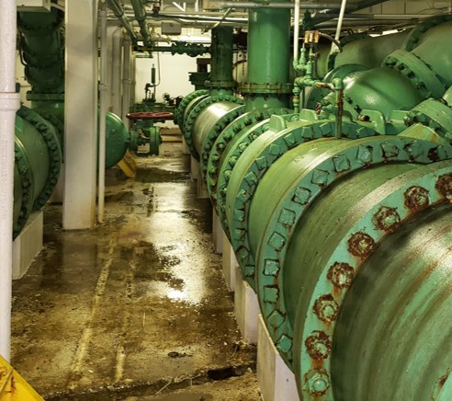
Challenges
Available Funding/ Financing
Timing of Project
Changing People in Key Positions
Commitment of governments beyond legislative time frames

Slide 6
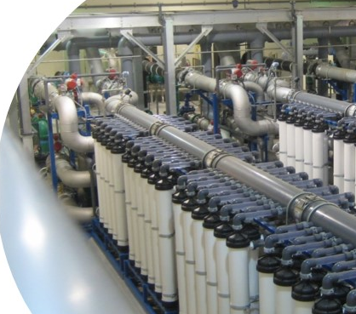
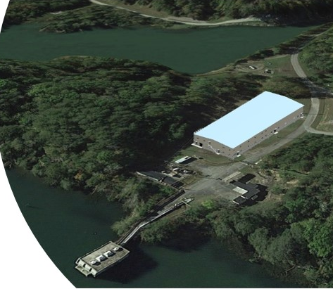

Oak Ridge Water Plant as a Modern Facility
Things have changed since the construction of the current World War II era treatment plant. The City of Oak Ridge is in a financial position to assume $41.8M in debt for construction of the original plant built in the mid 1940s.
Improvements
Today’s modern water plant has variable speeds, that will allow conservation of electricity.
The new plan is to move the entire treatment operation down to the edge of Melton Hill Lake, where the current intake structure is.
Highest quality potable water based on today’s technology.

Slide 7
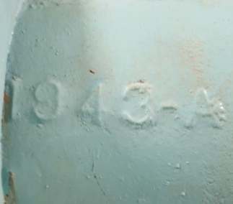
WIFIA & Tennessee State Revolving Fund
Per agreement of a WIFIA EPA Loan for 49% of the project, repayment will occur over 35 years and 30 years for the balance with the State of Tennessee SRF Loan.
Commitment by the United States government to assist the local government of Oak Ridge is requested for this major national security issue and replacement of facilities that have reached the end of its 75-year life.

Slide 8
Projected Project Schedule
Design – Aug 2019 – Sept 2020
TDEC Review/Approval – Sept 2020 – Nov 2020
Bid/Award – Dec 2020 – Mar 2021
Construction – Apr 2021 – Aug 2022
Project Start-up – Sept 2022 – Oct 2022

Slide 9
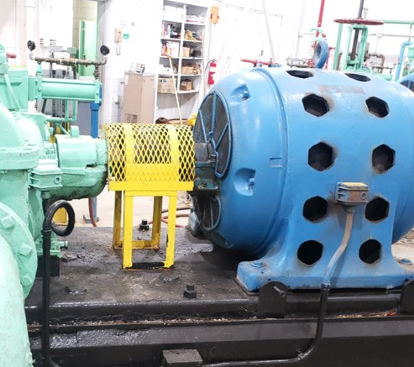
Questions?

