Slide 1
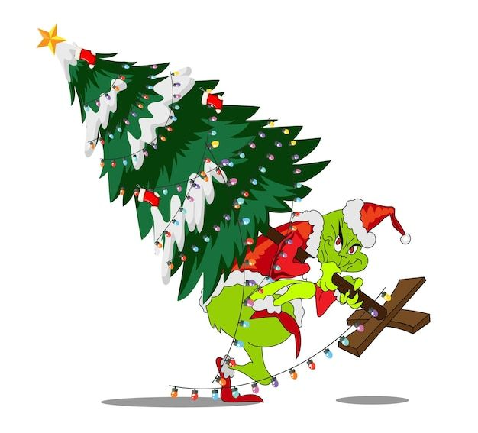
Waco Light’s Up for Christmas 2025

Slide 2


Contest Judges
Heath Talley
Yacqueline Remigio

Slide 3
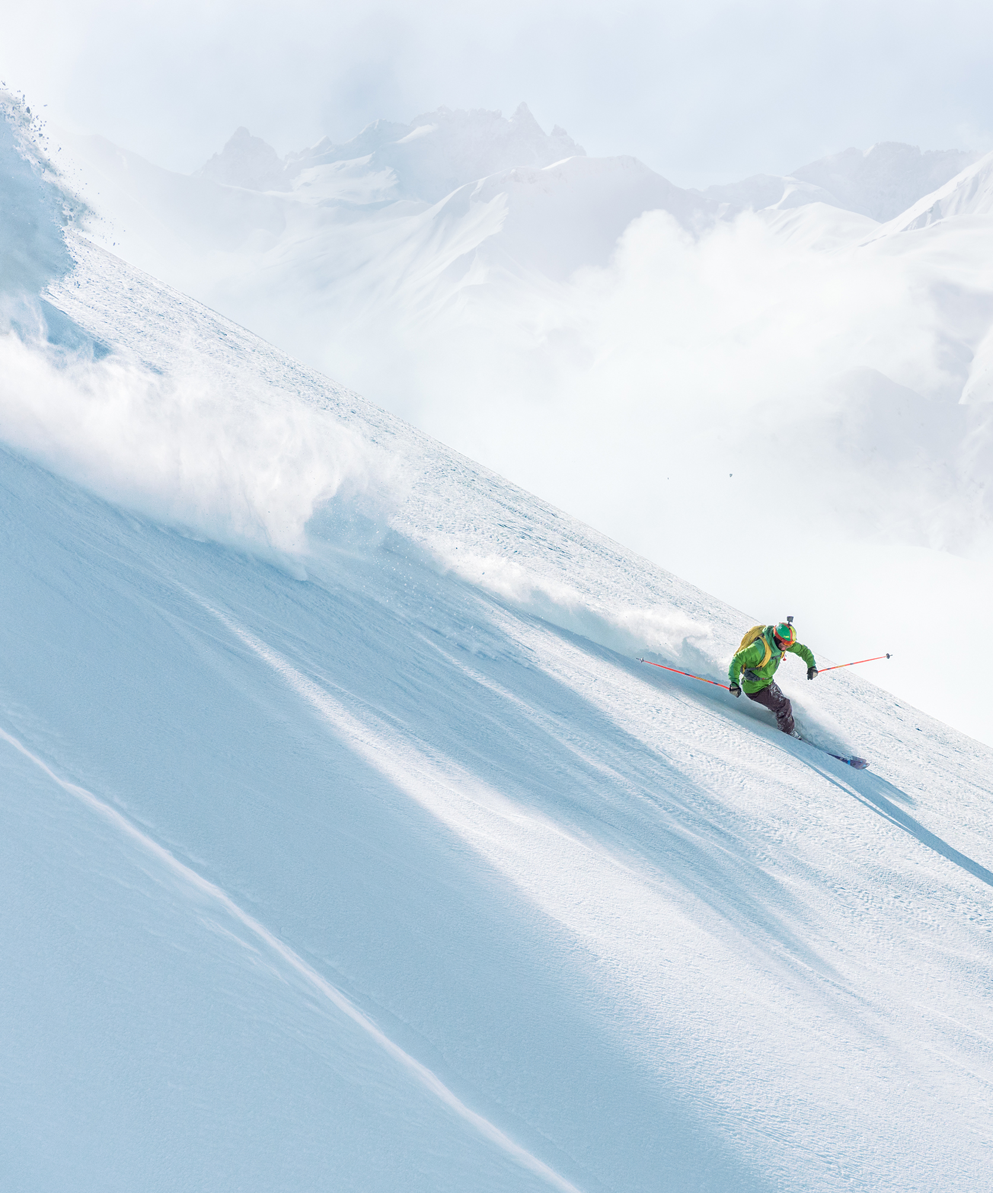
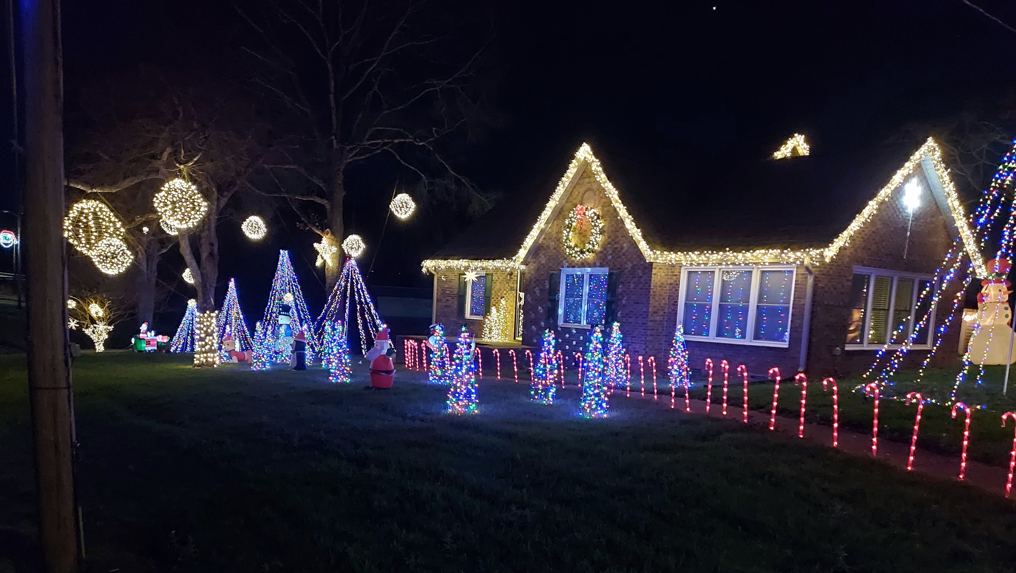
The power of communication
2024 Contest Winner:
Darrell and Amanda Vess Cherryville Rd. .

Slide 4


There were 30 homes judged
The decorations ranged from a classic tree in a window to blinking lights, inflatables and animations.

Slide 5

Scoring
Coverage 0 – 10 points
Atmosphere 0 – 10 points
Showmanship 0 – 10 points
Festiveness bonus 0 – 5 points
Traditional theme 0 – 5 points
Extra effort 0 – 5 points
Christmas tree visible 0 – 5 points
Total points available 50

Slide 6
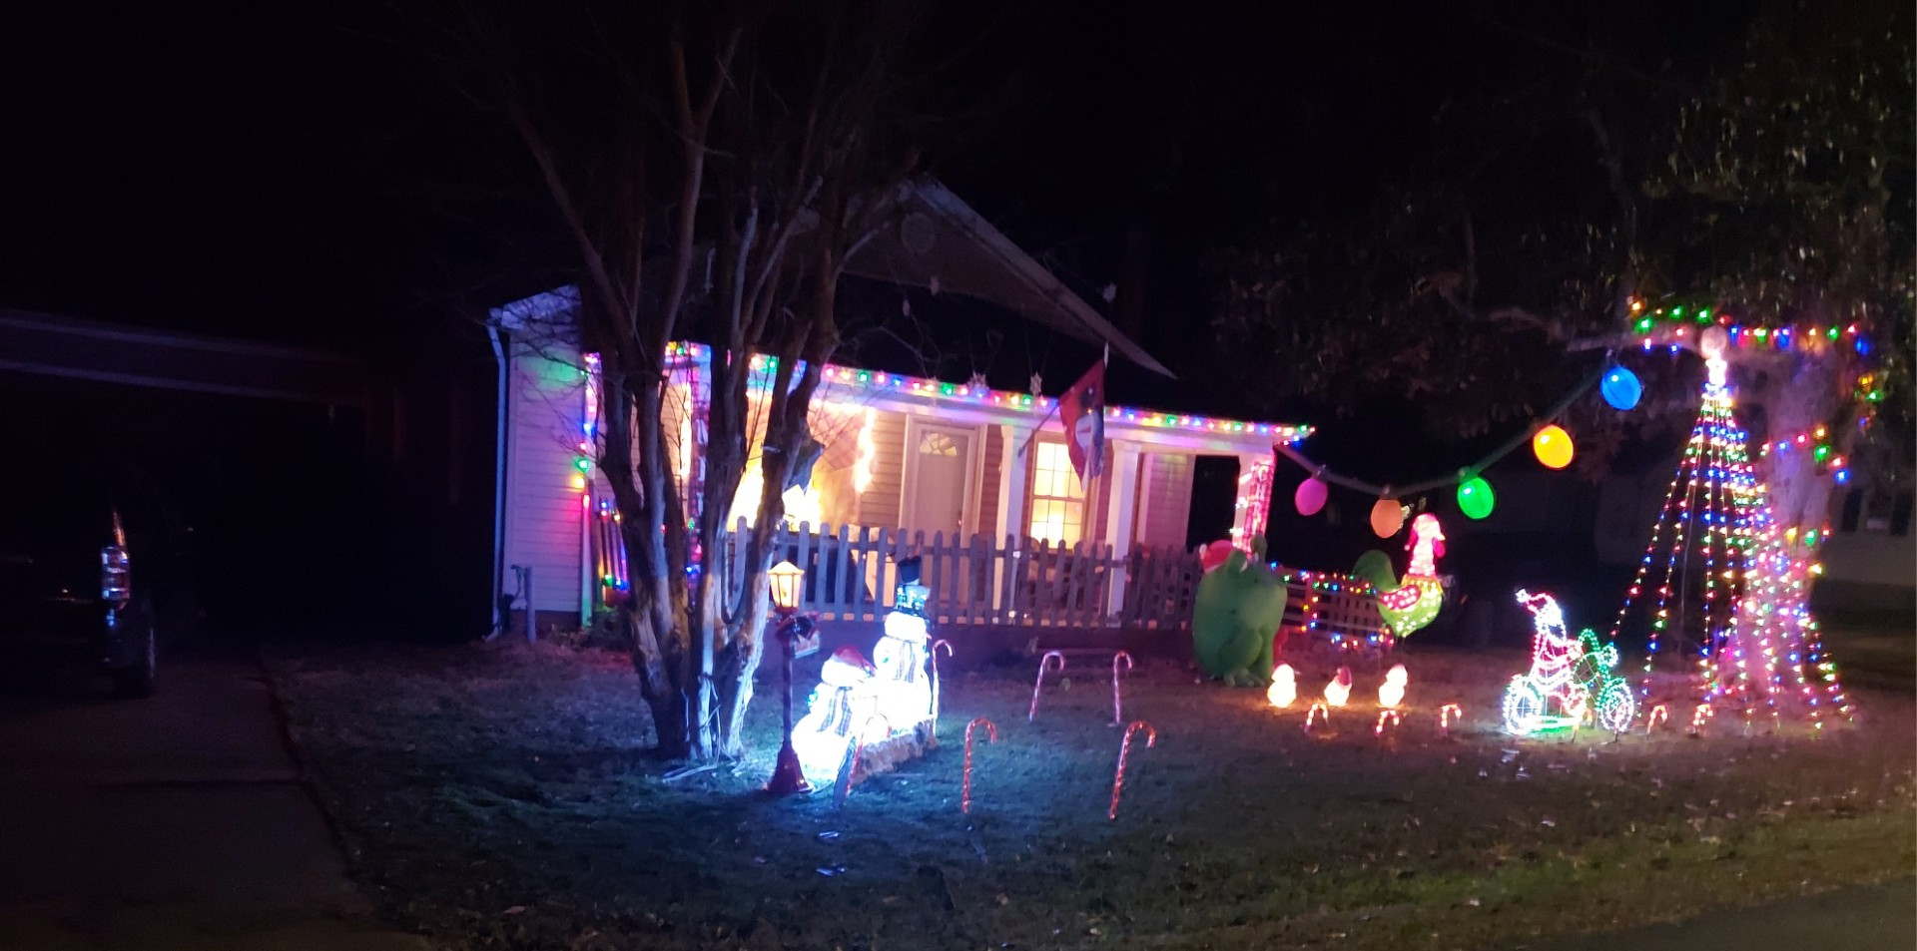
Selecting visual aids
Enhancing your presentation
5th Place - Score 36: Timothy Saxton
140 Moss St.

Slide 7
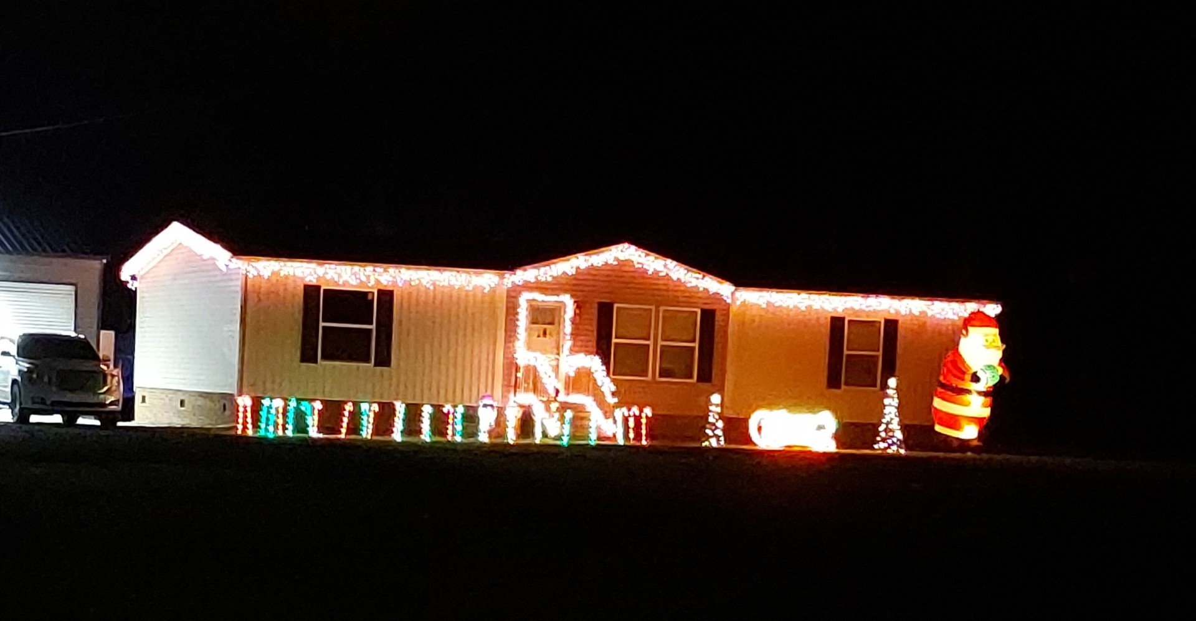
Effective delivery techniques
This is a powerful tool in public speaking. It involves varying pitch, tone, and volume to convey emotion, emphasize points, and maintain interest.
  Pitch variation
  Tone inflection
  Volume control
Effective body language enhances your message, making it more impactful and memorable.
  Meaningful eye contact
  Purposeful gestures
  Maintain good posture
  Control your expressions
4th Place - Score 38: Tyler and Jenna Ellis 2227 Stony Point Rd.

Slide 8
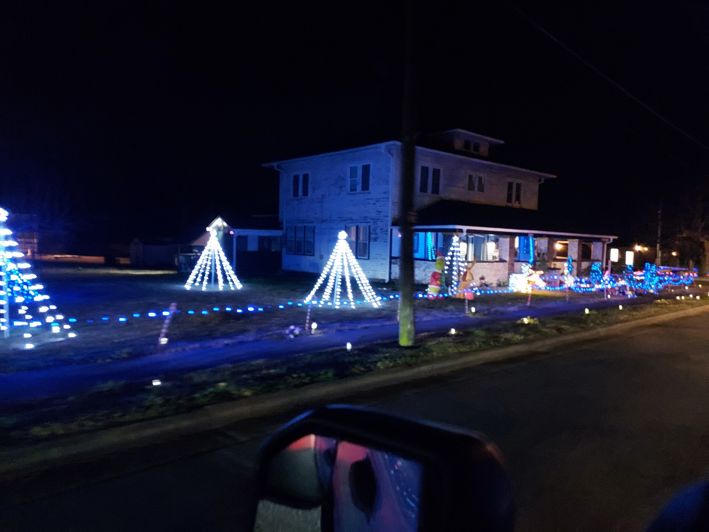
Effective delivery techniques
This is a powerful tool in public speaking. It involves varying pitch, tone, and volume to convey emotion, emphasize points, and maintain interest.
  Pitch variation
  Tone inflection
  Volume control
Effective body language enhances your message, making it more impactful and memorable.
  Meaningful eye contact
  Purposeful gestures
  Maintain good posture
  Control your expressions
3rd Place - Score 40: Andre and Nadisha Tyrell
200 North Main St.

Slide 9
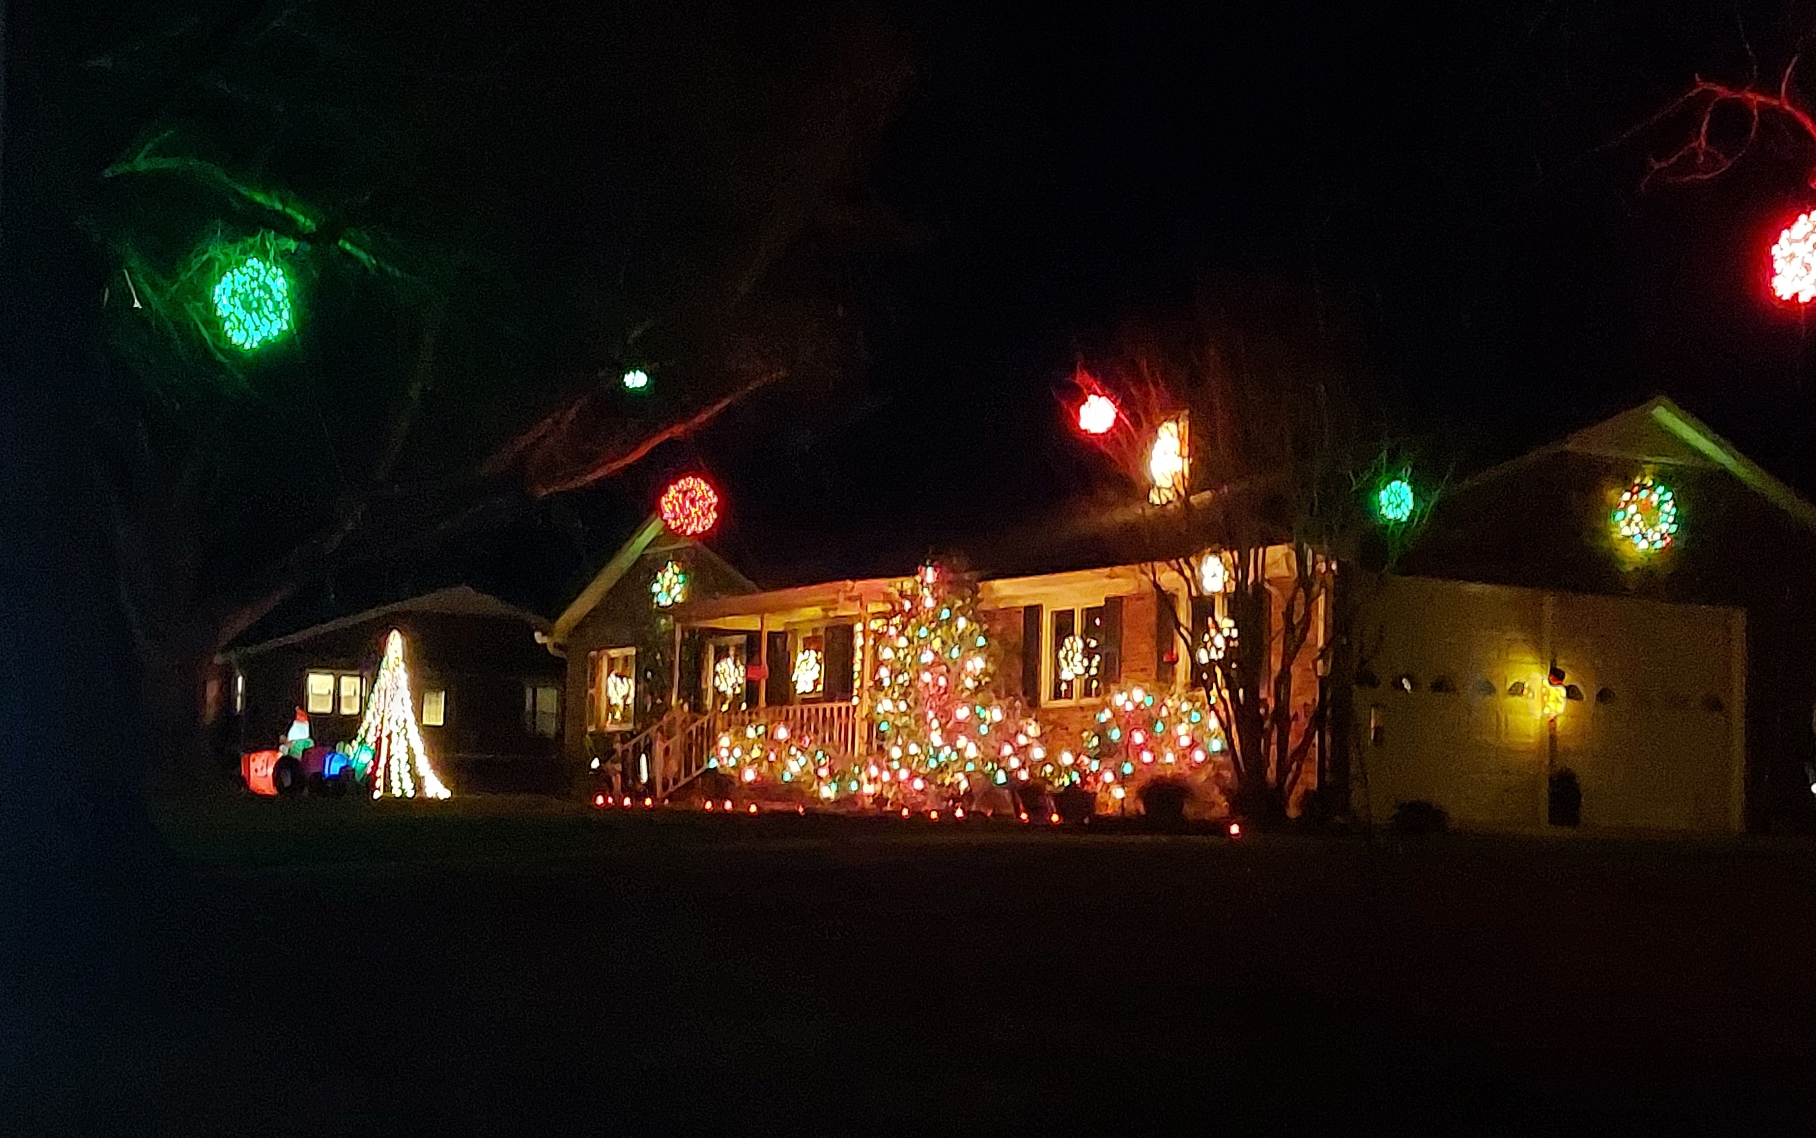
Navigating Q&A sessions
Know your material in advance
Anticipate common questions
Rehearse your responses
Maintaining composure during the Q&A session is essential for projecting confidence and authority. Consider the following tips for staying composed:
  Stay calm
  Actively listen
  Pause and reflect
  Maintain eye contact
2nd Place - Score 44: Joey and Lori Barrett
2804 Fallston Waco Rd.

Slide 10
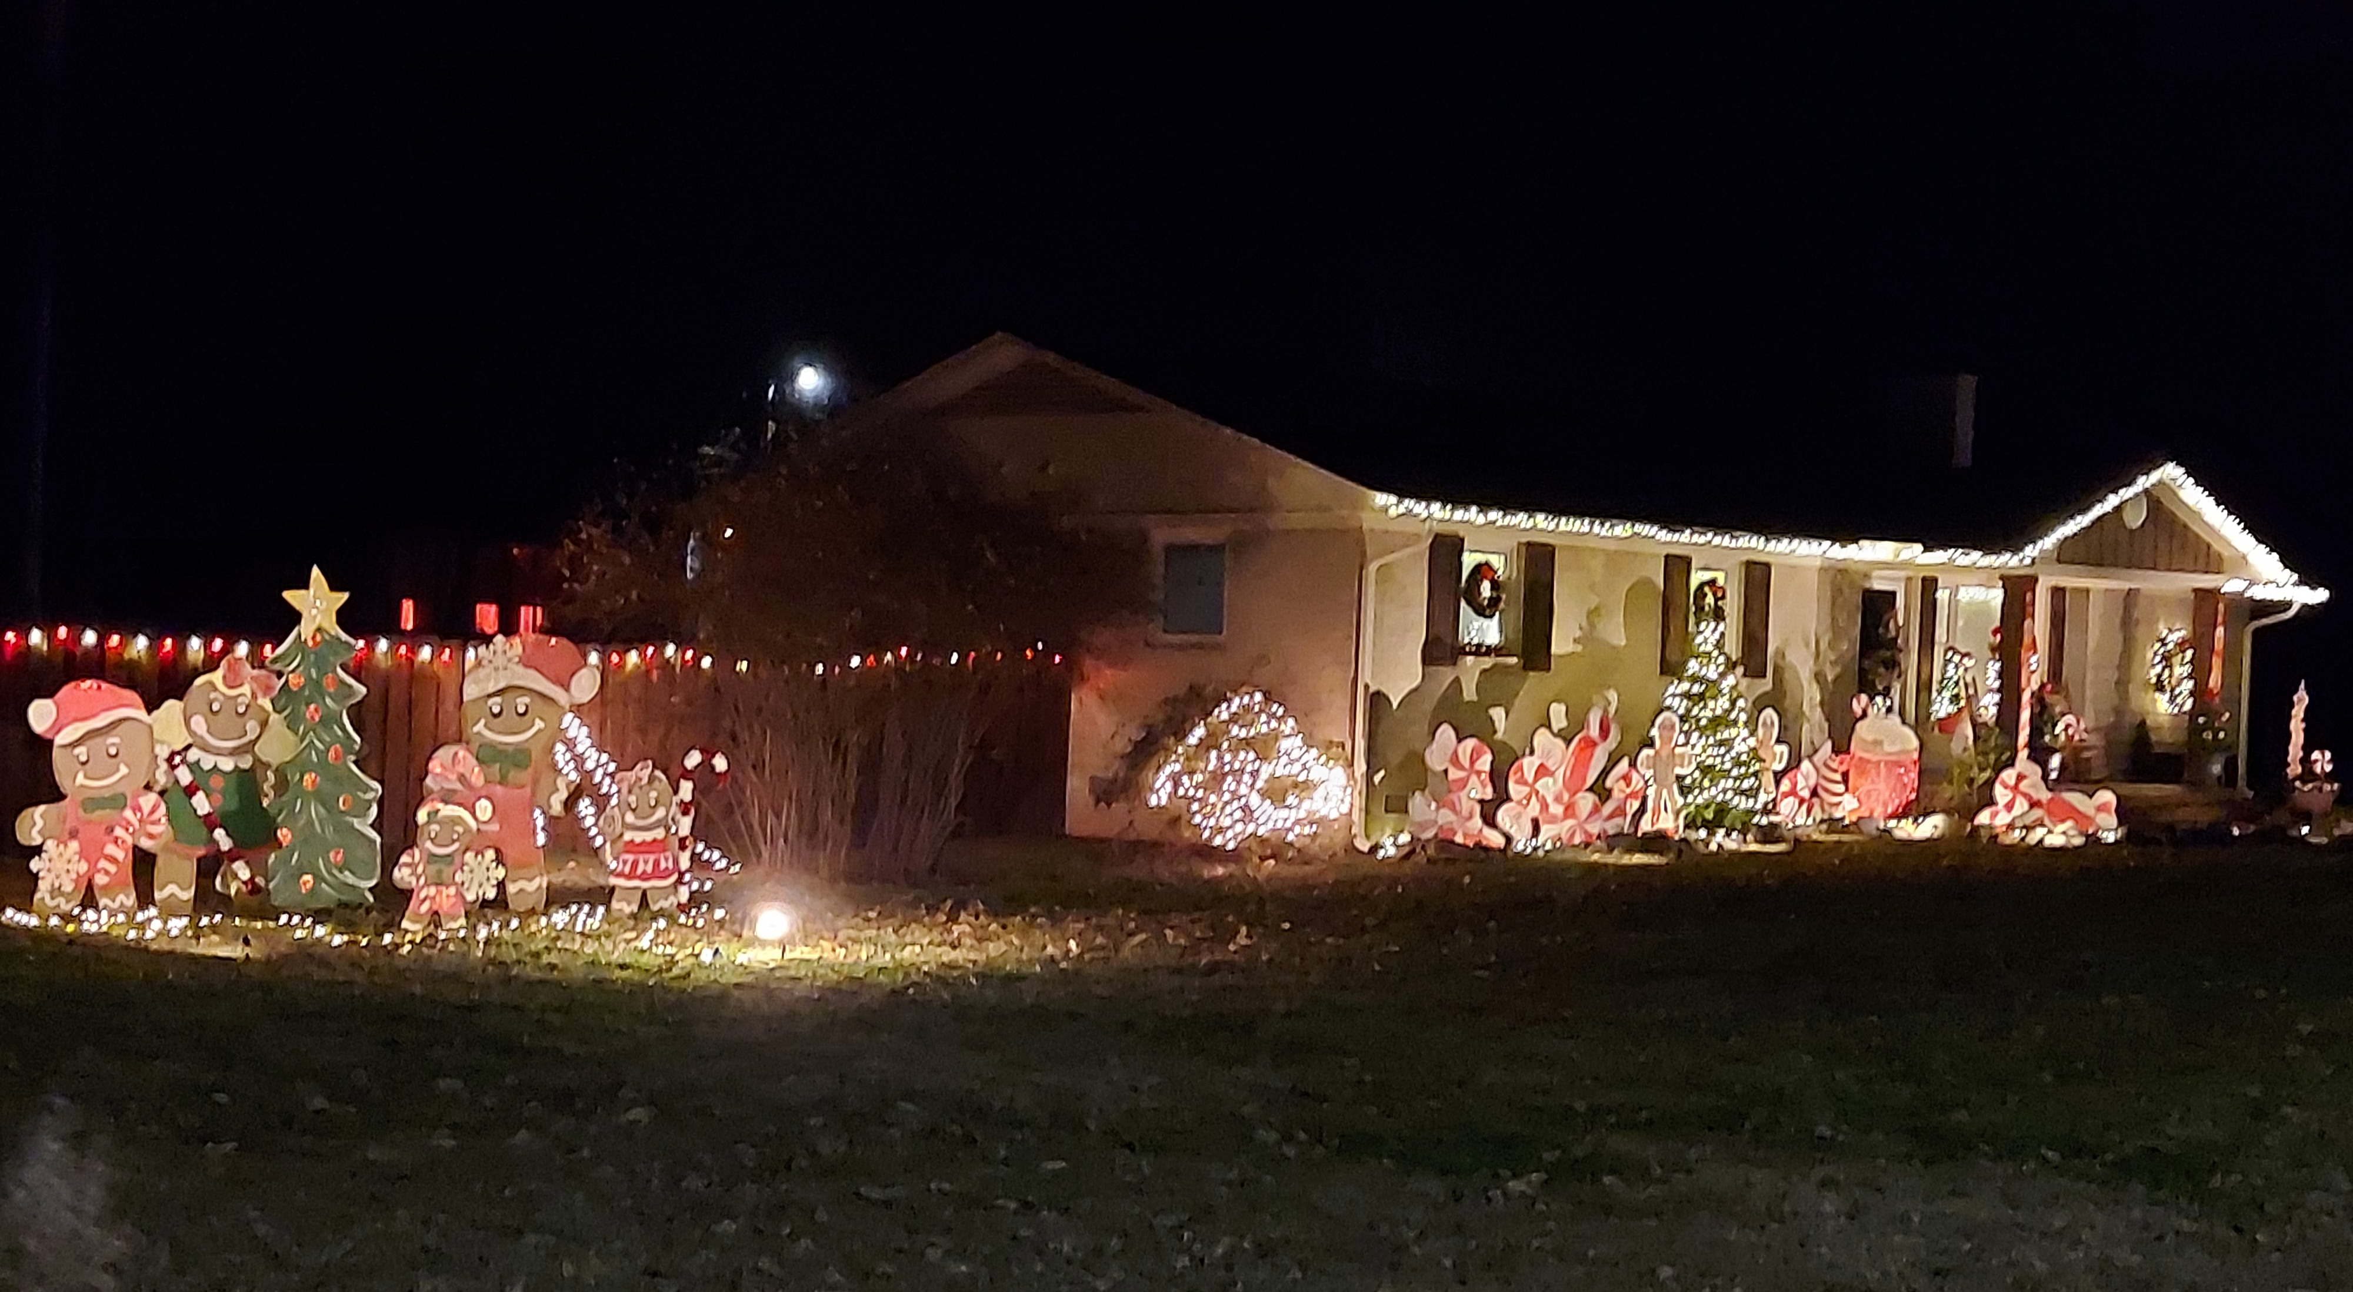
Navigating Q&A sessions
Know your material in advance
Anticipate common questions
Rehearse your responses
Maintaining composure during the Q&A session is essential for projecting confidence and authority. Consider the following tips for staying composed:
  Stay calm
  Actively listen
  Pause and reflect
  Maintain eye contact
1st Place - Score 46: Chris Ross Family
245 Devenny Rd.

