Slide 1
TILEBOND Installer & Instructor Training

Slide 2

Safety first…
Always follow proper
application procedures
Check with manufacturer and
local safety regulations
Wear suitable protective clothing,
eyewear and gloves. Refer to (Material) Safety Data Sheet ((M)SDS)
for additional details
Work in well ventilated area
Notes:
We are now moving onto the fourth (of five) learning objectives – installation guidelines for 1-part polyurethane.
When handling and installing any material, always check with the manufacturer and the local building officials for any special precautions. Generally, in accordance with safe construction practices, the applicator must wear safety glasses + chemical-resistant gloves when installing polyurethane foam adhesives. As common sense would dictate make sure that there is adequate ventilation. One of the positive aspects of using a 1 Part polyurethane adhesive is that potentially harmful chemicals such as MDI which is present in all polyurethanes are not atomized. In certain instances 2 Part adhesives require full respiration because of this atomization of MDI.
Always contact the adhesive manufacturer and follow their recommended operating and installation instructions.

Slide 3
Application Conditions
Optimal storage temperature is 40 – 80 F, Max 120 F.
Optimum Application Temperature is 70 - 90°F
Working/Open Time – Under optimum conditions set tile in adhesive pad within 4 minutes of dispensing adhesive.
High temperature and humidity will accelerate the curing process.
Lower temperature and humidity will slow down the curing process.
Damp underlayment and tile are not a problem, but there should not be standing water.
Product has 12 month shelf life

Slide 4
Preparation
Shake tank for 15 – 20 seconds prior to use.
Attach gun hose assembly to the tank using the supplied wrench.
Open the valve and apply foam.

Slide 5
Installation
Use installation manual to get proper adhesive pad size
  For flat/low and medium tile => 1”x1”x8” minimum bead size
  For high profile tile => 1 – 4”x4”x2” and 1 – 1”x1”x8” beads
Check at least 1 tile/square to confirm contact area
Modify pad size and placement to accommodate difference…but don’t reduce contact area
Notes:
The required amount of the adhesive ‘patty’ can be determined by either the size of the patty or the weight of the patty. In this case, let’s focus on the patty size.
For low or medium profile tiles, the recommended patty size for low wind areas is 1 ½”wide x by 1” high x 4” long. When the tile is placed into the patty, the contact area should compress the patty to 2” x 5”. It is recommended that the installer check at least one tile per square to confirm the contact area.
For higher wind areas – winds over 110 mph, the patty length is increased from 4” to 8” to increase the contact area.

Slide 6
Shut Down and Restart
To shut down the tank close the valve on the tank. Leave the gun and nozzle as is allowing foam to cure in the nozzle.
When ready to restart, shake the tank. Remove the nozzle by giving it a ¼ turn. Push the plug of foam out of the nozzle with a #2 screwdriver or similar object.
Be sure the O ring at the back of the nozzle is in place and reinstall the nozzle on the gun.
Open the valve on the tank and dispense foam.

Slide 7
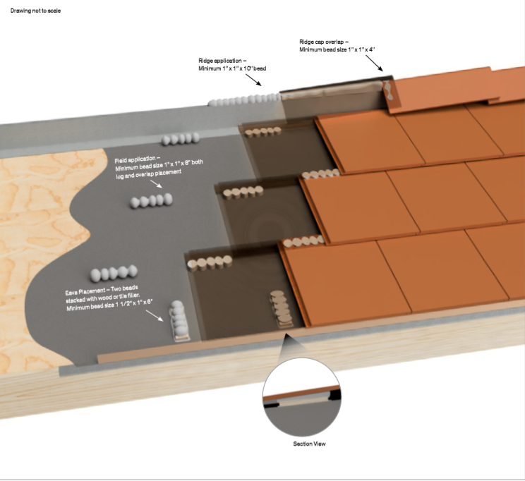

Installation Guidelines
Notes:
As you see in this figure, additional adhesives and fastening may be required at eaves and along the ridge. For example, across the ridge, use 1 x 1 x 10” patties to adhere the ridge tile. The field tiles are adhered directly to the cap sheet or batten strip. On the eaves, 1 ½ x 1 x 6” patties are dispensed onto the wood filler strip in either direction to maximize contact area.
Note that pad dimensions and placement should be modified to accommodate differences in tile configurations – just as long as the adhesive contact area is not reduced!

Slide 8
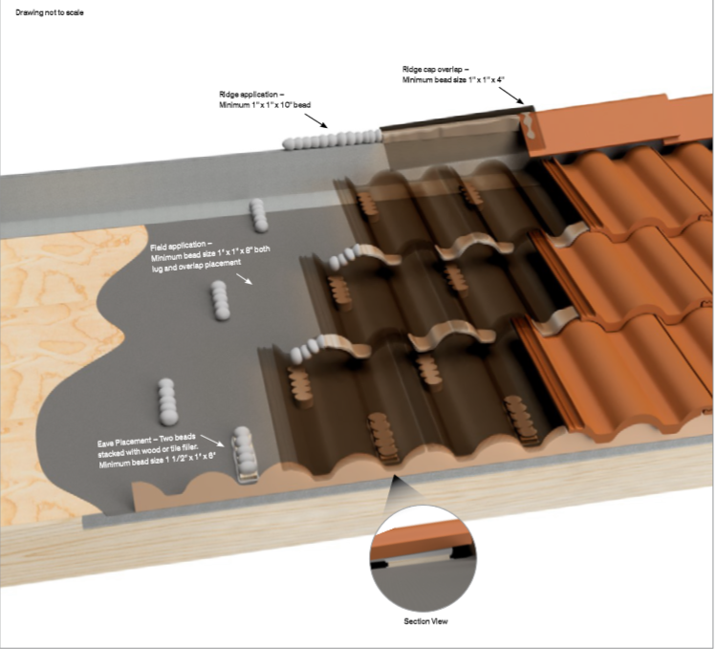
Installation Guidelines

Slide 9
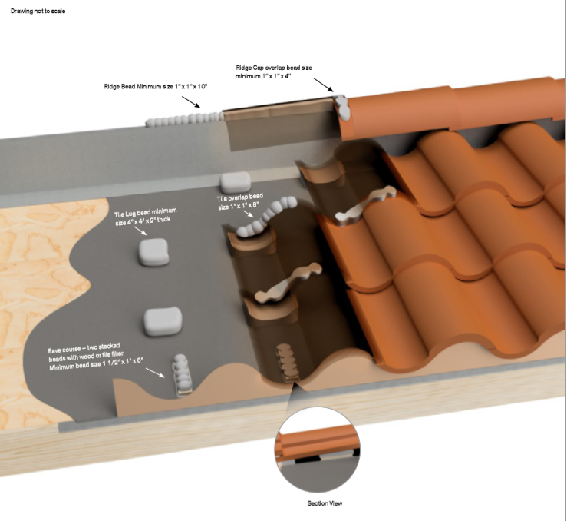
Installation Guidelines

Slide 10
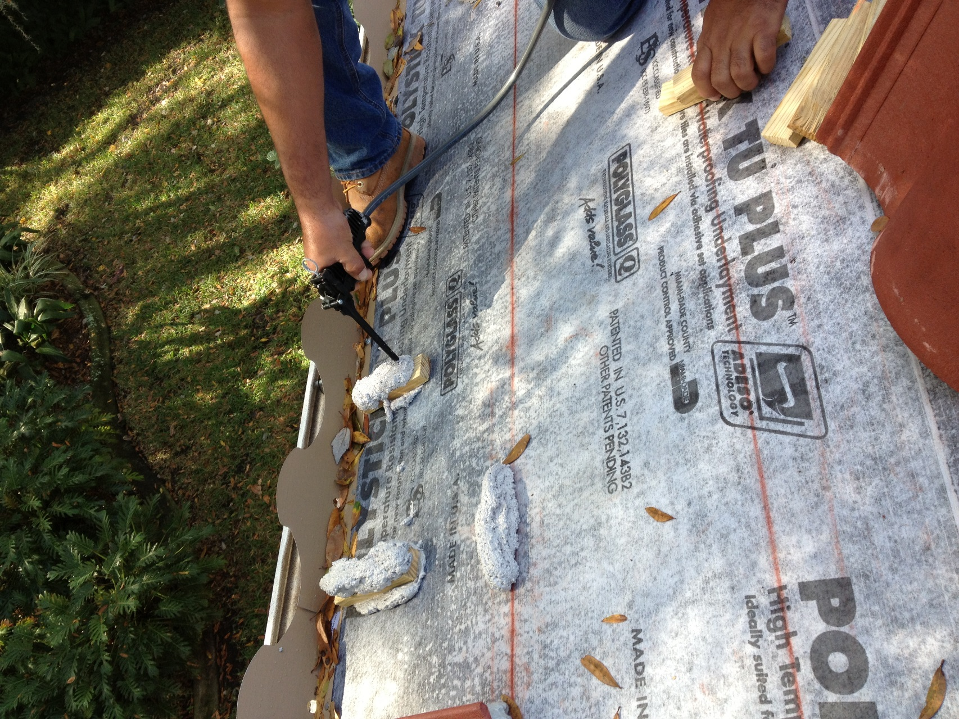
Place foam on block
WEAR suitable protective clothing (cover all skin);
Eyewear
And Gloves

Slide 11
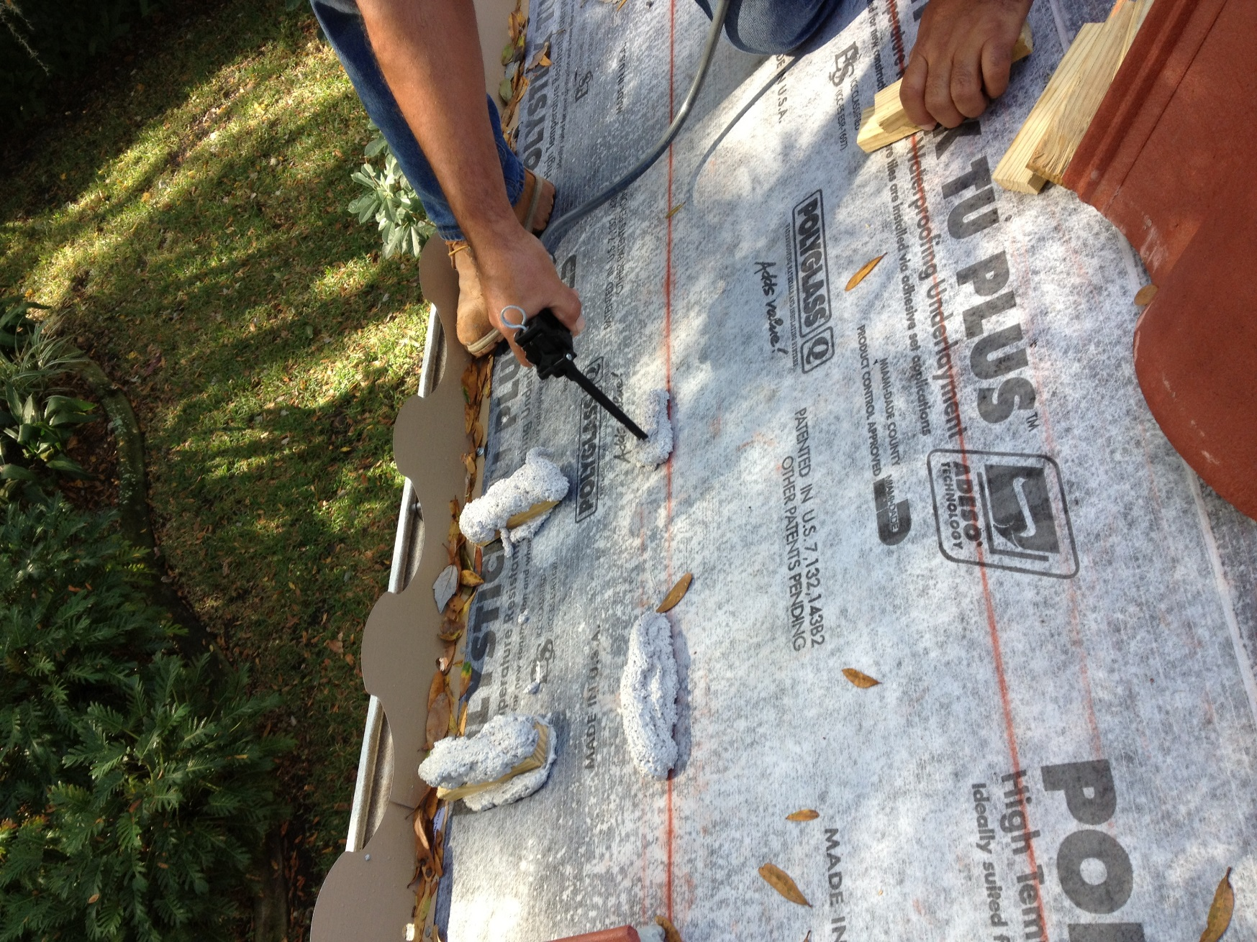
Place foam at tile head area
WEAR suitable protective clothing (cover all skin);
Eyewear
And Gloves

Slide 12
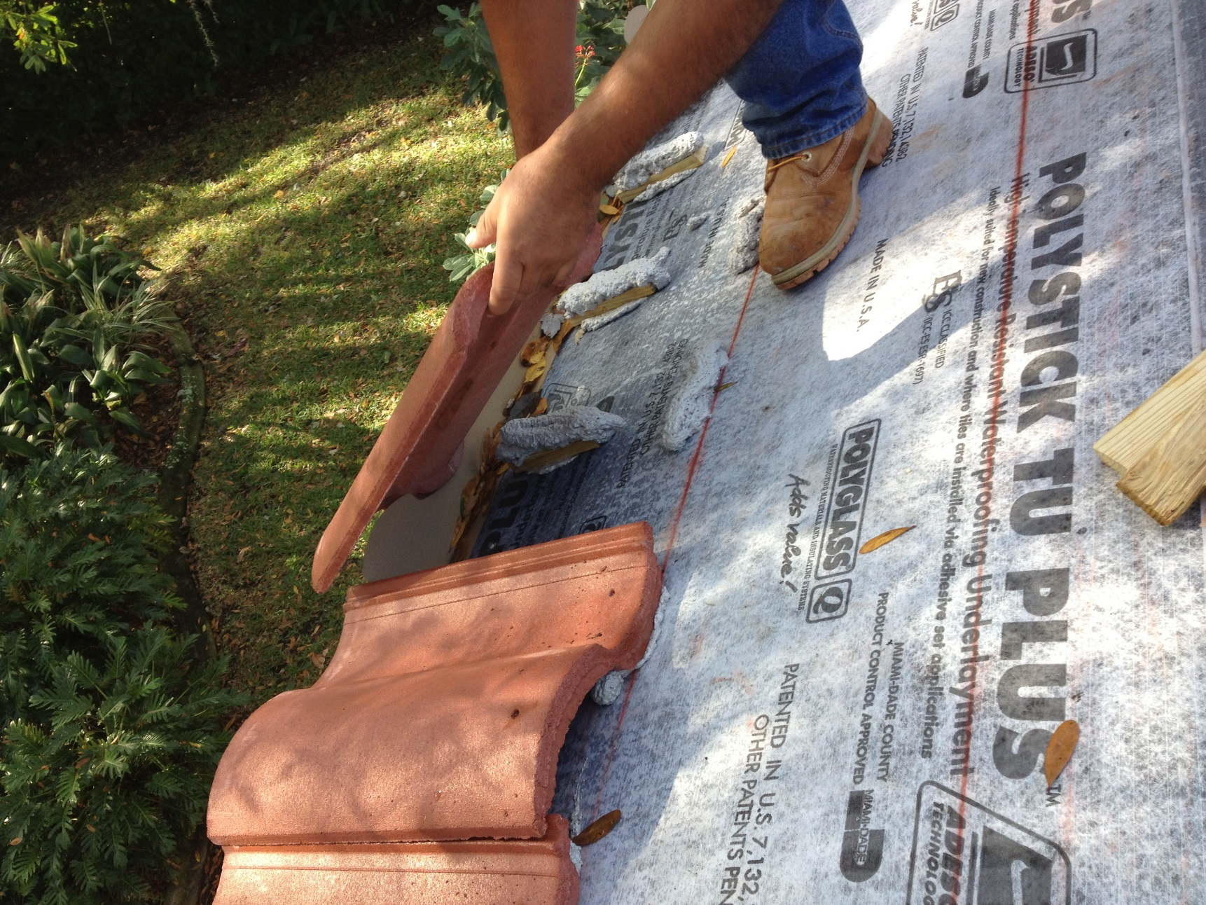
Place tile starting at bird stop
WEAR suitable protective clothing (cover all skin);
Eyewear
And Gloves

Slide 13
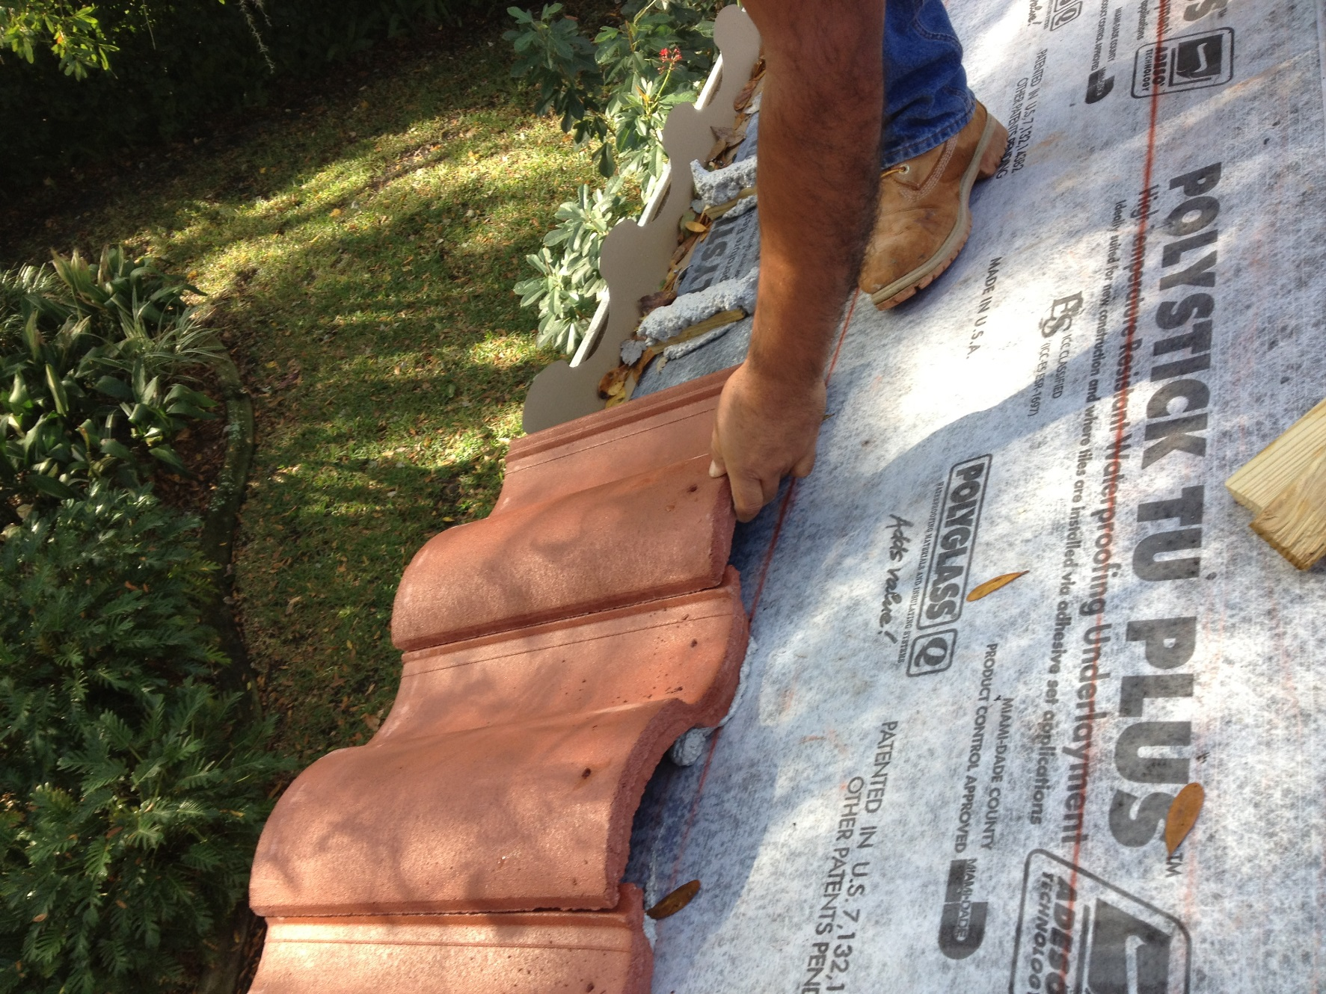
Place tile
WEAR suitable protective clothing (cover all skin);
Eyewear
And Gloves

Slide 14
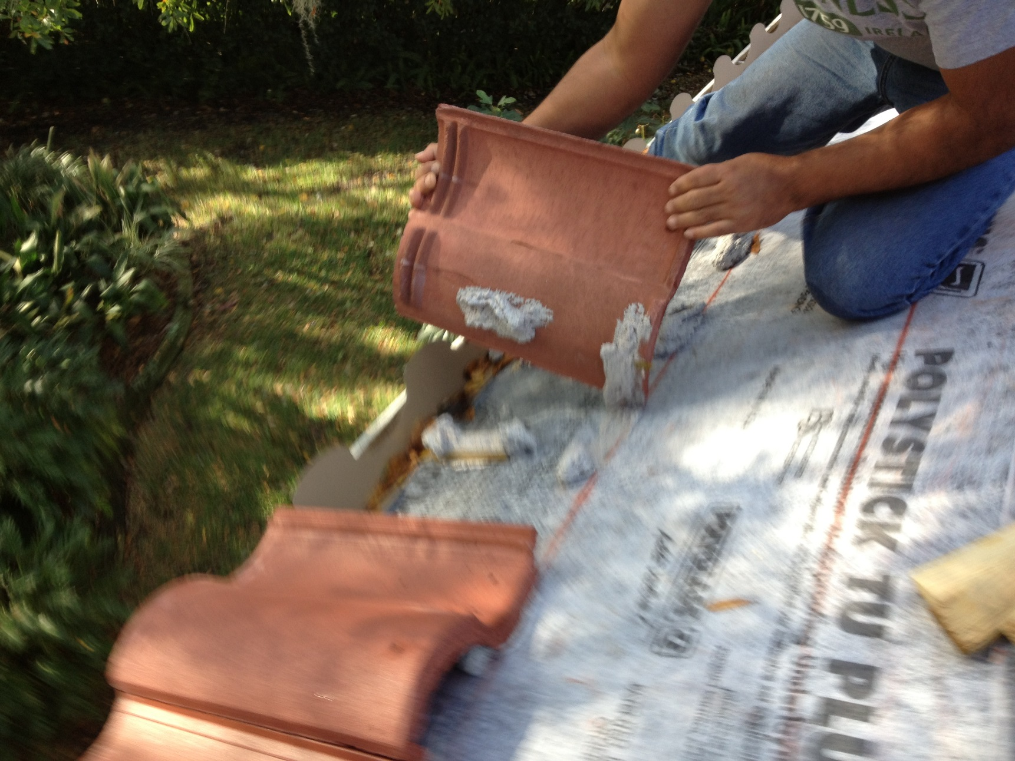
Check contact area
WEAR suitable protective clothing (cover all skin);
Eyewear
And Gloves

Slide 15
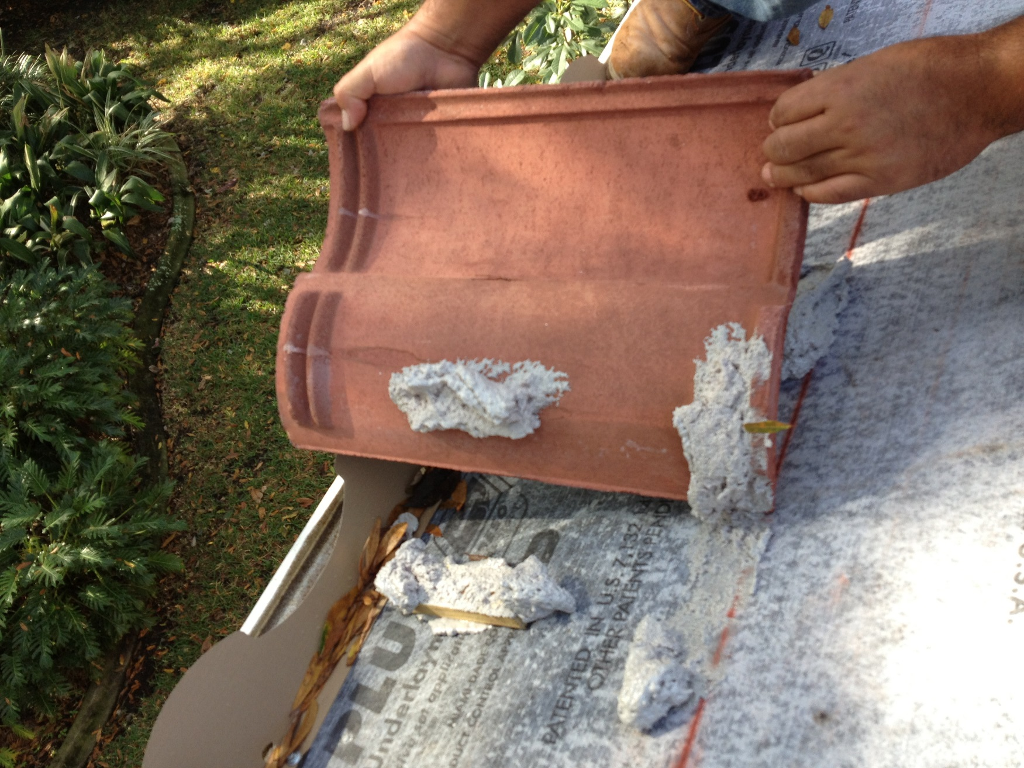
Good contact area
WEAR suitable protective clothing (cover all skin);
Eyewear
And Gloves

Slide 16
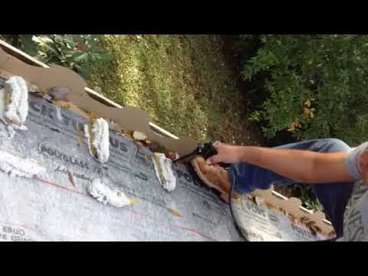
TILE BOND™ Application Video - Eave Course Part 1
WEAR suitable protective clothing (cover all skin);
Eyewear
And Gloves

Slide 17
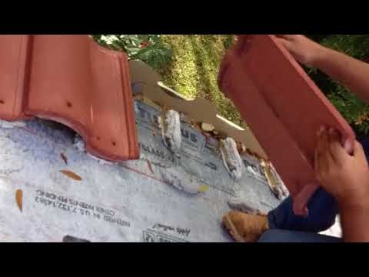
TILE BOND™ Application Video - Eave Course Part 2
WEAR suitable protective clothing (cover all skin);
Eyewear
And Gloves

Slide 18
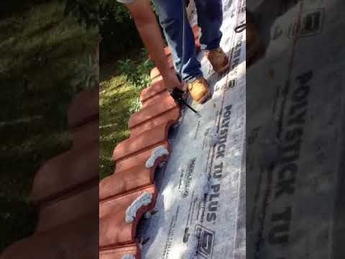
TILE BOND™ Field Installation Video
WEAR suitable protective clothing (cover all skin);
Eyewear
And Gloves

Slide 19
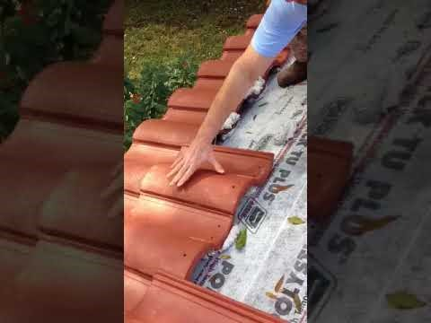
TILE BOND™ - A Rookie’s First Tile Installation
WEAR suitable protective clothing (cover all skin);
Eyewear
And Gloves

Slide 20
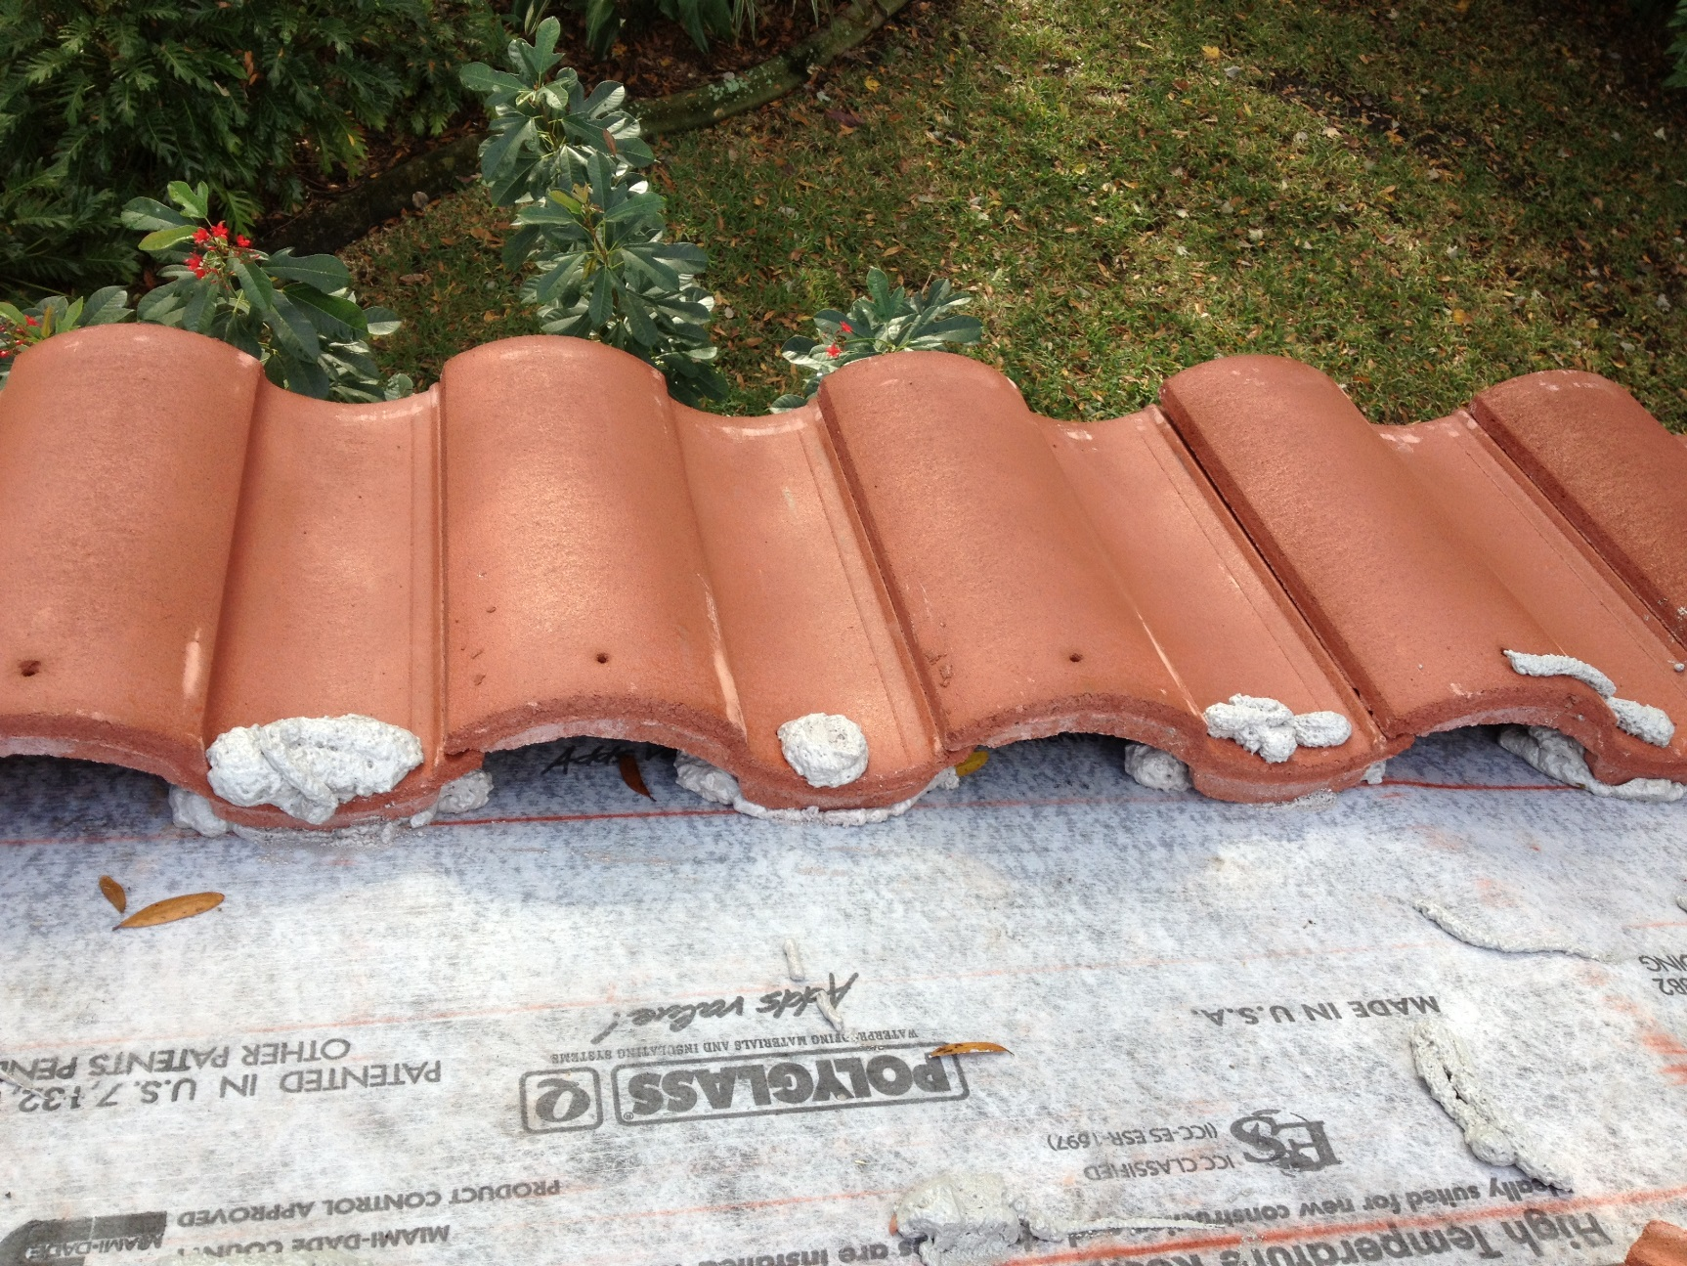
What is wrong with this picture?
WEAR suitable protective clothing (cover all skin);
Eyewear
And Gloves

Slide 21
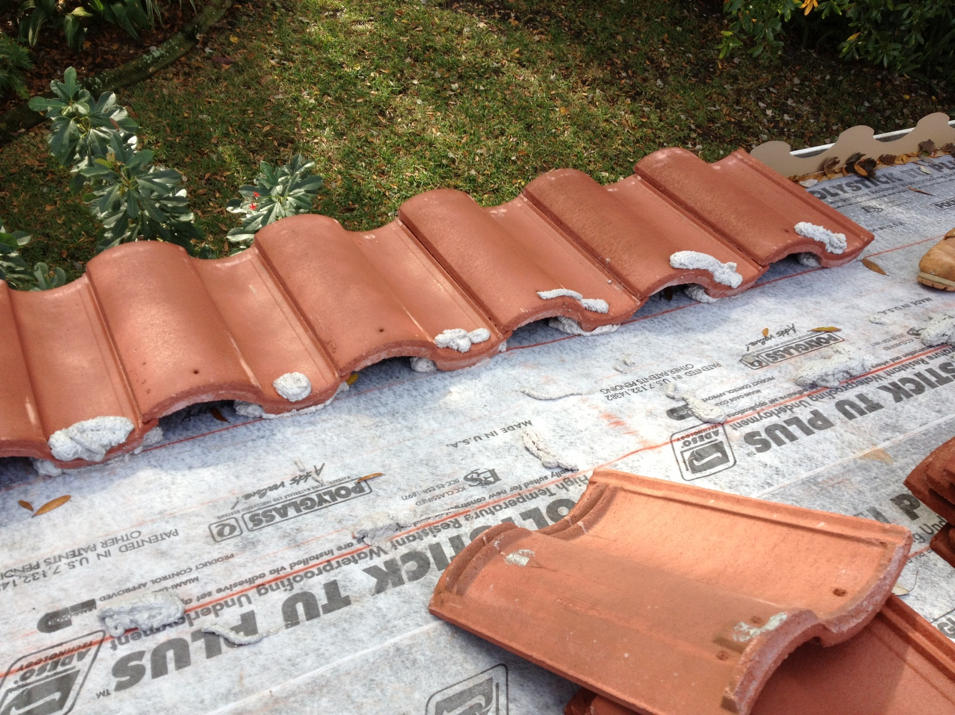
How about this?
WEAR suitable protective clothing (cover all skin);
Eyewear
And Gloves

Slide 22
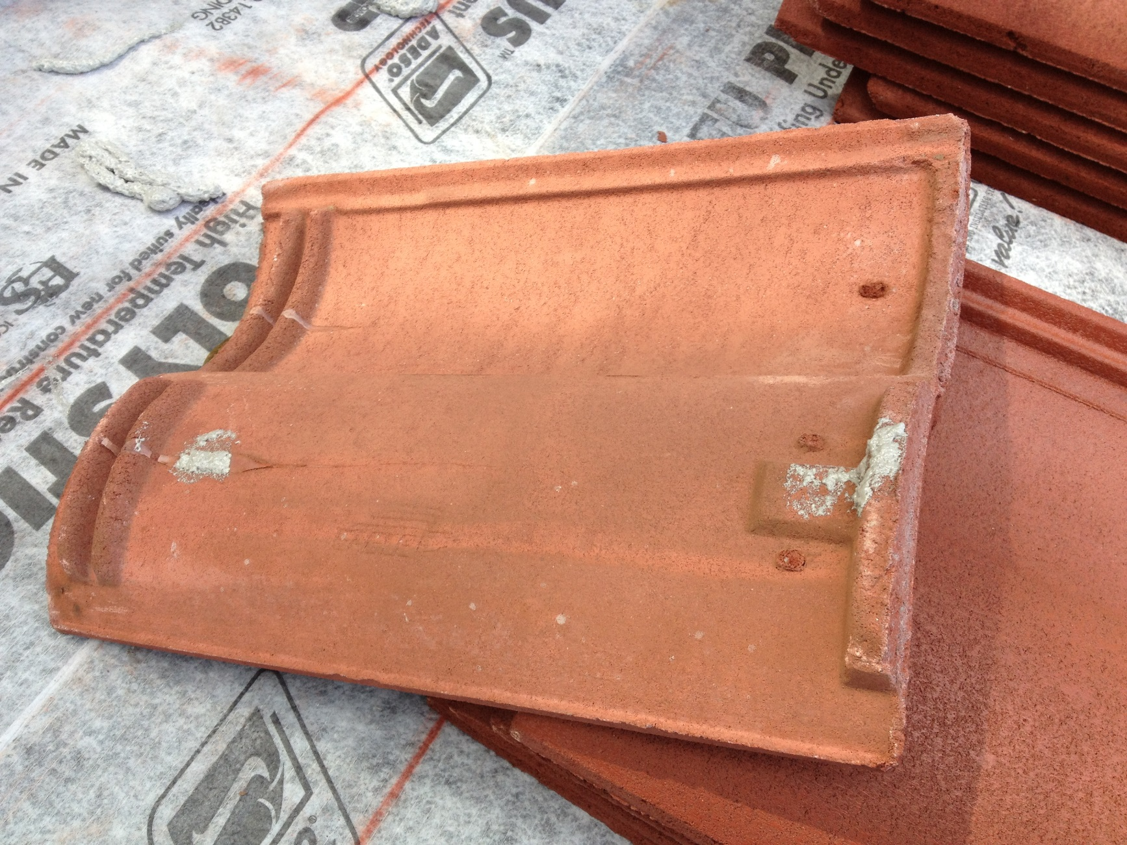
Inadequate contact area
WEAR suitable protective clothing (cover all skin);
Eyewear
And Gloves

Slide 23
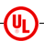
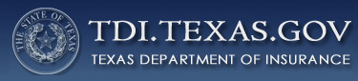
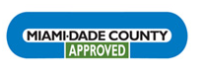
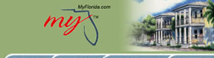
Approval Testing Overviews
Passed UL ASTM E108 fire testing
TEXAS Department of Insurance Approval
Florida Product Approval
Miami Dade- Notice of Acceptance
UL Code Evaluation Report ER18231

Slide 24

Quiz Time

