Slide 1
ISO 9001:2015 - Changes
Steve Barfoot, President
Advantage International Registrar, Inc.

Slide 2
Key Perspectives
ISO 9001 needs to change, to:
Ensure alignment with other management system standards
reflect the increasingly complex environments in which organizations operate (less prescriptive)
provide a consistent foundation for the future
reflect the increasingly complex environments in which organizations operate
ensure the new standard reflects the needs of all relevant interested parties

Slide 3
Key feature changes
10-clause structure and core text for all Management System Standards (MSS)
All ISO management systems standards will look the same with the same structure
Provides the option of integrating management systems
Clearer understanding of the organization’s context is required “one size doesn’t fit all”
Process approach strengthened/more explicit
Concept of preventive action now addressed throughout the standard by risk identification and mitigation
The term documented information replaces the terms document and record
Control of externally provided products and services replaces purchasing/outsourcing
Increased emphasis on seeking opportunities for improvement

Slide 4
Beneficial changes to ISO 9001
Enhanced leadership involvement in the management system
Risk-based thinking (improvement focused)
Aligning QMS policy and objectives with the strategy or strategic direction of the organization
Focus on achieving planned results (objectives)
Flexibility for documented information

Slide 5
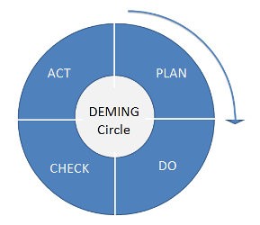
Basic ISO 9001:2015 Structure
Plan
Do
Check
Act
FROM THE 1980’S

Slide 6
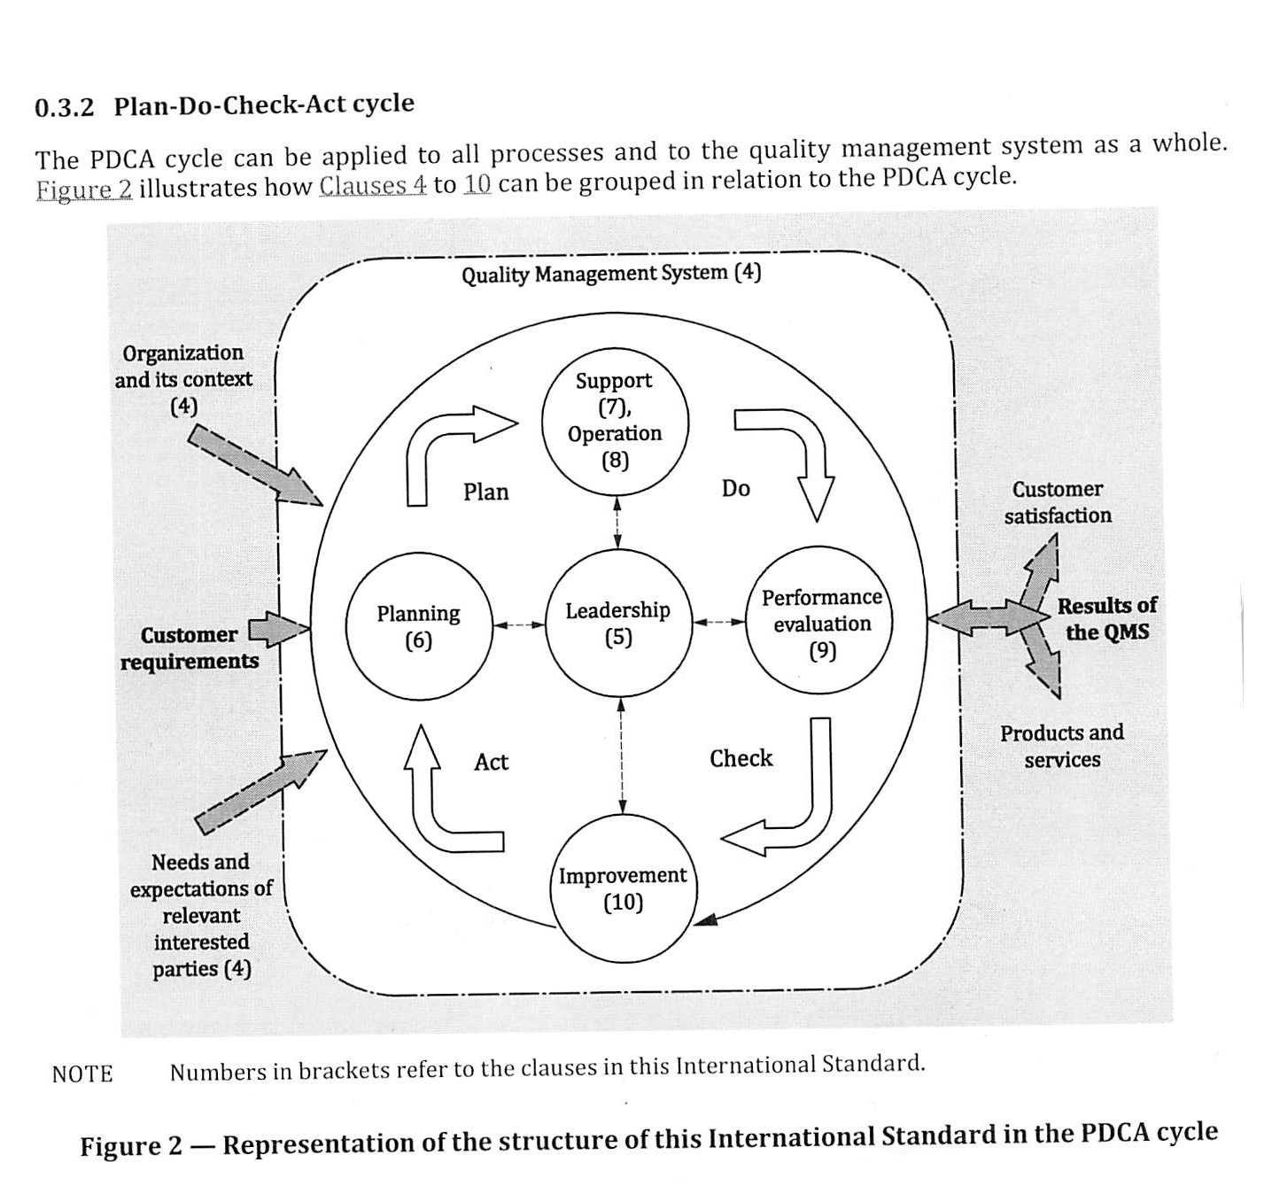

Slide 7
ISO 9001:2015 Structure (Plan)
4 Context of the organization
4.1 Understanding the organization and its context
External factors can include, for example, cultural, social, political, legal, regulatory, financial, technological, economic, and competitive environment, at the international, national, regional or local level.
Internal factors typically include the organization’s corporate culture, governance, organizational structure, technologies, information systems, and decision-making processes (both formal and informal).
4.2 Understanding the needs and expectations of interested parties
The organization will need to determine the interested parties that are relevant to the quality management system and the requirements of those interested parties, as outlined in clause 4.2.
This does not extend past the quality management system requirements and the scope of this International Standard.
An organization needs to demonstrate its ability to consistently provide products and services that meet customer and applicable statutory and regulatory requirements, and aims to enhance customer satisfaction.

Slide 8
ISO 9001:2015 Structure (Plan)
4 Context of the organization
4.3 Determining the scope of the quality management system
What is it that YOU do?
Determine ISO 9001 requirements that are NOT APPLICABLE to you and justify
4.4 Quality management system and its processes
Provide a detailed description of YOUR processes (sequence and interaction)
(May be high level, but a roadmap into YOUR system)
What is the criteria and methods that you use to ensure the effective operation of YOUR QMS
Determine and ensure availability of necessary resources and assign responsibilities
PLEASE - DO NOT REPRINT FLOWCHARTS OUT OF THE STANDARD, S/B YOUR PROCESSES.

Slide 9
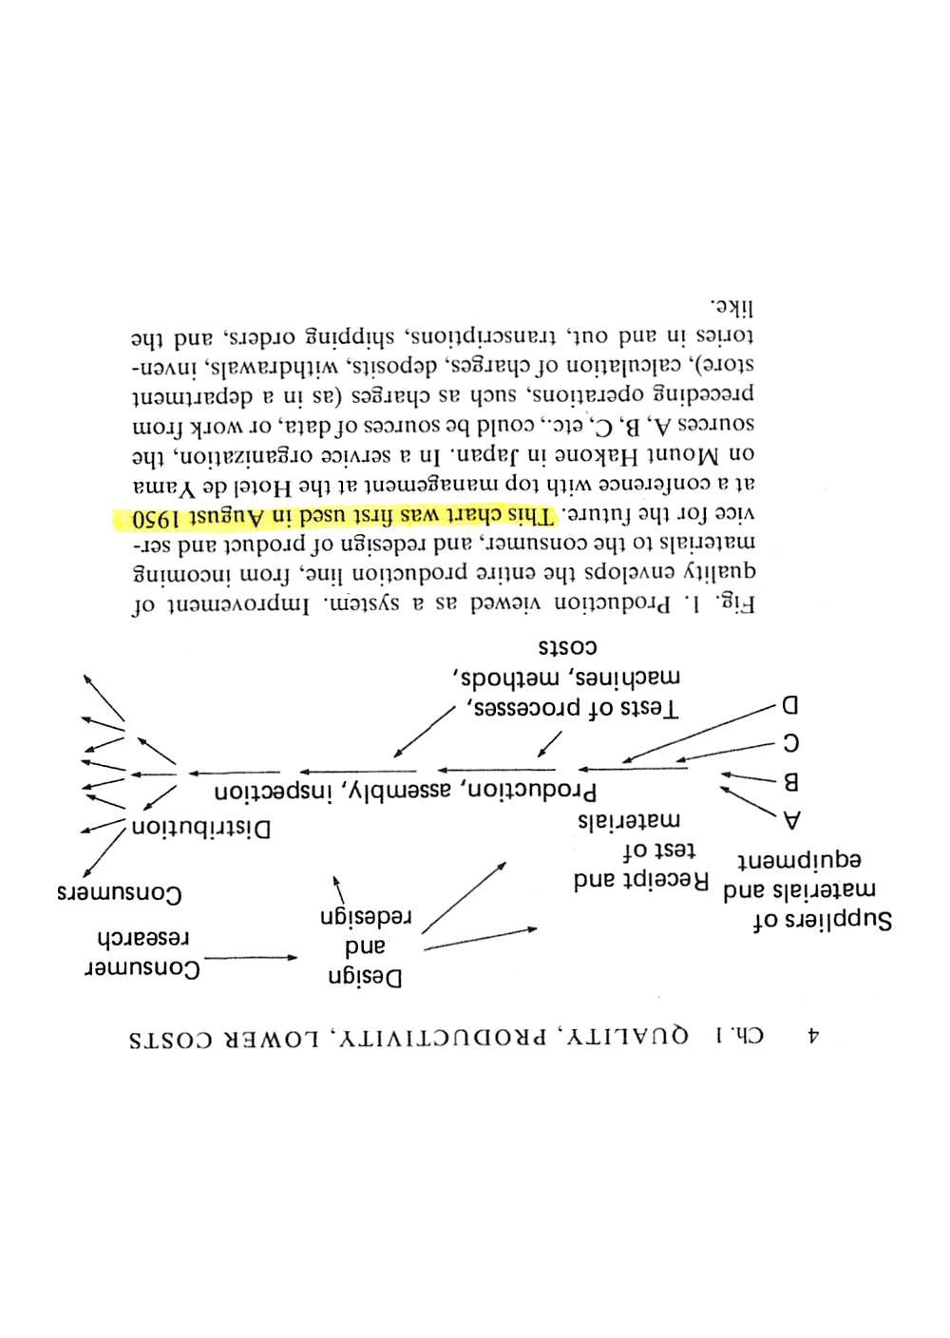
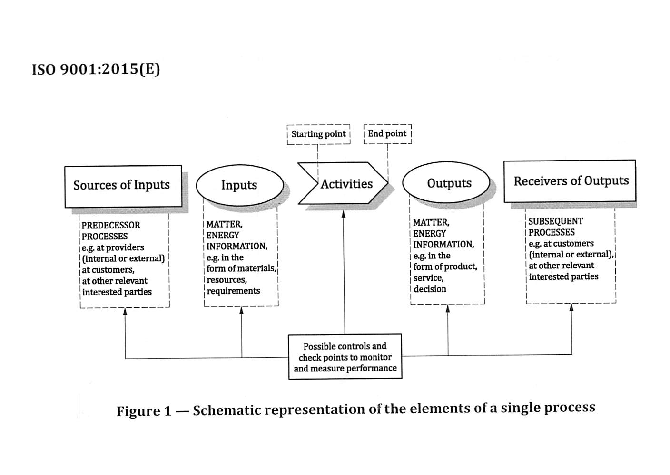

Slide 10
ISO 9001:2015 Structure (Plan)
5 Leadership
5.1 Leadership and commitment
5.2 Policy
5.3 Organizational roles, responsibilities and authorities
6 Planning
6.1 Actions to address risks and opportunities See AAQGs presentation
6.2 Quality objectives and planning to achieve them
6.3 Planning of changes

Slide 11
ISO 9001:2015 Structure (Plan)
7 Support
7.1 Resources
People, Infrastructure, Environment for the operation of processes
Monitoring and Measuring Resources, Organization Knowledge
7.2 Competence (See IAF’s ISO 9001 Auditing Practices Group)
7.3 Awareness
7.4 Communication
7.5 Documented information
Documentation, documents and records are now collectively referred to as documented information. Where that documented information might be subject to change (as in the case of procedures, work instructions, etc), organizations are required to MAINTAIN the information up-to-date; where the information is not normally subject to change (for example records) the organization is required to RETAIN that information.

Slide 12
ISO 9001:2015 Structure (Do)
ISO 9001:2015
ISO 9001:2008
8 Operation
8.1 Operational planning and control
8.2 Requirements for products and services
8.3 Design and development of products and services
8.4 Control of externally provided processes, products and services
8.5 Production and service provision
8.6 Release of products and services
8.7 Control of nonconforming outputs
7 Product realization
7.1 Planning of product realization
7.2 Customer related processes
7.3 Design and development
7.4 Purchasing
7.5 Production and service provision
7.6 Control of monitoring and measuring equipment
8.3 Control of nonconforming product

Slide 13
ISO 9001:2015 Structure (Check)
9 Performance evaluation
9.1 Monitoring, measurement, analysis and evaluation
Customer satisfaction, analysis and evaluation
9.2 Internal audit
9.3 Management review
Additional required inputs (as a minimum):
Changes in external and internal issues
Performance of external providers
Effectiveness of actions taken to address risk and opportunities
Expected Outputs: OFI’s, need for changes, resource needs

Slide 14
ISO 9001:2015 Structure (ACT)
10 Improvement
10.1 General
Improve products and services
Correct, prevent or reduce undesired effects
Improve performance and effectiveness
10.2 Nonconformity and corrective action
10.3 Continual improvement

Slide 15
ISO 9001:2015 Structure (Annex A1 – A8)
A1 Structure and terminology
A2 Products and services
A3 Understanding the needs and expectations of interested parties
A4 Risk based thinking
A5 Applicability
A6 Documented information
A7 Organizational knowledge
A8 Control of externally provided processes, producst and services

Slide 16
ISO 9001:2015 Related Documents
ISO 9000: Quality management systems – Fundamentals and vocabulary
ISO 9004: Managing for the sustained success of an organization
ISO 10000 series:
ISO 10001: Customer satisfaction – codes of conduct
ISO 10002: Customer satisfaction – complaints handling
ISO 10003: Customer satisfaction – dispute resolution
ISO 10004: Customer satisfaction – monitoring and measuring
ISO 10005; Quality plans
ISO 10018: People involvement and competence

Slide 17
Key Points - Summary
Determining the organizational context enables a more effective implementation of the quality management system
Greater emphasis on processes being managed to achieve planned results
Alignment with strategic direction
Integration of the QMS into organization’s business processes
Determining risks and opportunities increase the effectiveness of the organization’s QMS
Change management has been expanded to add emphasis that the QMS should be carried out in a planned manner
The concept of organizational knowledge introduced to ensure the organization acquires and maintains the necessary knowledge
Communication expanded to include external

