Slide 1
LOTO: Requirements
LOCKOUT / TAGOUT
29 CFR 1910.147

Slide 2
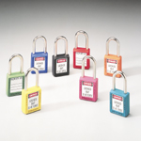
Locks Will be Singularly Identified
  Lockout devices shall be standardized within the facility.
    Color, shape, and size
  Locks shall be the only device(s) used for controlling energy;
  Shall not be used for other purposes.

Slide 3

LOTO Tags - Identifiable
Lockout devices and tagout devices shall indicate the identify of the employee applying the device(s).

Slide 4
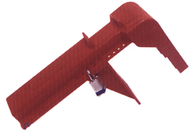
Requirements
Lockout and tagout devices shall be capable of withstanding the environment to which they are exposed for the maximum period of time that exposure is expected.
Lockout devices shall be substantial enough to prevent removal without the use of excessive force or unusual techniques, such as with the use of bolt cutters or other metal cutting tools.

Slide 5
Shift/Personnel Changes
Specific procedures to be implemented to maintain continuity.
Transfer of protection from off-going to oncoming personnel.
Minimize hazard(s) to all employees.

Slide 6
Employer Removal of a Lock
Verification by the employer that the authorized employee is not at the facility.
Making all reasonable efforts to contact the authorized employee to inform.
Ensuring that the authorized employee has this knowledge before he/she resumes work at that facility.

Slide 7
Periodic Inspection
The employer shall conduct a periodic inspection of the energy control procedure at least annually to ensure that the procedure and the requirements of this standard are being followed.

Slide 8
Periodic Inspection
The periodic inspection shall be performed by an authorized employee other than the one(s) utilizing the energy control procedure being inspected.
The periodic inspection shall be conducted to correct any deviations or inadequacies identified.
Include a review of employee's responsibilities under the energy control procedure being inspected.

