Slide 1


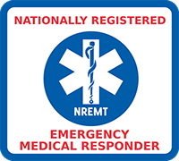
WVOEMS EMT REFRESHER
MODULE 1: AIRWAY
MODULE 2: CARDIOLOGY
MODULE 3: TRAUMA
MODULE 4: MEDICAL
MODULE 5: OPERATIONS

Slide 2
AIRWAY
VENTILATION
ORAL/NASAL AIRWAY
PEDIATRIC AIRWAY

Slide 3
AIRWAY
VENTILATION

Slide 4
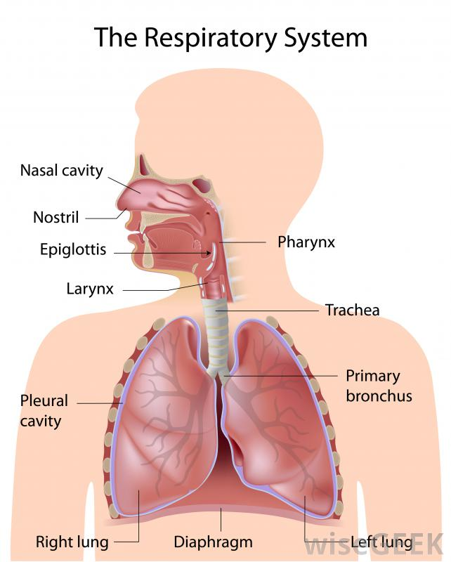
VENTILATION
Anatomy and Physiology of the Airway System
Oropharynx
Nasopharynx
Pharynx
Trachea
Esophagus
Bronchi
Lungs
Alveoli
Capillaries

Slide 5
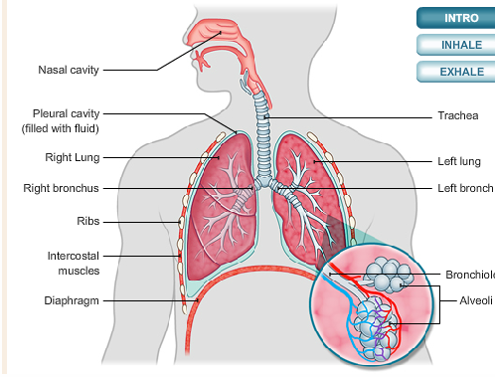
VENTILATION
The Ventilatory Process
Alveolar ventilation – the exchange of oxygen and carbon dioxide that occurs in the alveoli
Minute ventilation – the amount of air pulled into the lungs and removed from the lungs in one minute

Slide 6
VENTILATION
Adequate vs. Inadequate Breathing
Look, Listen, and Feel!
  Looking for rise and fall of the chest for equal expansion and adequate depth
  Listening for air flow and any obstructive sounds
  Feeling the air coming from the patients nose and mouth as well.
  *A normal adult, has a resting breathing rate of about 12-20 breaths per minute.
  Are there noisy respirations, wheezes, gurgling, gasping, any cyanosis, absent, slow or rapid

Slide 7
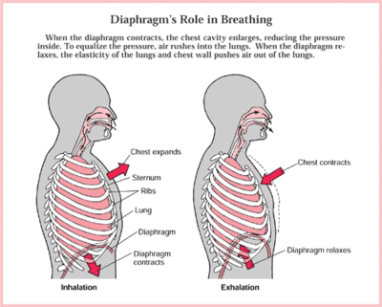
VENTILATION

Slide 8
VENTILATION
Respiratory Distress
  Retractions
  Two word sentences
  Pursed lips
  Cyanosis
Respiratory Failure
  Decreased consciousness
  Poor chest rise
  Pale, cool, mottled
  Minimal air movement

Slide 9
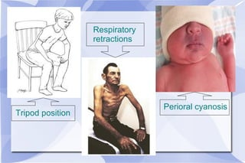
VENTILATION

Slide 10
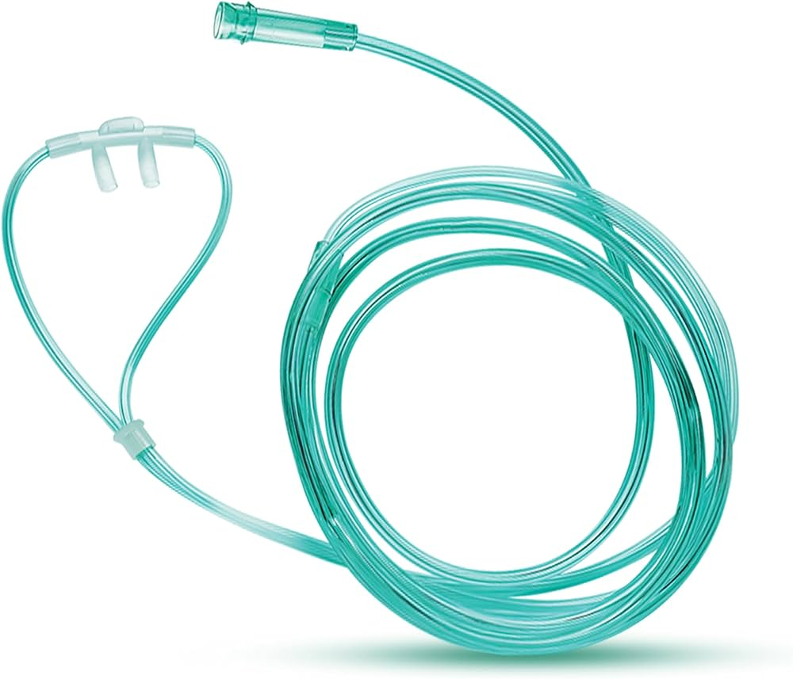
VENTILATION
Oxygen Delivery Devices
Nasal cannula
  Fairly stable patients
  Low-flow oxygen from 2-6 L/minute, 35 to 50%

Slide 11
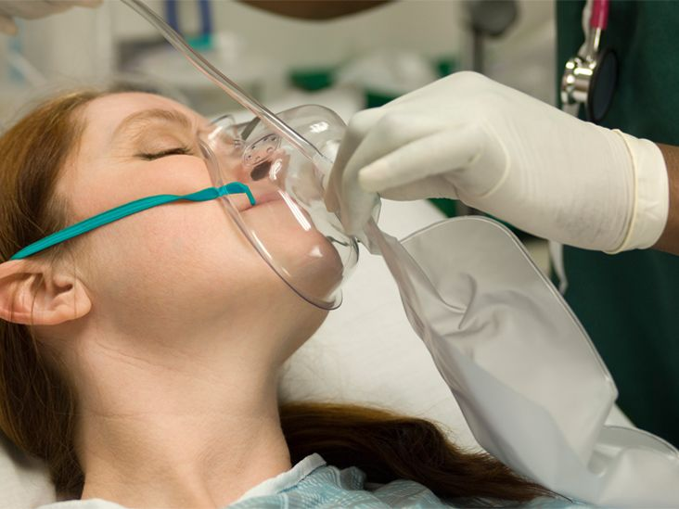
VENTILATION
Oxygen Delivery Devices
Non-rebreather
  Patients with serious s/s such as severe shortness of breath, severe chest pain, congestive heart failure and carbon monoxide poisoning as well as s/s of shock
  Delivers high flow oxygen at 8-15 L/minute, and concentrations as high as 90% with a reservoir bag

Slide 12
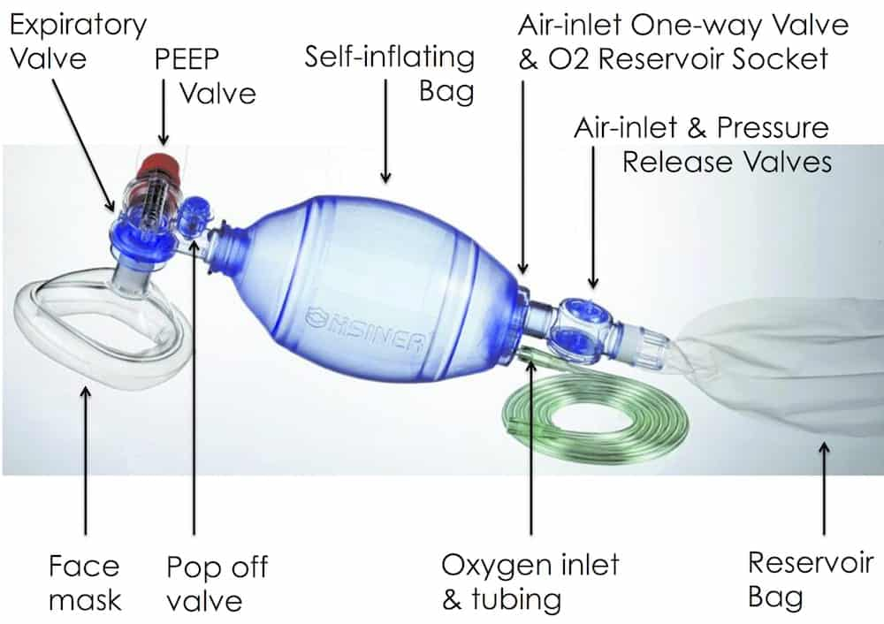
VENTILATION
Oxygen Delivery Devices
  BVM device consists of a reservoir and one way valve. With oxygen attached from 10-15 L/min it can deliver up to a concentration of up to 90%.
  This is more reliably accomplished as a two-person skill, although can be done by one person.

Slide 13
VENTILATION
Adult rescue breathing
  Kneel at patient's head maintaining an open airway. Assure the mouth is clear of any fluids or foreign bodies
  Select the proper mask size
  Place the mask on the patients face
  Seal the mask, forming an E – C with your fingers around the chin and mask
  Lifting the chin into the mask, then squeeze the bag and visualize chest rise
  Add supplemental oxygen
  Rescue breath once every 5-6 seconds
Child/infant rescue breathing
  Due to the smaller anatomy and airways of children you will not have to use as much of a head tilt. Also, padding under their torso may assist in maintaining an open airway.
  Use a sniffing position in most cases for infants.
  Too much of a tilt and you will close off the airway.
  The rate is also slightly faster with children with a rescue breath given once every 3-5 seconds

Slide 14
VENTILATION
Indications for Oxygen
Don’t deny any patient oxygen with shortness of breath or who is clearly having difficulty breathing.
Oxygen therapy for Acute Coronary syndrome and stroke patients should be guided by measured oxygen levels (SpO2). In the absence of SpO2 measurements, then it is reasonable to give 2 L/min nasal cannula.
A patient presenting with ACS and stroke with signs and symptoms of dyspnea, shock and heart failure, it is also reasonable to administer high flow oxygen via a non-rebreather mask.

Slide 15
VENTILATION
Safety Considerations for Handling Oxygen
Comes in highly pressurized cylinders
Is highly combustible with any spark, flame or heat
Always handle carefully, be sure to turn off tank when not in use and release any pressure on regulator
Store appropriately and make sure cylinder is secured with straps in unit

Slide 16
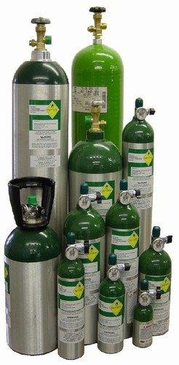
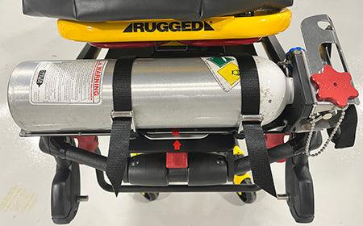
VENTILATION

Slide 17
AIRWAY
ORAL/NASAL AIRWAY

Slide 18
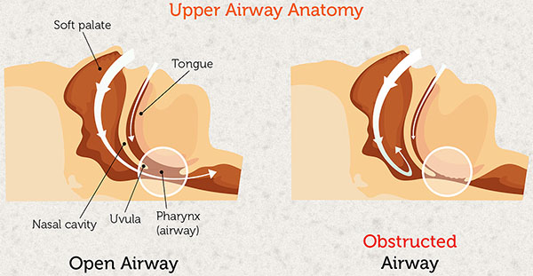
ORAL/NASAL AIRWAY
Opening the Airway
Always ensure you have an open airway before ventilating or placing an airway
Rapidly assess whether an unconscious patient has an open airway and is breathing adequately.
  Position the patient correctly
  Supine position is most effective
  Most common obstruction
  is the tongue

Slide 19
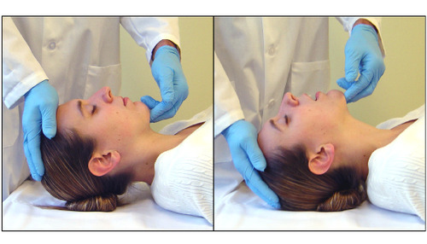
ORAL/NASAL AIRWAY
Head Tilt-Chin Lift Maneuver
Will open airway in most patients
Used on patients that have not sustained or are not suspected of having trauma
  With the patient supine, position yourself beside the patient’s head
  Place the heel of one hand on the forehead, and apply firm backward pressure with the palm
  Place the fingertips of the other hand under the lower jaw
  Lift the chin upward, with the entire lower jaw

Slide 20
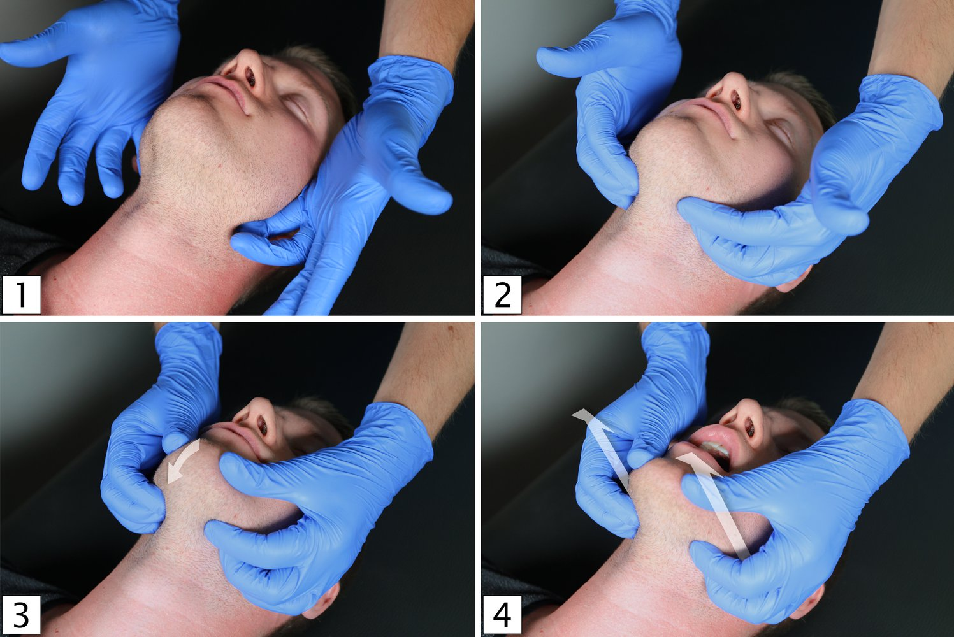
ORAL/NASAL AIRWAY
Jaw-Thrust Maneuver
If you suspect a cervical spine injury, use this maneuver
  Kneel above the patient’s head
  Place your fingers behind the angles of the lower jaw
  Move the jaw upward
  Use your thumbs to help position the jaw

Slide 21
ORAL/NASAL AIRWAY
Even if the airway is opened, the mouth may still be closed
Use the cross-finger technique
  Place the tips of your index finger and thumb on the patient’s teeth
  Push your thumb on the lower teeth
  Push your index finger on the upper teeth
  The index finger and the thumb cross over each other

Slide 22
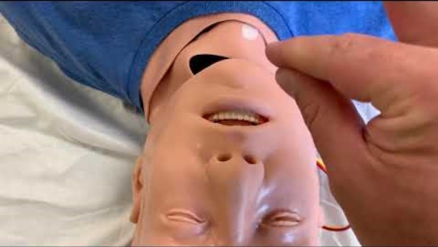
ORAL/NASAL AIRWAY

Slide 23
ORAL/NASAL AIRWAY
Basic Airway Adjuncts
Prevent obstruction by the tongue and allow for passage of air and oxygen to the lungs
2 types- Oropharyngeal and Nasopharyngeal

Slide 24
ORAL/NASAL AIRWAY
Oropharyngeal airways
  Keep the tongue from blocking the upper airway
  Make it easier to suction the oropharynx
Indications
  Unresponsive patients without a gag reflex
  Apneic patients being ventilated with a bag-mask device
Contraindications
  Conscious patients
  Any patient with a gag reflex

Slide 25
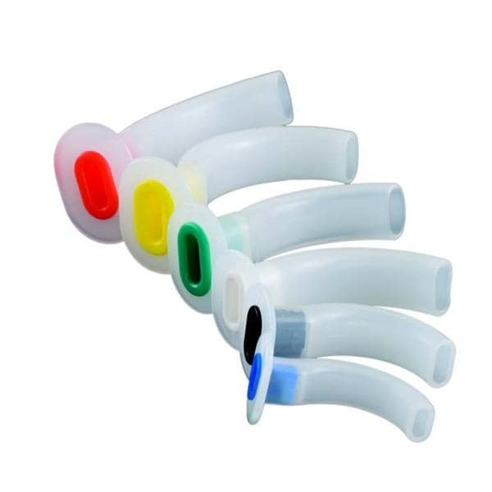

ORAL/NASAL AIRWAY

Slide 26
ORAL/NASAL AIRWAY
Nasopharyngeal airways
Used in patients who
  Are unresponsive or have an altered level of consciousness
  Have an intact gag reflex
  Are unable to maintain his or her own airway spontaneously
Indications
  Semiconscious/unconscious patients with gag reflex
  Patients who will not tolerate and oral airway
Contraindications
  Severe head injury with blood in the nose
  History of fractured nasal bone

Slide 27
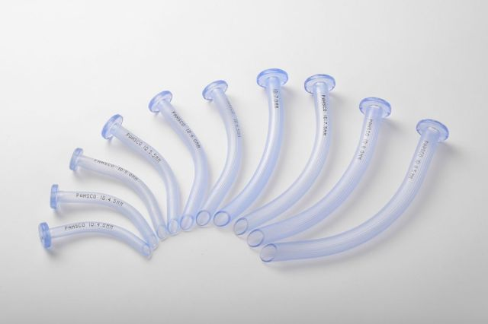
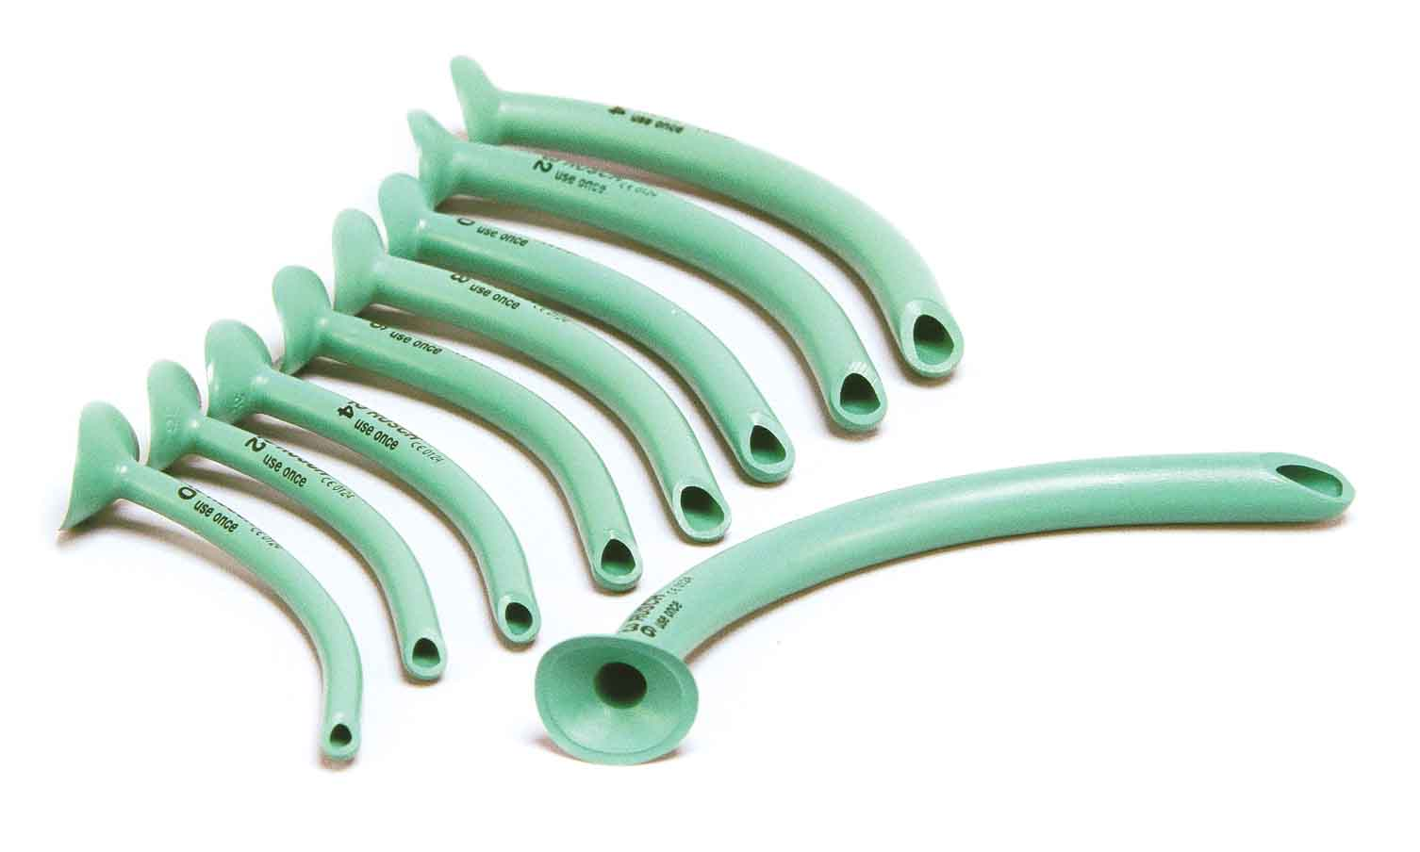
ORAL/NASAL AIRWAY

Slide 28
AIRWAY
PEDIATRIC AIRWAY

Slide 29
PEDIATRIC AIRWAY
The pediatric airway anatomy differs from that of an adult
  Smaller in diameter
  Shorter in length
  Lungs are smaller
  Heart sits higher in the chest

Slide 30
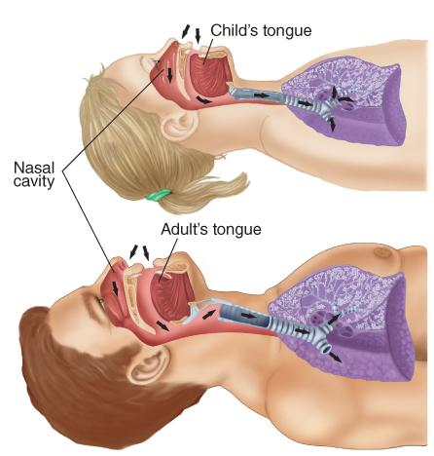
PEDIATRIC AIRWAY

Slide 31
PEDIATRIC AIRWAY
  Diameter of trachea in infants is about the same as a drinking straw.
  Airway is easily obstructed by secretions, blood, or swelling.
  Infants are nose breathers and may require suctioning and airway maintenance.
  Respiratory rate of 20 to 60 breaths/min is normal for a newborn.
  Children have a higher demand for oxygen
    They have an increased risk for hypoxia

Slide 32
PEDIATRIC AIRWAY
  Muscles of the diaphragm dictate the amount of air a child inspires.
    Pressure on child’s abdomen can cause respiratory compromise
    Use caution when applying the straps of a spinal immobilization device
  Gastric distention may interfere with diaphragm movement
    This may lead to hypoventilation
  Breath sounds are more easily heard
  Poor air movement or absent breath sounds may be more difficult to determine

Slide 33
PEDIATRIC AIRWAY
Keep the pediatric airway open in the sniffing position
  Overextending the neck could close off the airway due to undeveloped trachea
Padding may be needed under the shoulders to keep the head in a sniffing position

Slide 34
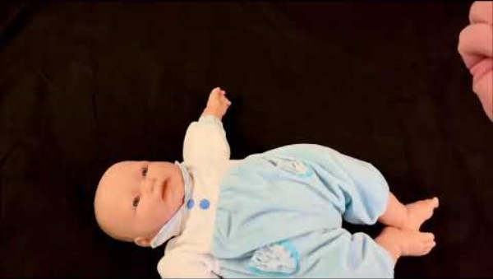
PEDIATRIC AIRWAY

Slide 35
PEDIATRIC AIRWAY
Children with significant injury should receive supplemental oxygen
Injury, fear, and crying all increase oxygen demands
Be prepared for the child to vomit
  Have suction readily available

Slide 36
PEDIATRIC AIRWAY
Upper Airway Emergencies
  Foreign Body Aspiration or Obstruction
    Small objects or food items may obstruct a child’s airway
    The tongue frequently cause upper airway obstruction due to its size in a child with a decreased LOC
  Anaphylaxis
  Croup
  Epiglottitis and Bacterial Infections

Slide 37
CARDIOLOGY
CARDIAC ARREST
PEDIATRIC ARREST
CHEST PAIN

Slide 38
CARDIOLOGY
CARDIAC ARREST

Slide 39
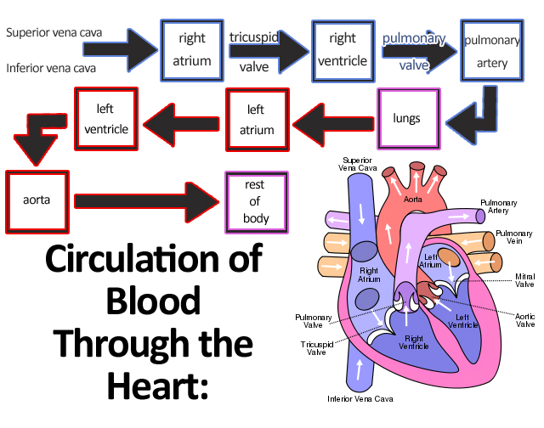
CARDIOLOGY
Anatomy and Physiology of the Cardiovascular System
The Circulatory System
  Heart (Atrium and Ventricles)
  Arteries
  Veins
  Capillaries
  Carotid Arteries
  Brachial Arteries
  Radial Arteries

Slide 40
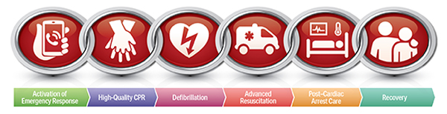
CARDIAC ARREST
5 Links in the Chain of Survival
  Recognition/Activation of EMS
  Immediate high-quality CPR
  Rapid defibrillation
  Basic and advanced EMS
  ALS and post arrest care

Slide 41
CARDIAC ARREST
    Immediate recognition of cardiac arrest includes:
      Identifying apnea in patients
      Distinguishing between agonal gasps and inadequate respirations
      Confirming pulselessness by checking carotid pulse for not more than 10 seconds
        The exception is patients in hypothermia get a pulse check for a full minute
        Activation of emergency response includes:
      Starting EMS if not already enroute
      Requesting additional resources as necessary

Slide 42
CARDIAC ARREST
Early CPR with emphasis on chest compressions
  Early CPR is key in cardiac arrest
  Chest compressions are the primary factor in restoring Coronary Perfusion Pressure (CPP)
  Chest compressions should have limited interruptions
  Observational study shows survival rates dropping when compressions fall between 80-90

Slide 43
CARDIAC ARREST
Rapid Defibrillation
  Defibrillation is the pass of DC current through the myocardium
  Successful defibrillation occurs with the current causes a uniform depolarization into the myocardium
  AEDs advise to shock in two rhythms:
    Ventricular Fibrillation and Ventricular Tachycardia
  Multiple studies have shown that defibrillation is most effect if performed within 8-10 minutes following a shockable arrest

Slide 44
CARDIAC ARREST
Effective advanced life support
  Effective advanced life support begins and should be maintained around effective BLS care
  Taking time away from chest compressions to perform advanced care techniques could be detrimental to patient well being
  Advanced procedures should be done only when enough personnel are available to provide effective BLS care
  IV/IO access should be obtained without interfering with compressions
  ETT access should also be obtained without interfering with compressions if possible.

Slide 45
CARDIAC ARREST
Post cardiac arrest care
12 lead ECG should be routinely performed on all ROSC patients to help to identify cardiac etiology
Use clues in patient’s presentation, bystander observations, and scene size up to determine the possible cause of arrest could be beneficial in long term post arrest care

Slide 46
CARDIAC ARREST
High performance CPR
The primary goal of high performance CPR is the reduction of interruption in compressions
Early compressions rotating between compressors every 100 compressions
  Shown to reduce rescuer fatigue and increase effective compressions
Each rescuer has a clearly defined role within the team
  Compressor 1, Compressor 2, Head/Airway, AED, ALS

Slide 47
CARDIAC ARREST
Roles of the Team
Compressor 1 assesses patient and begins CPR
Compressor 2 attaches AED as soon as possible without interrupting CPR
Head/Airway inserts airway adjunct, applies oxygen, ventilates in coordination with compressions and runs AED/Monitor
ALS establishes IV/IO access, administers medications, reversible causes

Slide 48
CARDIAC ARREST
Signs of Effective CPR
Pulse with compression
Skin color improves
Chest visibly rises during ventilation
Compression and ventilations delivered at appropriate rate and depth
Return of spontaneous circulation

Slide 49
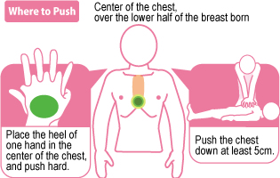
CARDIAC ARREST
Complications of Performing CPR
Broken ribs
Gastric distention
Vomiting

Slide 50
CARDIAC ARREST
Mechanical CPR
Mechanical CPR refers to the use of a mechanical device to perform compressions in place of a human rescuer
Mechanical CPR has been in study since the mid 1970s starting with the piston driven thumper
While the AHA shows no clear benefit to the use of mechanical CPR over manual CPR when in a controlled and stable sitting, there is evidence that mechanical CPR is more beneficial than manual CPR when it is difficult, dangerous, or unlikely for a provider to provide accurate, effective and consistent compressions

Slide 51
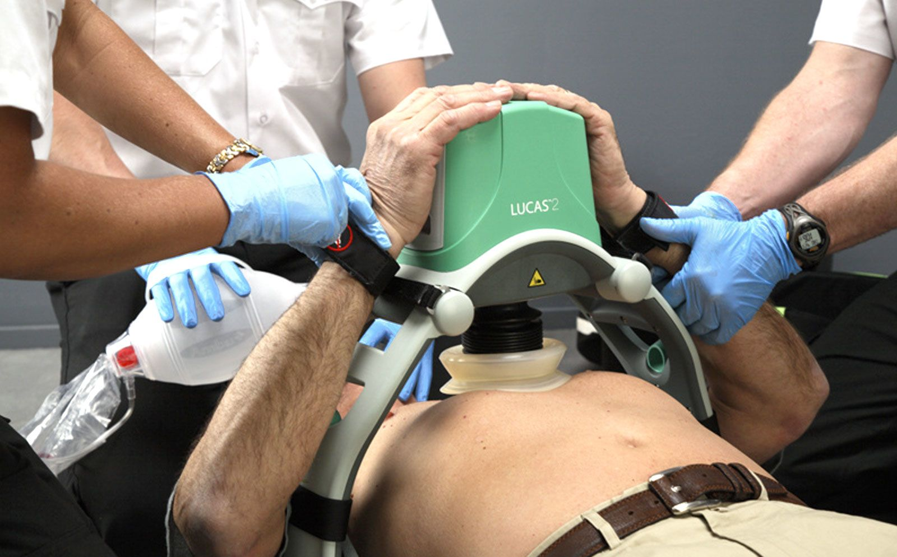
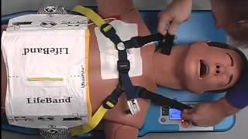
CARDIAC ARREST
Mechanical CPR
Two styles of devices
  Load distributing band devices such as the ZOLL Autopulse
  Lund University Cardiac Arrest System (LUCAS) devices

Slide 52
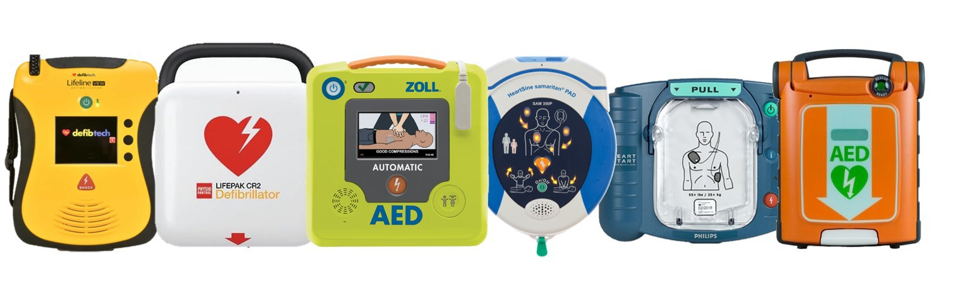
CARDIAC ARREST
Automated External Defibrillator
70% of all out of hospital cardiac arrest patients have irregular heart electrical rhythms
Defibrillator provides the greatest chance of survival when delivered early
Vary by design, make sure to be familiar with what your department has

Slide 53
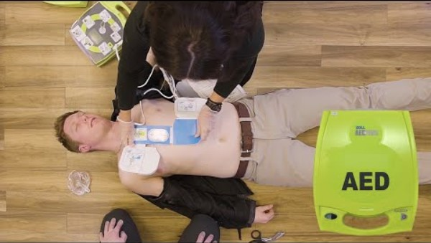
CARDIAC ARREST

Slide 54
CARDIAC ARREST
Assure defibrillation safety for crew members, yourself, and bystanders
Proper placement of pads- Do not place over medication patches or implanted devices
Assure patient is in dry area not lying in a puddle of water prior to defibrillation and patient’s chest should be dried
Make sure you have good pad contact- hairy chests must be dealt with
Consider spinal immobilization where trauma is concerned

Slide 55
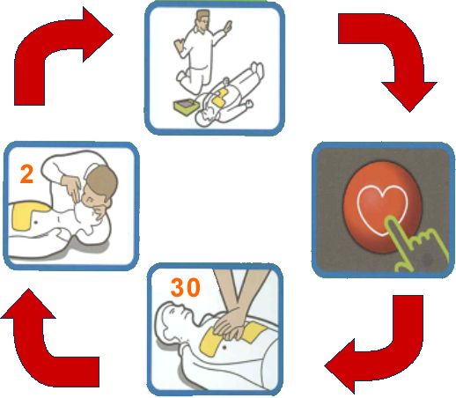
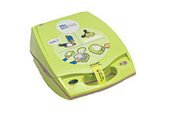
CARDIAC ARREST
Early defibrillation offers the best opportunity to achieve a successful patient outcome
AED’s have become readily available in many schools, sports venues, and most public settings
Relatively self guiding to make it very easy to use
High quality compressions can be started and should be done while AED is being prepared

Slide 56
CARDIAC ARREST
Airway management with BVM
Avoid hyperventilation- one breath every 6-8 seconds
Only squeeze bag until chest rise is noted
Place oral or nasal airway

Slide 57
CARDIAC ARREST
Return of Spontaneous Circulation
Signs of life are observed
  Patient breathing
  Patient movement
Assure proper ventilation and oxygenation
  Avoid excessive ventilation ( over bagging)
    Reduces cardiac output

Slide 58
CARDIOLOGY
PEDIATRIC CARDIAC ARREST

Slide 59
PEDIATRIC CARDIAC ARREST
Neonate
  Refers to children newly born through the first 28 days of life.
Infant
  Child who is between 29 days and 1 year old.
Child
  Any child between the age of 1 year and Puberty (roughly 12).
  For AED USE: 1 year through 8 years old (Pediatric pads).

Slide 60
PEDIATRIC CARDIAC ARREST
Infant Single Rescuer CPR
  2-fingers just below the inter-mammary (nipple) line
  100 – 120 compressions per minute
  Number of compressions per minute is an important determinant of return of spontaneous circulation and good neurological outcomes.
  Compress 1/3 the anterior-posterior diameter of the chest (about 1 ½ inches)
  Allow complete recoil of chest between compressions v. Minimize interruption

Slide 61
PEDIATRIC CARDIAC ARREST
Infant Single Rescuer Ventilations
  Resuscitation outcomes in infants and children are best if compressions are combined with ventilations
  Two breaths after every 30 compressions
  Ventilate with only enough volume to observe chest rise

Slide 62
PEDIATRIC CARDIAC ARREST
Infant Two Rescuer CPR
  Rescuer fatigue can lead to inadequate rate, depth and recoil in CPR in minutes, even when the rescuer does not feel fatigued
  When performing 2-Rescuer CPR, rotate the rescuer who is performing compressions with the rescuer who is performing ventilations at least every two minutes.
  Two thumb encircling hands technique, just below the inter-mammary (nipple)
  100 – 120 compressions/min
  1/3 the anterior-posterior diameter of the chest (about 1 ½ inches)
  Allow complete recoil of chest between compressions
  Minimize interruption
  Ventilation/Compression Ratio: Two breaths after every 15 compressions
  Ventilate with enough volume to see chest rise

Slide 63
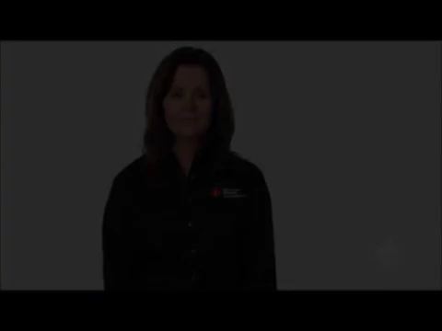
PEDIATRIC CARDIAC ARREST

Slide 64
PEDIATRIC CARDIAC ARREST
Child Single Rescuer CPR
  100 – 120 compressions per minute
  Use one or two hands on the lower half of the sternum
  Compress 1/3 the anterior-posterior diameter of the chest (approximately 2 inches)
  Allow complete recoil of chest between compressions
  Minimize interruption

Slide 65
PEDIATRIC CARDIAC ARREST
Child Single Rescuer CPR
  Resuscitation outcomes in infants and children are best if compressions are combined with ventilations
  Two breaths after every 30 compressions
  Ventilate with enough volume to observe chest rise

Slide 66
PEDIATRIC CARDIAC ARREST
Child Two Rescuer CPR
  Rescuer fatigue can lead to inadequate rate, depth and recoil in CPR in minutes, even when the rescuer does not feel fatigued
  When performing 2-Rescuer CPR, rotate the rescuer who is performing compressions with the rescuer who is performing ventilations at least every two minutes.
  Use one or two hands on the lower half of the sternum
  100 – 120 compressions per minute
  1/3 the anterior-posterior diameter of the chest (about 2 inches)
  Allow complete recoil of chest between compressions
  Minimize interruption
  Ventilation/Compression Ratio: Two breaths after every 15 compressions
Ventilate with only enough volume to see chest rise

Slide 67
PEDIATRIC CARDIAC ARREST
Bag Valve Mask (BVM)
Appropriately sized mask
High flow oxygen
2 breaths for every 30 compressions (one-rescuer)
2 breaths for every 15 compressions (two-rescuer)

Slide 68
CARDIOLOGY
CHEST PAIN

Slide 69
CARDIOLOGY
Congestive Heart Failure (CHF)
  Issue with pump that allows fluid to back up into lungs, usually involves shortness of breath without chest pain
Acute Coronary Syndrome (ACS)
  Due to blood supply to heart being suddenly blocked, usually has chest pain
Heart Attack (Myocardial Infarct)
  Immediate and severe pain that may not go away with rest or nitroglycerin

Slide 70
TRAUMA
HEMORRHAGE CONTROL
COMMERCIAL TOURNIQUET
TRAUMA IN GERIATRICS
TRAUMA IN CHILDREN

Slide 71
TRAUMA
HEMORRHAGE CONTROL

Slide 72
TRAUMA
Hemorrhage Control
Management of severe external bleeding is an important step in treating trauma. Severe life-threatening hemorrhage should be addressed immediately.
Remember to use proper BSI and infection control precautions.
Causes of external bleeding can be managed with direct pressure over the source of bleeding.

Slide 73
TRAUMA
External Hemorrhage
  Capillary – usually oozes
  Vein – flows
    Varicose veins can produce copious bleeding
  Artery – spurts
    Incised directly across/transverse manner may recoil and attempt to slow the bleeding
    Vertically cut or partially transected will not recoil and continues to bleed
  Exsanguination – the loss of the total blood volume, resulting in death

Slide 74
TRAUMA
Internal Hemorrhage
  May result in any area of the body
  Bleeding in the trunk tends to be severe and uncontrolled
  Nontraumatic internal hemorrhage
    GI bleeding from the upper and lower GI tract
    Ruptured ectopic pregnancies
    Ruptured aneurysms

Slide 75
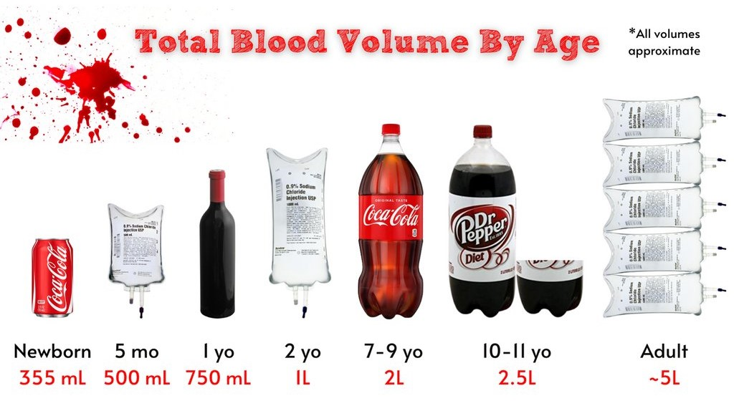
TRAUMA

Slide 76
TRAUMA
Bleeding is serious if the following conditions are noted:
  Significant MOI
  Poor general appearance of the patient
  Signs/symptoms of shock
  Blood loss of 20% or more
  Uncontrollable bleeding

Slide 77
TRAUMA
External Hemorrhage Control
  Take standard precautions
  Apply direct pressure over the wound
  If bleeding stops, apply a pressure dressing
  If direct pressure does not control bleeding, apply a tourniquet above the injury
  Tighten the tourniquet until the bleeding stops (Record the time)
  Administer oxygen
  Keep the patient warm
  Transport immediately
  Monitor vital signs and watch for shock

Slide 78
TRAUMA
COMMERCIAL TOURNIQUET

Slide 79
TRAUMA
Commercial Tourniquet
  A commercial tourniquet’s purpose is to restrict distal arterial flow in the event bleeding cannot be controlled by other means
  Apply the tourniquet 2-3 inches proximal to the source of bleeding
  Avoid any joints on the extremity
  Always note the time of application
  Never cover the tourniquet

Slide 80
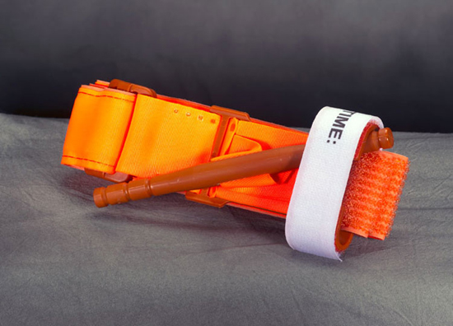
TRAUMA
Combat Application Tourniquet (CAT)

Slide 81
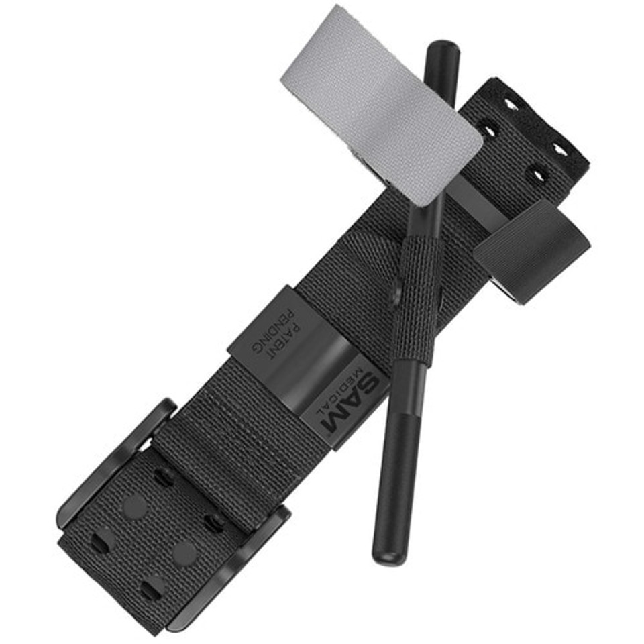
TRAUMA
SAM XT Tourniquet

Slide 82
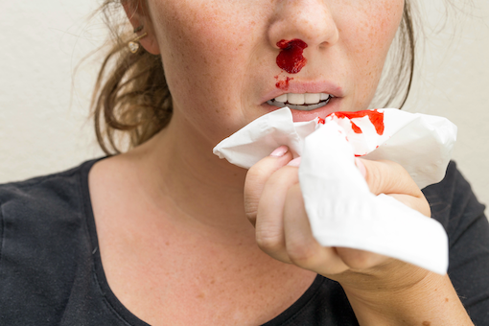
TRAUMA
Epistaxis—hemorrhage from the nose
  Apply a cold compress
  Have the patient lean forward
  Monitor vitals
  Evaluate for hypertension
If epistaxis is the result of a head injury, do not attempt to stop the bleeding. Excessive pressure used to stop the bleeding may cause blood to collect within the head.
  Will result in increased intracranial pressure

Slide 83
TRAUMA
Suspected skull fracture
  Cover the bleeding site
  Dressing should be loose
  This will help keep the site clean
  Check for CSF

Slide 84
TRAUMA
Hemostatic Agents
  Successful use within the military
  Adhere to damaged tissue
    Dehydrate the blood or undergo a chemical reaction to stimulate natural blood clotting
  Procedure
    Push gauze into the wound with an index finger
    Completely pack the wound
    Place extra gauze on top of the wound
    Hold direct pressure for 3 minutes (at least)
    Secure with a snug bandage

Slide 85

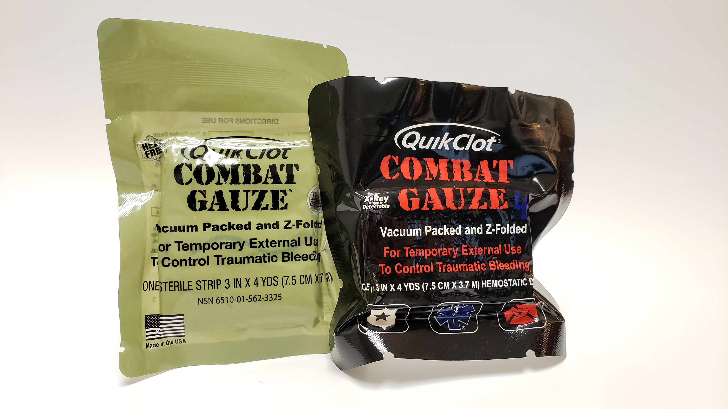
TRAUMA

Slide 86
TRAUMA
Head Trauma
Traumatic brain injury (TBI) is a major cause of death and disability
Multi trauma patients with a traumatic brain injury have a death rate twice as high as those with no central nervous system injury present
Early recognition and transport to a trauma center capable of definitive surgery is key to traumatic brain injury management

Slide 87
TRAUMA
TRAUMA IN GERIATRICS

Slide 88
TRAUMA
Trauma in Geriatrics
Never underestimate the severity of patient
Never approach or speak to in a condescending manner
Prepare for complications
  Multiple layers of clothes, multiple medications
Explain any actions prior to starting an assessment
  When removing clothing
  What checking vitals means

Slide 89
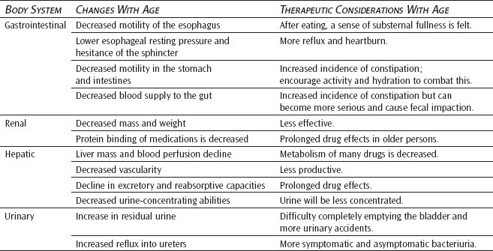
TRAUMA

Slide 90
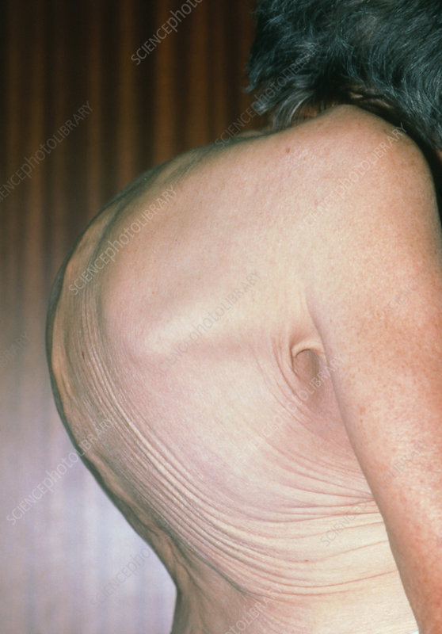
TRAUMA
Trauma in Geriatrics
Packaging and Transport
Package elderly patients as quickly and gently as possible
If you backboard, pad all voids, but remember that backboards can cause more harm than good in certain cases
Never force the neck into a neutral position if it causes pain
Supine patient may have respiratory difficulty
  Angle head of stretcher upward if needed

Slide 91
TRAUMA
TRAUMA IN PEDIATRICS

Slide 92
TRAUMA
Pediatric Trauma
Can be difficult to communicate
  Speak simply, slowly and clearly
  Avoid “no” questions
  Allow parent to accompany child
Do not delay critical care due to parental consent

Slide 93
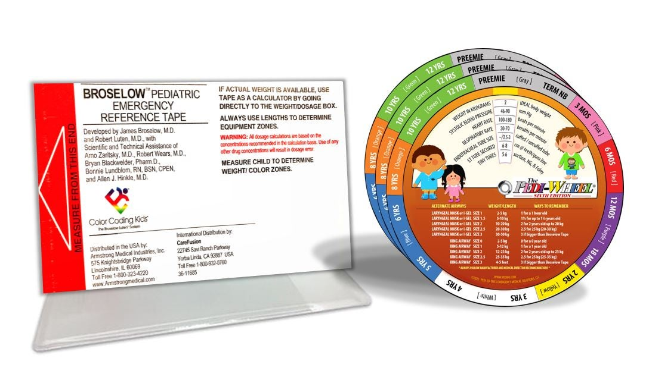
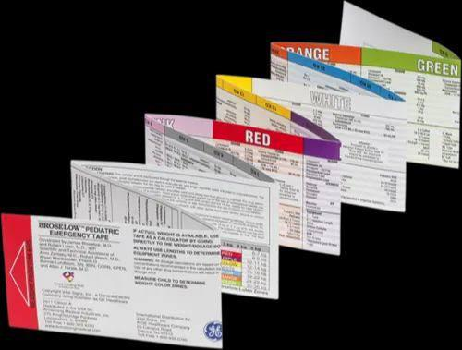
TRAUMA

Slide 94
TRAUMA
Pediatric Trauma
Mechanisms of Injury
  Falls
  MVCs
  Auto-pedestrian or bicycle accidents
  Burns
  Drownings
  Child Abuse

Slide 95
TRAUMA
Pediatric Trauma
Child Abuse is a major cause of death
  Be alert to signs
  Transport if suspected
  More reported cases in low-income homes and single parent homes

Slide 96
TRAUMA
Risk Factors for Child Abuse
Child has a disability
Attention Deficits
Difficult temperament of child
Parent history of abuse
Substance abuse by parent/caregiver
Disorganized family structure
Marital or partner discord
Financial or outside stressors
Violent or crime filled community
Isolation of caregivers

Slide 97
TRAUMA
Child Abuser
The abuser is usually any person who cares for the child, has control of the child, or custody of the child.
Can be:
  Parents
  Step parent
  Foster parent
  Babysitter
  Relatives

Slide 98
TRAUMA
Child Abuse
Be sure to have another provider with you when doing exam
Be thorough on scene safety and surroundings
Make sure that the findings of your exam match the story
Is the injury/story consistent with the developmental stage of child
Contact Law Enforcement
Report to CPS

Slide 99
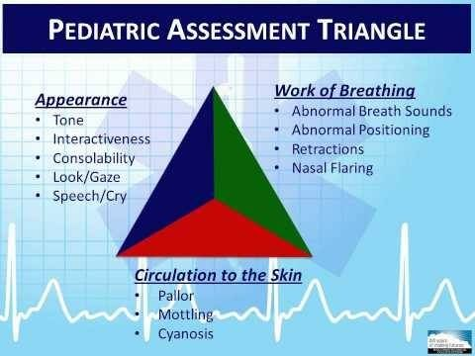
TRAUMA

Slide 100
MEDICAL
OB AND DELIVERY
ENDOCRINE EMERGENCIES
ENVIRONMENTAL EMERGENCIES
TOXICOLOGICAL EMERGENCIES
SEPSIS
CHALLENGES FOR GERIATRIC PATIENTS
SHOCK
BEHAVIORAL EMERGENCIES

Slide 101
MEDICAL
OB AND DELIVERY

Slide 102
MEDICAL
OB and Delivery
Pregnant women will have an increased amount of overall blood volume and a 20 % increase in heart rate
May experience significant amount of blood loss before you will see signs of shock

Slide 103
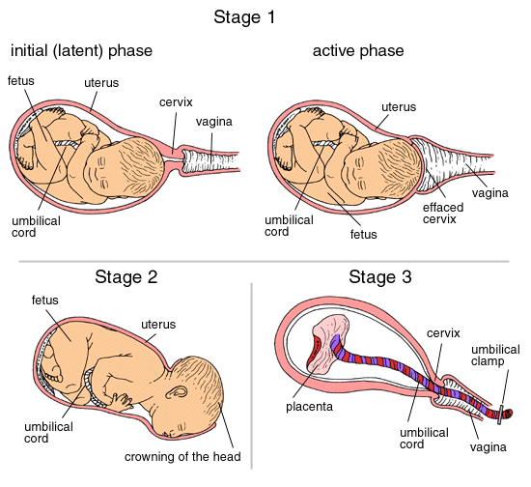
MEDICAL
OB and Delivery
Stages of Labor
  Dilation of the Cervix
  Delivery of fetus
  Delivery of the placenta

Slide 104
MEDICAL
OB and Delivery
Consider delivery on scene if delivery is imminent or there is a major environmental factor that will make it impossible to reach the hospital
If the patient says she is about to deliver, she has to move her bowels, or feels the need to push, you should prepare for delivery
  Inspect vagina for crowning
  Do not touch the vaginal area
  Only assist with normal delivery

Slide 105
MEDICAL
OB and Delivery
Prepare for delivery
  Preserve patient privacy
  Make sure patient is on a firm surface
  Elevate hips 2 to 4 inches
  Open OB kit and put on sterile gloves and BSI
  As baby is delivered, be sure to support head as it rotates
  Do not pull baby from birth canal

Slide 106
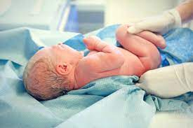
MEDICAL
OB and Delivery
Dry off baby and wrap in towel
Clamp and cut cord
Obtain APGAR Score
Assist in delivery of placenta
Treat for any serious bleeding

Slide 107
MEDICAL
OB and Delivery
Complications in Delivery
  Breech (Buttocks or both feet present first)
  Limb Presentations
  Multiple births
  Prolapsed Cord
  Nuchal Cord
  Should Dystocia

Slide 108
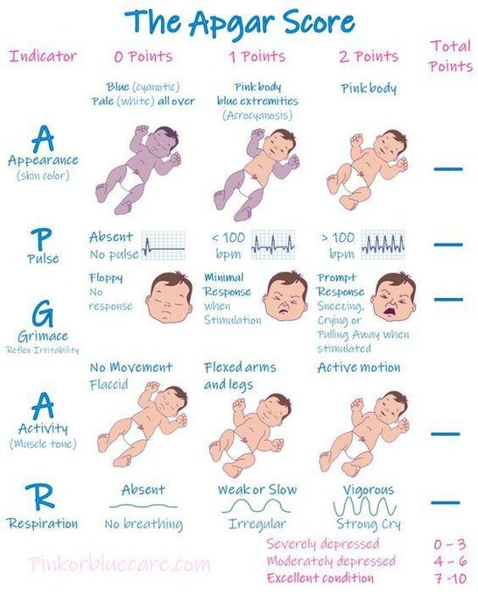
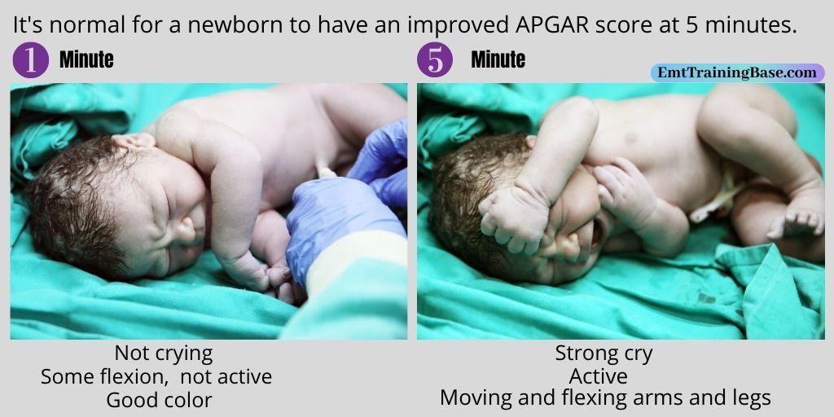
MEDICAL

Slide 109
MEDICAL
Most newborns will begin to breath just after birth with minimal stimulation after their airway is cleared.
Some may need a little more assistance.
If the newborn does not cry and breathe on his or her own within the first minute after birth, proceed with the following:
  Tilt the head down to the side to encourage drainage and clear secretions from nose and mouth
  Suction the mouth then nose with a bulb syringe
  Stimulate by flicking the soles of feet or rubbing the baby’s back gently, if no response
  Begin mouth to mouth or nose breathing with gentle puffs just enough for chest rise
  Reassessing every 30 seconds respirations and pulse to assure they reach at least 40
  breaths or 100 heart beats before going to the next step
  If not and pulse is not yes increased and is below or at 60 begin chest compressions
  and make sure oxygen has been added to your ventilations

Slide 110
MEDICAL
ENDOCRINE EMERGENCIES

Slide 111
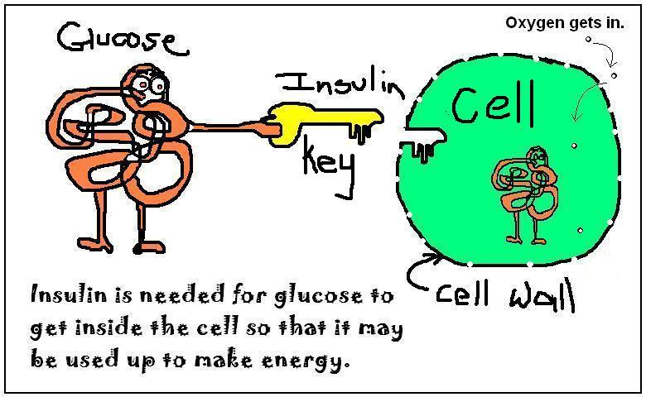
MEDICAL
Endocrine Emergencies
Glucose is an essential nutrient for the cells.
Fuel for cells
Ensures proper brain and cell functioning
Changes in levels may result in altered behavior

Slide 112
MEDICAL
Hypoglycemia (low blood sugar) symptoms
Pale, moist, cool skin
Rapid, weak pulse
Dizziness or headache
Confusion or headache
Confusion or unconsciousness
Sweating
Hunger
Rapid onset of symptoms (within minutes)

Slide 113
MEDICAL
Hyperglycemia (high blood sugar) Symptoms
Slow onset and changes in mental status
Rapid breathing, sweet breath odor
Dehydration, pale, warm, dry
Weakness, nausea, vomiting
Weak, rapid pulse
Polyuria, polydipsia, polyphagia

Slide 114
MEDICAL
Hypoglycemia Treatment
Ensure open airway, adequate breathing, circulation and ability to swallow
Check glucose
If able to swallow and alert can have patient take oral glucose or drink juice
Hyperglycemia Treatment
Ensure open airway, adequate breathing, circulation and ability to swallow
Check glucose
Supportive care until transport arrives, place in recovery position

Slide 115
MEDICAL
ENVIRONMENTAL EMERGENCIES

Slide 116
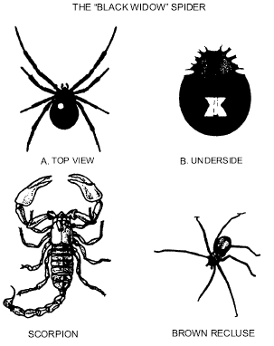
MEDICAL
Environmental Emergencies
Injection occurs when a poison enters the body through a small opening in the skin and spreads through the circulatory system.
  Tenderness at the site
  Swelling
  Red streaks
  Weakness
  Dizziness
  Localized pain
  Itching
  Hives
  Rapid, weak pulse
  Rapid, shallow breathing
  Identify the source but protect yourself

Slide 117
MEDICAL
Environmental Emergencies
Absorption occurs when a poison enters the body through intact skin and spreads through the circulatory system.
  Traces of powder or liquid on the skin
  Inflammation or redness on the skin
  Chemical burns
  Rash
  Burning
  Itching
  Nausea and vomiting
  Dizziness
  Shock
  Protect yourself, obtain hazmat, remove the patient from the source,
  brush before you flush.

Slide 118
MEDICAL
Allergic reaction
  Hyperactive, localized immune response to an allergen
  Some histamine is released
  Localized: redness, swelling, hives, itching
  May cause nausea, vomiting, and/or diarrhea
  Usually requires minimal supportive treatment
Anaphylaxis
  Multiple body systems are affected
  Life threatening reaction of the immune system to an allergen
  Large quantities of histamine are released throughout the body
  Vasodilation and increased capillary permeability
  May lead to shock
  Bronchoconstriction and mucous production
  May lead to respiratory distress
  Swelling of the upper airways

Slide 119
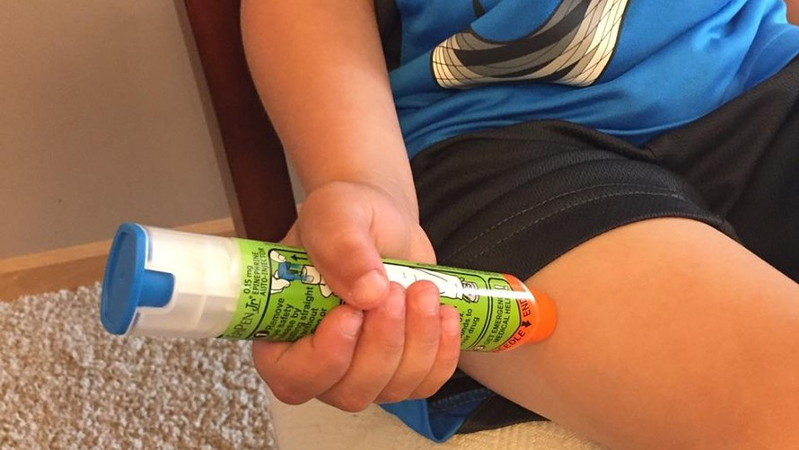
MEDICAL
Medication to Treat Anaphylaxis
Patient assisted auto injector Epi Pens
Be sure to follow state protocols
Ensure adequate airway, ventilation and oxygenation
Assist patient with epinephrine auto injector if available

Slide 120
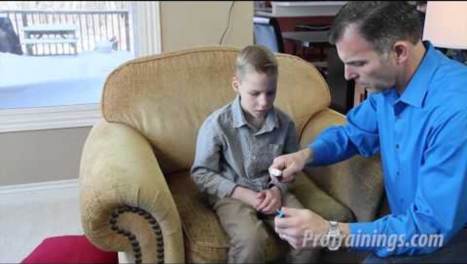
MEDICAL

Slide 121
MEDICAL
Environmental Emergencies
Conditions can complicate environmental situations
  Air temperature, humidity level and wind
Cold exposure injuries
  Feet, hands, Ears, nose, entire body (hypothermia)
Five ways the body can lose heat
  Conduction, Convection, Evaporation, Radiation, Respiration

Slide 122
MEDICAL
Hypothermia
Core temperature below 95 degrees Fahrenheit
Body loses the ability to regulate its temperature and generate body heat
Key organs such as heart will begin to slow down and mental status will deteriorate
Can lead to death
People most at risk: Homeless people, Swimmers, Geriatric,
pediatric and ill individuals

Slide 123
MEDICAL
Ensure scene safety
Assess to make sure airway is open and assess for alert status
If not alert check for pulse for at least one minute: if no pulse, start CPR
Remove patient from cold environment
Remove any wet clothing and cover with blankets. Obtain vital signs.
Do not rub extremities or frostbit area, do not actively heat.

Slide 124
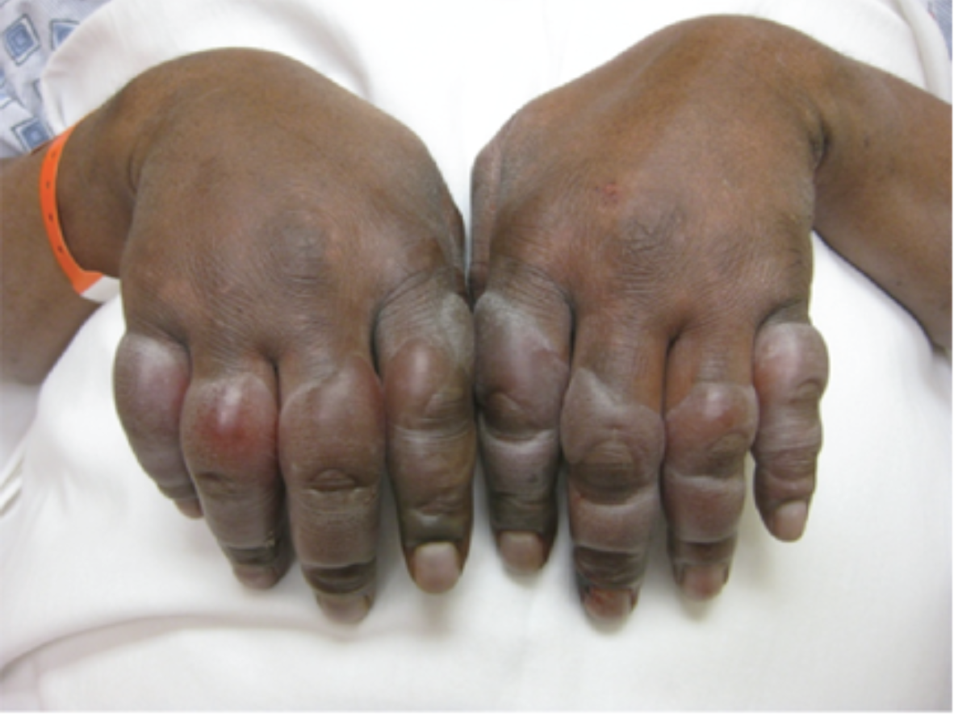
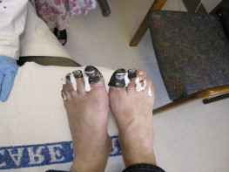
MEDICAL

Slide 125
MEDICAL
Hyperthermia
Core temperature of 101 degrees Fahrenheit or higher
Persons at risk: Children, Geriatrics, Patients with heart disease, COPS, Diabetes, dehydration and obesity, Patients with limited mobility
Risk factors
  High air temperature
  High humidity
  Lack of acclimation to the heat
  Vigorous exercise

Slide 126
MEDICAL
Hyperthermia
Heat Exhaustion
  Dizziness, weakness or syncope
  Nausea, vomiting, or headache
  Cold, clammy skin with ashen color
  Dry tongue and thirst
  Normal vital signs
  Normal or slightly elevated body temperature

Slide 127
MEDICAL
Hyperthermia
Heatstroke
  Least common but most serious
  During vigorous physical activity
  Outdoors or in a closed, poorly ventilated, humid space
  During heat waves
  Children left unattended in hot car

Slide 128
MEDICAL
Hyperthermia
Heatstroke
  Hot, dry, flush skin
  Quickly rising body temperature
  Change in behavior
  Unresponsiveness or seizures
  Rapid, weak pulse
  Increased respiratory rate
  No longer sweating

Slide 129
MEDICAL
Hyperthermia
Ensure scene safety
Ensure the patient is alert and has an open airway
Remove patient from hot environment
Place in air conditioning and remove clothing
If airway is open and they are alert, encourage them to drink fluids

Slide 130
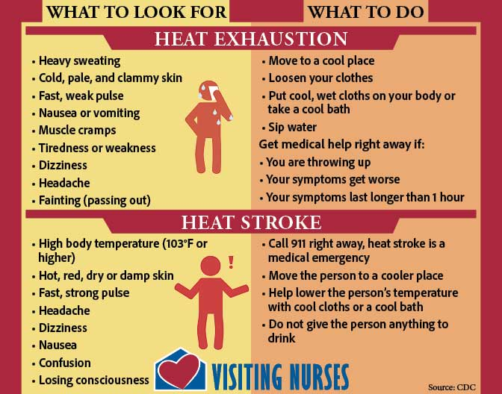
MEDICAL

Slide 131
MEDICAL
Drowning
Risk factors: Alcohol consumption, seizure disorder, geriatric patients, children unsupervised near water
Always assume a spinal injury with unconscious patients in water
Have a trained professional remove victim from water
Assess for mental status and open airway
If no pulse, start CPR, dry patient and apply AED

Slide 132
MEDICAL
TOXICOLOGICAL EMERGENCIES

Slide 133
MEDICAL
Toxicological Emergencies
Symptoms of overdose from different substances
  Slow, difficult, shallow breathing, no breathing
  Small or pinpoint pupils
  Weak pulse
  Low blood pressure
  Blue nails and lips
  Drowsiness
  Confused
  Irritable
  Hallucinations

Slide 134

MEDICAL
Common Synthetic Stimulants
Amphetamines
Cocaine
Bath Salts
THC

Slide 135


MEDICAL
Common Opioids
Heroin
Morphine
Oxycodone
Codeine
Fentanyl
Hydrocodone
Hydromorphone
methadone

Slide 136


MEDICAL
Treatment for opioid overdose
Naloxone (Narcan)
  Opioid antagonist
  Reverses CNS and respiratory depression due to overdose
  Not effective against non opioid drugs
  Follow state protocol on administration

Slide 137
MEDICAL
SEPSIS

Slide 138
MEDICAL
Sepsis
Body’s response to infection
Most common in older adults
Can be life threatening
If left untreated can develop into shock, which can cause blood pressure to drop, altered mental status, may or may not have a fever

Slide 139

MEDICAL

Slide 140
MEDICAL
CHALLENGES FOR GERIATRIC PATIENTS

Slide 141
MEDICAL
Challenges for Geriatric Patients
Injuries and illness can be affected by chronic conditions, multiple medications, and the physiology of aging
Do not assume
  That all older people have dementia
  That all older people are hard of hearing
  That all older people are immobile
  That because it takes a second for them to gather their thoughts that
  they are altered

Slide 142
MEDICAL
Geriatric Patients Common Complaints
Hip fractures are extremely common
Pneumonia or blood clots
Difficulty breathing
Ground level falls
Pulmonary Embolism

Slide 143
MEDICAL
Geriatric Patients
More prone to stroke
  Acute altered level of consciousness
  Numbness, weakness or paralysis on one side
  Slurred speech
  Visual disturbances
  Headaches and dizziness
  Incontinence
  Seizure

Slide 144
MEDICAL
Geriatric patients
Dementia- slow onset of progressive disorientation, shortened attention span, and loss of cognitive function
Bone density issues
Skin becomes thinner, muscle mass decreases, less fat
Neuropathy
  Disorder of nerves in peripheral nervous system, symptoms depend on which nerves are affected and where they are located

Slide 145

MEDICAL
Be advised that older patients may present differently
Be sure to get a thorough medical history and try to obtain medication list

Slide 146
MEDICAL
SHOCK

Slide 147

MEDICAL
Shock
A life threatening form of acute circulatory failure associated with inadequate oxygen utilization by the cells

Slide 148
MEDICAL
Compensated
  15-25% blood volume
  Weakness
  Pallor
  Tachycardia
  Narrowed pulse pressure
  Thirst
  Delayed capillary refill
Decompensated
  30-45% blood volume
  Hypotension
  Weak or no peripheral pulse
  Prolonged capillary refill

Slide 149
MEDICAL
Type of Shock
Hypovolemic Shock
Distributive Shock
Obstructive Shock
Cardiogenic Shock
Where the problem is
Low Volume
Problem with the “pipes”
Problem with the pump

Slide 150
MEDICAL
Treatment for Shock
  Ensure airway is open and patient is alert
  Check for pulse, if none found start CPR
  Treat for any gross bleeding
  Apply oxygen
  Cover patient and keep them warm

Slide 151
MEDICAL
BEHAVIORAL EMERGENCIES

Slide 152
MEDICAL
Behavioral Emergencies
What is a behavioral crisis?
  A sudden disruptive event such as a physical illness, a traumatic injury, or the death of a loved one which causes a person to exhibit abnormal behavior that is unacceptable or cannot be tolerated by the patient himself or by friends, family or the community.

Slide 153
MEDICAL
Main factors that contribute to Behavioral Emergencies
Medical conditions such as uncontrolled diabetes, stroke, brain injuries, high fevers, infections
Physical trauma
Psychiatric illnesses such as depression, panic disorders
Mind-altering substances such as alcohol and drugs
Situational stresses from emotional traumas such as death of a loved one or serious injury to a loved one

Slide 154

MEDICAL
Components of Mental Status Exams
Mechanism of injury or nature of illness?
  Injuries/illnesses can cause altered behavior
  Medication side effects
Mental health history
General appearance
  Dress
  Grooming
  Posture
  Wringing of hands
  Facial grimaces
  Mannerisms
  Actions
  Violence

Slide 155
MEDICAL
Risk Factors for Suicide
History of depression or other mental disorders
Previous attempts
History of abuse
Feelings of hopelessness
Aggressive behavior
Recent loss of loved one, job, money
PTSD
Drug or alcohol abuse

Slide 156
MEDICAL
Dealing with Agitated Delirium Patient
Stay calm, and do not cause more harm to the patient
This state is caused by a sudden onset of extreme agitation and extremely irrational or combative behavior
  Bizarreness, aggressiveness, agitation, ranting, hyperactivity, paranoia, panic
  Resulting from substance intoxication, psychiatric illness, alcohol withdrawal, head trauma, or a combination of these
  Patient can have hypertension, tachycardia, diaphoresis, dilated pupils, tachypnea, abnormal tolerance to pain, hyperthermia, noncompliance, and endless endurance and strength
  May lead to respiratory and cardiac arrest
    Restraints may increase the risk

Slide 157
OPERATIONS
TRIAGE
SCENE SAETY AND SITUATIONAL AWARENESS
CREW RESOURCE MANAGEMENT

Slide 158
OPERATIONS
TRIAGE

Slide 159
OPERATIONS
Mass Casualty Incident
MCIs are incidents where there are more than one sick or injured person, often more than one jurisdiction can handle
Can range from a serious motor vehicle accident to a burning building, explosion, anything involving numerous people

Slide 160
OPERATIONS
MCI
Goal is to do the greatest good for the greatest number
Be sure to survey the scene, ensure safety for yourself, look for hazards and give an estimation of what the situation may be
When sending information via radio report:
  Where
  What
  Hazards
  How many (approximately)
  Type of help or resources needed

Slide 161
OPERATIONS
Field Triage
Step I
  Assess vital signs and level of consciousness
    GCS
    Resp Rate
    Systolic BP (peripheral pulses, perfusion)
Step II
  Assess anatomy of injury
Step III
  Assess mechanism of injury
Step IV
  Assess special patient or system considerations
    Considering priority transport to trauma center for older adults, pediatrics, burns, OB patients, anticoagulant and bleeding disorders

Slide 162
OPERATIONS
Different Triage Methods
Salt
  Sort
  Assess
  Lifesaving interventions
  Treatment/transport
Start
  Simple
  Triage
  And
  Rapid
  transport
JumpStart (pediatric version of START)

Slide 163

OPERATIONS

Slide 164
OPERATIONS
SCENE SAETY AND SITUATIONAL AWARENESS

Slide 165
OPERATIONS
Common Hazards
Infectious diseases
Traffic
Crime and violence
Crowds
Electrical hazards
Fire
Hazardous materials
Unstable objects
Animals

Slide 166
OPERATIONS
Scene Safety
Begin thinking as soon as you are dispatched
Scene hazards
  Hazardous materials
  Electricity
  Fire
  Vehicle Crashes
  Violence( Assault, Hostage situations, riots)

Slide 167
OPERATIONS
Scene Safety
Protective clothing
  Gloves
  Helmets
  Eye protection
  Gown

Slide 168
OPERATIONS
Scene Safety
Do a windshield survey prior to leaving unit
Ensure that scene is safe to enter
Check for any bystanders, live power lines, unsafe vehicles
Be sure to park in a way to allow quick egress if needed
Never allow yourself to be blocked in by Fire department, Law Enforcement, Towing, etc

Slide 169
OPERATIONS
CREW RESOURCE MANAGEMENT

Slide 170
OPERATIONS
Crew Resource Management
Crew Resource Management (CRM)
  CRM is a set of training procedures for use in environments where human error can have devastating effects. Used primarily for improving safety, CRM focuses on interpersonal communication, leadership, and decision making. It raises the safety and quality service bars, as well as enhances and strengthens the daily operations.
  Using CRM methods, crews can avoid, manage and mitigate human errors. And as secondary benefits, CRM programs improve morale and enhance efficiency of the department.

Slide 171
OPERATIONS
Crew Resource Management
  A comprehensive system for improving crew performance
  A process addressing the entire crew and other related staff
  A system that can be extended to all forms of crew training
  A concentration on crew member attitudes and behaviors and their impact on safety
  An opportunity for individuals to examine their behavior and make individual decisions on how to improve teamwork
  A utilization of the crew as the unit of training
  Active participation training that focuses on safety improvement

Slide 172
OPERATIONS
Benefits of Crew Resource Management to EMS
  Overarching aim is to minimize errors
  Improved safety for patients and care providers
  Improved team performance
  Improved situational awareness
  All team members have equal value and input
  All members of the organization participate in CRM and CRM training

Slide 173
OPERATIONS
Advocacy and Inquiry Communication; appreciative inquiry
  Four steps to using inquiry/advocacy or appreciative inquiry to improve communication among teams
      Alert the other members of the team to a situation or action of concern
      State the problem as it is seen
      State a solution or alternative
      Obtain agreement among the team to alter plan or action

Slide 174
OPERATIONS
Communication in the Team
    Frame of Mind
    If you assume that you are obviously right and that your job is to get others to realize what you already know, you will be unable to create mutual learning. Therefore:
    Assume you may be missing things others see, and seeing things others miss. If you start with this assumption, you will listen more intelligently and inquire more genuinely without downplaying your own views.
    Assume others are acting in ways that make sense to them and that they are seeking to act with integrity.
    Seek to understand what leads to behavior you find problematic. Are people caught in dilemmas? Are you contributing to the problem?

Slide 175
OPERATIONS
Advocacy
  Help others see what you see and how you think about it by giving examples of the data you select, stating the meaning that you find in the examples, and explaining the steps in your thinking.
  Describe your understanding of the other person’s reasoning.
  If you see negative consequences to what others are doing, identify the consequences without attributing intent to create those consequences. Distinguish between intent and impact.
  When you choose to disclose your emotions, do so without implying
  that the other person is primarily responsible for creating your
  emotional reactions.

Slide 176
OPERATIONS
Inquiry
  Find out how others see the situation by asking them to give examples of the data they select and to explain the steps in their thinking.
  Ask for help in finding out what you may be missing by encouraging others to identify possible gaps or errors in your thinking.
  When you have difficulty with how others are acting, ask them to explain what leads them to act as they do, in a tone that suggests they may have a reasonable answer.
  Inquire into others' emotions.
  Ask for help in exploring whether you are unknowingly contributing
  to the problem.

Slide 177
OPERATIONS
Effectiveness of the team
    Characteristics of effective team leaders
      Creates, implements and revises an action plan
      Communicates accurately and concisely while listening and encouraging feedback
      Receives, processes, verifies, and prioritizes information
      Reconciles incongruent information
      Demonstrates confidence, compassion, maturity, and command presence
      Demonstrates a role of authority for the group and scene
      Maintains accountability for team’s actions/outcomes
      Assesses situation and resources and modifies accordingly

