Slide 1

www.itssumnertime.com
Please post any questions in the chat box.

Slide 2
Largo Community Church
1701 Enterprise Rd.
Mitchellville, Md 20721
(Camp entrance down by the playground)
Camp Starts: Monday June 22, 2026
Camp Ends: Friday August 28, 2026
Camp Closed: Friday July 3rd
Camp Hours: 8:00 am-4:00 pm
BC (7am-8am) AC (4pm-5:30pm)
Rangers: Age 3.5-5
Rock Stars: Age 6+7
Super Heros: Age 8-10
Champions: Age 11-14

Slide 3
Camp Rates
Weekly Rate: $275.00 Monday - Friday.
Weekly Rate includes 3-4 weekly field trips.
Field Trips:​ Every Tues. and Thurs. field trips (plus 5 Fridays)
​*Before Care: 7:00 am-8:00 am
​*After Care: 4:00 pm-5:30 pm ($1.00 per minute late)
​*Each service provided for a $25.00 weekly additional fee.
2 or more Siblings: ​*Before care and after care fee waived.
Daily Drop-Ins Welcome- $65.00 per day

Slide 4
Tuesday Splash Park (1:00pm-3:00pm)
Wear regular bookbag. No drawstring bookbags.
Pack plastic bag for wet clothes with camper’s name written on it.
Pack towel and swimsuit.
If 2 piece, can wear. If 1 piece, please bring.
Please bring cold plastic bottled water.
Crocs are fine to wear. No open toe shoes please.

Slide 5
Rangers
Please put sunscreen on daily before you leave home.
Please label bookbag, lunch bag, and ALL items with camper’s first and last name.
Please keep a change of clothes in a Ziploc bag with camper’s first and last name on it.
No pull ups. Have to be potty trained.
No nap time in schedule.

Slide 6


Your camper may wear their bathing suit under their clothes if it is a 2 piece.
If it is a one piece and your child may need assistance with using the bathroom, please send it with them.
Bathing Suit

Slide 7
Rangers Academics
Daily
writing name and letter sounds
Read alouds
letter and number recognition
seasons, months, days of the weeks
shapes, read alouds
weekly themes
Social skills and interacting

Slide 8
Rockstars Academics
Weekly
Read alouds with critical thinking
Reading fluency
Reading comprehension and vocabulary
Weekly themes
Social skills and interacting
Real life skits
Time, Money, Patterns, 3 Dimensional Shapes

Slide 9
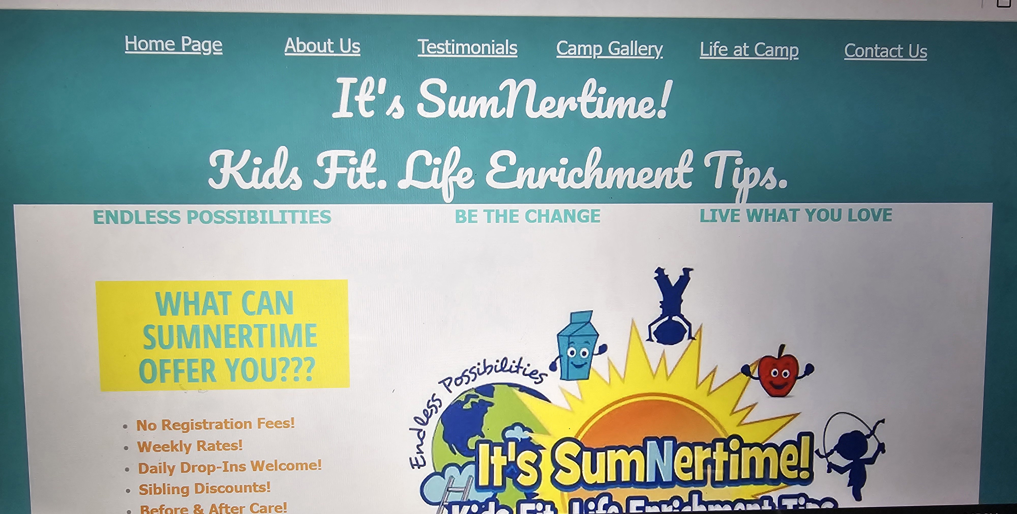
http://www.itssumnertime.com/life-at-camp.html
View “Life at Camp” page on website.

Slide 10
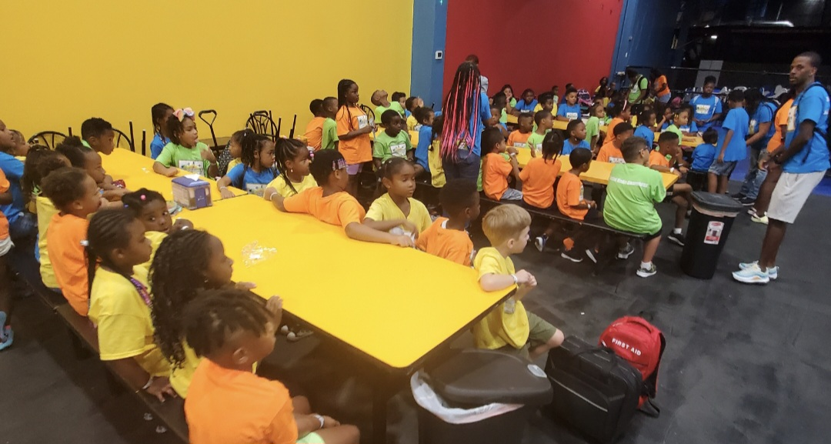
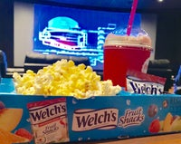
FIELD TRIP DAYS
**9:00am Bus Departure**
Field Trip Days
  Must wear Camp t-shirt- $15
Every Tuesday Splash Park
  Rain or shine except first and last Tuesday of camp.
Kids Combo at movies on Tuesday is $5.50.
  Includes icee, popcorn and gummies.
  CASH ONLY. Please give ALL CASH to Mrs. Green.
Please complete ALL WAIVERS for field trips now.

Slide 11
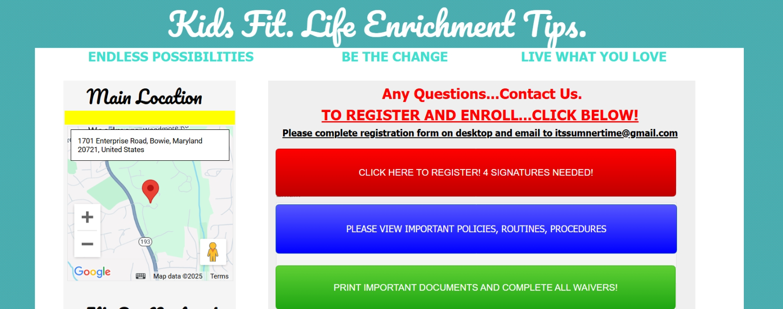
http://www.itssumnertime.com/contact-us.html
View “Contact Us” page on website.
Click on green button “Print Important Documents!”
Please complete all field trip waivers!

Slide 12
Waivers are located on the green
“Contact Us” tab on the website.
Please Complete ALL Field Trip Waivers.
Rangers and Rockstars (Ages 3.5-7)
Hyper Kidz- Crofton Waivers
Scramble Waiver | Scramble Play Group
Climb Zone Waivers
Funbox Waivers
Sky Zone (Crofton-Gambrills) Waivers
Hyper Kidz-Columbia- Waivers
Get Air Trampoline Park- Alexandria, VA GetAir Waiver
Kids Empire Gravity Online Service
Play EC Waiver
Sky Zone Bowie Waivers
Laugh Out Loud Stations- Greenbelt- Liability Waiver - New Guest
Urban Air- Laurel- Laurel, MD - Urban Air
Super Heros and Champions (Ages 8-14)
Hyper Kidz- Crofton Waivers
Climb Zone Waivers
Activate White Marsh Online Waiver
Funbox Waivers
Sky Zone (Crofton-Gambrills) Waivers
Hyper Kidz-Columbia- Waivers
Get Air Trampoline Park- Alexandria, VA GetAir Waiver
Wonderfly Arena -Arbutus Wonderfly Arena Waiver | WaiverFile
Dodge Arrows Digital Liability Waiver Software by eWaiverPro
Beat the Bomb Waiver - Beat the Bomb
Sky Zone Bowie Waivers
Laugh Out Loud Stations- Greenbelt- Liability Waiver - New Guest
Urban Air- Laurel- Laurel, MD - Urban Air
Please Complete All Waivers!

Slide 13
Group Me
Group Me will be the main means of communication.
Please DO NOT POST or write in the group chat.
Please UPDATE your group me name and picture.
Click on "Edit profile" and add your camper's name.
If you can kindly post a picture of you and your camper together, that would be most helpful.
Thank you!

Slide 14
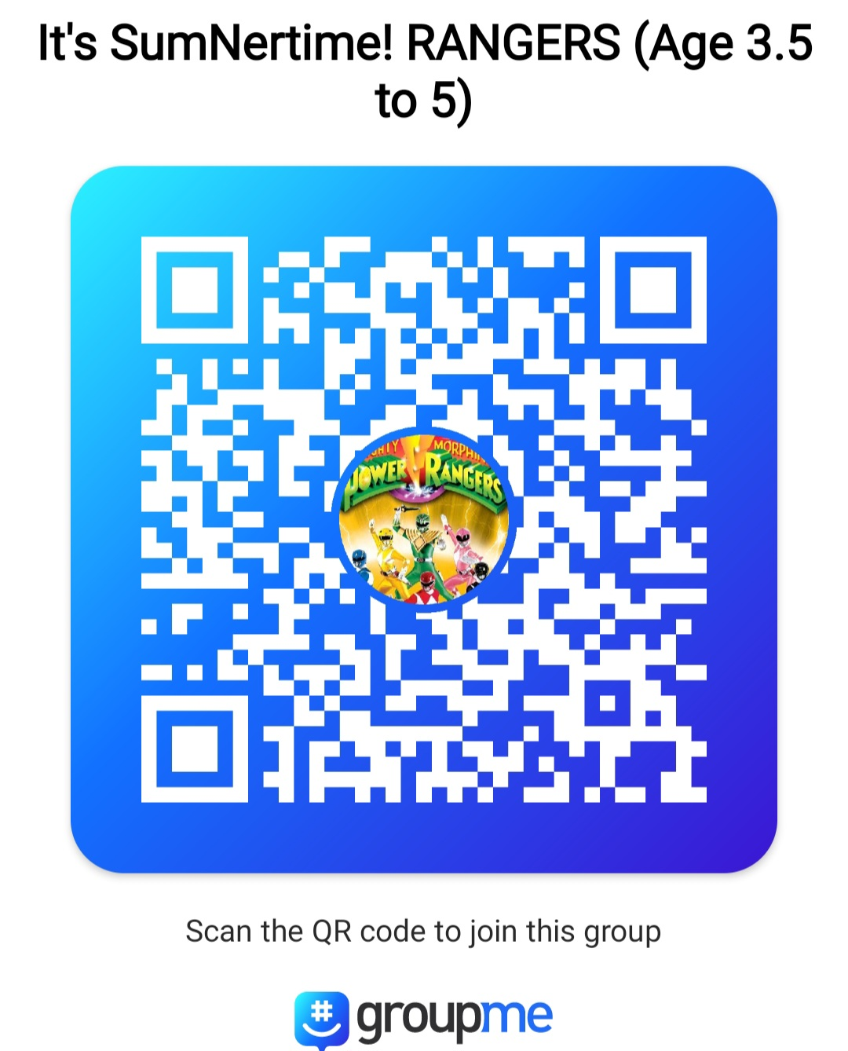
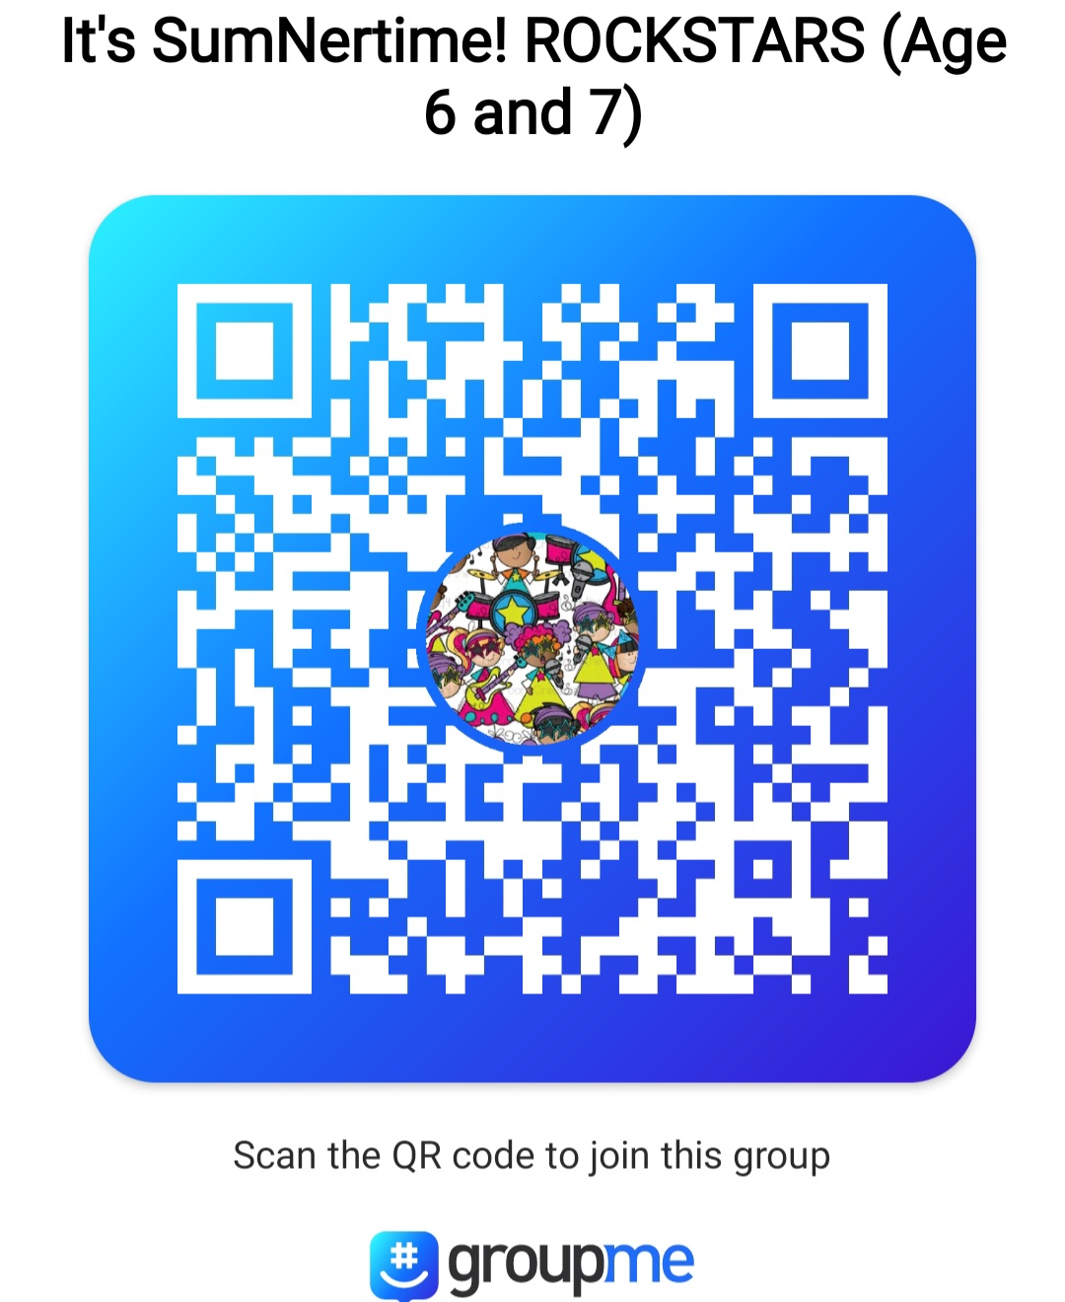
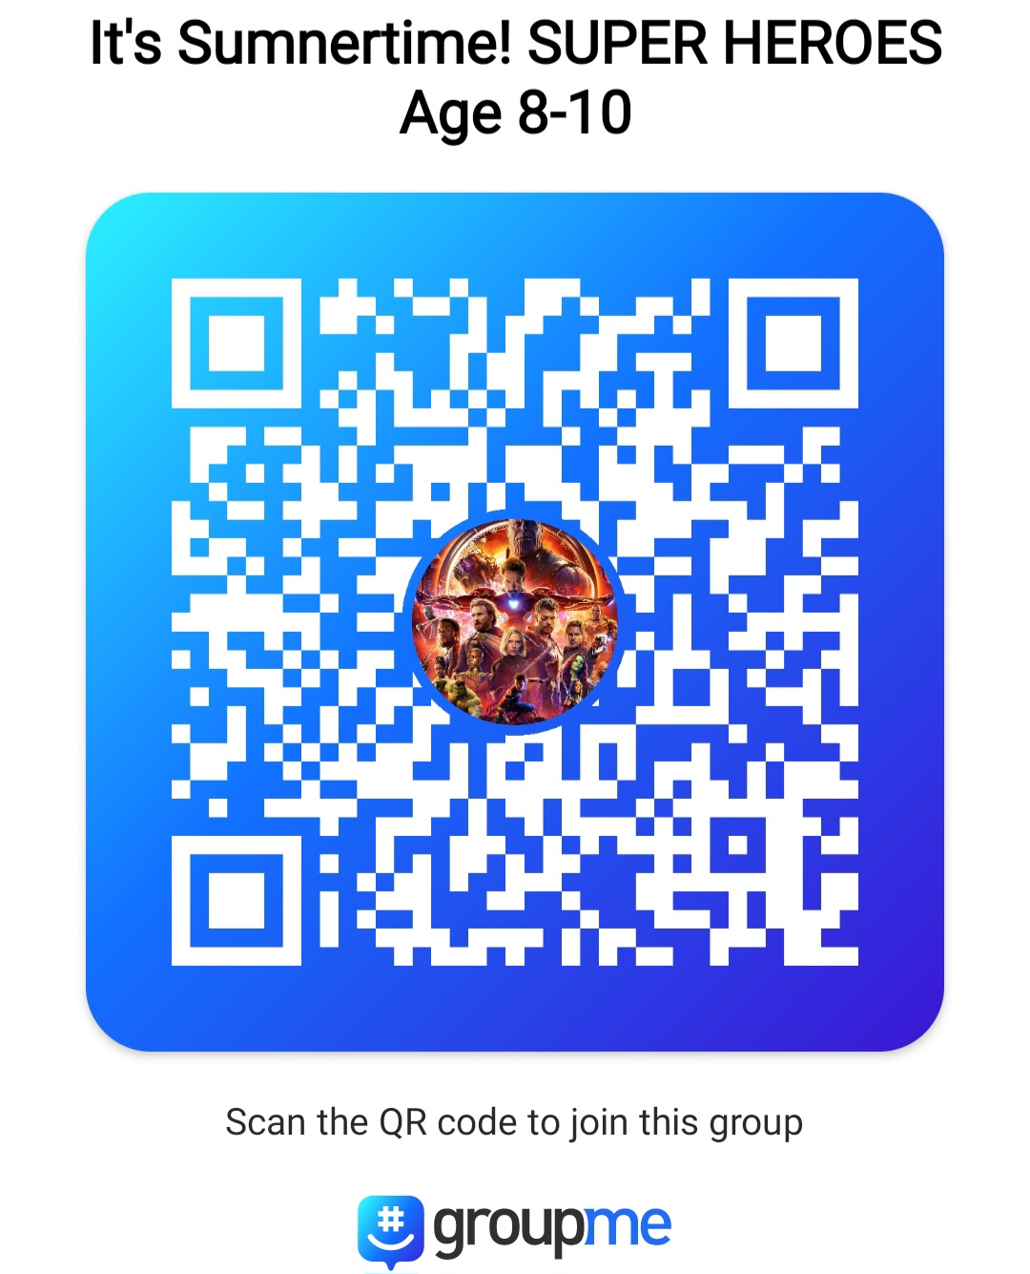
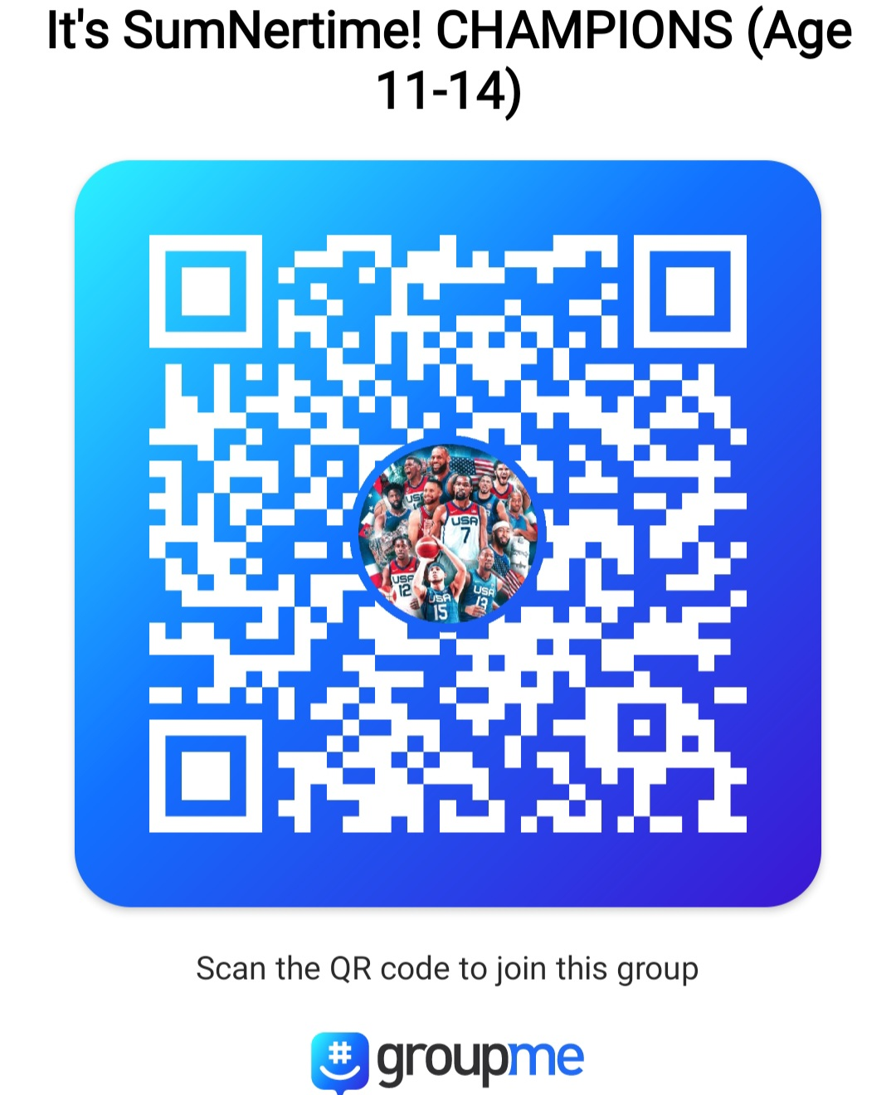
Group Me
Group Me will be the main means of communication.
Please DO NOT POST or write in the group chat.
Please direct message or text me.
Please scan the Group Me that applies.
1 2 3 4

Slide 15
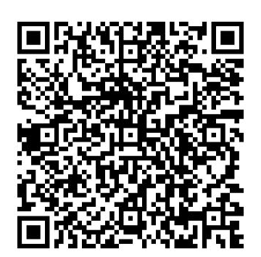
1 Rangers Only
Jason Sumner 202-556-6422
Group #
1 Rangers
------------------------------------------------------------------------------------------------------
Lunch $8 per day. If paying for lunch the entire week ($40), it can be included in Zelle weekly tuition payment.
Ex. 1 Kathy S. wk1 +pizza +ac
If paying for lunch DAILY, please put $8 cash in a Ziploc with your camper’s first name and group #. All cash goes to Mrs. Green.

Slide 16
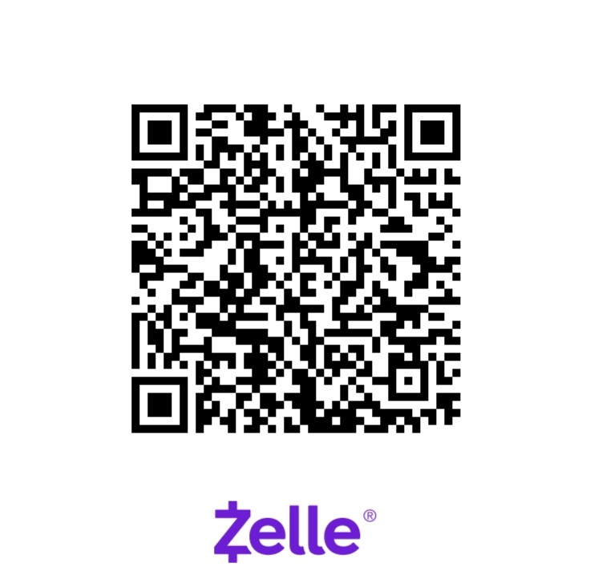
Kathy Sumner 301-704-8495
itssumnertime@gmail.com
Group #
2 Rock Stars
3 Super Heros
4 Champions
----------------------------------------------------------------------------------------------------
Lunch $8 per day. If paying for lunch the entire week ($40), it can
be included in weekly tuition payment. Ex. 2 Kathy S. wk1 +pizza+ac
If paying for lunch DAILY, please put $8 cash in a Ziploc with your camper’s first name and group #. All cash goes to Mrs. Green.

Slide 17
Kathy Sumner 301-704-8495
Examples of how to write in the
“Add a message” line of Zelle after you choose payment date.
2 Kathy S wk1 +pizza (Would total $315)
4 Kathy S wk1 +ac + pizza (Would total $340)
1 Kathy S wk1, bc, ac (Would total $325)
3 Kathy S wk1, bc, ac, pizza (Would total $365)
If paying for lunch DAILY, please DO NOT INCLUDE IN YOUR WEEKLY PAYMENT.
Only include pizza for the week in payment.

Slide 18
Camp Donations Accepted
Case of waters
Snacks (No nuts or chocolate please)
Construction Paper
Disinfectant Wipes
Small hand Sanitizers
You can leave items at the front.
Thank you!!!

Slide 19

Thank You!
The Sumner Family

