Slide 1

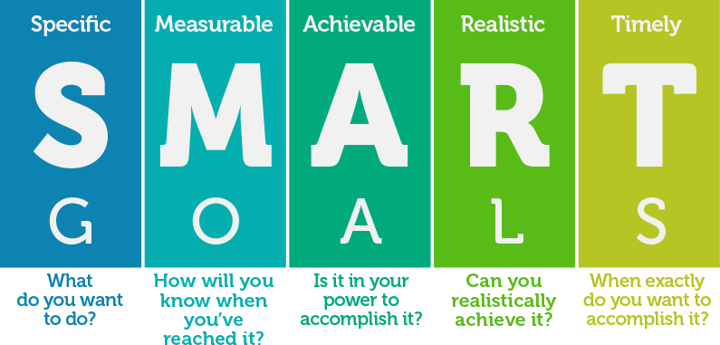

Slide 2

What are SMART Objectives?
SMART is an acronym, giving criteria to guide in the setting of objectives, for example in project management, employee-performance management and personal development.
Often the term S.M.A.R.T. Goals and S.M.A.R.T. Objectives will surface. Although the acronym SMART generally stays the same, objectives and goals can differ. Goals/Dreams are the distinct purpose that is to be anticipated from aspiration of what you are looking to achieve overall. Objectives are the steps that you will take to achieve your Goals/Dreams

Slide 3

Specific
Your goals/Dreams should be clear and specific, otherwise you won't be able to focus your efforts or feel truly motivated to achieve it. When writing your goals/dreams, try to answer the five "W" questions:
What do I want to accomplish?
Why is this goal important?
Who is involved?
Where is it located?
Which resources or limits are involved?

Slide 4

Measurable
It's important to have measurable goals/dreams, so that you can track your progress and stay motivated. Assessing progress helps you to stay focused, meet your deadlines, and feel the excitement of getting closer to achieving your goals/dreams.
A measurable goal/dream should address questions such as:
How much?
How many?
How will I know when it is accomplished?

Slide 5

Achievable
Your goals/dreams also needs to be realistic and attainable to be successful. In other words, it should stretch your abilities but still remain possible. When you set an achievable goal/dreams, you may be able to identify previously overlooked opportunities (Use the W.I.J.A.-SWOT Analysis Sheet to help you) or resources that can bring you closer to it.
An achievable goal will usually answer questions such as:
•How can I accomplish this goal?
•How realistic is the goal, based on other constraints, such as financial factors?

Slide 6

Relevant/Realistic
This step is about ensuring that your goals/dreams matters to you, and that it also aligns with other relevant goals/dream you may have. We all need support and assistance in achieving our goals, but it's important to retain control over them. So, make sure that your plans drive you forward, but that you're still responsible for achieving your own goal.
A relevant goal can answer "yes" to these questions:
Does this seem worthwhile?
Is this the right time?
Does this match our other efforts/needs?
Am I the right person to reach this goal?
Is it applicable in the current socio-economic environment?

Slide 7

Time-bound
Every goal/dream needs a target date, so that you have a deadline to focus on and something to work toward. This part of the SMART goal criteria helps to prevent everyday tasks from taking priority over your longer-term goals.
A time-bound goal will usually answer these questions:
When?
What can I do six months from now?
What can I do six weeks from now?
What can I do today?

Slide 8


