Slide 1

The Next Big Jump in Technology and Standards
Session ID 5238 Sunday July 14th 2:15
Doug Holmes, Ontario Universities’ Application Centre
Jeff Elliott, University of Missouri System
Matt Bemis, University of Southern California
Michael Sessa, Postsecondary Electronic Standards Council (PESC)
Monterey Sims, University of Phoenix

Slide 2


Etiquette
Please silence your electronic devices
Please complete the session evaluation using the AACRAO mobile app
If you must leave the session early, please do so as discreetly as possible
Please avoid side conversation during the session

Slide 3



Introduction
Welcome
PESC Interoperability
GEO Code
JSON
EdExchange
Canadian Update
Wrap up and Questions

Slide 4

PESC
Postsecondary Electronic Standards Council
Trusted, free & open PESC Approved Standards
Equal focus on Business Interoperability as Technical Interoperability
Focus on common business and data challenges
Partnerships & collaboration are required
Standards, Technology & Services
PESC is technology neutral
Focus on quality, integrity, secure delivery of data
Incubator, data standards-development, data standards-setting
Common solutions for ‘access’, ‘content’, ‘transport’
learn more...

Slide 5

PESC
CanPESC User Group
Competencies & Credentials User Group
DPPI – Data Privacy & Protection Indicator
JSON Task Force
EdExchange User Group
Global Education Organization (GEO) Code User Group
learn more...

Slide 6
PESC GEO Code – Overview
Born out of a need to have a unique identifier for every postsecondary institution on the planet
Many code sets exist, but none were complete, and most were considered a regional or country-based index
Examples of code sets in North America alone include: APAS, ACT, ATP, CCD, CEEB, CSIS, DUNS, ESIS, FICE, IPEDS, NCHELPID, OPEID, USIS
All EDI/XML open standards require a known SOURCE ID as part of the organization’s transmission identifier
PESC members and leaders recognized the need, and in July 2016, a workgroup was formally established to begin the design, concept, use cases, and development of the PESC GEO Code

Slide 7
PESC GEO Code
Early Decisions + Pilot = Success
Guiding Principles of agreement:
Each institution would be assigned a unique index value
Minimum requirements = Name and location of school
GEO Codes assigned by ISO country codes based on the location of school
Index value would be big enough to handle all schools within any single country
Index = ISO 2-character code plus 5-digit alphanumeric code
* Not case sensitive
* 0 and O = same value
* 1 and L = same value
* Total combinations for any one country = 45 million
* Example: US00528 = GEO Code for USC
CH03264 = GEO Code for Central China Normal University

Slide 8
PESC GEO Code –
More Guiding Principles
Schools would be listed with active/inactive status
Inclusion does not imply validity, accreditation, official status
A process for additions, corrections, etc. would be made available
GEO Code would be provided at NO COST to the education community
Country lists would be reviewed for additions/changes on a 5-year schedule (Country Admins may perform yearly reviews)
No re-use of GEO Code would be allowed
GEO Code would be added to PESC approved standard (completed in October 2018 to XML standard)

Slide 9


PESC GEO Code
The Pilot – USC with IERF
Early additions to indexed values included China, India, UK, Canada, and the US
International Education Research Foundation (IERF) began sending all prior degree certifications through PESC approved EDI standard, for these early indexed countries
Since 2013, IERF has expanded the use of PESC GEO Code for nearly all of its 3600 degree verifications sent to USC each year
All of the overhead in providing IERF internal school indexes was eliminated (i.e. manufactured code sets no longer needed to be tracked)
Pilot was a complete success – all overhead was removed from the process of recording prior degrees and notifying students

Slide 10

PESC GEO Code –
Where we are today
learn more...
Countries indexed and published at GEOCODE.PESC.ORG include:
  All of North America
  All of Africa (54 countries total)
  All of Europe (44 countries total)
  1/3 of Latin America and the Caribbean (11 of 33 countries)
  1/2 of Asia (24 of 48 countries)
  Top 4 countries in Oceania

Slide 11
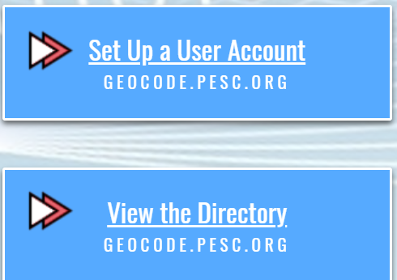
PESC GEO Code –
Web Services features
Downloadable by country code
Ability to request additions/corrections to country lists
Country and sub-country administrators access control
Institutions can be listed both in English and native language
GEO Code Link

Slide 12
PESC GEO Code –
Where we are going
Remaining countries expected to be published in Fall 2019
Most high schools in North America will be indexed and published in Fall 2019
Adoption and use of PESC GEO Code with ERP and other service providers
Enhancements to web services will continue to be deployed in Fall 2019
  Addition of native language field for locations of institutions
  Enhanced search capabilities
  Ability to sort by date, for lists of institutions recently added or updated
  Ability to download all countries in one query
  Adding native indexes (FICE, CEEB, CSIS, etc.) to GEO Code listing for North America

Slide 13

What is JSON?
JSON is short for JavaScript Object Notation
Text format that employs name/value pairs
Hierarchical in nature
Notes:
JavaScript is a web based scripting language. JSON is a means of encapsulating data and in theory is similar to XML.
The differences lie in that JSON uses constructs more closely tied to programming languages
Like EDI, JSON is terse while XML is verbose. Like XML, JSON is human and machine readable.

Slide 14
Technology is a Tool
Use cases inform how technology can be used.
Technology must not compromise data integrity and data quality.
Technology can improve service delivery and the presentation, exchange, access and viewing of data.
Various technologies can support data privacy and protection.

Slide 15
JSON/XML Comparison
JSON
{“name”:
{“fname”:”Jane”,” lname”:”Smith”}
}
XML
<name>
<fname>Jane</fname>
<lname>Smith</lname>
</name>
Notes:
For large documents such as transcripts, a significant savings in size will be recognized with JSON
Due to terseness, JSON has more stringent rules and generally one right way to organize data.

Slide 16

PESC Compliant JSON
Request to develop JSON standards
Multi-phase approach
Phase I – XML Compliant JSON – March 2019
Additional phases will evaluate JSON-LD, JSON Schema Language, OpenAPI specifications
Notes:
Development of JSON was conducted and produced through the JSON Task Force, launched at PESC’s Spring 2017
Data Summit. In January 2018, PESC joined forces with the Access 4 Learning Community (previously the SIF
Association), one of PESC’s long-time Partners in PK12 to adopt a unified, education-wide strategy on JSON.

Slide 17

PESC Compliant JSON
The standard describes the rules and methods to create JSON that can be validated using existing XML Schemas
Using programming tools to serialize JSON to XML and XML to JSON
Approved as a PESC standard March 2019

Slide 18

PESC EdExchange
Common, neutral platform for data exchange (Platform as-a-Service PaaS)
Digital lookup of senders/receivers
Peer-to-Peer – No PII through or stored by PESC ever
Global applicability

Slide 19

EdExchange Pilot –
University of Phoenix
Problem Statement
There is no consistent way for institutions to request and exchange documents with each other. Service provider exchange networks are operated in isolation from one another creating convoluted processes that do not span the full transcript lifecycle from the point of initiating a request to the point of receiving a document.
Strategic Alignment – Operational Efficiency for students and staff
Optimize core business functions making them more secure, less complex, and less manual
Support customers by reducing time to admit by reducing time to wait for transcripts
Administer process which pave the way for future self-service

Slide 20

EdExchange Pilot –
UOPX Current State
Time to Fulfill Request
Electronic (PDF, EDI) 1.5 days
PAPER 17 days
Time to Process Transcript Received
PAPER 3 days
PDF 2 days
EDI/XML SAME DAY!!!
Rework/Student Experience
PDF/PAPER errors 5%
EDI exceptions 1%

Slide 21
EdExchange Pilot -
UOPX Scope of Work
Completed
Future
Enable a match on institutional individual record number
Stand up network server to communicate with EdExchange directory and other institution’s network servers
Test proof of concept for transcript request and receipt in both EDI and PESC XML formats
Set up internal connections for data received to be received and batch processed into SIS and document management system
Enable User Interface (UI) for Network Server functions such as managing partner table, placing an order and sending a transcript
Identity potential EdExchange partners
Soft launch

Slide 22
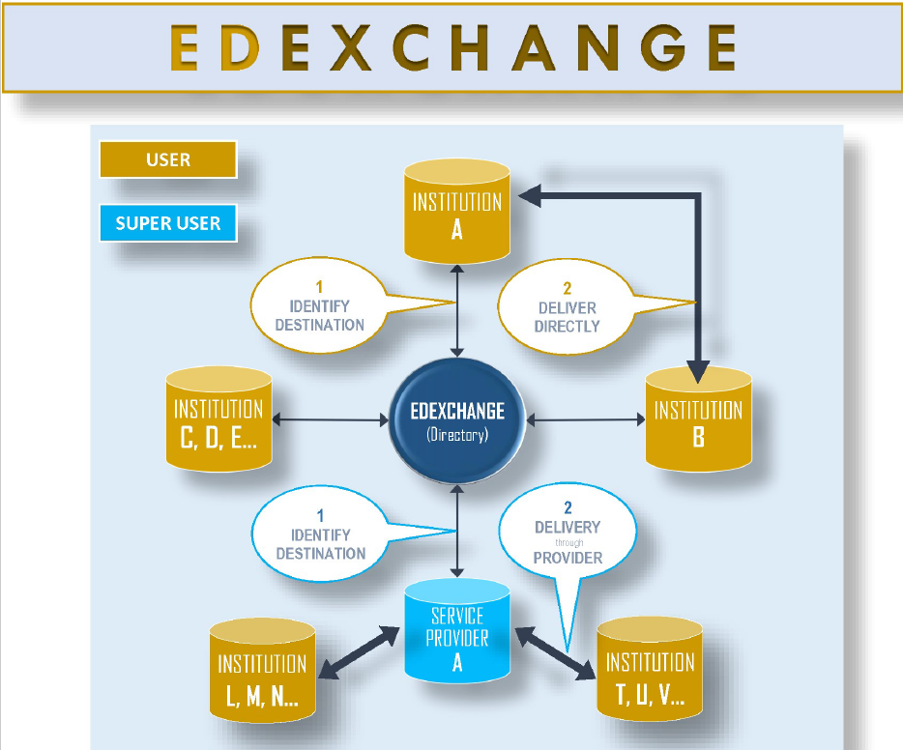

Slide 23
PESC EdExchange –
Active Participants
California Community Colleges
Credentials Solutions
Digitary
Education Credentials Evaluators
ECE
Parchment
University of Phoenix

Slide 24

PESC in Canada
CanPESC
  Volunteer group (est. 2011) within PESC, representing Canadian schools, application centres, Ministries of Education and vendors, to discuss, promote, coordinate and liaise with PESC on behalf of ARUCC and its members
Best Practice winners: OUAC (1999), OCAS (2012), NSCAT (2018)
Several PESC Data Summits … including Fall 2019 in Montréal!

Slide 25
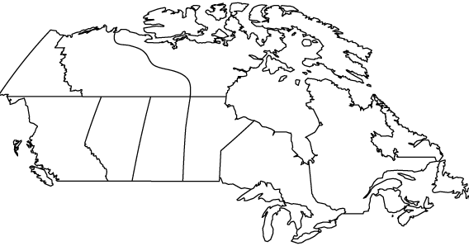
Canadian Implementations of PESC Standards
  EDI Transcript Suite
  XML High School Transcript
  XML College Transcript
  XML Transcript Request
  XML Transcript Response
  XML Admission Application
  XML Test Score
  GEO Code
  Note: Also some use of both
  Transcript and Functional
  Acknowledgements
  In Production
  In Development
1
2
3
2
4
4
5
5
6
2
3
2
3
1
8
4
5
4
5
2
6
2
1
3
9
6
5
4
6
8
3
2
3
2
4
5
4
5
Source: CanPESC
9
9

Slide 26
Enabling Additional Initiatives
Increasingly
standardized educational data exchange across
the country
Facilitate mobility and interoperability
of educational data
Assist student mobility within Canada
Assist student mobility
into and out of Canada
…
ARUCC Groningen & Student Mobility Project
Source: https://www.pesc.org/pesc-approved-standards.html

Slide 27
ARUCC Groningen & Student Mobility Project
Advancing Student Mobility through Trusted Data Exchange
  “The Project leadership is doing this by focusing on improving academic document exchange to address document fraud and advance access and social mobility.”
Social Mobility = Student Mobility + Data Portability
Source: https://www.arucc.ca/en/projects/task-force-groningen

Slide 28




ARUCC Groningen & Student Mobility Project
Partners:
  Assoc. of the Registrars of the Universities and Colleges of Canada
  Pan-Canadian Council on Admissions and Transfer
  Canadian University Council of Chief Information Officers
  Canadian PESC User Group
Source: https://www.arucc.ca/en/projects/task-force-groningen

Slide 29
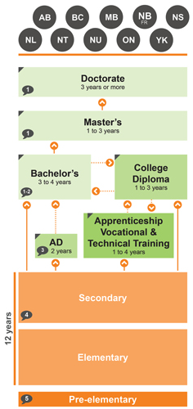
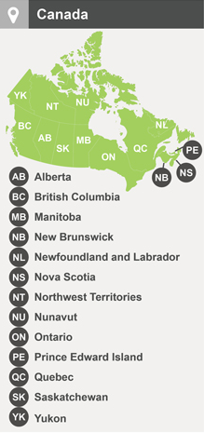
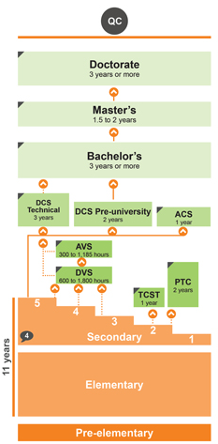
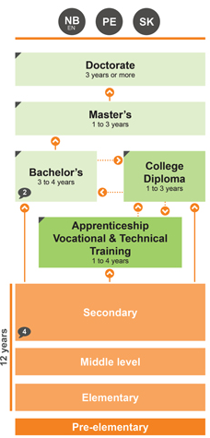
Education in Canada
Source: https://www.cicic.ca/1130/an_overview_of_education_in_canada.canada

Slide 30
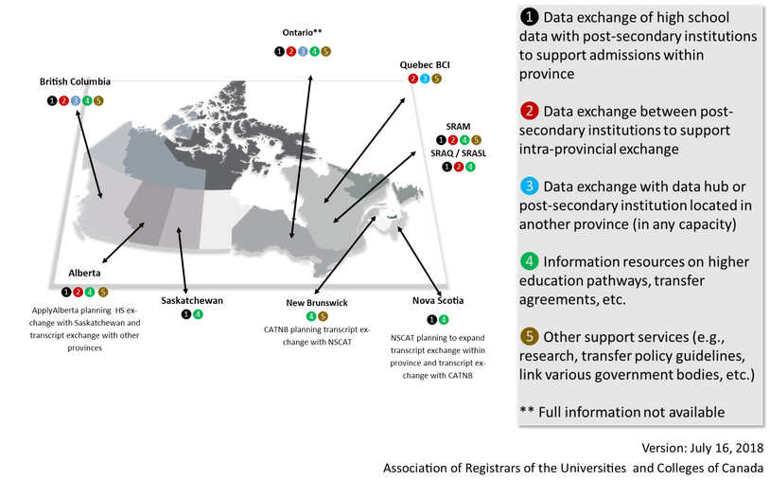
Current Canadian Data Exchange Landscape: Strengths
Source: https://www.arucc.ca/en/project-overview

Slide 31
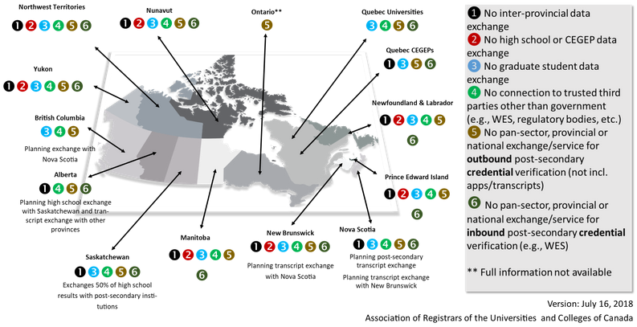
Current Canadian Data Exchange Landscape: Gaps
Source: https://www.arucc.ca/en/project-overview

Slide 32
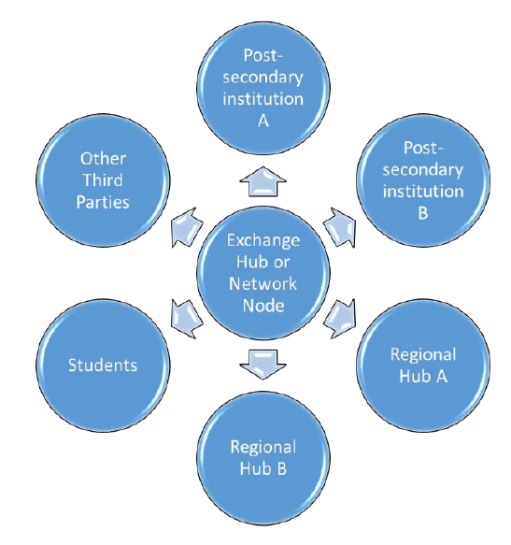
Canadian Data Exchange:
Future Direction
“Network” of:
  existing exchanges
  currently unconnected partners
  international
Honour each provincial and federal privacy regulation
Source: https://www.arucc.ca/en/projects/task-force-groningen

Slide 33
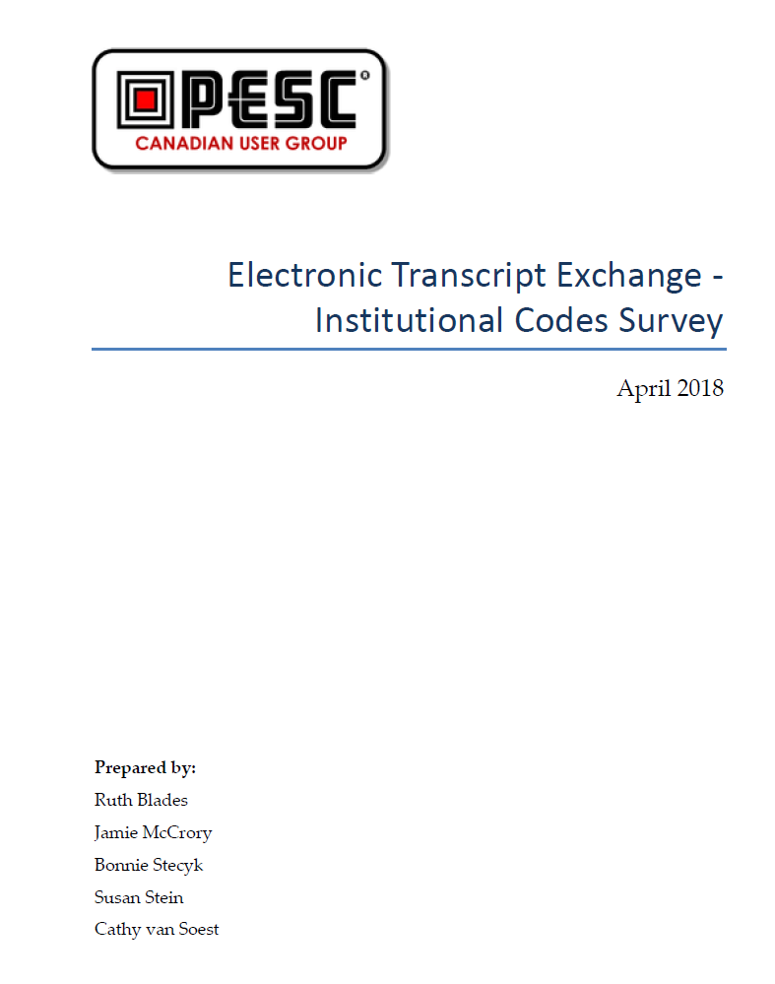
CanPESC’s Institutional
Code Survey
Full report available on ARUCC’s web site
Overall finding: no consistency across the country
Opportunity: GEO Code!
  codifying all Canadian postsecondary and secondary,
  both public and private, is underway

Slide 34
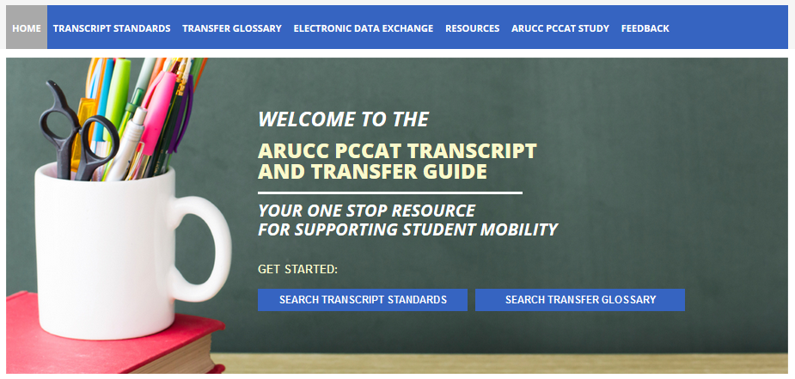
Standardizing Nomenclature
2
1
Source: https://guide.pccat.arucc.ca/en/

Slide 35

Bilingual (English & French)
2
1
Source: https://guide.pccat.arucc.ca/fr/

Slide 36
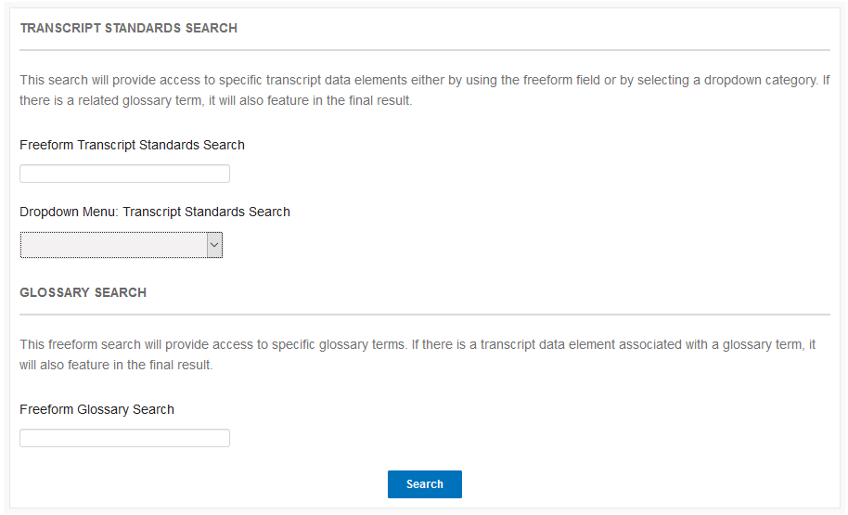
Transcript Data Elements
1
Source: https://guide.pccat.arucc.ca/en/

Slide 37
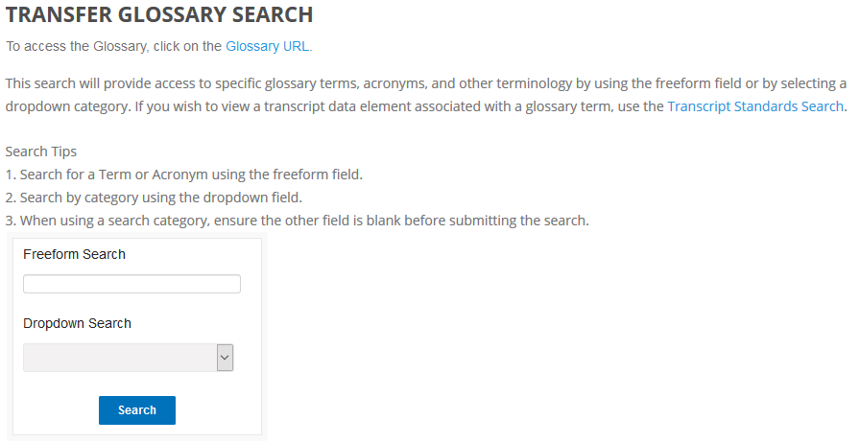
Transfer Terminology
2
Source: https://guide.pccat.arucc.ca/en/

Slide 38
SPEEDE sessions at this conference
Sunday 2:15pm - The Next Big Jump in Technology and Standards
Monday 8:15am - Considerations, Best Practices & Recommendations in Electronic Transcript Exchange: EDI, XML, PDF
Monday 11:00am - Case Studies: The Secure Electronic Exchange of PDF Student Transcripts
Monday 1:45pm - What the heck is EDX? Optimize Your Admissions Document Process
Tuesday 9:15am - EDX: Electronic Exchange of Student Records Roundtable

Slide 39

EDX Resource available via AACRAO Publications!

Slide 40

QuestionsSummary

Slide 41



Please send questions to SPEEDE@AACRAO.ORG
Please complete the session evaluation using the AACRAO mobile app. (Session ID 5238)

