Slide 1
Dark Skies

Slide 2
Background: What is Light Pollution?
Most of us are familiar with air, water, and land pollution, but light can also be a pollutant.
The inappropriate or excessive use of artificial light – known as light pollution – can have serious environmental consequences for humans, wildlife, and our climate. Components of light pollution include:
Glare – excessive brightness that causes visual discomfort
Skyglow – brightening of the night sky over inhabited areas
Light trespass – light falling where it is not intended or needed
Clutter – bright, confusing and excessive groupings of light sources

Slide 3
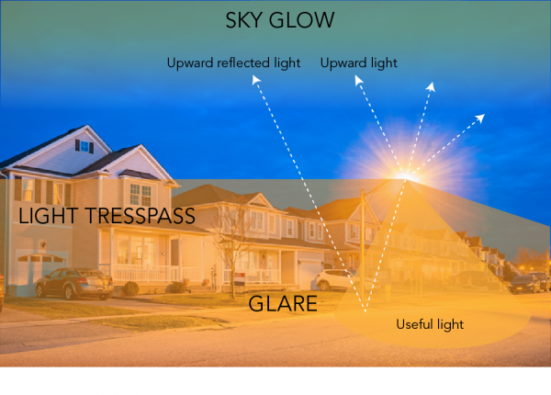

Slide 4
Glare Glare can easily cause us not to see important objects such as the couple crossing in front of the car. (Photos from IDA).

Slide 5
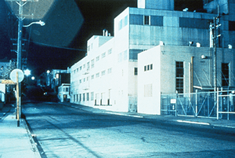
Light Trespass Light trespass has caused the light sensor in the streetlight to think it is daytime! Imagine what it would be like to have a bedroom in one of the building rooms.

Slide 6
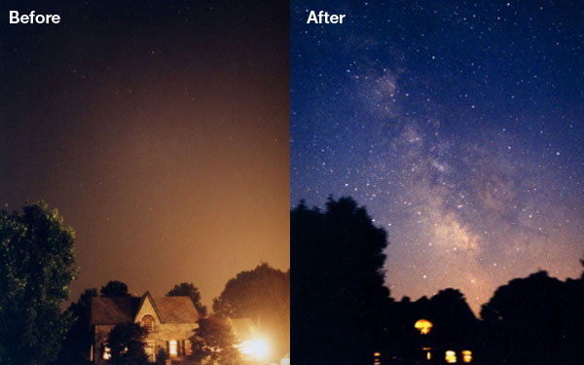
Sky Glow Sky Glow is a general brightening of the normally black night sky caused by artificial light pollution. Excessive sky glow can almost completely block out views of stars. The main causes are upward-directed light from poorly shielded fixtures and too much light power used for the application.

Slide 7
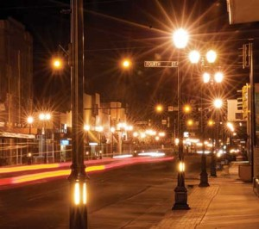
Brighter Does Not Mean Safer:
According to a 2012 report of the American Medical Association, “Glare from nighttime lighting can create hazards ranging from discomfort to frank visual disability.”
Outdoor lighting is intended to enhance safety and security at night, but too much lighting can actually have the opposite effect. Visibility should always be the goal. Glare from bright, unshielded lights actually decreases safety because it shines into our eyes and constricts our pupils. This can not only be blinding, it also makes it more difficult for our eyes to adjust to low-light conditions.
The truth is bad outdoor lighting can decrease safety by making victims and property easier to see. A Chicago Alley Lighting Project showed a correlation between brightly lit alleyways and increased crime.

Slide 8
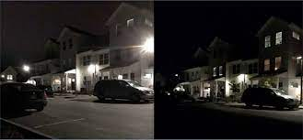
Before & After

Slide 9
EXCESSIVE LIGHTING
Adversely effects the quality of life and harms human health
Disrupts the ecosystem, wildlife and migratory birds
UT Ordinances
Commercial (006-2002-2)
No equipment or trained employees to measure; contract out
A general lighting standard (20.5.8)
No quantifiable limits
Not measurable
Unable to enforce
No “dark skies” or residential ordinances
Strathmere lot sizes are relatively small (typically 40 wide X 100 feet deep), so the impacts are pronounced: backlighting, up lighting and glare

Slide 10
LIGHTING RECOMMENDATION:
Draft dark skies and residential ordinances based on other communities’ ordinances
Create an independent section of the Municipal Code
Incorporate into the existing Building Code for new construction
Must be measurable and/or definitive to be enforceable.
Dark skies ordinance
Example of things that could be included:
Requiring motion detection lighting for lights facing into adjacent properties and security lights such as floodlights over garages, back entrances, decks, patios, flag poles etc.
Language about direction, angles and color of the lighting.
Prohibit/limit full façade lighting or lighting to accentuate architectural or aesthetic elements a building façade, decorative lights and other lighting that are not functional.
Low effort, high impact
Residential ordinance
Must contain technical, measurable requirements
Specify lumens, footcandles, wattage etc.
Twp will need to contract out enforcement or purchase equipment, hire lighting expert, technician
High effort, high impact

Slide 11
LIGHTING RECOMMENDATION CONTINUED:
2. Develop educational document
Describe dark skies important impact on preservation of the ecosystem, the beauty of dark skies, better vision without glaring lighting etc.
Describe the impact of excessive lighting on quality of life and human health
Identify ways to minimize impact of existing lighting by usage, using lesser wattage etc.
Educate property owners, renters, builders, architects, real estate agents on the above
Consider adding lease requirements regarding wattage, use, color etc. of existing lighting.
High impact, high effort

Slide 12
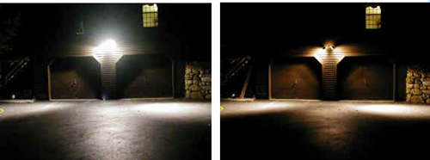
The first step is as easy as taking a look at your own home, respecting your neighbors, the ecosystem and wildlife. THANK YOU!

