Slide 1
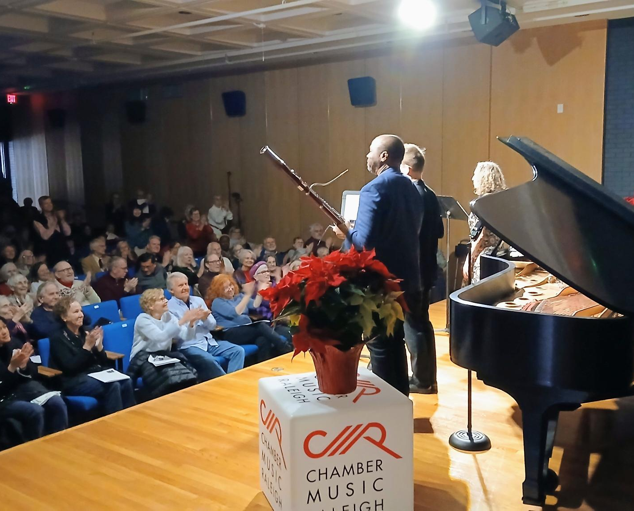
Season
December 14
Poulenc Trio
84
CMR

Slide 2
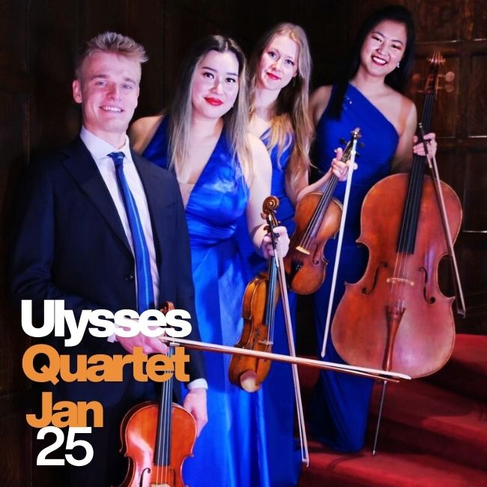


Together for
SUNDAY, MAY 24
Includes May 23
Cardinal North Hills & NCCMI
84
years

Slide 3
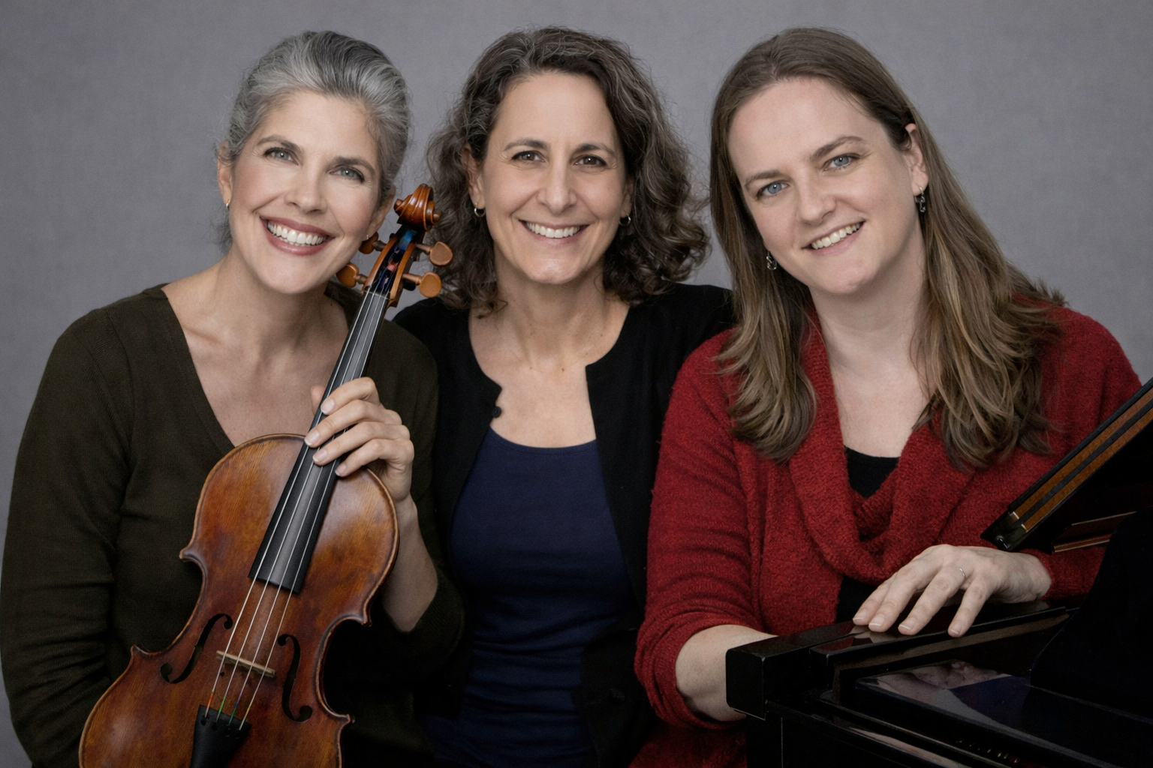
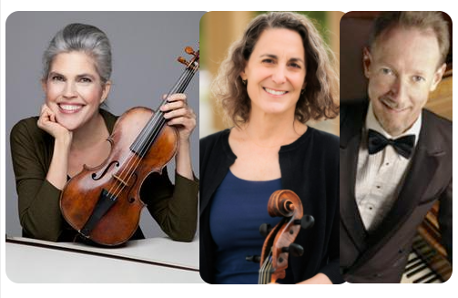
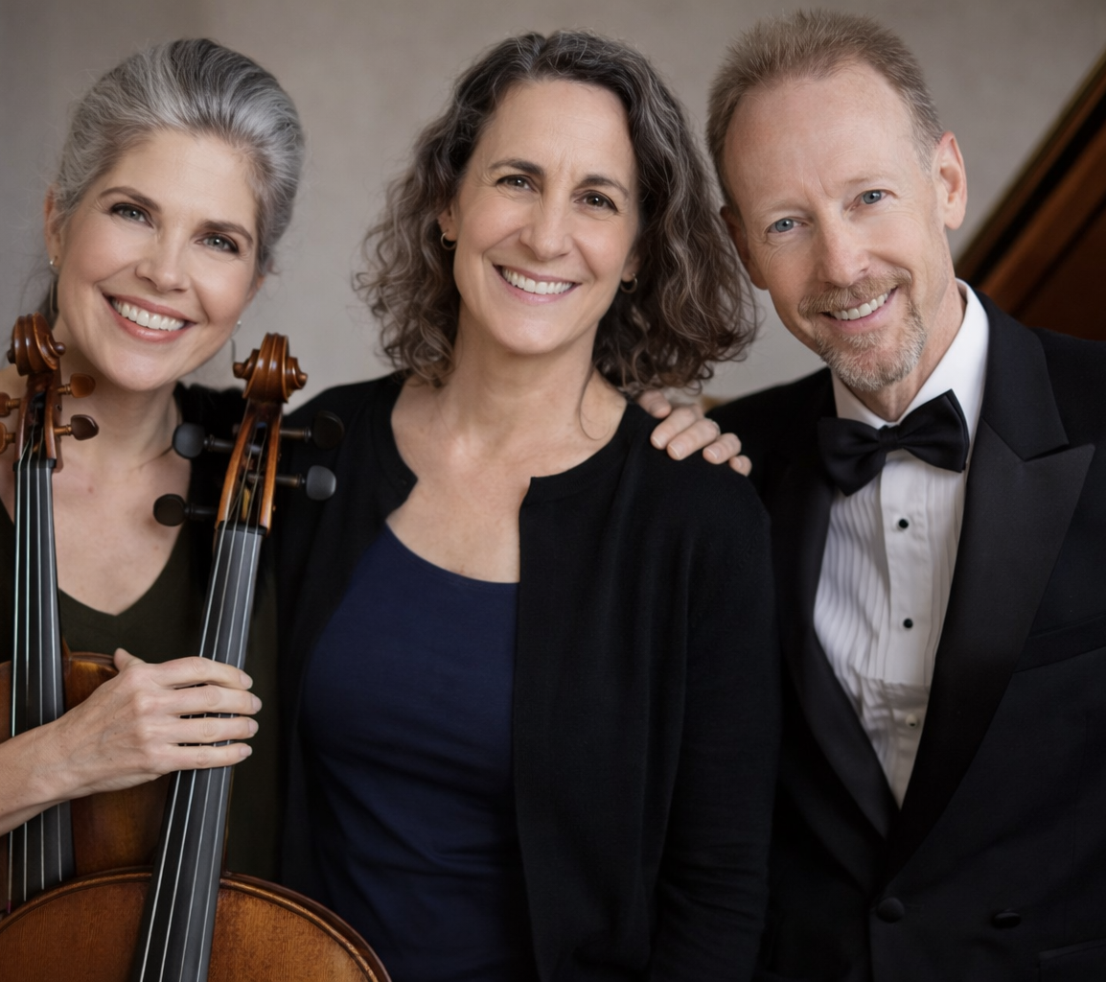
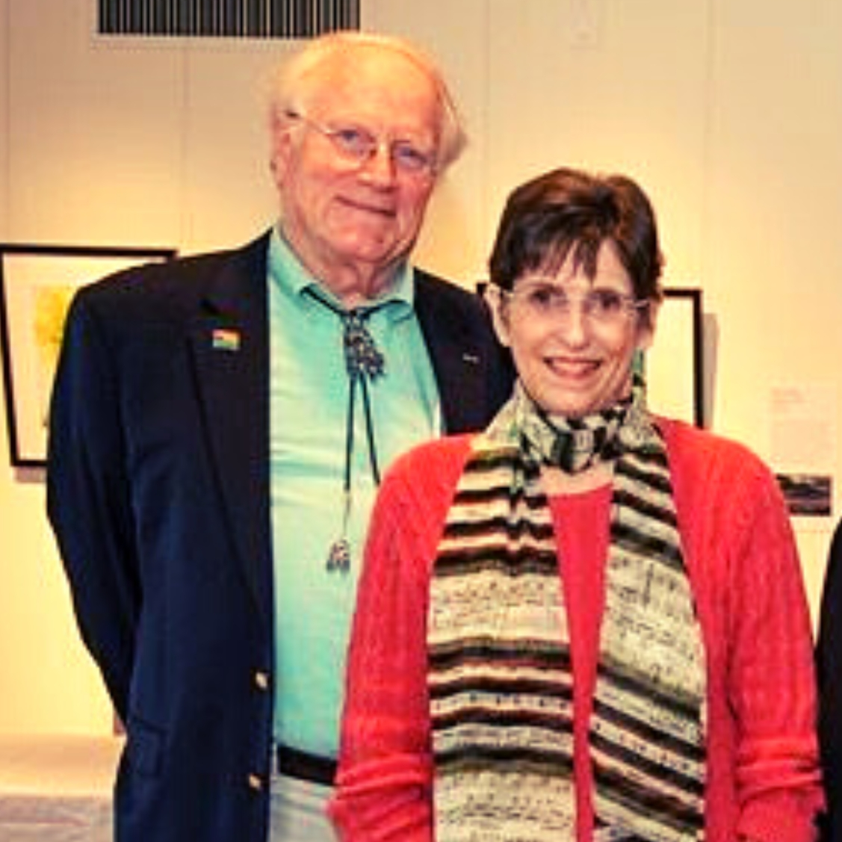
May 10 Mother’s Day
Ingrid Matthews, violin
Jennifer Vial, cello
Stephanie Streeter, harpsichord
Ingrid Matthews, violin
Jennifer Vial, cello
Andrew Willis, piano
Presented by John & Nancy Lambert

Slide 4
2026-2027
85
years
Now Programming
Vote April 6
Over 80 options

Slide 5
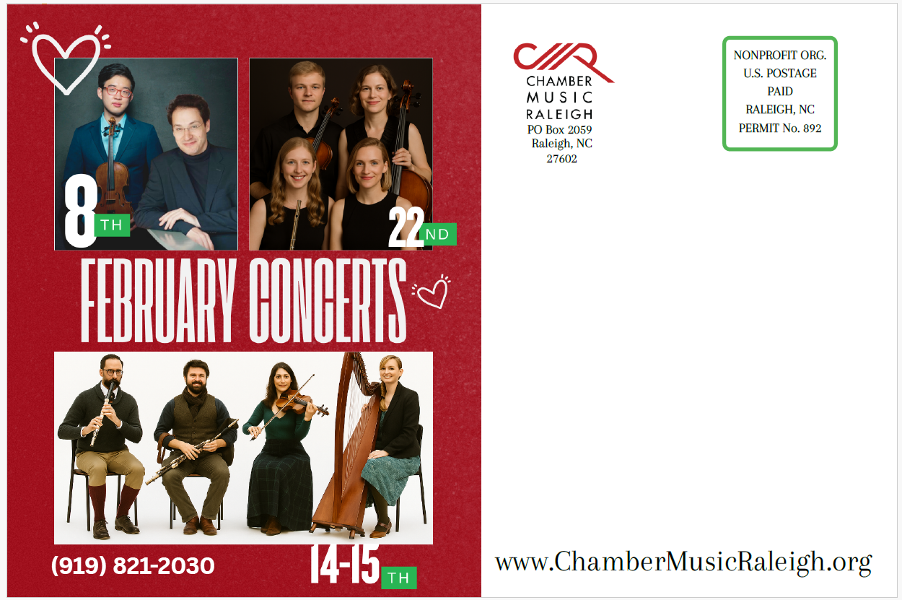
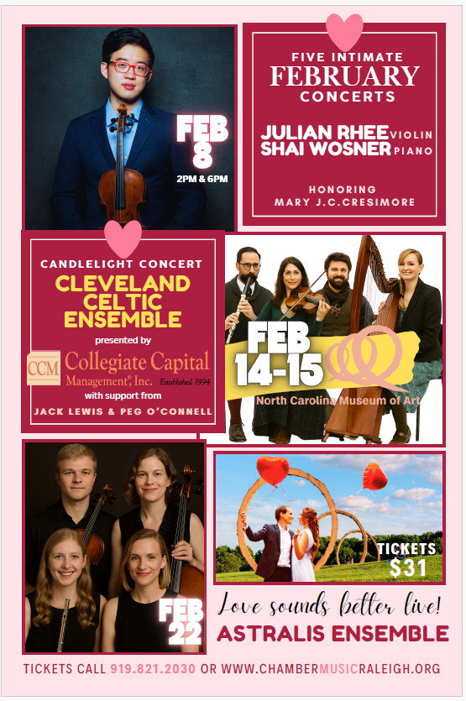
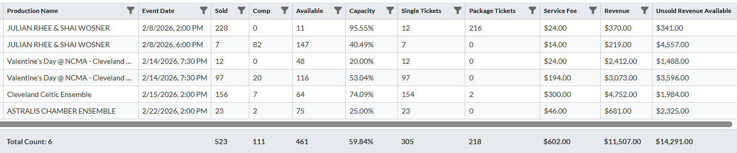
85
years
10,000 6X9 Postcards Arriving by USPS This Week

Slide 6





Cleveland Celtic Ensemble
presents
with support from
Jack Lewis & Peg O’Connell
Friday, Feb 13 7PM The Clayton Center
Saturday, Feb 14 7:30 NCMA
Sunday, Feb 15 2:00 NCMA

Slide 7
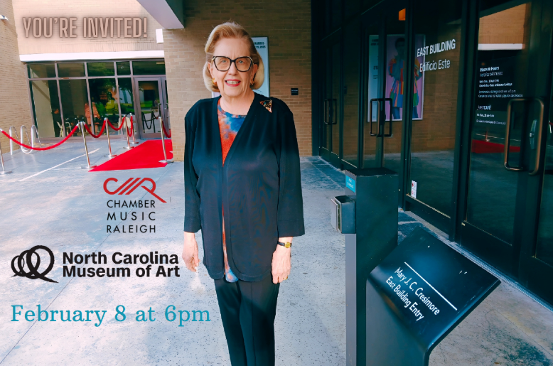
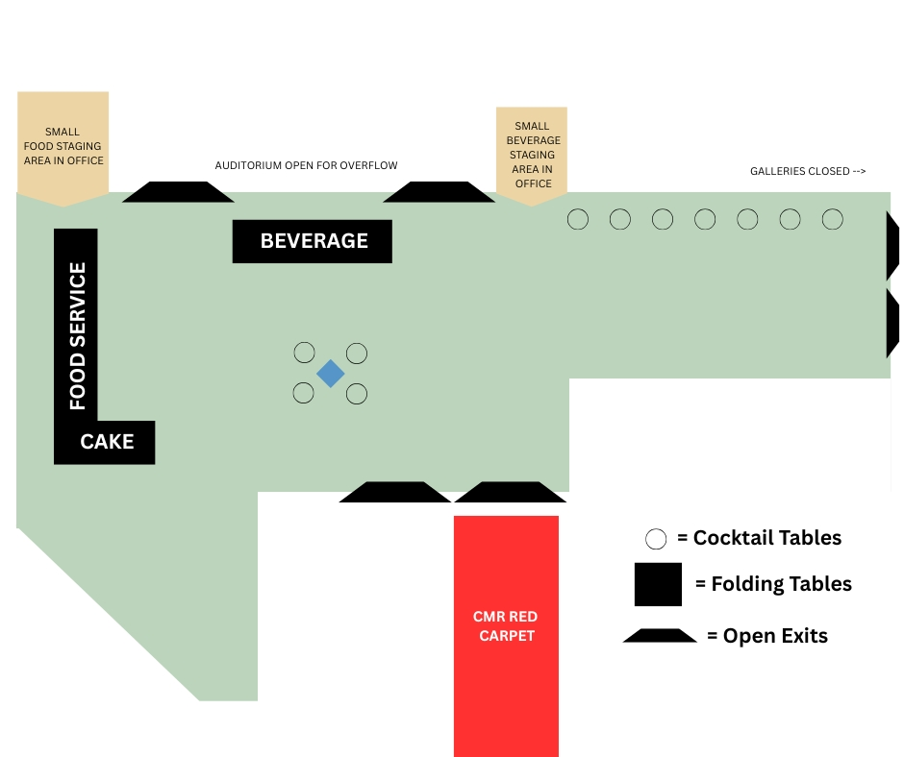

presents
with support from

Slide 8
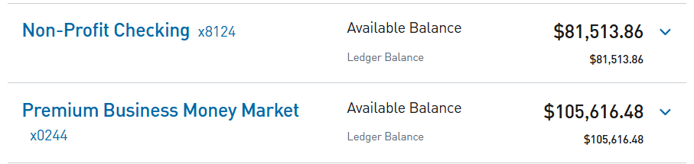
Financial Report
- 2024-2025 Audit Completed in December
- No adverse audit findings
- Endowment balance correction noted
- PNC corrected the interest error on our
Money Market Savings account
doing
well
Sounding great!
- Mid Year (as of December 31, 2025

Slide 9
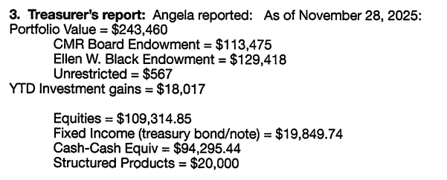
Financial Report
As of 1/30/2026 in RED
$244,251
$113,584
$130,100
$567
ASSET ALLOCATION
45.22%
8.18%
38.37%
8.23%
doing
well
This represents an increase of $791 over approximately two months, or a 0.33% gain for the period.
If this rate of return were sustained over a full year, it would equate to an annualized return of approximately 2.0%.
Sounding great!
- Mid Year (as of December 31, 2025
A rough estimate of the S&P 500 price return for a similar period is higher — on the order of ~1–1.5%.

Slide 10
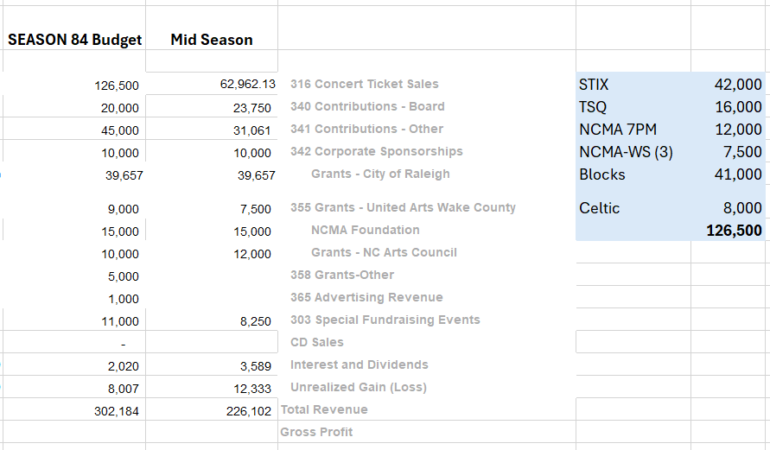
REVENUE

Slide 11
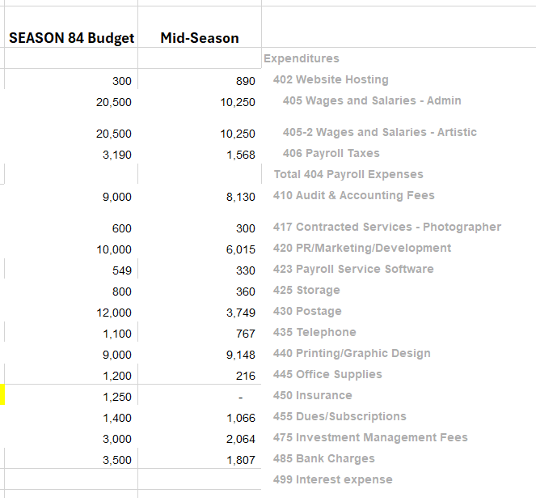
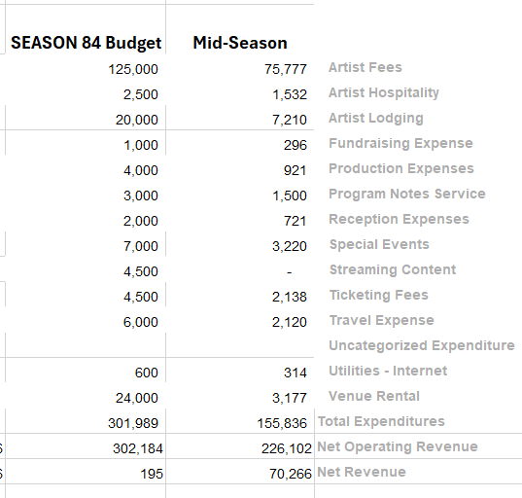
EXPENSES
Season 82 $15,182
Season 83 $14,966

Slide 12

Strategic plan
2027-2031

Slide 13
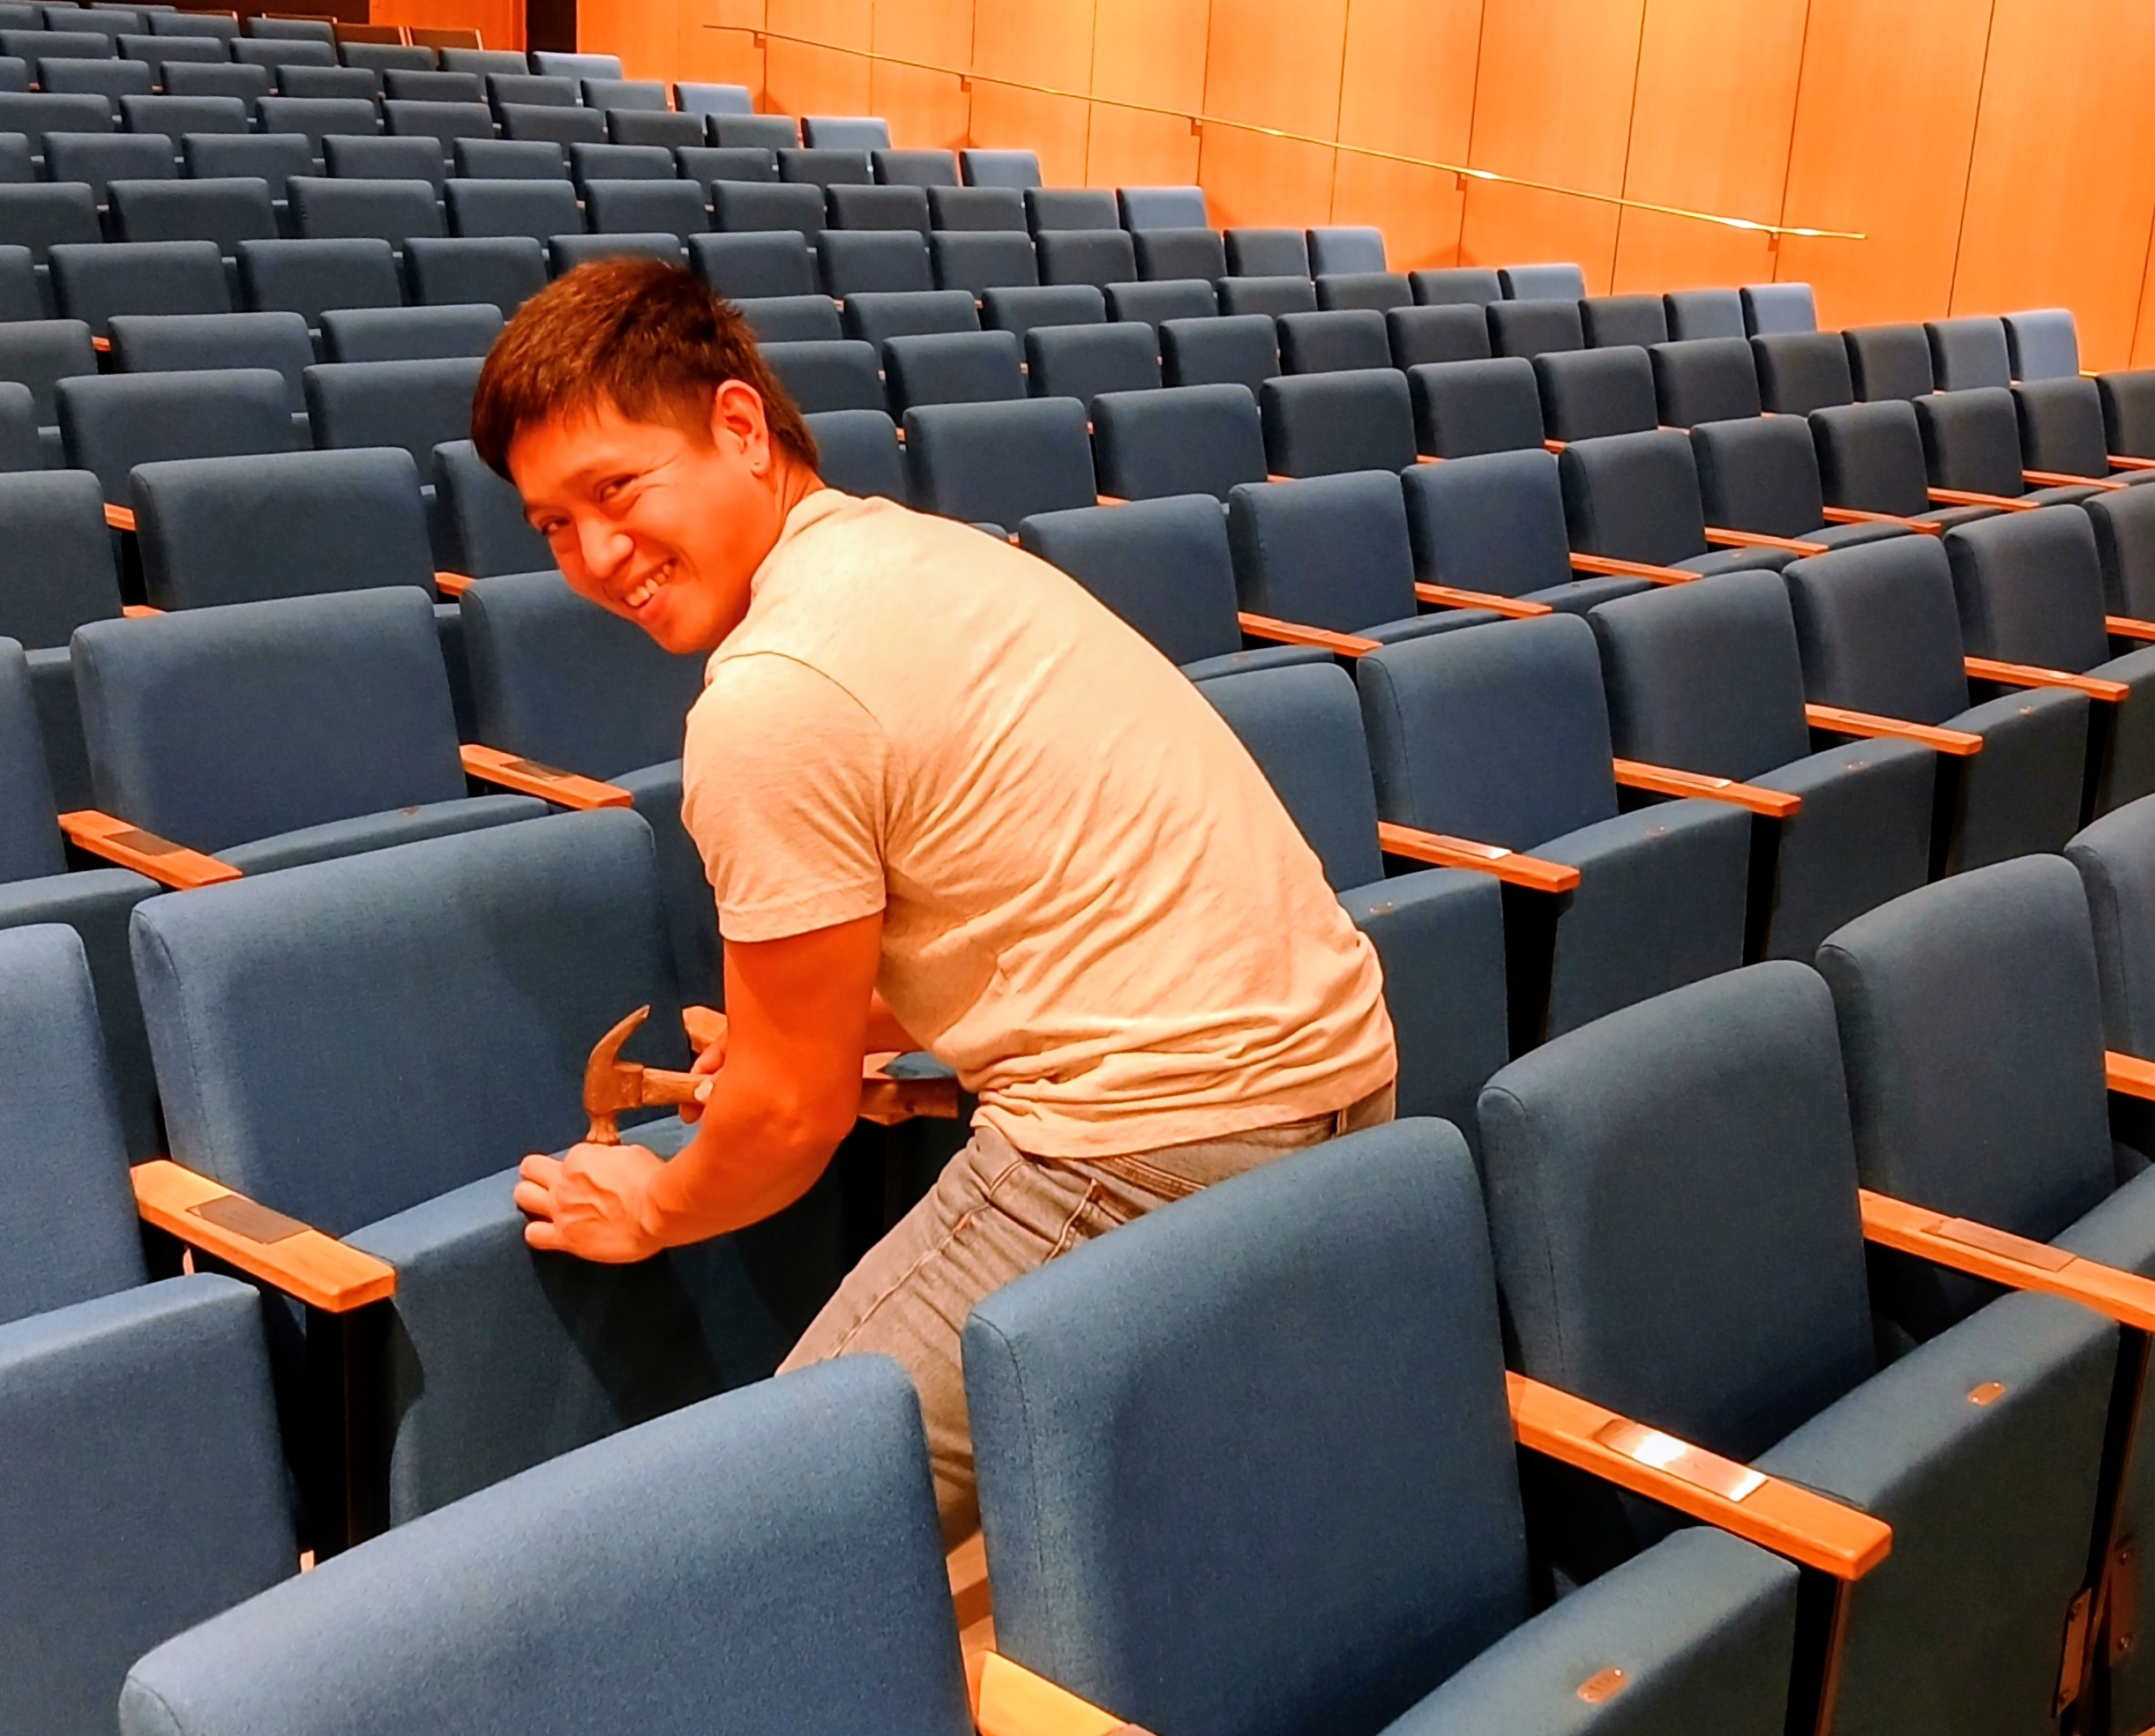
Season
THANK YOU
84
CMR
Junylle Alburo

